Slide 1
Humanoid 8/7
Notes:
Title slide, same naming convention as previous meetings.

Slide 2
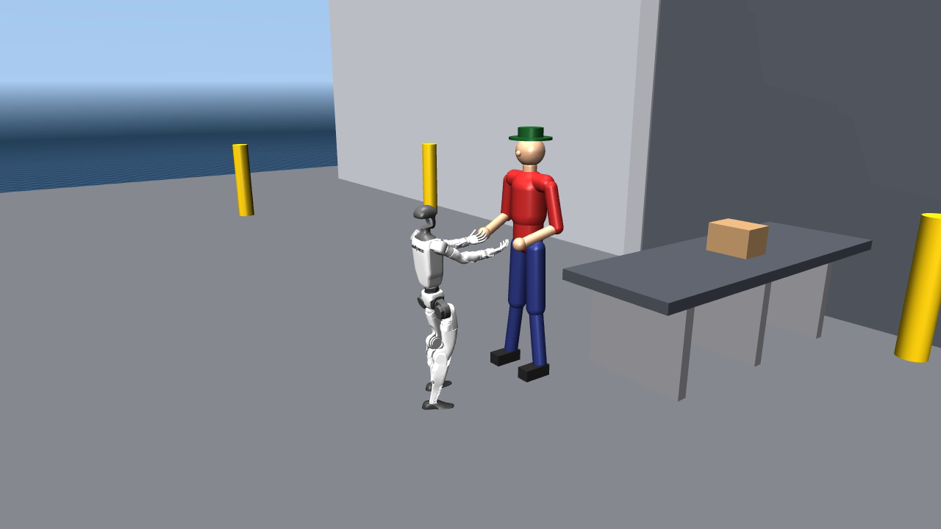
Humanoid 8/7
Recap
1. Warehouse sim: full catch-and-deliver LOOP (real vision)
2. Capability envelope measured; targeted finetune 18% → 79%
3. Deploy safety audit: joint-limit abuse found & fixed
Notes:
Three lines of what happened since last meeting.

Slide 3
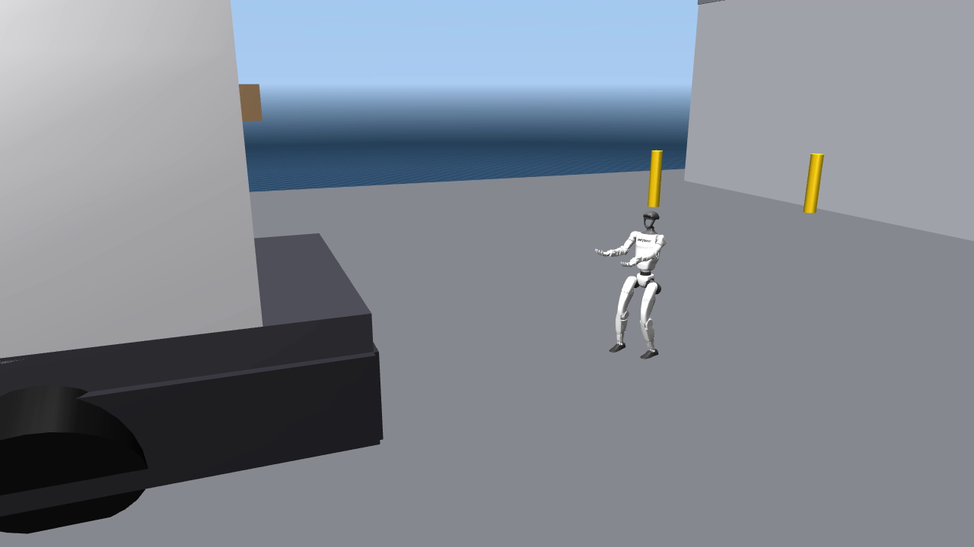
New scene: warehouse loading dock (full loop)
Catch → carry → find receiver → hand over → loop
1. Vision-centric: YOLO box + GroundingDINO person, no ground truth
2. Full physics: catch impact, slips, drops, colliding props
3. Same code as the real robot (twin only swaps the NIC)
Notes:
The warehouse loading-dock scene. Sim IS the deployment: the demo runs the same binary that goes on hardware; going real = one NIC param + the real camera node.

Slide 4
Full loop — one take: 8/9 caught, 6 delivered, 0 falls
misses re-thrown, slips refused by the guard, ghost carries abandoned — the loop never deadlocks
Notes:
Play 40-60 s. One continuous take: 9 thrown / 8 caught / 6 delivered (4 consecutive), two slipped catches auto-recovered, zero falls.

Slide 5
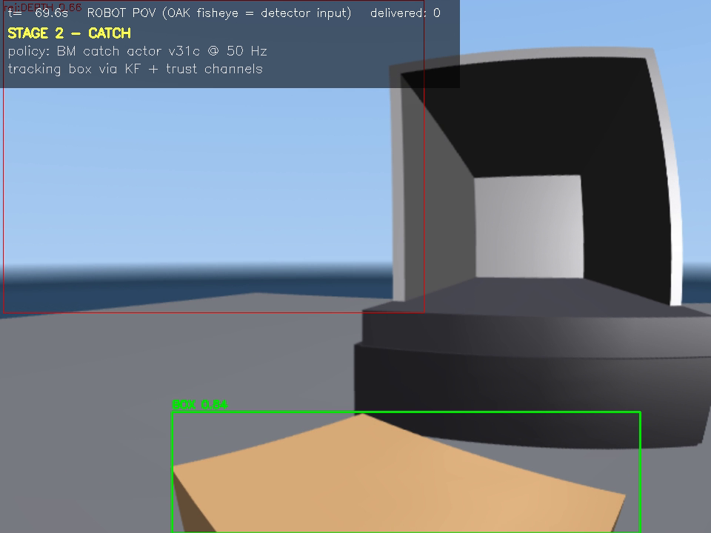
Robot first-person view — what the detector sees
HUD: stage / active policy / per-detection verdict (green pass, red reject, yellow heartbeat)
Notes:
Play 30 s. Green = passed all gates, feeds the Kalman filter. Red = rejected with reason (truck wheels were carton-sized false positives). Yellow = hugged box feeding the carry heartbeat. Tilted start = hanging on the gantry; policy takes over in one tick at 41 s.

Slide 6
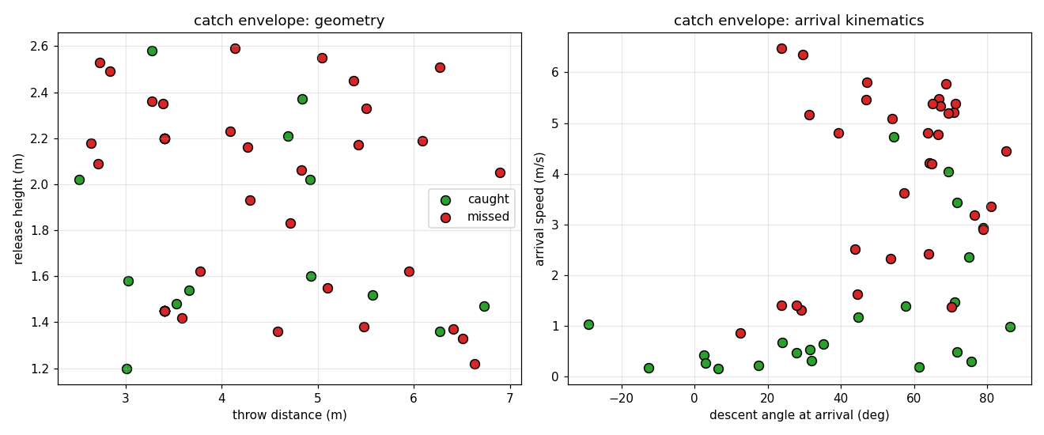
Catch envelope = training distribution
55-throw scan (v31c)
1. training box: 80%
2. high release 1.7–2.4 m: 18%
3. far 4–7 m: 36%
finetune = widen throw DR only
1. death band 18% → 79% (one night)
Notes:
Capability boundary = training-distribution boundary, cell by cell (55-throw scan). Widening only the throw DR (one overnight finetune, warm-start) takes the death band from 18% to 79%, no regression elsewhere, zero falls under freeze injection.

Slide 7
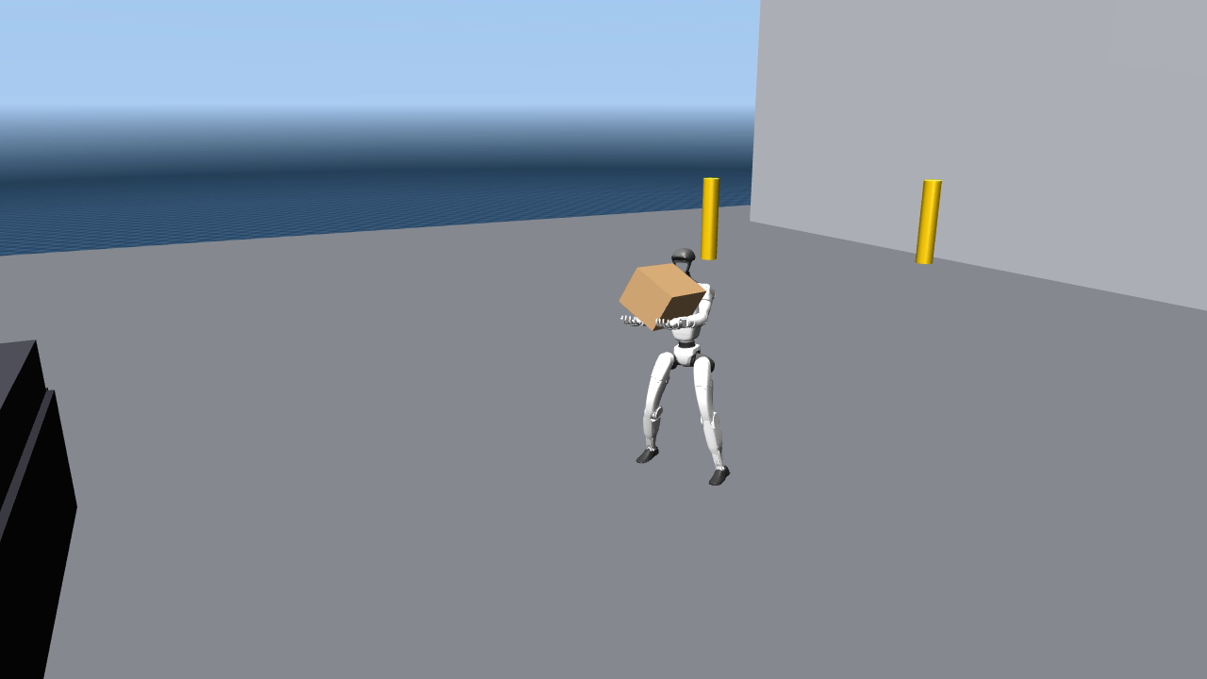
After finetune: 7/7 in the death band
walking thrower, random 3–9 s hold, ~2 m release — same scene, same ruler, only the training distribution changed
Notes:
Play 30 s. Yesterday 18%, today 7/7. The G1 thrower walks the truck bed holding the box 3-9 s, releases without warning at ~2 m. While held, the policy deliberately sees nothing; on release the KF re-acquires in 0.2-0.3 s.

Slide 8
Safety finding: joint limits used as a free throttle
1. torque = kp × (target − actual) — the policy wrote targets 1.8–2.45 rad beyond the mechanical stop = max torque pressed into the end stop
2. invisible under load (community-standard penalties watch the REALIZED position — it never reaches the wall); slams the stop the moment a limb unloads
3. fix: clamp every PD target to joint limits, in training AND deploy — motors can no longer receive out-of-range commands (guaranteed by code)
4. honest price: unclamped scores (79/80%) were partly bought by stop-grinding; legal-torque ceiling is 36–50% today — the gap = action-space upgrade target
refs: LATENT (G1 tennis) · ETH badminton (Sci. Robotics 25) · HITTER
Notes:
PD target is a throttle, not a position: torque = kp x (target - actual). A target 1.8-2.45 rad beyond the stop = sustained max torque into the end stop. Invisible under load; slams when the limb unloads (the physics of our 07/18 hardware incident). Since v34 the motors can never receive an out-of-range target (code-level clamp). Retraining with the clamp: falls fixed, habit 97.6% extinct; legal-torque ceiling currently 36-50% (the honest price).

Slide 9
Sim-to-real: honest status
Closed
1. deploy-code identity · real detectors · full contact physics · dirty-vision battery (freeze: tilt peak 7.8°, zero falls)
Measured
1. walking odometry drift: 0.28 m per delivery chain (bounded by per-chain re-calibration)
Open
1. camera artifacts (blur / stereo-depth noise) · handoff pull force · carry reference waist-limit fix before real carry
Notes:
What is closed, measured, open. The 0.28 m/chain walking-odometry drift came free from loop forensics — our first quantitative sim2real number.

Slide 10
Next steps
Performance (back to 80% on legal torque)
1. imitation guidance + contact-window reward
2. ankle kp / feed-forward torque (action space)
3. LATENT-style action-manifold prior
Hardware ladder (when G1 returns)
1. gantry static: stand + guards live
2. catch in place + torque calibration
3. hands-free navigation + scan
4. the full loop, on hardware
videos & data: toberj.github.io/dashboard → Box Catch
Notes:
Close with the two ladders and the dashboard link. Q&A.

