Slide 1
Legolens
Building LEGO in AR with Microsoft Hololens
Notes:
© Copyright Showeet.com
1

Slide 2
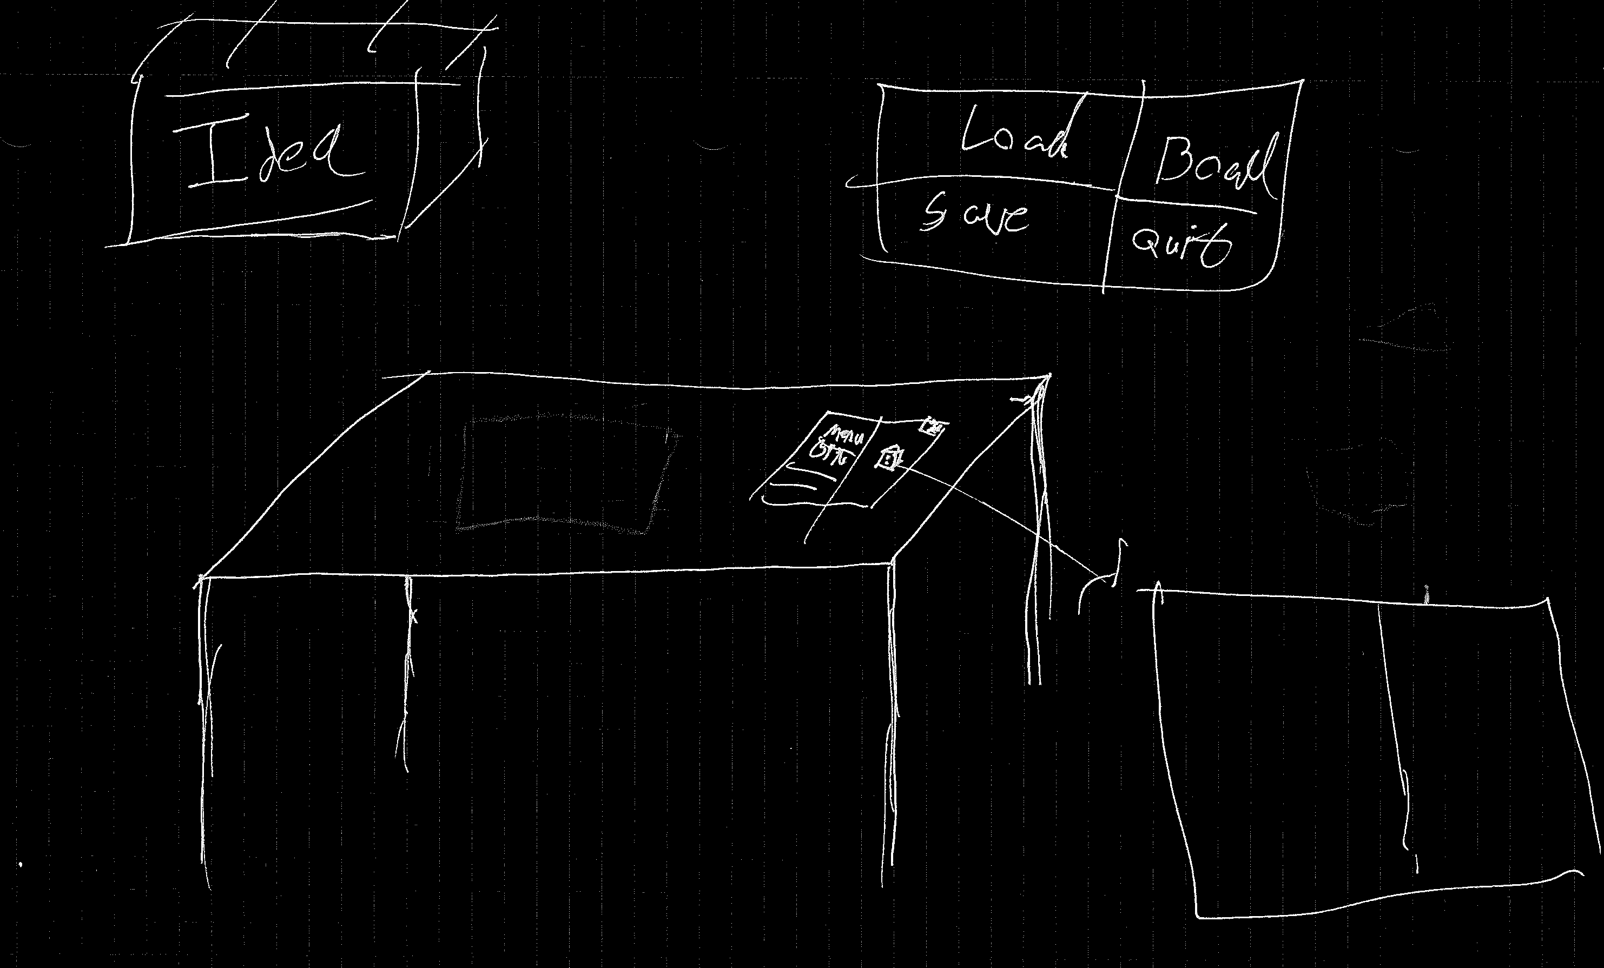
Project overview
Initial idea
Legolens
1
Notes:
© Copyright Showeet.com
1

Slide 3
Where are we?
Unity programming
Single block interaction
‘Snapping’
Rotation
Paper prototype (PoP)
1
Notes:
© Copyright Showeet.com
1

Slide 4
What needs to be done
Testing and evaluation
Deploying to Hololens
1
Notes:
© Copyright Showeet.com
1

Slide 5
What is the expected outcome?
Building with simple Lego bricks
Very simple menu navigation
1
Notes:
© Copyright Showeet.com
<number>

