Slide 1
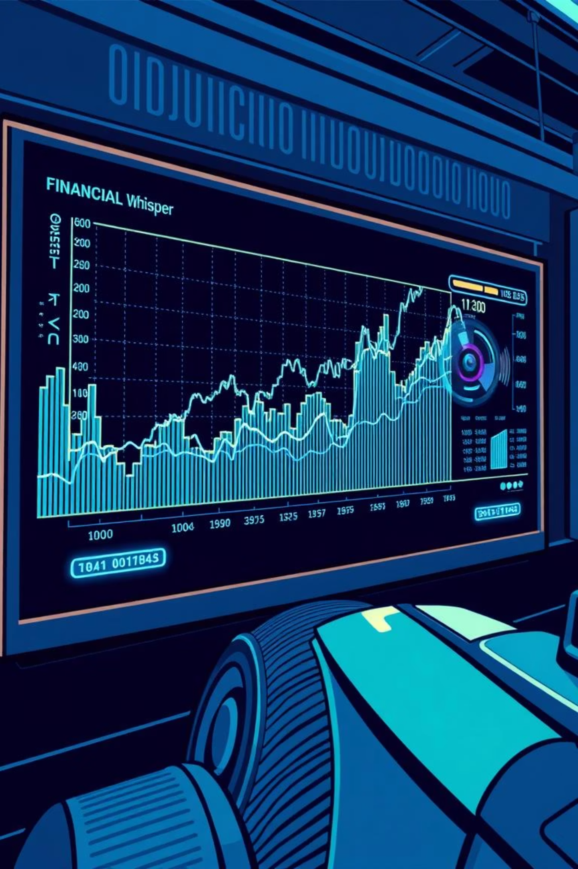
Unveiling PyTrend: Data Visualization for Informed Decisions
Welcome, judges and fellow developers! Today, we're excited to present PyTrend, a powerful tool designed to transform complex financial data into actionable insights. PyTrend leverages innovative visualization techniques to empower users to make more educated decisions in the dynamic world of finance.

Slide 2
Agenda
Navigating the Future of Financial Visualization
01
02
Introduction to PyTrend
Deep Dive: Finance.py
Overview of the project's purpose and capabilities.
Exploring cryptocurrency and currency trend analysis with Streamlit.
03
04
Deep Dive: Projection.py
Technical Architecture
Understanding higher-dimensional data projection for advanced insights.
Behind the scenes: the technologies and design principles.
05
06
Live Demonstration
Impact and Future Roadmap
Witnessing PyTrend in action.
Discussing potential applications and next steps.

Slide 3

PyTrend: Bridging the Gap Between Data and Decision
PyTrend addresses a critical challenge in financial analysis: the overwhelming volume and complexity of data. Traditional charts often fall short when trying to convey multi-faceted relationships and future trends.
Our solution focuses on intuitive, interactive visualizations that not only display data but also enable users to explore it dynamically, uncovering patterns that might otherwise remain hidden.

Slide 4
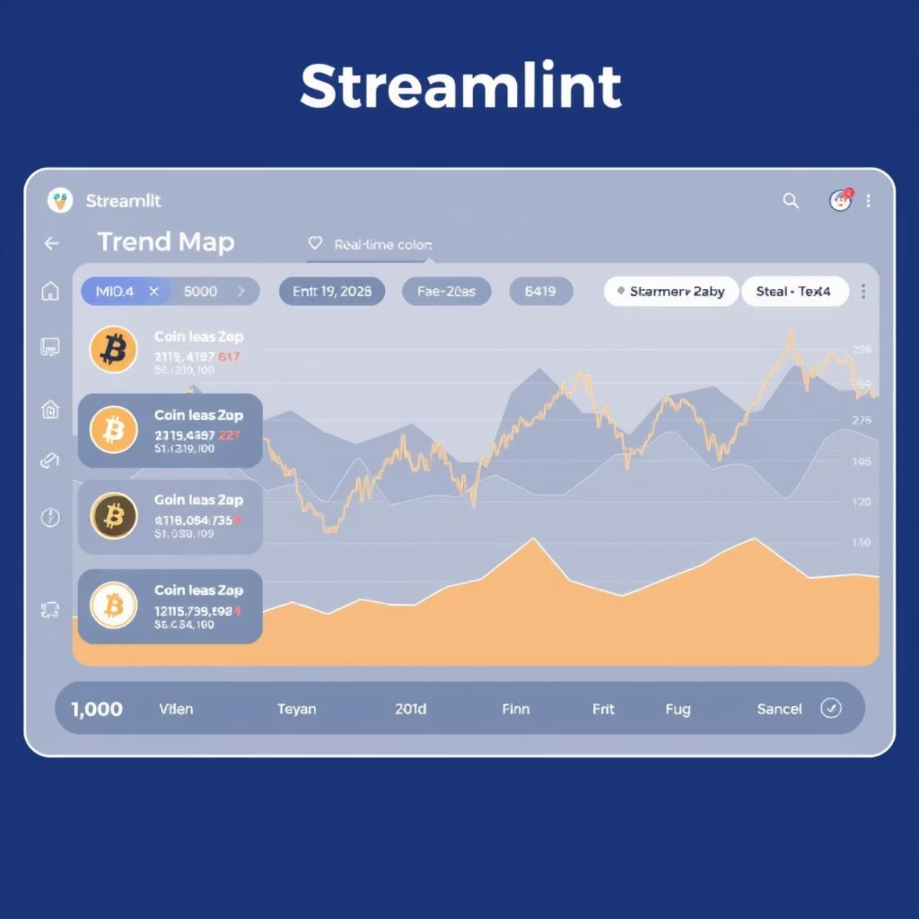
Finance.py: Real-time Financial Trend Analysis
Interactive Streamlit Application
Local execution for secure and personalized analysis.
User-friendly interface for seamless interaction.
Customizable Data Selection
Choose any cryptocurrency or fiat currency for study.
Focus on specific assets relevant to your interests.
Dynamic Trend Mapping
Visualize value fluctuations over custom timeframes.
Identify historical patterns and potential market movements.

Slide 5

Projection.py: Illuminating Higher Dimensions
Advanced Data Projection
Utilizes unit vectors to project complex, higher-dimensional data.
Transforms multi-variable financial relationships into comprehensible visuals.
Integrated Camera and Projection Skill
Enables novel interactions with the projected data.
Allows for dynamic adjustment of projection angles and focus areas.
Empowering Educated Decisions
Reveals intricate correlations and dependencies previously hidden.
Supports more nuanced and robust financial decision-making.

Slide 6
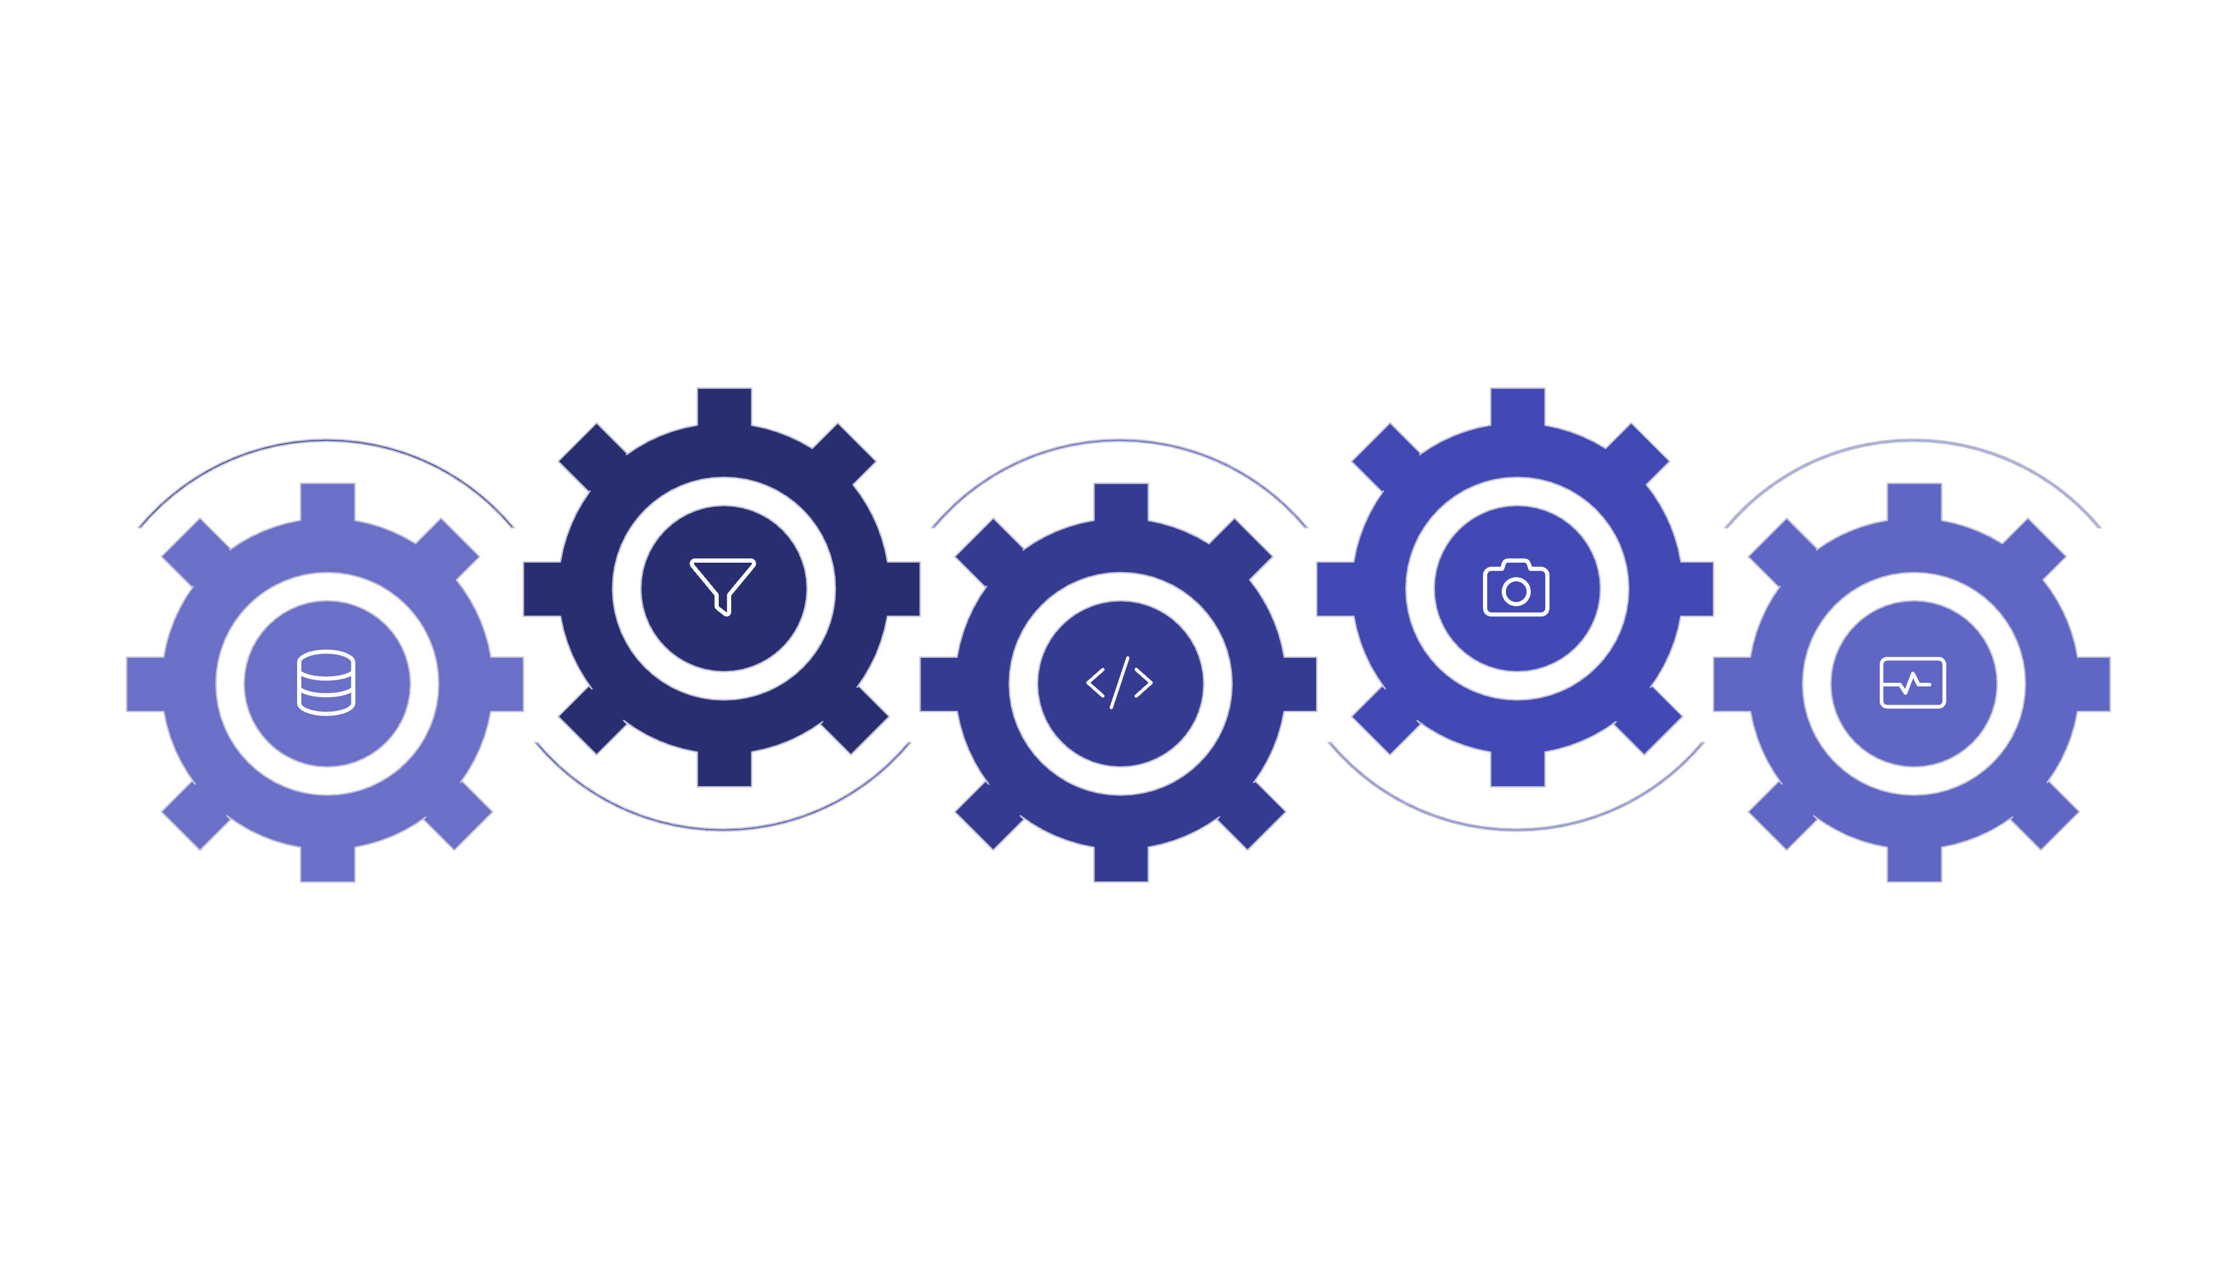





The Technical Backbone: Architecture Overview
Preprocessing
Camera & Unit Vector
Clean and prepare financial feeds
Apply camera and vector projection
Data Inputs
Projection.py
Display
Finance.py, Streamlit, APIs
Compute projections and transforms
Interactive UI via Streamlit
PyTrend is built upon a modular architecture, ensuring scalability and maintainability. Finance.py acts as the data acquisition and initial visualization layer, feeding refined information to Projection.py for advanced spatial analysis. Streamlit provides the intuitive front-end, while the projection module handles the intricate mathematical transformations.

Slide 7

Getting Started with PyTrend
For detailed setup instructions, please refer to README.md and SETUP.md in the project repository.
1
2
Clone Repository
Install Dependencies
Fetch the project files from the provided Git repository.
Utilize pip install -r requirements.txt to set up the necessary Python libraries.
3
4
Run Finance.py
Explore Projection.py
Execute streamlit run Finance.py to launch the interactive trend analysis tool.
Run python Projection.py to engage with the higher-dimensional data projection. Ensure camera setup is complete as per SETUP.md.

Slide 8

Live Demonstration: PyTrend in Action
Let's see how PyTrend empowers users to quickly analyze market trends and gain deeper insights into complex financial datasets. We'll start with a cryptocurrency trend, then transition to a higher-dimensional projection, showcasing the dynamic camera interaction.

Slide 9




Impact & Future Enhancements
Enhanced Insights
Faster Analysis
Uncover hidden correlations and make more informed financial decisions.
Streamline the process of understanding market movements and data complexities.
Predictive Capabilities
Broader Data Sources
Future integration with machine learning models for forecasting.
Expansion to include more diverse financial instruments and global markets.

Slide 10
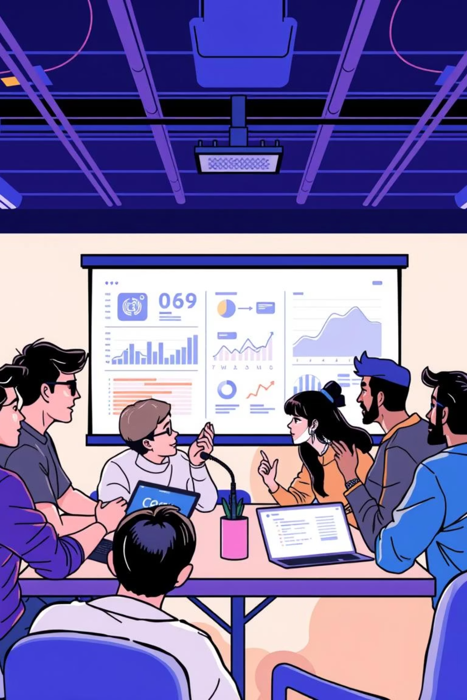


Thank You!
Questions & Discussion
We believe PyTrend offers a compelling vision for the future of financial data visualization. We are eager to hear your feedback and explore the potential for further development.

