Slide 1


AUTOMATION
A reflective presentation about the largest trend in EIT by Tobias Zeier

Slide 2
Agenda
Introduction
Robotics and Automation
Efficiency and Skill Shift
Module Reflection
Conclusion

Slide 3





Introduction
Tobias Zeier, 35
Zurich, Switzerland
2011: Apprenticeship in IT System Engineering
2020: Advanced Federal Diploma of Higher Education in Business Informatics
Head of two DevOps Teams within the Banking industry

Slide 4

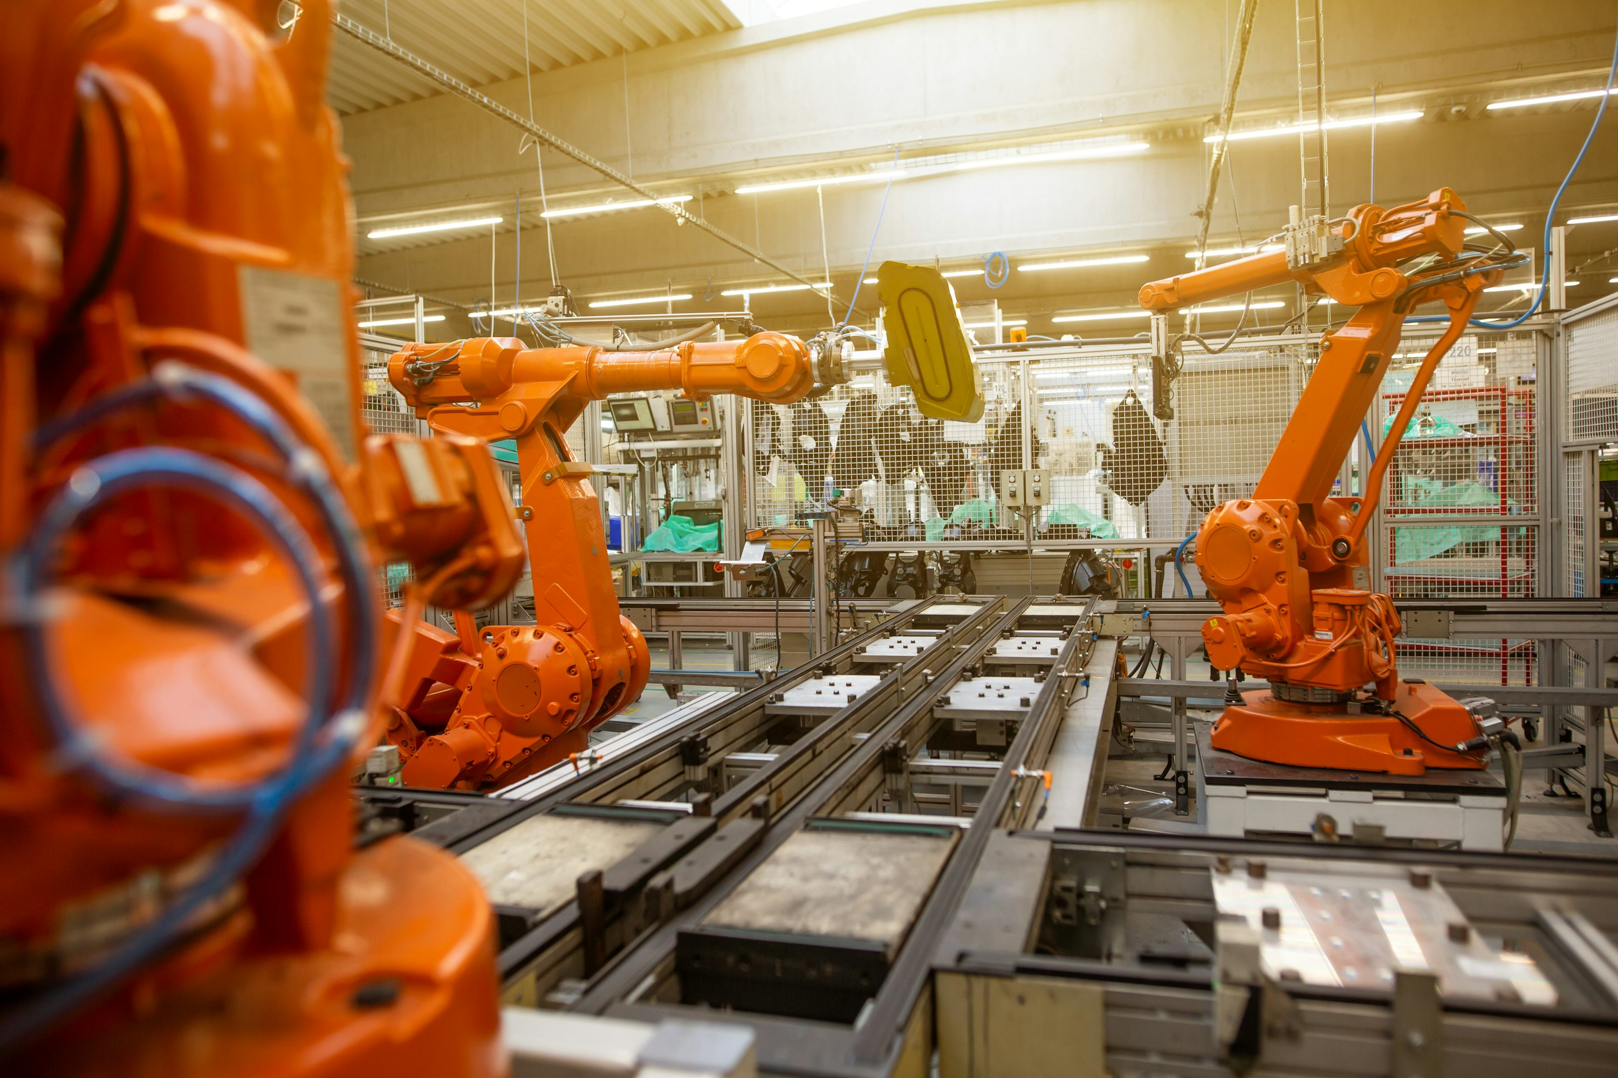

Robotics and Automation
Fig 1-3: Robotics and Automation (copyright free from https://unsplash.com/)

Slide 5
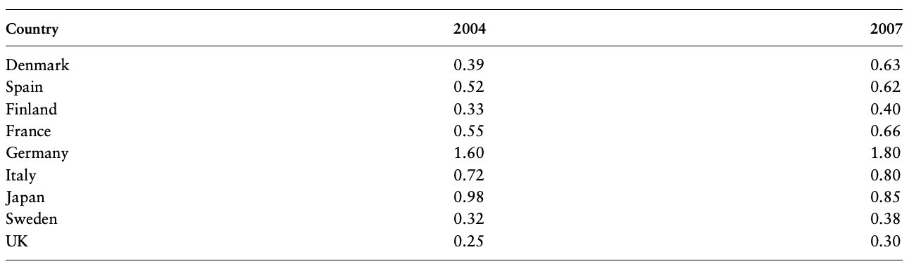
Automation - Efficiency
Table 1: Robots per Country (Kromann et al., 2020)

Slide 6
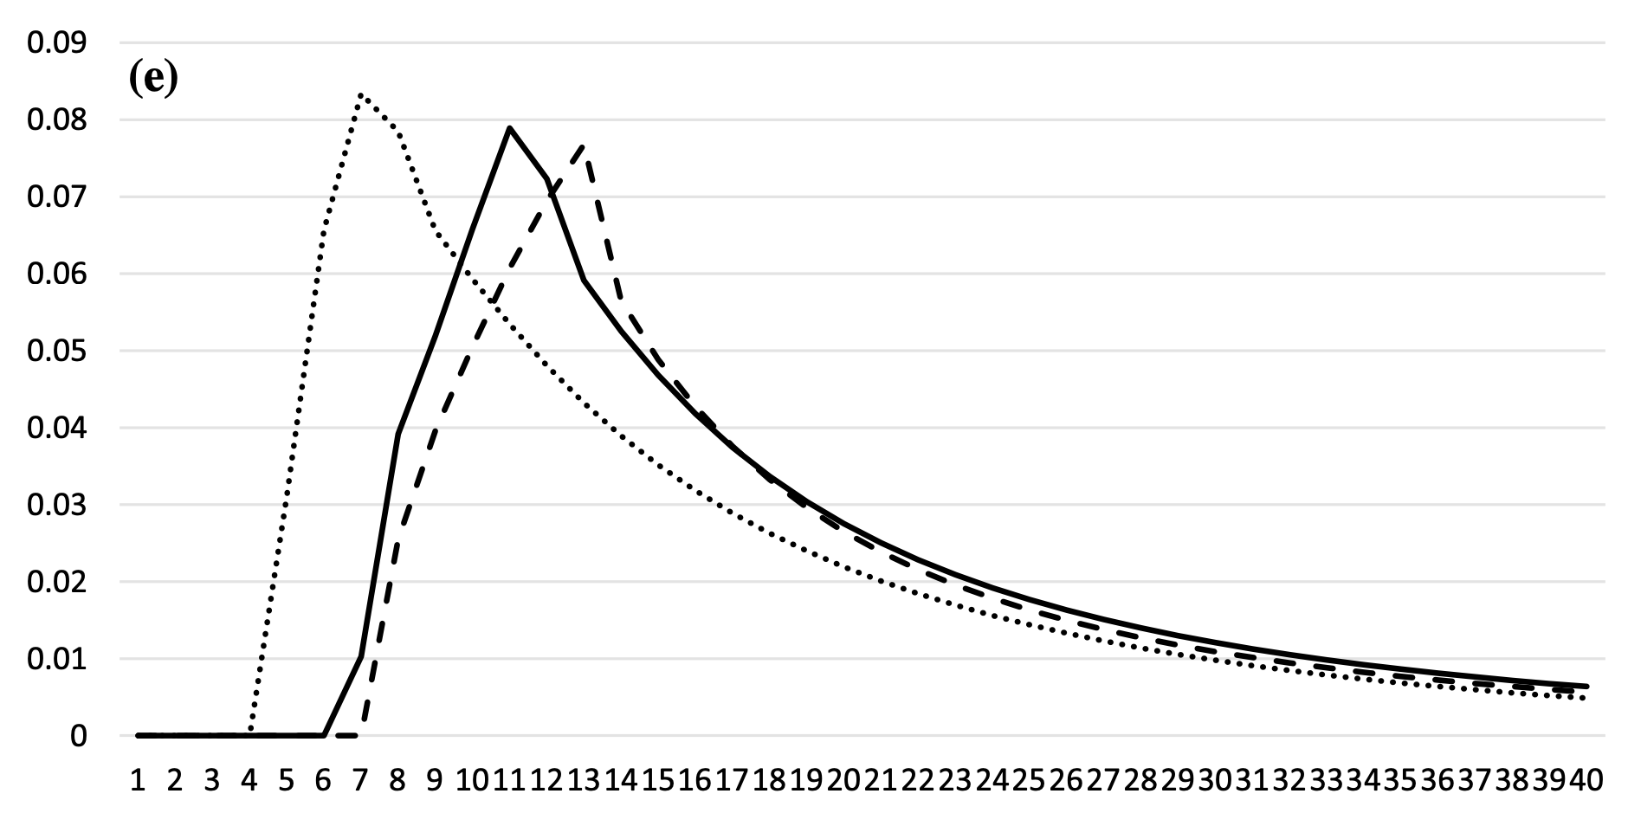
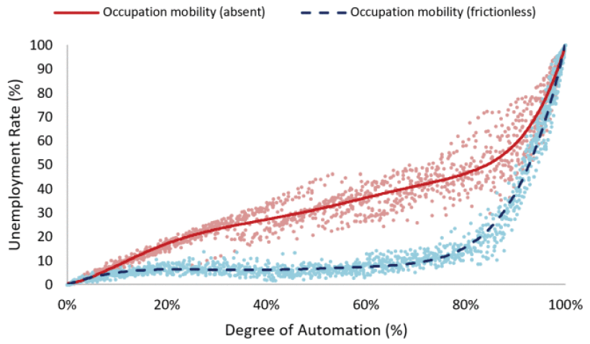
Automation – Skill Shift
Figure 4: Automation will boost employment (Nakamura & Zeira, 2023)
Figure 5: Importance of training (Upreti & Sridhar, 2024)

Slide 7




Reflection
EIT: TOGAF
Reflection
Python Coding
Frustration, Challenge

Slide 8



Conclusion
Upskilling
Customer expectation
Education

Slide 9
References
Goldberg, K. (2012) What Is Automation?. IEEE Transactions on Automation Science and Engineering 9(1): 1–2. DOI: https://doi.org/10.1109/tase.2011.2178910
Kromann, L., Malchow-Møller, N., Skaksen, J.R. & Sørensen, A. (2019) Automation and productivity - a cross-country, cross-industry comparison. Industrial and Corporate Change 29(2): 265–287. DOI: https://doi.org/10.1093/icc/dtz039
Herm, L.-V., Janiesch, C., Helm, A., Imgrund, F., Hofmann, A. & Winkelmann, A. (2022) A framework for implementing robotic process automation projects. Information Systems and e-Business Management 21(1): 1–35. DOI: https://doi.org/10.1007/s10257-022-00553-8
Nakamura, H. & Zeira, J. (2023) Automation and unemployment: help is on the way. Journal of Economic Growth. 29: 215–250. DOI: https://doi.org/10.1007/s10887-023-09233-9
Acemoglu, D., & Restrepo, P. (2019) Automation and New Tasks: How Technology Displaces and Reinstates Labor. The Journal of Economic Perspectives. 33(2): 3–30. Available from: https://www.jstor.org/stable/26621237 [Accessed 19 July 2024].
Upreti, A., & Sridhar, V. (2024) Assessing the Effect of Task Automation in Labor Markets: Case of IT Services Industry. IEEE transactions on technology and society. 5(1): 107-117. DOI: https://doi.org/10.1109/tts.2024.3365423.

