Slide 1
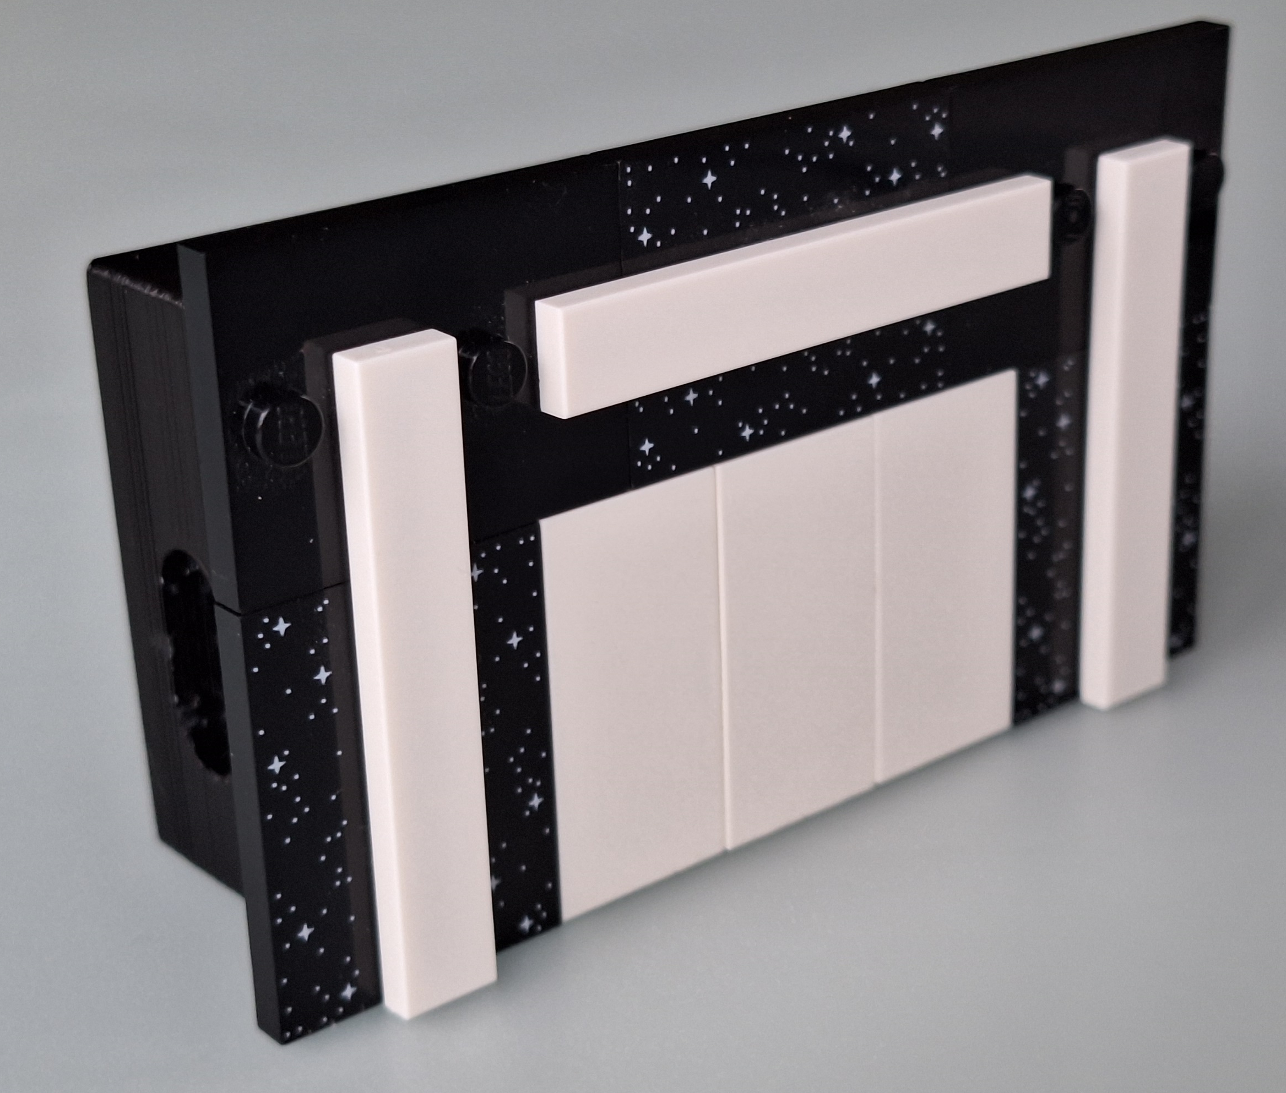
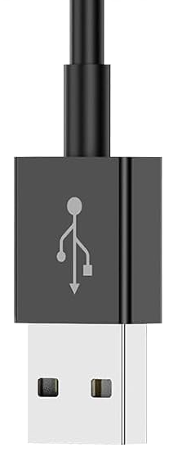
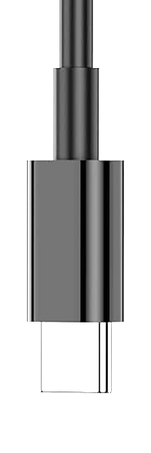

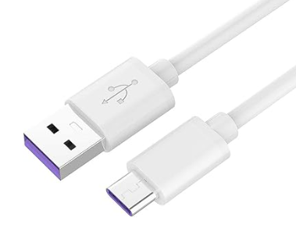
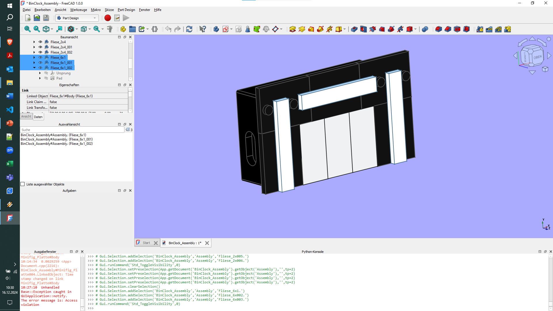
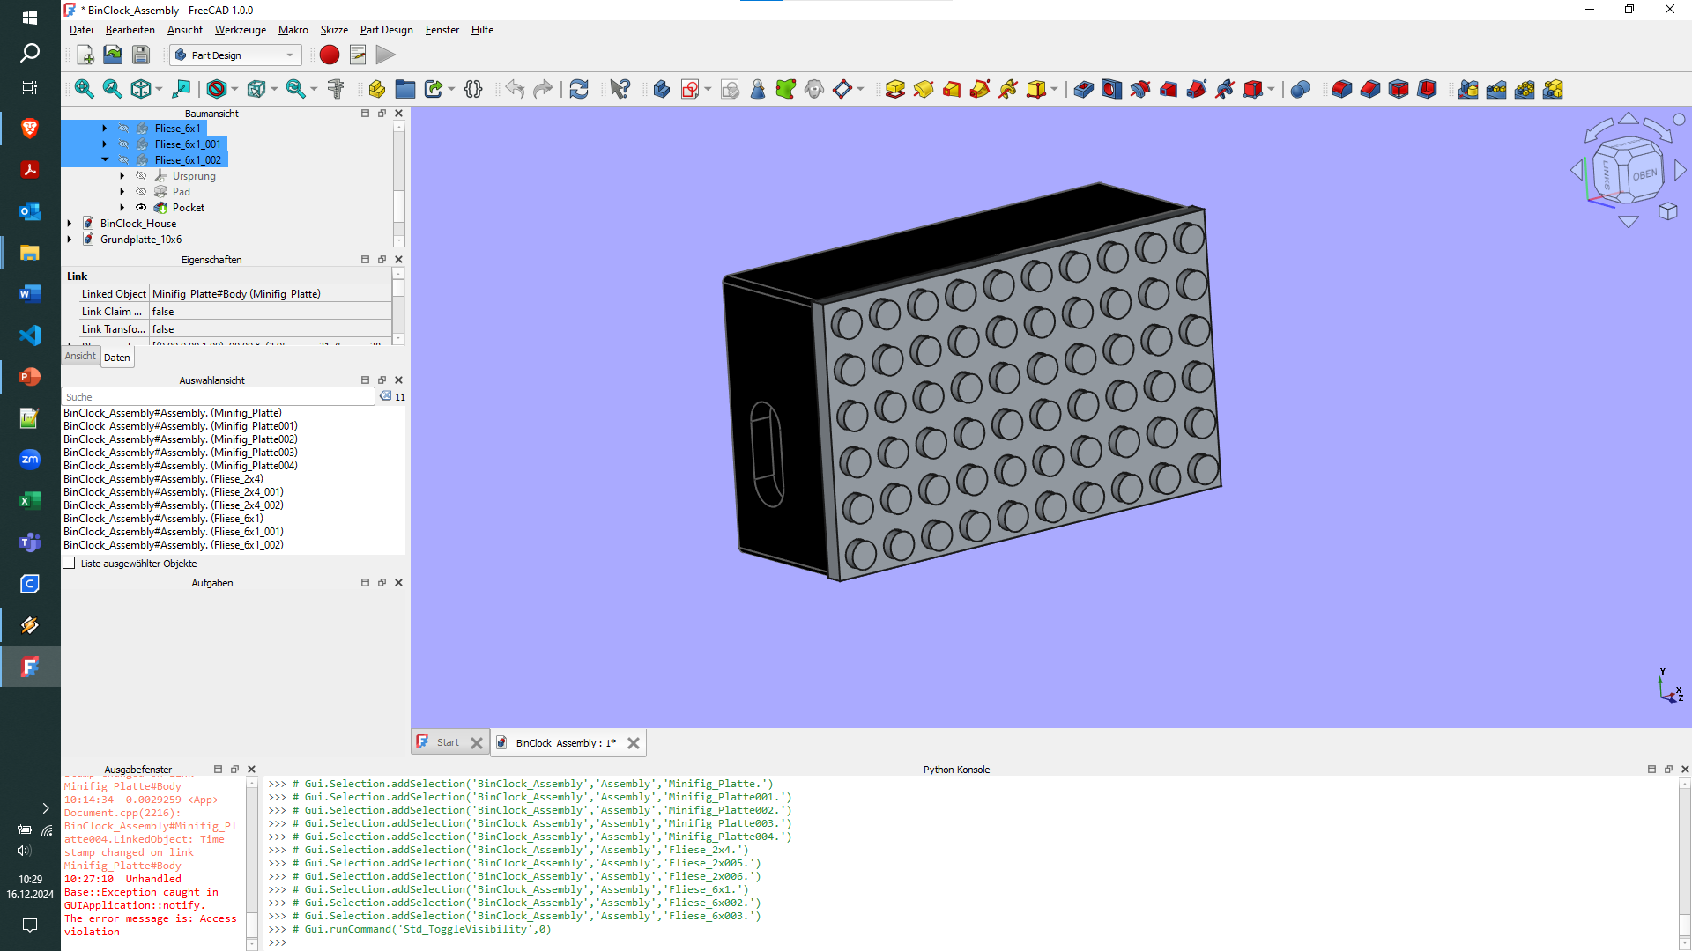


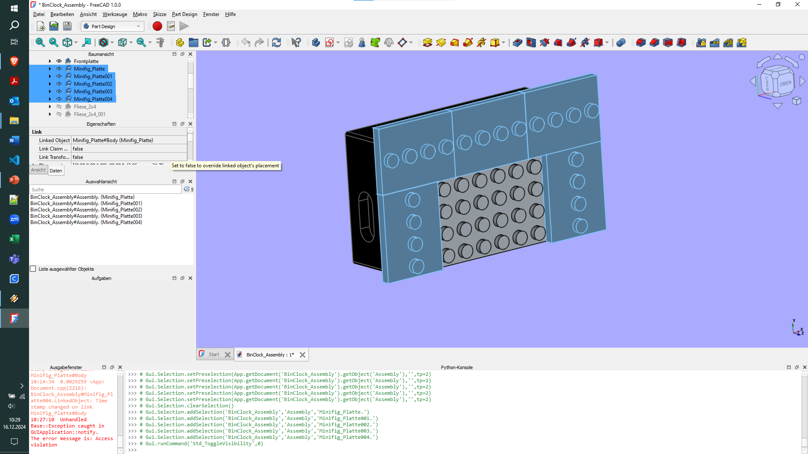
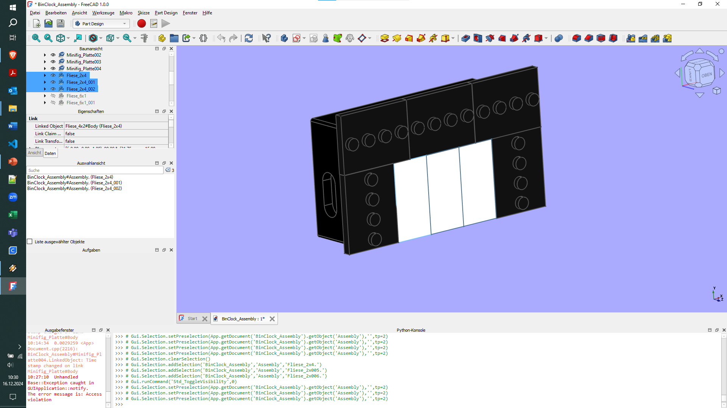
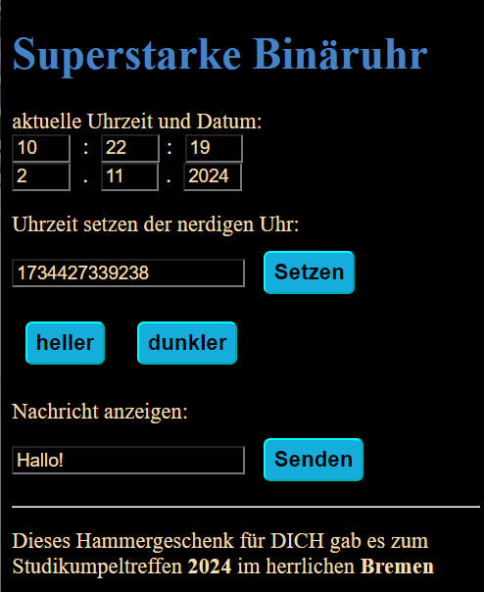
Temple Of Time
1
708145
XX_BinClock
2b
2a
IP: 192.168.1.4
http://192.168.1.4
3
4
H
M
S
32
16
8
4
2
1
22:14:59
10:52:35

Slide 2
1
1
XX_BinClock
2b
XX_BinClock
2b
2a
2a
IP: 192.168.1.4
IP: 192.168.1.4
http://192.168.1.4
http://192.168.1.4
3
3
4
H
4
H
M
M
S
32
16
8
4
2
1
S
32
16
8
4
2
1
22:14:59
10:52:35
22:14:59
10:52:35

