Slide 1

How can we improve the in-game experience in the presence of misbehaving players?
Supercell
START Hack 2023
Team Cantaloupe
Notes:
Welcome to our solution presentation.

Slide 2






Current Process
*****, *******!!!
Incident happens
Reports by players
Moderator analysis
Moderator decision
Notes:
2 main pain points:

Slide 3
1. Pain Point: Long Feedback Time
*****, *******!!!
Incident happens
Reports by players
Moderator analysis
Moderator decision
Notes:
2 main pain points:
Very long feedback cycle
Makes bad stuff stay around for long

Slide 4
2. Pain Point: Late Integration of Moderators
*****, *******!!!
Incident happens
Reports by players
Moderator analysis
Moderator decision
Notes:
Moderator only included very late
Sees only the baddest examples
Can rarely turn situtation around anymore

Slide 5



Hybrid Intelligence
Excel in
latency
throughput on huge datasets
Excels in
emotional intelligence
including contextual information
Notes:
While Modern computing machines excel in pattern recognition and provide the fastest possible reaction times,
Humans provide different qualities which we think are essential in community building.
Therefore, we defined our goal to build a system that uses hybrid intelligence, which combines the strength and let’s humans work as a team with AI.

Slide 6



Behavioral Pattern Recognition
Pattern Sequence
Frequency
Leave
Join
Hate
Leave
0.4
Hate
Kick
Join
Leave
Harass
Kick
0.3
Leave
Leave
Join
0.2
Chat Data
Events
Notes:
To understand what happens inside the communities, we design a behavioral pattern recognition system and analyzed over 130.000 interactions inside.
In our method, we derived different events of interest, like people joining or leaving an alliance, or writing an offensive message.
These interactions were generated for all chats for one day.
Using Apache Spark framework, we mined the most frequent sequences in the data, and want to show you two examples of our findings.

Slide 7
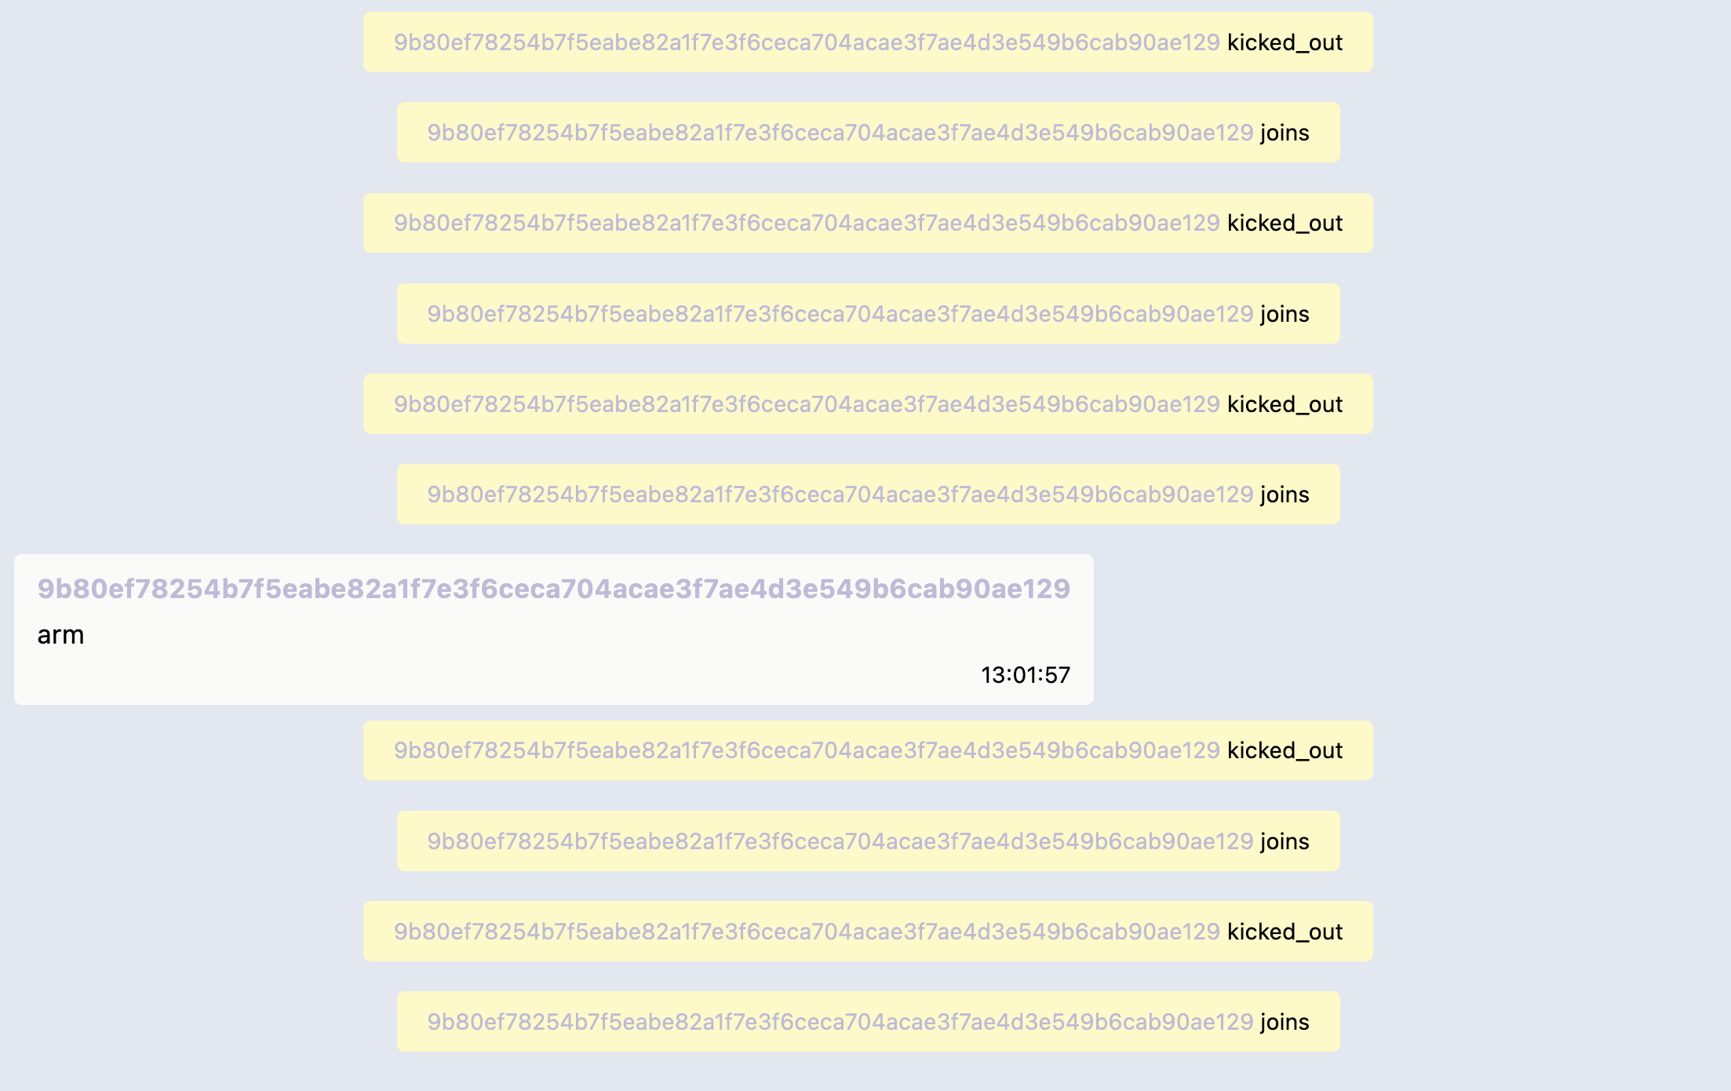
Pattern 1: Join Kick War
Join
Kick
14x
/day
Join
Kick
…
Notes:
We called our first pattern “Join Kick War”. When going through the data, we found some instances where people join a community, immediately get kicked, but try again and again to join and getting kicked, happening around 14 times a day.

Slide 8
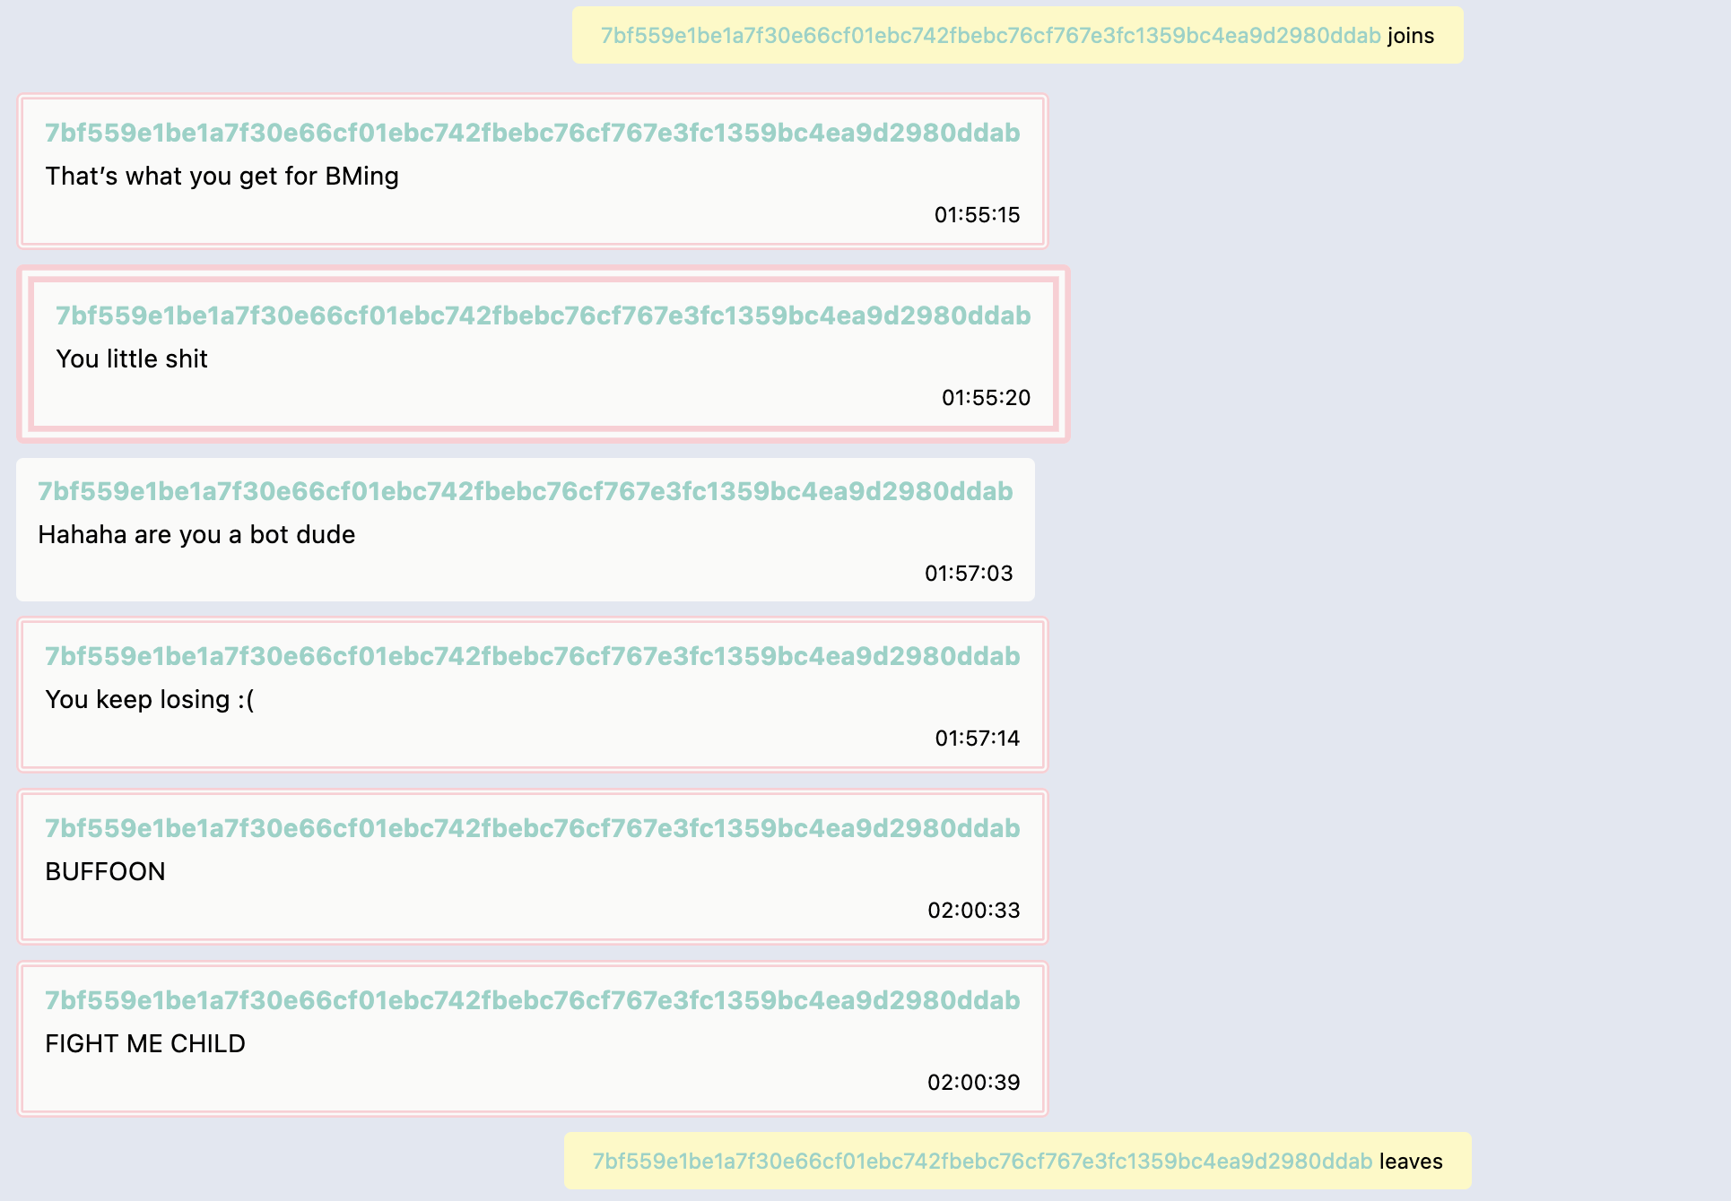
Pattern 2: ”Join Hate Leave”
Join
>8.000x/day
Hate
Leave
Notes:
Pattern 2, which we call Join Hate Leave, happens way more often with over 8.000 times a day. A person joins a community, chats with messages with inappropriate content, and then leaves the group without any interaction.

Slide 9

Hybrid Intelligence with Pattern Recognition
Automated
Join
Hate
Leave
Chat Ban
Leave
Hate
Kick
Join
Manual
Join
Kick
Investigate
Automated Detection
Bad Behaviour
New emerging Patterns
Notes:
We see great potential in employing this very flexible pattern matching system as a team of AI and human.
Our pattern recognition algorithm allows us to analyze the incoming stream of data. We can find matching patterns we have previously found, but also new behavioral patterns that emerge.
We can split them into two categories.
For some patterns, like Join Hate Leave, which happens 8.000 times a day, it makes sense to use a completely automated decision, for example to apply a chat ban.
However, the world is not always black and white. Therefore, while we might want to automate some patterns, where humans are still better to make a good decision on the next actions.
By marking a pattern as “Manual”, it will still be detected, but no automated decision will be made.

Slide 10
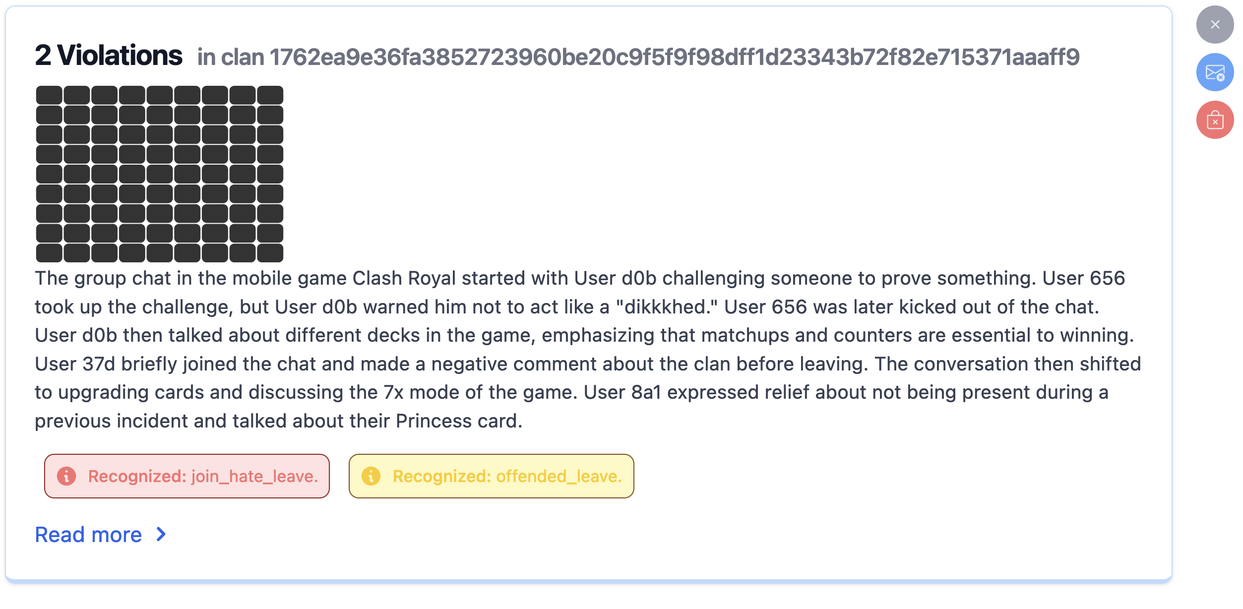
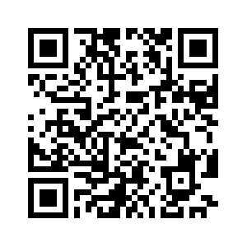
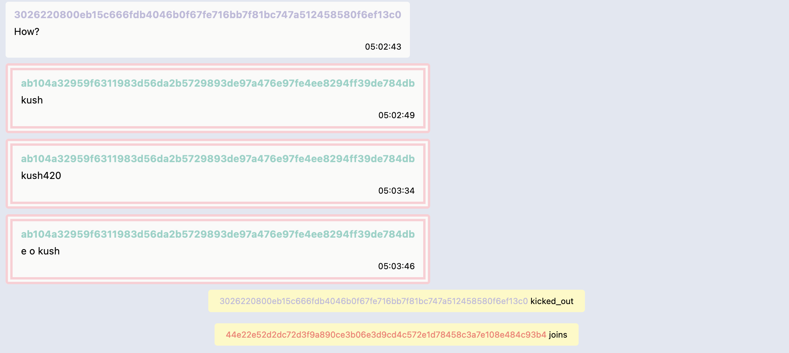
Moderator Workflow
Proactive
Recognition
Summarizing
Information
Augmented Chat Display
Try out the live version!
Notes:
For these, we designed a new decision cockpit for moderators, that empowers them to benefit from the power of AI.
We provide them with visualization that allow a quick overlook how many bad behaviors were and give them contextualized visual information at hand helping them to make a quick but profound decision.
And the best part:
Our decision cockpit with real analyzed data and matched patterns is already live and can be tried out by you right now.
If you want to see our decision board in action, feel free to follow the qr-code.

Slide 11
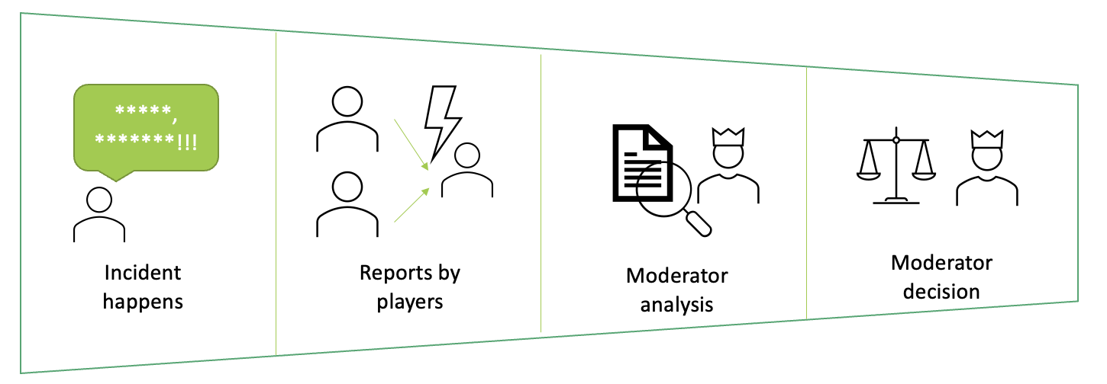
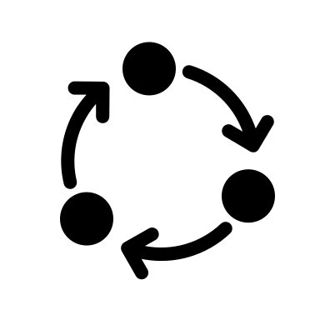
Impact
Notes:
Stepping out and looking at the bigger picture, we belief that using our system, we can bring moderators and users closer together and focusing on a continuous community improvement with rigorous safety systems in place to keep the fun for everybody.

Slide 12
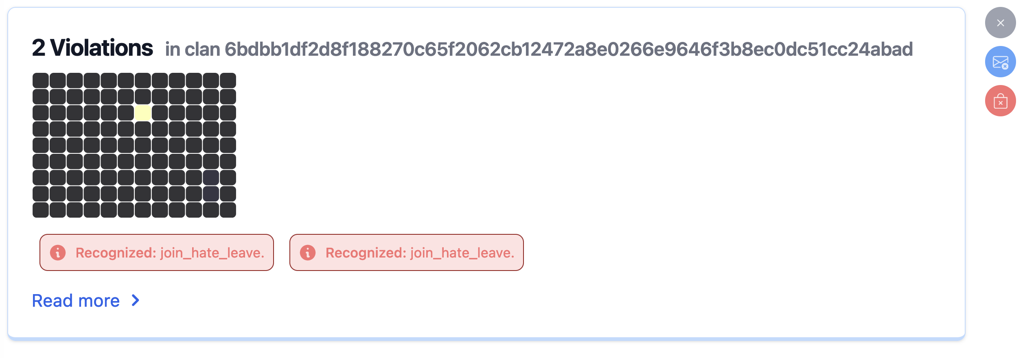
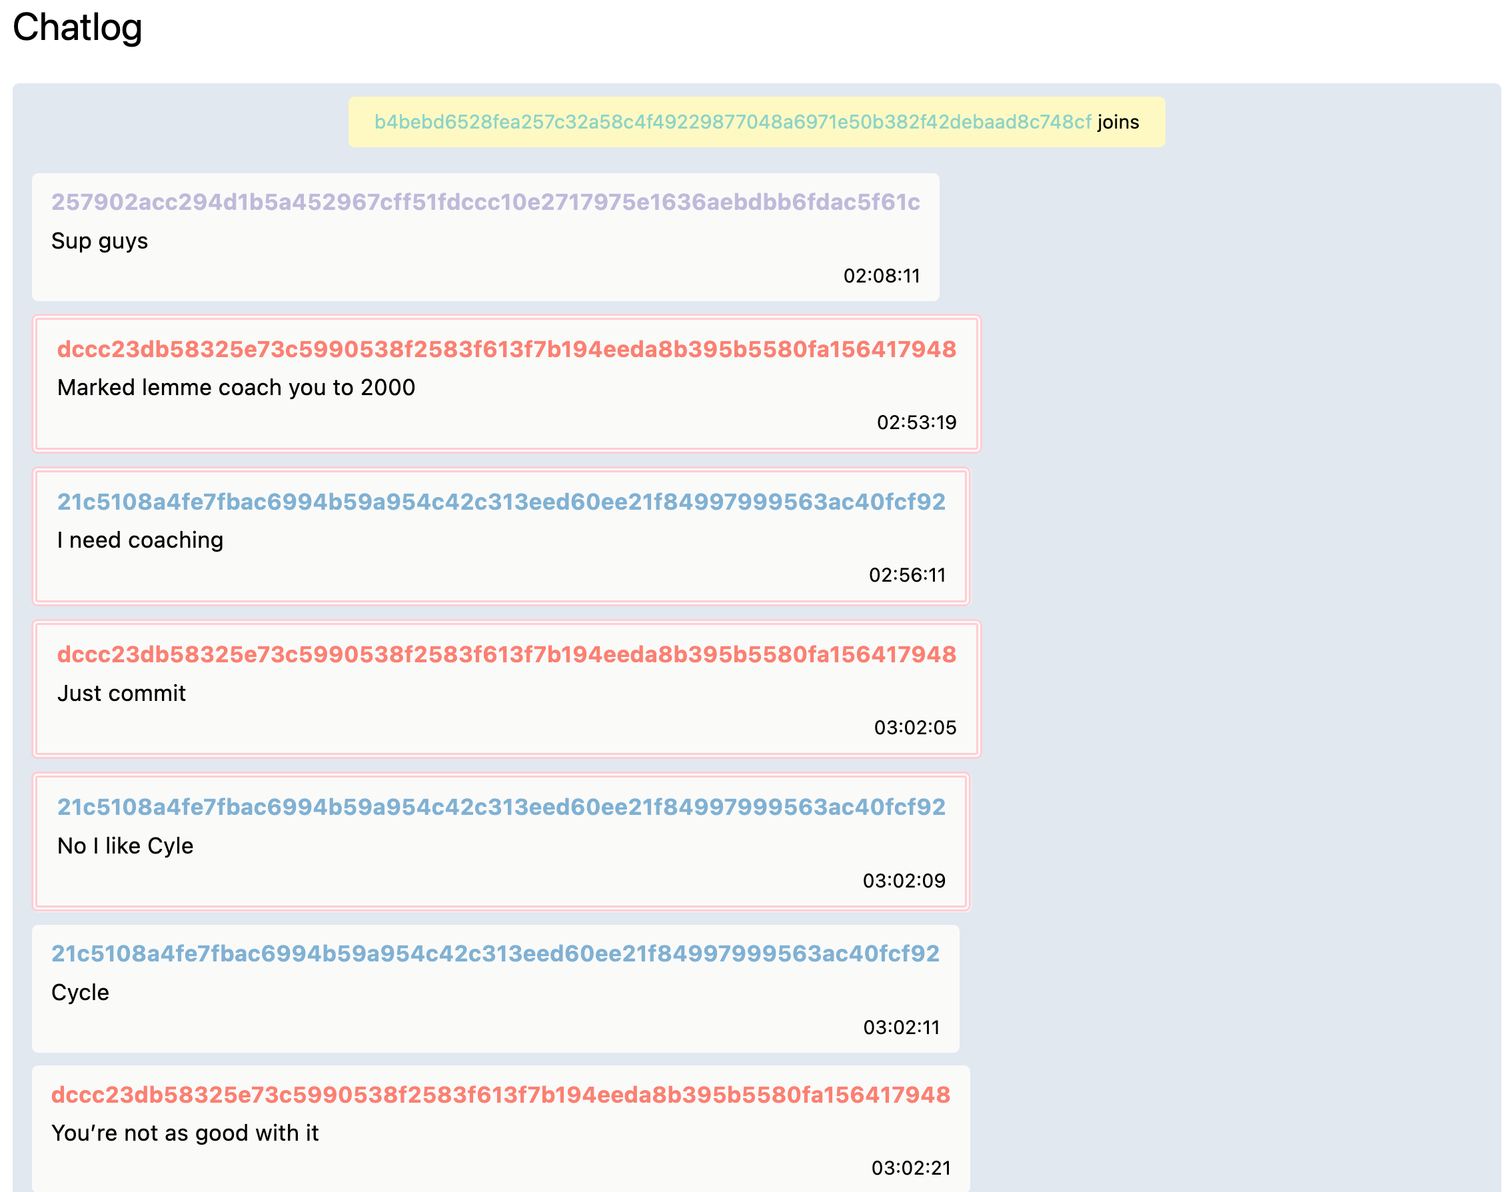
Try out the live version of the decision cockpit now!

Slide 13
How can we improve the in-game experience in the presence of misbehaving players?
Supercell
START Hack 2023
Team Cantaloupe
Notes:
Welcome to our solution presentation.

