Slide 1
Scaling Out a Database
Sharding

Slide 2
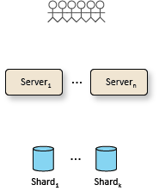
Scale Out

Slide 3
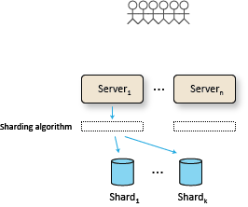
Sharding Algorithm

Slide 4
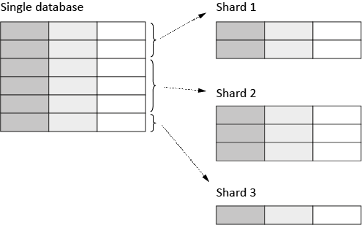
Horizontal Partitioning
Notes:
Correctly designed, horizontally partitioned tables can offer huge scalability gains. For example, a history archive based on a date column value can off-load huge amounts of data and keep the operational part small.
Note that normalization is not possible across shards, which makes selection of the partition key very important.
There is also vertical partitioning and we can have a combination of both (which we do since Table Storage has a required partition key built-in, given my solution, there is no need for partitioning the SQL database since it only contains users and customers).
One way to implement partitioning is to have a data layer that contains a proxy that will route queries to the correct connection string based on some partition identifier.

Slide 5
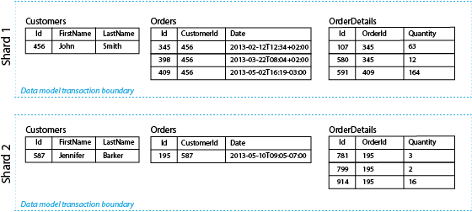
Sharding

Slide 6
Sharding Algorithm
We aim to avoid hot-spots
Uniform distribution by hash algorithms (FNV or similar)
Based on actual sharding measurements
Notes:
FNV hashes are designed to be fast while maintaining a low collision rate. The FNV speed allows one to quickly hash lots of data while maintaining a reasonable collision rate. The high dispersion of the FNV hashes makes them well suited for hashing nearly identical strings such as URLs, hostnames, filenames, text, IP addresses, etc.

