Slide 1
Security

Slide 2
OAuth2
Claims based using token.
Claims vs Roles??
Defines four basic flows for authorization delegation.
Active vs Passive (redirects or not)
Confidential vs non-Confidential (can the client be trusted with the users credentials?).

Slide 3
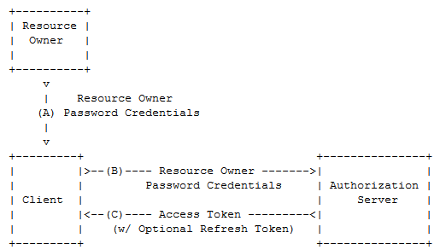
Resource Owner Password Credentials flow

Slide 4
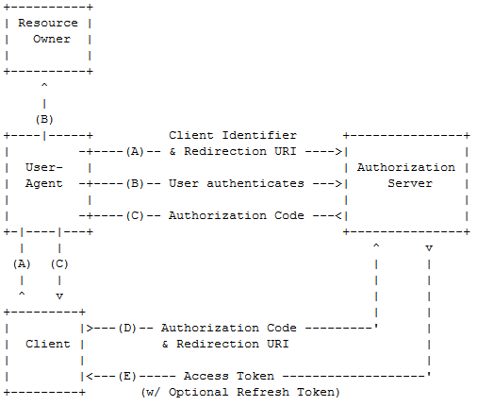
Authorization Code Grant

Slide 5
Secure the Resource Server
[Authorize]
F5+Postman (401)

Slide 6
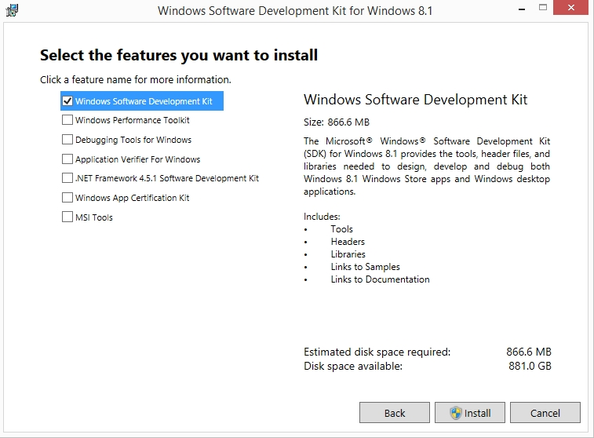
Create Signing Certificate
Install Windows SDK (from https://msdn.microsoft.com/en-us/windows/desktop/bg162891.aspx)

Slide 7
Create Signing Certificate
See http://brockallen.com/2015/06/01/makecert-and-creating-ssl-or-signing-certificates/
C:\Program Files (x86)\Windows Kits\8.1\bin\x64>makecert -r -pe -n "CN=AuthorizationServer" -b 01/01/2015 -e 01/01/2020 -eku 1.3.6.1.5.5.7.3.3 -sky signature -a sha256 -len 2048 -ss my -sr LocalMachine

Slide 8
Install Signing Certificate
Open MMC and add it to Trusted People in order to make it valid.
Right click on the cert and give e g “IIS AppPoolIdentity\AuthorizationServerAppPool” read access to the private key
Export the Public Key, and install that in the Resource Server.

Slide 9
Set up trust
Install-Package Microsoft.Owin.Security.Jwt
Add app.UseJwtBearerAuthentication() in Startup.cs
Make sure that correct issuer, audience and signing certificate identifier is set in web.config for the Resource Server.

Slide 10
Get Access Token
Postman POST /token, (jwt.io??)
Bearer header
GET /values, 200 OK

Slide 11
Authorization
RequestContext.Principal

Slide 12
Frågor?

