Slide 1
Security

Slide 2
OAuth2
Claims based using token.
Active vs Passive.

Slide 3
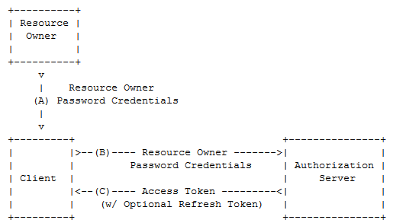
Resource Owner Password Credentials flow

Slide 4
Secure the Resource Server
[Authorize]
F5+Postman (401)

Slide 5
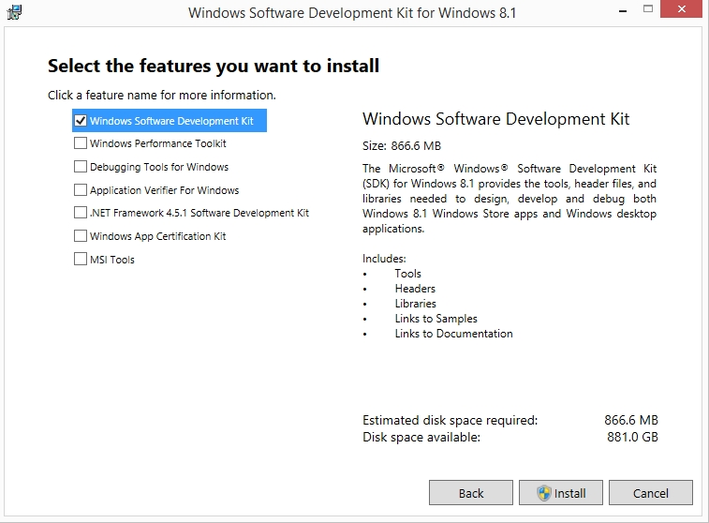
Create Signing Certificate
Install Windows SDK (from https://msdn.microsoft.com/en-us/windows/desktop/bg162891.aspx)

Slide 6
Create Signing Certificate
See http://brockallen.com/2015/06/01/makecert-and-creating-ssl-or-signing-certificates/
C:\Program Files (x86)\Windows Kits\8.1\bin\x64>makecert -r -pe -n "CN=AuthorizationServer" -b 01/01/2015 -e 01/01/2020 -eku 1.3.6.1.5.5.7.3.3 -sky signature -a sha256 -len 2048 -ss my -sr LocalMachine

Slide 7
Install Signing Certificate
Open MMC and add it to Trusted People in order to make it valid.
Right click on the cert and give e g “IIS AppPoolIdentity\AuthorizationServerAppPool” read access to the private key
Export the Public Key, and install that in the Resource Server.

Slide 8
Set up trust
Install-Package Microsoft.Owin.Security.Jwt
Add app.UseJwtBearerAuthentication() in Startup.cs
Make sure that correct issuer, audience and signing certificate identifier is set in web.config for the Resource Server.

Slide 9
Get Access Token
Postman POST /token, (jwt.io??)
Bearer header
GET /values, 200 OK

Slide 10
Authorization
RequestContext.Principal

Slide 11
Frågor?

