Slide 1

Public Infrastructure in Argentina (Regional Analysis)
PORTFOLIO PROJECT BY CASCO TOBIAS

Slide 2
Index
P. 2 . 0.Project Summary
P3 - Data Utilized and Notes
P4 – Argentina’s regions classification
P. 6. 1.Distribution of Infrastructure Projects
P7-8 – How are the projects distributed across regions ?
P9 – What’s the most prevalent sector / infrastructure type ?
P. 10. 2.Current Status of the country’s projects
P11 – What’s the percentage of finished and ongoing projects ?
P12 – What’re the sectors with the highest and lowest completion rates ?
P. 13. 3.Duration of the Projects & Trends
P14 – What’s the average “completion” time ?
P15 – Insights about projects durations
P16 – Projects Duration evolution over time
P. 17. 4.Conclusions & further Analysis
P18 – Conclusions
P9 – Further Analysis & Data Limitations

Slide 3

Project Summary
The project is based on a comprehensive analysis about Argentina’s Public Infrastructure by region, utilizing a dataset provided by the Government and performing several Data Science techniques for data cleaning, arranging and visualization. The study addresses key questions in three main categories:
The distribution of the infrastructure projects
Analysis of the current statuses of the projects
Duration of the projects & trends

Slide 4
Data & Notes
DATA:
The data for this analysis was collected directly from the Argentine Government. To facilitate the subsequent analysis, it was necessary to rearrange and wrangle the data.
The data required for the study included the number of infrastructure projects, the project’s initiation year, the sector the project belong, the Argentine province and region in which the project is located, and the duration in days of this.
NOTES:
*The dataset contained data from 2008 to 2023
**The Argentina’s regions are graphed and explained on the following slide

Slide 5
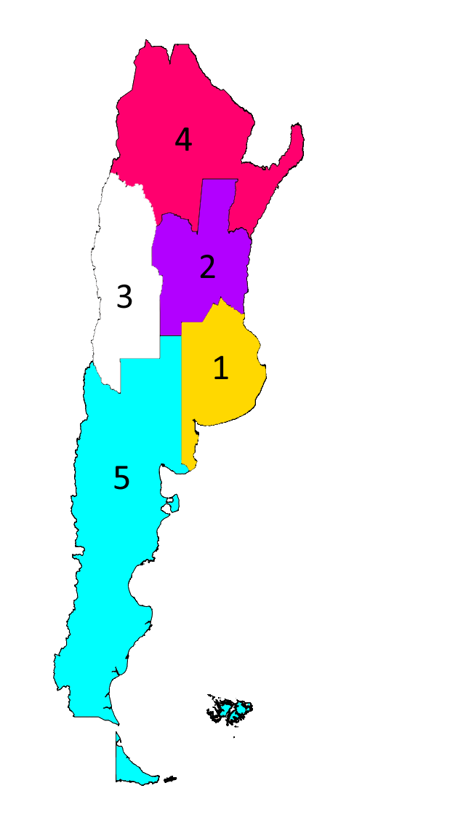
Argentina’s regions
Argentina, situated in South America, is a federal republic with a population of 45 million inhabitants. The nation is conformed by 23 provinces and one Federal District. To conduct a regional Analysis, the 24 districts were categorized into 5 regions (following the economic & social development region separation):
Buenos Aires Region : Formed by only two districts, Buenos Aires Province and the Autonomous City of Buenos Aires (the national capital), this region is the richest and most populated.
Central Region: Located in the central-eastern part of the country, It’s the third most populated region and the second richest. It’s composed by three provinces
New Cuyo Region: Considerate as the poorest Region in the country, New Cuyo is made up of four provinces and is situated in the central-western part of Argentina
Great North Region: The second most populated and third wealthiest region, the Great North is formed by eight provinces. It’s located all over the north of the country
Patagonia Region: The least populated region. Located all over the south of the country, it’s formed by six provinces.

Slide 6
1.Distribution of infrastructure Projects

Slide 7
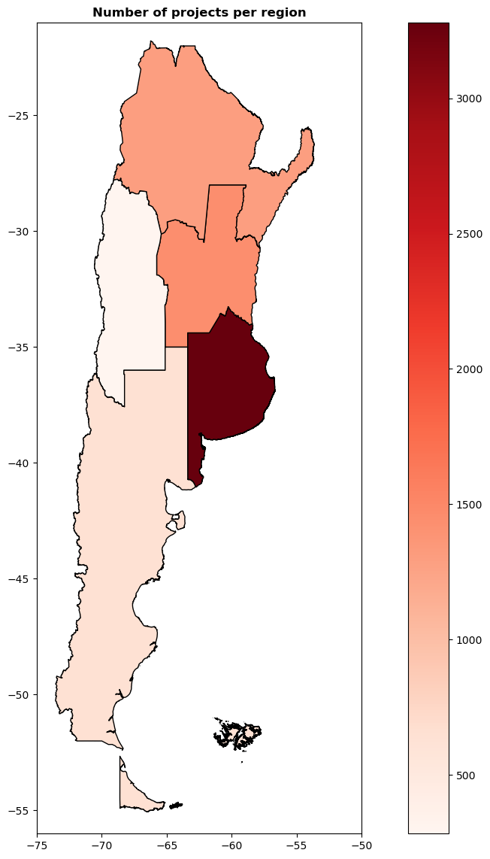
1.1. How are the projects distributed across region ?
In the following map we can see clearly how the region with most projects is Buenos Aires, followed by the Central and Great North region.
It’s important to note that There’s a really big gap between Buenos Aires and the rest of the regions.
To really understand the distribution, it would be necessary to observe the following pie chart →

Slide 8
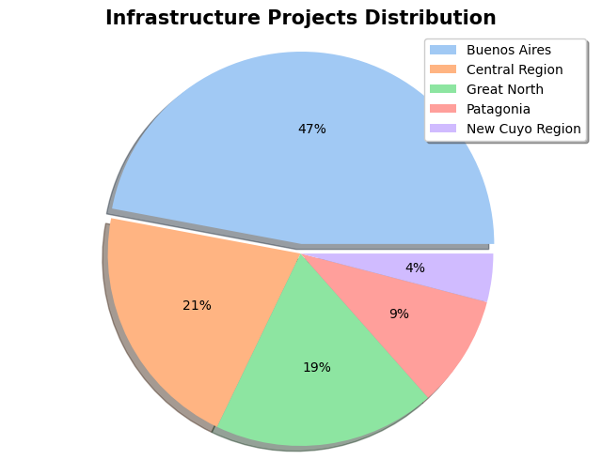
1.1. How are the projects distributed across region ?
Now, observing the distribution on a pie chart we can clearly understand the difference that exists between Buenos Aires and the rest of the regions.
Almost half of the infrastructure projects in the country take place in Buenos Aires.

Slide 9
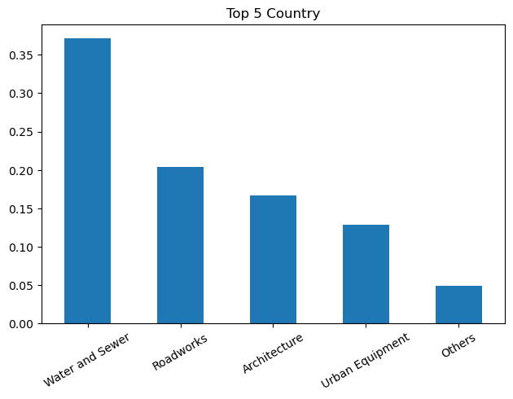
1.2. What is the most prevalent sector/infrastructure type?
At country level we can see that the top 5 sectors, where most infrastructure projects falls on, are the:
Water and Sewers Infrastructures
Roadworks
Architecture Projects
Urban Equipment
Other Types of Projects
(This distribution changes when analysing each region individually, this can be observed in the interactive dashboard provided )

Slide 10

2.Current Status of the Country’s projects

Slide 11
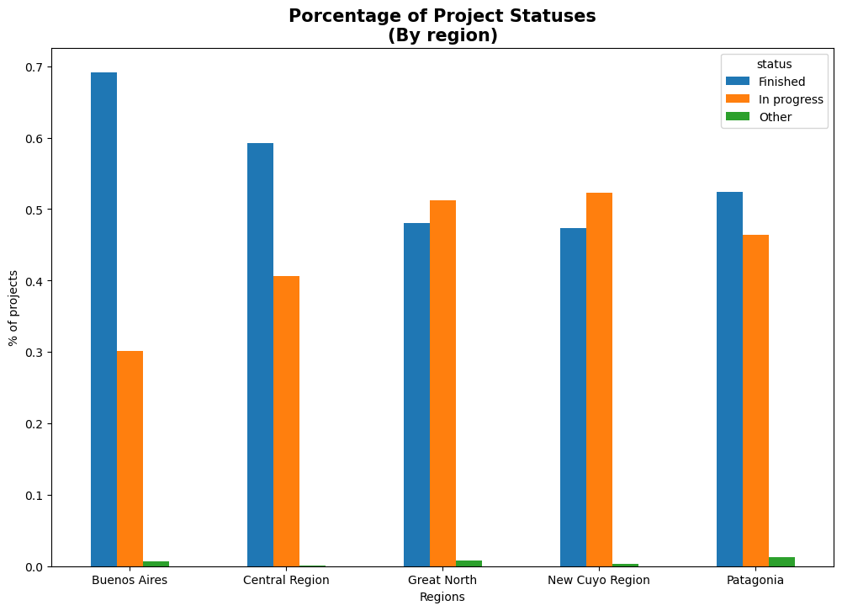
2.1. What’s the percentage of finished and ongoing projects ?
We can see that the regions with the highest rate of finished projects, are Buenos Aires and the Central Region.
We can also see that there’re two regions, Great North and New Cuyo, that have more ongoing projects that finished projects.
I suggest investigating two possible causes to explain this:
The wealth of the individual provinces that conform those regions, could be related to why there’re least finished projects.
It`s possible that inversion on those regions only began in more recent years, having less time to complete those projects.

Slide 12
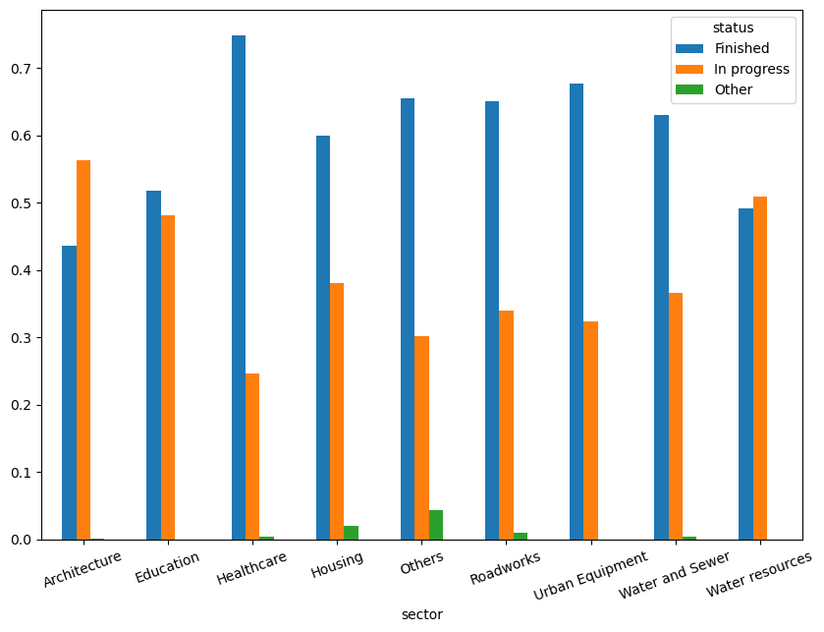
2.2. What’s projects sectors with highest and lowest completion rate?
In the following bar chart, we can observe the completion rate for each infrastructure sector.
The healthcare sectors has the highest completion rate
Architecture and Water Resources sectors are the only ones with more unfinished projects than finished ones.

Slide 13

3.Duration of the projects & trends

Slide 14
3.1. What’s the average “completion” time ?
In the following table we can find the average completion (in days) time for each infrastructure project sector/type in each region.
Sector | Architecture | Education | Healthcare | Housing | Roadworks | Urban Equipment | Water and Sewer | Water Resources | Other
Region
Buenos Aires | 317 | 551 | 369 | 327 | 367 | 184 | 257 | 758 | 299
Central | 298 | 538 | 241 | 168 | 421 | 210 | 317 | 725 | 352
Great North | 336 | 507 | 285 | 107 | 632 | 171 | 417 | 409 | 429
New Cuyo | 347 | 580 | 497 | No Data | 894 | 180 | 463 | 1125 | 363
Patagonia | 306 | 313 | 332 | 90 | 854 | 235 | 404 | 489 | 448
*There`re no registered Housing Projects in New Cuyo region
**The highlighted zone in the table suggest a focus point on the data

Slide 15
3.2. Projects Duration Insights
After observing the previous table, we can notice valuable information.
If we focus on a regional analysis, the region with the highest average completion time is New Cuyo (556 days), while the one with the lowest is the Central Region (363 days).
On the other hand, if we focus on a sector analysis, the sector with the highest average completion time is the Water Resources Sector (701 days), while the one with the lowest is the Housing Sector (173 days)
As an additional we can notice that Roadworks projects have a larger duration in Patagonia and New Cuyo Region, to provide an exact reason it would be necessary to realize a more detailed investigation. But at first hand I will consider looking the relief of those regions and other terrain “abnormalities” that could be affecting the duration of this types of projects.

Slide 16
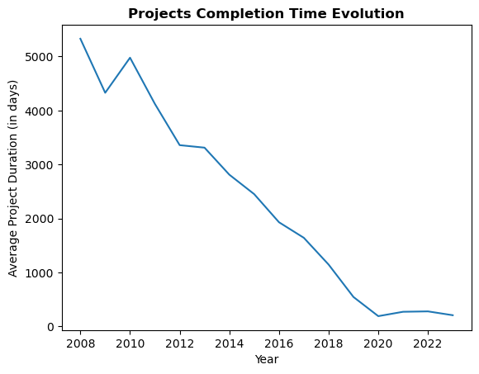
3.3. Project Completion Time evolution
In this graph we can see how the average completion time (at country level) evolved over the years.
We can see clearly the descending trend, indicating that projects tend to take less time in more recent years. As to stablish a cause will need further investigation, I suggest that the development of new technologies and machinery, are improving the time infrastructure projects require to be completed.

Slide 17

Conclusions & Further Analysis

Slide 18

Conclusions
After working with a Dataset Provided by Argentina’s government, I was able to clean, wrangle, rearrange and classify the data in order to perform a Regional Analysis about Argentina’s Public Infrastructure, and provide answers to key questions about the infrastructure distribution, projects statuses , durations & trends in different Argentina Regions
I also provided an interactive dashboard, where everyone can visualize the graphs in this report, and interact with them in order to visualize more specific questions that can surge outside the explained in this report

Slide 19

Further Analysis & Limitations
Further Analysis
In this final section, I want to make clear that there’s still a lot more of additional analysis that can be made and questions that can be answered with the data. For instance, exploring a potential relationship between money spent on each project and their duration in days, and if it does, developing a simple statistic model to predict project costs based on their duration, project type, and region.
Limitations
In the utilized data, the number of projects before the year 2020 was very small compared to projects after that date, making trends and summary statistics from those years less reliable.
It would be great to count with the annual GDP of each region, in order to know how it affected (if it did) the amount of money spent, and the number of infrastructure projects made.

Slide 20
Thanks for reading !

