Slide 1
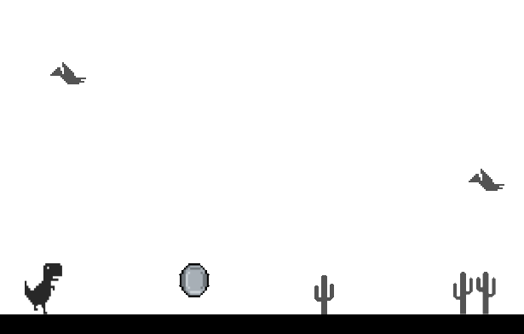
Der T-Rex Sidescroller

Slide 2
Inhaltsverzeichnis
Idee
Datenbank
Sprungmechanik
Fragen

Slide 3
Idee
IST-Zustand
SOLL-Zustand

Slide 4
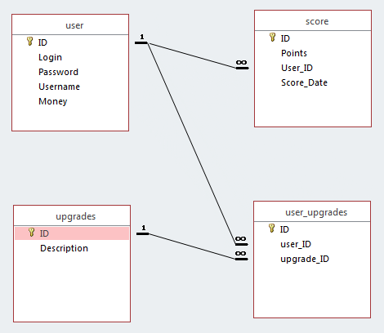
Datenbank

Slide 5
Problem: Sprungmechanik
public void gameEvent(object sender, EventArgs e)
{
if (jumping)
{
trex.Top += currJumpSpeed;
currJumpSpeed += GRAVITY;
if (trex.Top >= 380)
{
trex.Top = view.getFloor().Top - trex.Height;
currJumpSpeed = 0;
jumping = false;
doubleJumping = false;
}
}
}
public void keyisdown(object sender, KeyEventArgs e)
{
if (State == GameState.STARTED)
{
if (e.KeyCode == Keys.Space)
{
if (!jumping)
{
jumping = true;
currJumpSpeed = JUMP_SPEED;
spaceLetGo = false;
}
if (doubleJumpUnlocked && !doubleJumping && spaceLetGo)
{
currJumpSpeed = JUMP_SPEED;
doubleJumping = true;
}
}
}
}

Slide 6
Gibt es Fragen?

