Slide 1
◆ Digital Earth Sweden
Breaking the label ceiling
Field-calibrated land-cover mapping for Sweden
On 209 held-out field plots the model reaches 50.2% and its forest-type layer 57.9% — versus 43.1% for the NMD2023 map it was trained on.
28
7,882
944
34,480
unified classes
Sentinel-2 tiles
NFI field plots
LUCAS points
Notes:
Our headline: a model trained on Sweden's national land-cover map ends up more accurate than that map, when both are scored on independent field plots. I'll show how field calibration breaks a ceiling that hard labels impose. Four datasets underpin the work: 28 unified classes, 7,882 Sentinel-2 tiles, 944 NFI plots and over 34,000 LUCAS points.

Slide 2
◆ Digital Earth Sweden
The label-ceiling question
The national land-cover map (NMD) is Sweden's standard reference — but it is a modelled proxy, not field truth. Can a model trained on it beat it?
NMD is produced from satellite imagery and modelling — it carries its own class errors.
Distillation can denoise a teacher, but only up to the teacher's own accuracy.
The open question: is the ceiling the representation (features), or the supervision target (labels)?
To answer it we need supervision and evaluation grounded in the field — not in NMD.
Why field truth?
NMD tells you what another model believed. National Forest Inventory (NFI) plots and LUCAS points are surveyed on the ground. Only independent field truth can tell whether a map is right — and whether a model has out-learned its teacher.
Notes:
The premise: NMD is everywhere used as ground truth, but it is itself a model output. A student model can denoise its teacher, yet classical distillation is bounded by the teacher's accuracy. So the scientific question is whether the ceiling lives in the representation or in the label. Answering that requires evaluation on real field data, which is what the rest of the talk uses.

Slide 3
◆ Digital Earth Sweden
Data and truth sources
TRAINING SIGNAL
INDEPENDENT TRUTH
Sentinel-2 + NMD2023
NFI · LUCAS · LPIS
7,882 tiles across all of Sweden, 4 temporal frames each. Pixel labels come from the NMD2023 national land-cover map — the proxy we train against.
944 NFI field plots (209 held out for testing), 34,480 Swedish LUCAS points, and year-matched LPIS crop parcels. None of these ever enters training.
7,882
944 / 209
34,480
28
tiles
NFI plots / held out
LUCAS points
unified classes
The models see only Sentinel-2 pixels and NMD2023 labels; every accuracy number in this talk is measured against field truth the model never touched.
Notes:
Two worlds of data. On the left, the training signal: nearly 8,000 Sentinel-2 tiles labelled by the NMD2023 map, four temporal frames each. On the right, independent field truth we never train on — NFI plots, LUCAS points and LPIS crop parcels. That separation is what makes the later comparisons honest.

Slide 4
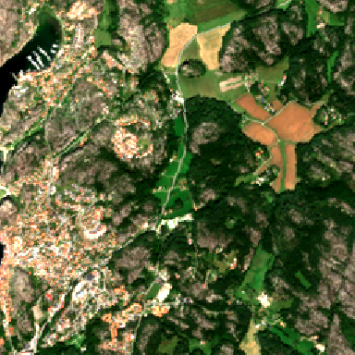
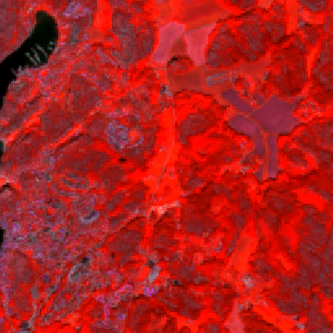
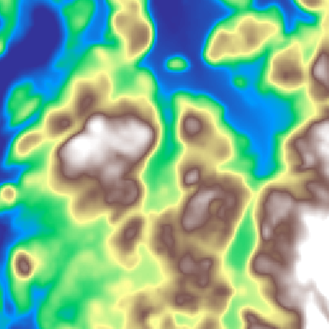
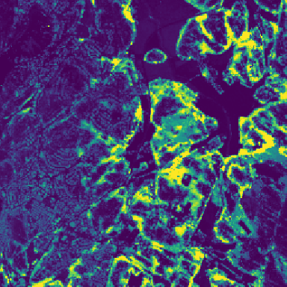
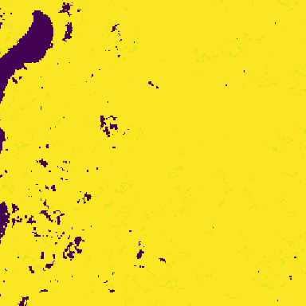
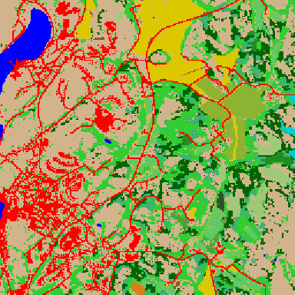
◆ Digital Earth Sweden
Anatomy of a training tile
One example tile shown as its inputs: four seasons of Sentinel-2 plus a deep auxiliary stack — 35 channels — with one merged 28-class label.
Sentinel-2 RGB
(1 of 4 frames)
False-colour NIR
(vegetation red)
Terrain
Copernicus DEM
Forest height
SLU grunddata
Phenology
VPP start-of-season
Merged
28-class label
Spectral — 4 frames × 6 bands = 24
Auxiliary — 11 channels
Frame 0 is autumn (Sep–Oct) of the year BEFORE the label; frames 1–3 follow VPP phenology through the growing season. Each frame carries B02 B03 B04 B8A B11 B12 (Prithvi order; NIR is B8A, not B08).
SLU forestry: canopy height, volume, basal area, stem diameter. Terrain: Copernicus DEM. Phenology (HR-VPP): start- & end-of-season, season length, peak & trough vegetation. Plus SLU soil moisture (markfukt).
Label build: NMD2023 land cover (base) → LPIS crop parcels (year-matched SJV codes) → SKS clear-cut (hygge). QC drops tiles with >5% nodata or <3 of 4 usable frames. 7,882 tiles · 10 m GSD · 2018–24 · Sweden-wide.
Notes:
Now made concrete: the same tile shown as its actual inputs. The first two panels are two renderings of one Sentinel-2 frame — true colour and false-colour near-infrared — and there are four such temporal frames, six bands each, giving 24 spectral channels. The next three panels are auxiliary layers: Copernicus terrain, SLU forest canopy height, and a Copernicus phenology metric; eleven auxiliary channels in total — four SLU forestry metrics, the DEM, five HR-VPP phenology features, and SLU soil moisture. The last panel is the training target: the 28-class label, merged from NMD2023 land cover, LPIS crop parcels rasterised from year-matched agricultural codes, and Skogsstyrelsen clear-cut notifications, after quality control.

Slide 5
◆ Digital Earth Sweden
Label taxonomy and class distribution
28 classes drawn from four national label sources
10
11
1
5
NMD land cover (1–10)
LPIS crops (11–21)
SKS clear-cut (22)
NMD2023 additions (23–27)
NFI reference forest types (944 field plots)
Forest-dominated, and imbalanced
Of 944 NFI plots, 884 are forest and only 60 are non-forest. Within forest, pine (372) and spruce (247) are 70% of plots; deciduous (133) and mixed (132) about 15% each.
The training labels inherit this skew: forest covers most of Sweden, crops occupy a thin southern agricultural band, and clear-cut (hygge) is rarer still.
So the rare classes — mixed forest, minor crops, non-forest — carry the widest confidence intervals, and are why a thin 209-plot held-out set limits statistical power.
Notes:
The taxonomy and its balance. The bar at the top shows the 28 classes split by their source survey: ten NMD land-cover classes, eleven LPIS crop classes, a single SKS clear-cut class, and five classes new in NMD2023. The distribution is deeply uneven. On the field-truth side, of 944 NFI plots 884 are forest and only 60 non-forest; within forest, pine and spruce alone are seventy percent, with deciduous and mixed around fifteen percent each. The training labels inherit the same skew — forest everywhere, crops in a thin southern band, clear-cuts rarer still. That imbalance is why the rare classes have the widest error bars and why our thin held-out set limits statistical power.

Slide 6
◆ Digital Earth Sweden
Methods: architecture
Prithvi-EO-2.0 600M backbone
Tessera (frozen embeddings)
Geospatial foundation encoder. Input: 4 temporal frames plus 11 auxiliary channels — forestry height, volume, basal area and diameter, a DEM, and VPP phenology.
A second backbone that uses precomputed Tessera embeddings. No 600M encoder forward pass at train or inference time — a deployment-cheap alternative.
Dual output head
11 auxiliary channels
Head 1 predicts the 28-class land-cover map. Head 2 predicts a Trädslag forest-type fraction layer — the per-pixel mix of tree species.
Forestry stand metrics (height, volume, basal area, diameter), terrain (DEM), and Vegetation Phenology & Productivity (VPP) features guide the seasonal signal.
Same features, two backbones, two heads — the design lets us separate representation quality from supervision quality.
Notes:
Architecturally: a Prithvi-EO-2.0 600M foundation backbone consumes four temporal frames and eleven auxiliary channels — forestry stand metrics, a DEM, and phenology. It carries two heads: a 28-class land-cover head and a forest-type fraction head. We also run a Tessera backbone on frozen, precomputed embeddings so we can ask whether an expensive encoder is even necessary.

Slide 7
◆ Digital Earth Sweden
Methods: honest evaluation
Grouped-tile split
Calibration on train only
735 plots for training, 209 held out. The split is by tile, so no plot near a training tile can leak into the test set.
Thresholds and the collapse rule are fit on the 735 train plots exclusively. The 209 held-out plots stay untouched.
NMD2023 on the same plots
Three independent truths
The baseline map is scored on the exact same 209 plots — a like-for-like comparison, not a favourable subset.
NFI, LUCAS and LPIS cross-check the result from three directions, none of them in the training loop.
Notes:
Rigor matters more than the headline. We split by tile, not by plot, so nothing spatially adjacent leaks across the train-test boundary. Every threshold and collapse rule is calibrated only on the 735 training plots. The NMD2023 baseline is scored on the identical 209 held-out plots. And three independent field sources — NFI, LUCAS, LPIS — cross-check the conclusion.

Slide 8
◆ Digital Earth Sweden
Result: the label ceiling
NFI overall accuracy (944 plots) across the experiment series
Hard labels cap ~46%
Trained against NMD classes of any generation, accuracy sticks near 46%. NMD2023 is too clean to beat by imitation.
Field target breaks it
The SAME features with NFI supervision reach 63.7% (leak-free out-of-fold). The supervision TARGET was the ceiling — not the representation.
Notes:
This is the central finding. The three left-hand bars — different NMD generations as the training target — all sit around 46 to 49 percent. Distillation nudges it to 52.7. But take the identical features and supervise with NFI field data, and out-of-fold accuracy jumps to 63.7 percent. The representation was never the bottleneck; the label was.

Slide 9
◆ Digital Earth Sweden
Result: held-out benchmark
209 NFI plots, grouped-tile split, calibration on train-735 only
Honest evaluation
Thresholds and head trained ONLY on the 735 train plots — the 209 are untouched.
Distilled model = full 28-class product; every class is functional (+7.2 pp over NMD2023).
The fraction layer reaches 57.9% on forest type — pine F1 0.74. Cohen's kappa rises 0.298 → 0.420.
Notes:
On the held-out plots the numbers speak for themselves: NMD2023 scores 43.1 percent, the distilled 28-class model 50.2, and the forest-type fraction layer 57.9. Kappa climbs from 0.30 to 0.42. Crucially, all thresholds were fit only on the training plots, so this is a clean generalization result, not a tuned one.

Slide 10
◆ Digital Earth Sweden
The student beats the teacher
In distillation a student normally cannot exceed its teacher. Trained ONLY on NMD2023 labels, on independent NFI field truth it does — and its forest-type layer more so.
Label noise averages out
Random per-pixel teacher errors regularize away over 7,882 tiles — denoising you can see.
Field truth exposes the teacher
NMD's own errors are invisible when it is scored against itself; NFI plots reveal them.
+14.8 pp
+7.1 pp
Richer than the label
4 temporal frames + 11 auxiliary channels carry what a single-date NMD label cannot.
Cohen's kappa 0.298 → 0.371 → 0.420
Notes:
The scientific hook: in classical distillation a student is bounded by its teacher. Here the student, trained only on NMD2023 labels, beats it on independent NFI field truth — 50.2 versus 43.1 percent overall, and 57.9 on forest type, gains of 7.1 and 14.8 points. Kappa rises from 0.30 to 0.42. Three reasons: label noise averages out over nearly 8,000 tiles, field truth exposes the teacher's own errors that self-scoring hides, and four temporal frames plus eleven aux channels encode more than a single-date label ever could.

Slide 11
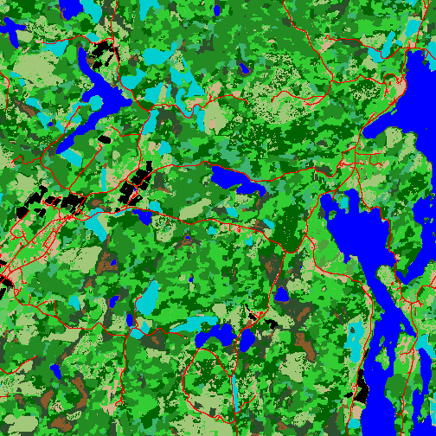
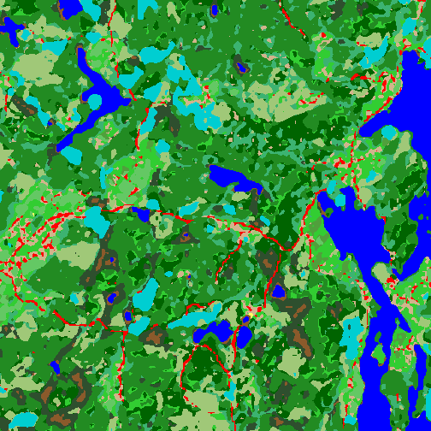
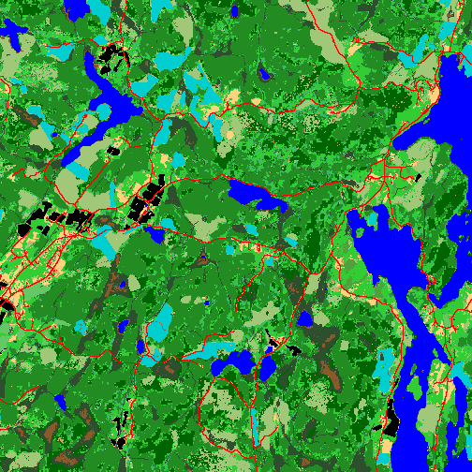
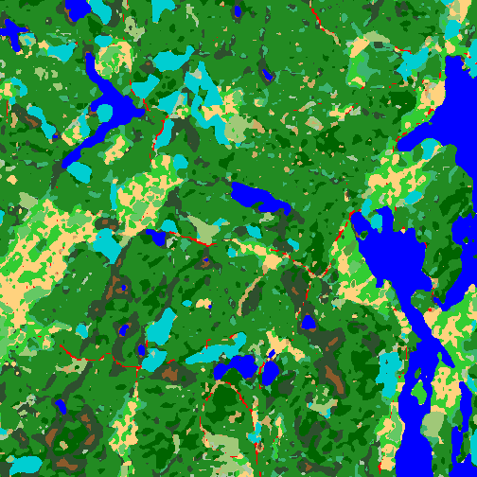
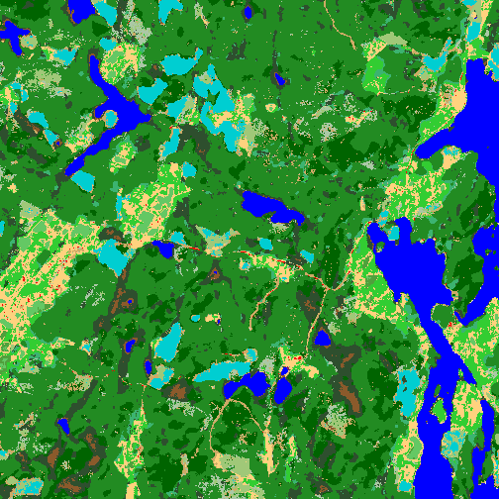
◆ Digital Earth Sweden
Five views, same landscape
One 5×5 km tile, identical extent and unified palette (tile_331280_6541280): the 2018/2023 label sources, and three models — v8b, the distilled Prithvi, and Tessera — each trained against the field-calibrated target.
NMD2018 label
v8b (trained on 2018)
NMD2023 label
Distilled Prithvi
Tessera
Pine
Spruce
Deciduous
Mixed
Swamp forest
Clear-cut
Open land
Water
Built-up
Grass-dom.
Dwarf-shrub
Shrub-dom.
Notes:
Qualitatively, the same 5-by-5 kilometre tile through five lenses. Left to right: the 2018 NMD label, our model trained on 2018, the 2023 NMD label, the distilled Prithvi model, and Tessera. Both models' outputs are visibly crisper and more coherent than the labels they learned from — denoising you can see, not just measure — and Tessera matches the 600-million-parameter Prithvi from a frozen, precomputed embedding.

Slide 12
◆ Digital Earth Sweden
Per-class F1 on the held-out plots
Three sources on the exact same 209 field plots
Overall accuracy
Cohen's kappa
NMD2023 43.1% Distilled 50.2% Fractions 57.9%
NMD2023 0.298 Distilled 0.371 Fractions 0.420
Class | NMD2023 | Distilled | Fractions
Pine | 0.59 | 0.61 | 0.74
Spruce | 0.56 | 0.63 | 0.55
Deciduous | 0.30 | 0.43 | 0.59
Mixed | 0.28 | 0.30 | 0.29
Non-forest | 0.24 | 0.32 | 0.00
Green = best F1 per row. Distilled wins spruce and non-forest; the fraction layer wins pine and deciduous. The fraction path cannot predict non-forest (0.00) — in production a hard mask decides forest/non-forest, fractions decide type.
Notes:
Class by class, the story is nuanced. The distilled model wins spruce and non-forest; the fraction layer wins pine, at F1 0.74, and deciduous. Non-forest is a structural zero for the fraction path — by design it only assigns forest type, so production pairs it with a hard forest mask. No single column dominates every row, which is why we ship both.

Slide 13
◆ Digital Earth Sweden
Does combining models help?
Ensemble of 6 members, evaluated on the 209 held-out plots
0.579
0.617
p = 0.37
< 0.03
Single best member
Best stacked combiner
McNemar on Δ
Tessera adds (G2)
(gate)
OOF-locked
not significant
encoder diversity
Honest verdict: within noise
The best stacked combiner (0.617) edges the single best member (0.579), but McNemar gives p = 0.37 and the bootstrap 95% CI on the difference is [−0.038, +0.11] — it spans zero. Encoder-diversity ablation G2 (adding the Tessera member) moved the combiner by less than 0.03. Conclusion: the ensemble does not significantly beat the single best member, and encoder diversity did not pay off.
Notes:
A natural question: does ensembling help? We tried six members and an out-of-fold-locked stacked combiner. It reaches 0.617 versus 0.579 for the single best member — but McNemar's p is 0.37 and the bootstrap confidence interval on the gap spans zero. Adding an encoder-diverse Tessera member changed almost nothing. Honestly reported: the ensemble is within noise. We do not ship it.

Slide 14
◆ Digital Earth Sweden
Prithvi vs Tessera: head to head
Two backbones, same field-calibrated target, raced on three independent truths — Tessera ≥ Prithvi on every one.
 | Prithvi-600M | Tessera
Encoder | 600M forward | frozen 128-d
Inference cost | heavy | ~ free
NFI-209 type | 0.579 | 0.589
LUCAS-28 | 0.477 | 0.499
LUCAS-frac | 0.784 | 0.809
Deployment winner: Tessera
Statistical tie on accuracy across three independent truths (NFI McNemar p = 0.88) — Tessera wins decisively on compute.
Notes:
Now race the two backbones directly on the same field-calibrated target across three independent truths. On NFI-209 forest type Tessera scores 0.589 to Prithvi's 0.579; on the LUCAS 28-class task 0.499 to 0.477; on LUCAS forest fraction 0.809 to 0.784. Tessera is at least as good on all three. But it runs on precomputed 128-dimensional embeddings — no 600-million-parameter forward pass at train or inference time. A statistical tie on accuracy, a decisive win on compute: Tessera is the deployment winner.

Slide 15
◆ Digital Earth Sweden
The foundation-model race: what gates accuracy?
Five geospatial encoders, one field-calibrated target, scored on the same NFI truth — finer resolution alone does not predict the winner.
Backbone | Patch | Encoder | NFI OA
Tessera | 1 | frozen 128-d | 0.589
Clay | 8 | ViT SSL | 0.435
Prithvi-600M | 14 | 600M ViT | 0.579
Prithvi-300M | 16 | 300M ViT | 0.545
CROMA | 8 | ViT+SAR | pending
TerraMind | 16 | multimodal | pending
The reversal: encoder gates resolution
If finer patches drove accuracy, Clay (p8) would beat both Prithvis (p14/p16). It lands last (0.435). Tessera wins by being p1 AND a strong encoder. CROMA/TerraMind retrain on S1 v3 — pending.
bars ordered by ViT patch size → finer coarser
Notes:
A five-way foundation-model race on the identical field-calibrated target, all scored the same way on the held-out NFI plots. The intuition going in was 'resolution beats size' — a finer patch should see more detail. The data refutes it: Clay, at patch-8, is finer than either Prithvi (patch-14 and patch-16) yet lands dead last at 0.435, well below Prithvi-600M's 0.579 and Prithvi-300M's 0.545. So patch size alone does not gate accuracy — encoder quality does. Tessera wins not merely because it is effectively patch-1, but because it pairs that with a strong pretrained representation. Two more points, CROMA at patch-8 and TerraMind at patch-16, are retraining on the new S1 data and will complete the curve. This is the model-race result C9 and the reformulated C6.

Slide 16
◆ Digital Earth Sweden
Independent validation: LUCAS
10,108 year-matched field points, never trained on
L2b — 28-class overall
L2a — forest fraction (dominant-species agreement)
Backbone | Overall
Tessera | 0.499
Distilled | 0.484
Prithvi-600M / tradslag | 0.477
Spruce is the hard axis — for both
Breadth: strong vs weak (LUCAS F1)
Per species: pine 0.83/0.81, deciduous 0.95/0.92, but spruce only 0.55/0.53. The spruce weakness is shared across backbones — a task/data limit, not a model-specific failure.
Strong: water 0.96, maize 0.94, sugar-beet 0.93, wheat 0.78. Weak: open land 0.02, shrub 0.07, mixed forest 0.21. Both corroborate NFI: Tessera ≥ best Prithvi on independent truth.
Notes:
An entirely separate truth source: over ten thousand year-matched LUCAS points. On the 28-class task Tessera leads at 0.499; on threshold-free forest fraction it reaches 0.809 dominant-species agreement, again ahead of Prithvi. Both backbones struggle with spruce at around 0.54 — that is a shared task limit, not a model quirk. LUCAS independently confirms the NFI ordering.

Slide 17
◆ Digital Earth Sweden
Label cross-check: LUCAS × LPIS
Year-matched crop truth, no model in the loop
79.8%
0.81
0.25
LUCAS crop points on a
year-matched LPIS parcel
agreement excluding
pasture
pasture agreement, but
87% still LPIS grass
Crop agreement (cereals & roots)
Labels are well-founded
3,496 of 4,382 LUCAS crop points fall on a year-matched LPIS parcel. Cereals and roots agree 0.69–0.91. The pasture split is a ley-vs-pasture boundary the two surveys draw differently — not an error. Year-matching is essential: crops rotate annually.
Notes:
A pure label sanity check, no model involved. Nearly 80 percent of LUCAS crop points land on a year-matched LPIS parcel, and excluding pasture the two surveys agree at 0.81 — sugar-beet and potato above 0.90. Pasture looks low at 0.25, but 87 percent is still grass in LPIS: the two surveys simply draw the ley-versus-pasture line differently. Our crop labels are independently well-founded.

Slide 18
◆ Digital Earth Sweden
Discussion: four takeaways
The TARGET was the ceiling
Representation is cheap
Not the representation. Hard NMD labels cap accuracy near 46%; NFI supervision on the same features reaches 63.7%.
Tessera's frozen embeddings tie the 600M Prithvi (p = 0.88). A large encoder buys no accuracy here.
Ensembling doesn't pay
Hard classes are shared
Members are correlated: the stacked combiner is within noise (p = 0.37), and encoder diversity added < 0.03.
Spruce and open/shrub are weak across every backbone and every truth source — a data limit, not a model flaw.
Notes:
Four things to take away. First, the supervision target — not the feature representation — was the ceiling. Second, representation is cheap: frozen Tessera embeddings match a 600-million-parameter encoder. Third, ensembling doesn't pay because the members are correlated. Fourth, the hard classes — spruce, open land, shrub — are hard for every backbone and every truth source, so they are a data limit we should target next.

Slide 19
◆ Digital Earth Sweden
Limitations
Thin held-out set: 209 plots limits statistical power — several head-to-head gaps sit within noise.
Spruce accuracy (~0.53–0.55) is the persistent weak axis across both backbones and both truth sources.
Crop classes are year-sensitive: labels and spectra must be matched to the same year, since crops rotate.
Ley-vs-pasture grass classes are not cleanly separable across truth sources — a boundary, not an error.
LUCAS coverage: only ~29% of crop points fall on a year-matched LPIS parcel, bounding that cross-check.
What would move the needle
More field plots — especially spruce-dominated stands — would tighten every confidence interval and is the single highest-leverage next step.
Strict year-matching of spectra to crop labels is already enforced and must stay enforced.
The grass ambiguity is a survey-definition issue, best resolved upstream in the truth sources rather than in the model.
Notes:
Being honest about the boundaries. The held-out set is thin at 209 plots, so several close comparisons are genuinely within noise. Spruce stays weak everywhere. Crops demand strict year-matching. The ley-versus-pasture ambiguity is a survey-definition problem, not a model error. And LUCAS-LPIS overlap is only about a third of crop points. More field data — especially spruce — is the clearest path forward.

Slide 20
◆ Digital Earth Sweden
Conclusions
Field calibration wins
Deploy the pair
On independent field truth the field-calibrated model beats NMD2023 — 43.1% → 50.2%, and 57.9% on forest type.
Ship the distilled 28-class base plus the forest-type fraction layer: hard mask decides forest, fractions decide species.
Tessera for cost
Skip the ensemble
Use Tessera's precomputed embeddings for deployment — it ties the 600M model at a fraction of the compute.
Combining models is not worth it: the gain is within noise and adds serving complexity for nothing.
Provenance: docs/data/{distill,tradslag_fraction,hybrid_nfi_head}_finding.md — all held-out figures use 209 plots, grouped-tile split, calibration on the train side only.
Notes:
To conclude: field calibration wins on independent truth, beating the very map it learned from. For deployment we recommend the distilled 28-class base paired with the forest-type fraction layer, and Tessera's cheap embeddings to run it. Skip the ensemble — the gain is within noise. All figures trace to the finding documents on the last line. Thank you.

