Slide 1
◆ Digital Earth Sweden
v8b-NFI
Field-calibrated land-cover model for Sweden
The model now beats NMD2023 — on independent field data
Held-out validation (209 NFI plots unseen by any training stage): full model 50.2% vs NMD2023 43.1% · forest-type layer 57.9%
28
7,882
944
+0.07 / +0.15
classes (unified)
tiles, all of Sweden
NFI field plots
over NMD2023 (held-out)

Slide 2
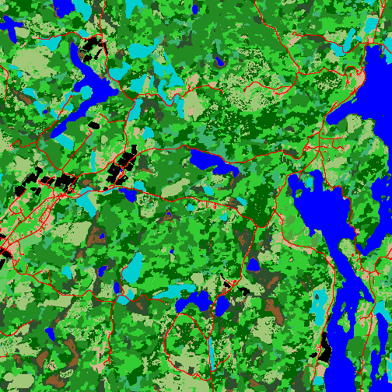
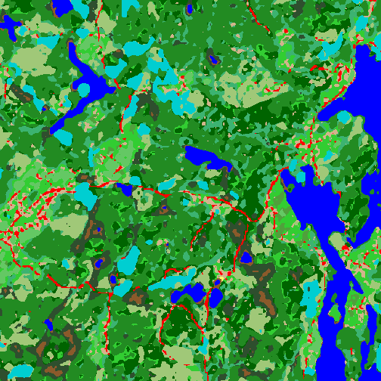
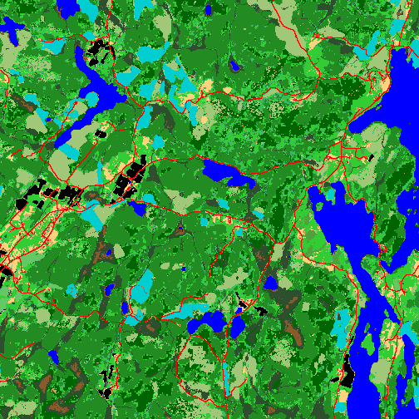
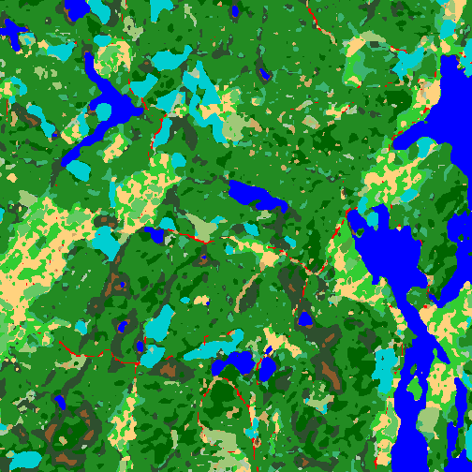
◆ Digital Earth Sweden
Four generations — same landscape
One 5×5 km tile, identical extent and unified palette (tile_331280_6541280): the 2018/2023 label sources and the models trained against each target.
NMD2018 label
v8b (trained on 2018)
NMD2023 label
v8b-NFI (distilled)
Pine
Spruce
Deciduous
Mixed
Swamp forest
Clear-cut
Open land
Water
Built-up
Grass-dom.
Dwarf-shrub
Shrub-dom.

Slide 3
◆ Digital Earth Sweden
Held-out results — overall accuracy
209 NFI plots on tiles unseen by head training, distillation and finetune. NMD2023 scored on the exact same plots.
Honest evaluation
Thresholds and head trained ONLY on the 735 train-split plots — the 209 are untouched.
Distilled model = full 28-class product, every class functional (+7.2 pp).
The fraction layer (NFI collapse rule) reaches 57.9% on forest type — pine F1 0.74.

Slide 4
◆ Digital Earth Sweden
Per class — F1 on the held-out plots
Three sources on the exact same 209 field plots
Overall accuracy
Cohen's kappa
NMD2023 43.1% Distilled 50.2% Fractions 57.9%
NMD2023 0.298 Distilled 0.371 Fractions 0.420
Class | NMD2023 | Distilled | Fractions
Pine | 0.59 | 0.61 | 0.74
Spruce | 0.56 | 0.63 | 0.55
Deciduous | 0.30 | 0.43 | 0.59
Mixed | 0.28 | 0.30 | 0.29
Non-forest | 0.24 | 0.32 | 0.00
Green = best F1 per row. Distilled wins spruce & non-forest; the fraction layer wins pine & deciduous. The fraction path cannot say non-forest (production: hard mask + fraction type).

Slide 5
◆ Digital Earth Sweden
Breaking the label ceiling
NFI overall (944 plots) across the experiment series
Hard labels = proxy ceiling
Training against NMD classes capped at ~0.46 regardless of generation — the denoising effect scales with teacher noise, and NMD2023 is too clean to beat by imitation.
The field target broke it
Same features + NFI supervision: 0.64 (leak-free OOF). The representation sufficed — the supervision TARGET was the constraint.
Production recommendation
Distilled 28-class base + the fraction head as a forest-type layer (hard mask decides forest/non-forest, fractions decide type).
All held-out figures: 209 plots, grouped tile split, calibration on the train side only. Detail: docs/data/{distill,tradslag_fraction,hybrid_nfi_head}_finding.md

