Slide 1
Data Analytics, Final Project
Gregory Hill hillgre1@students.zhaw.ch
Michael Neukom neukomic@students.zhaw.ch
Tobias Fatzer fatzetob@students.zhaw.ch

Slide 2
Introduction

Slide 3
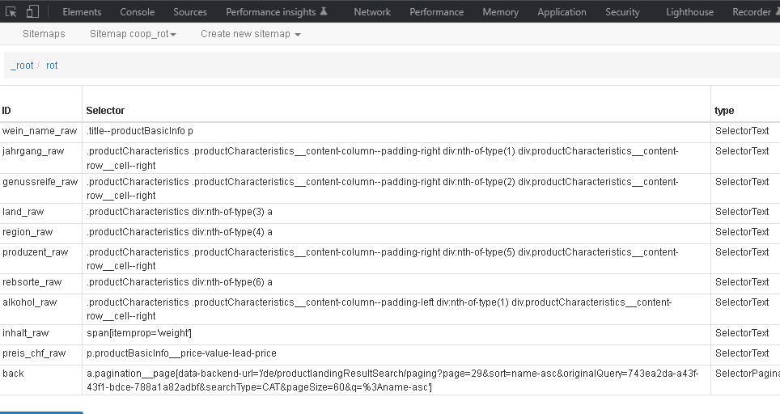
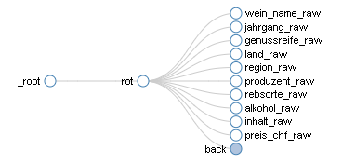
Data Collection
Chrome Web Scraper Extension

Slide 4
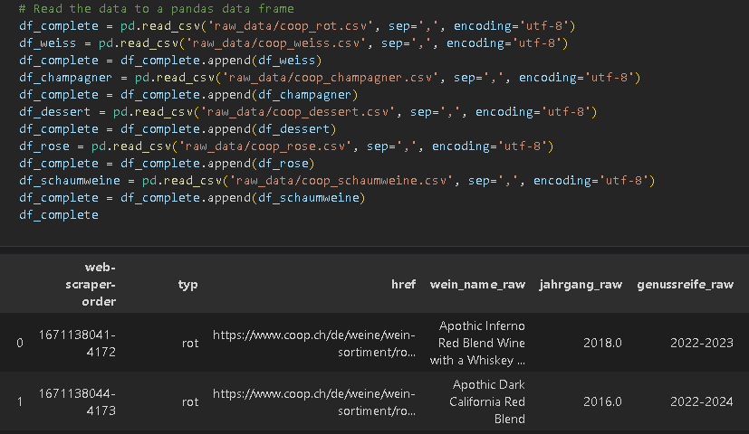
Data Collection
Import with pandas csv reader

Slide 5
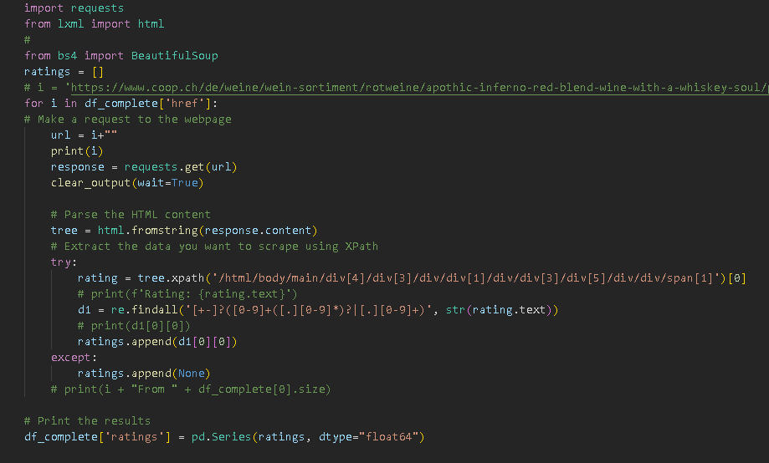
Data Collection
Importing missing data using href links scraped in previous step

Slide 6
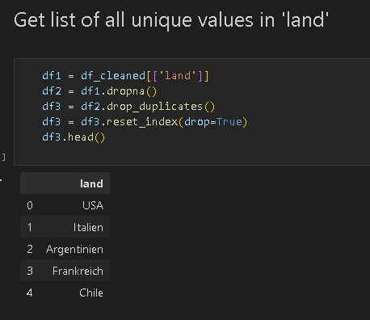
Data Collection
Implemented latitude and longitude values using the openstreetmap Web API (Geocoding)
To reduce the number of queries to
the API we got a list of unique values
in the field ‘land’

Slide 7
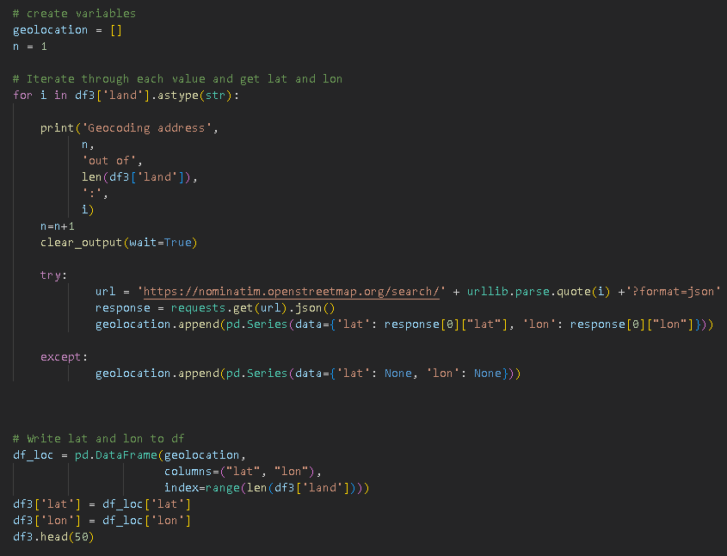
Data Collection
Query the API for each
value and write to
dataframe

Slide 8
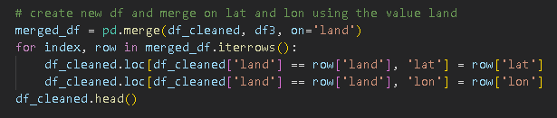
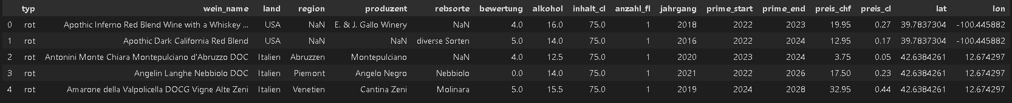
Data Collection
Merge to existing dataframe

Slide 9
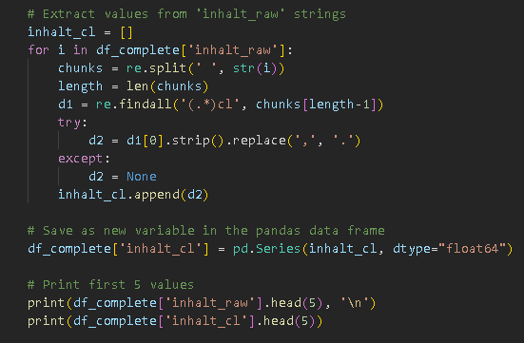
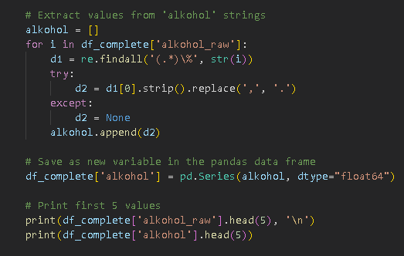
Data Preparation
Extract and save relevant information from raw data using regular expressions (regex)

Slide 10
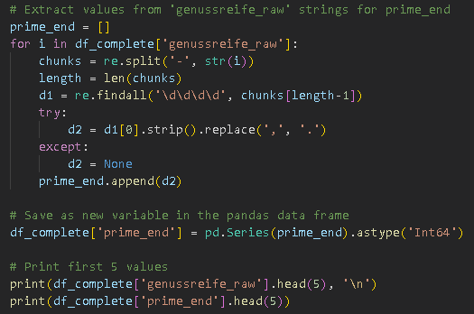
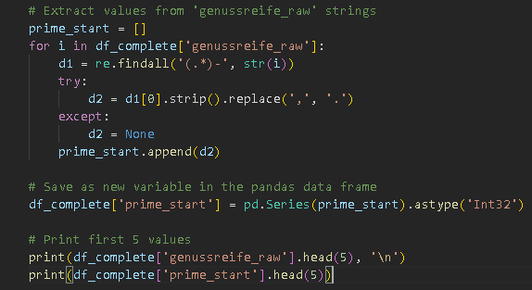
Data Preparation
Split the values ‘genussreife_raw’ in preparation for the next step

Slide 11
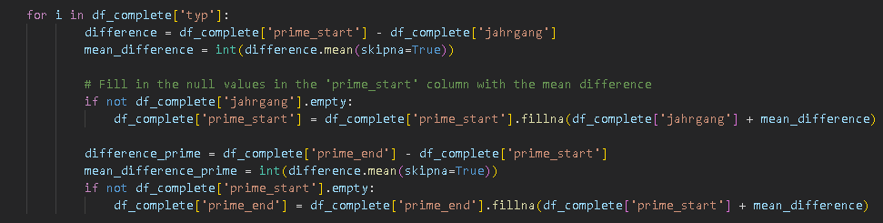
Data Preparation
Imputation of missing values in the columns prime_start and prime_end using mean()

Slide 12
Data Preparation
Created new variable

Slide 13
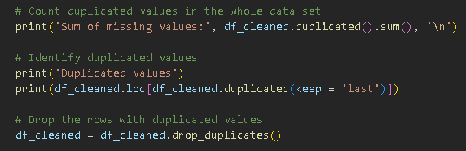
Data Preparation
Deleted duplicate values
Dropped datasets that had null in important fields

Slide 14
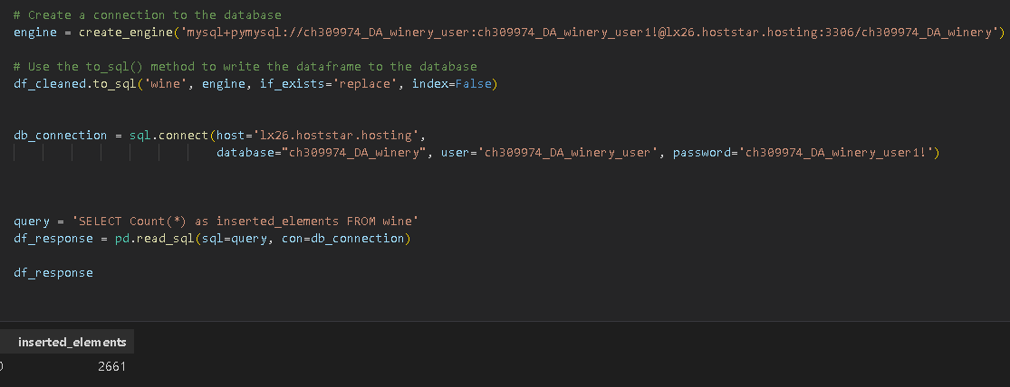
Data Preparation
Export to MySQL Database
This is a password

Slide 15
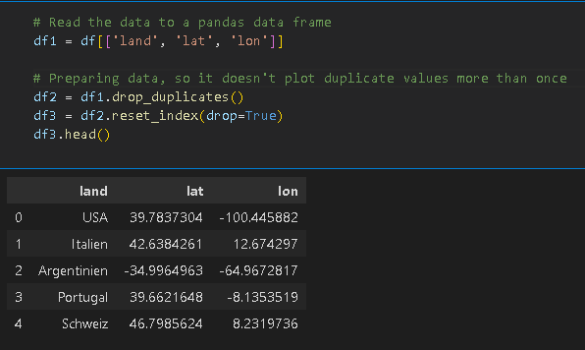
Geocoding the data

Slide 16
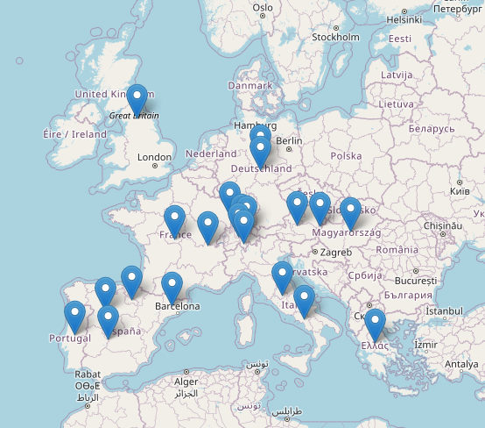
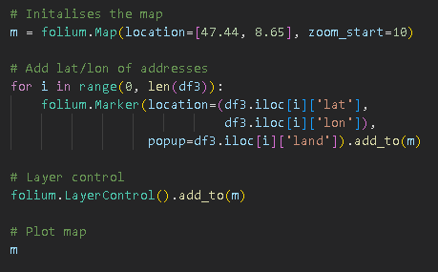
Geocoding the data

Slide 17
Exploratory Data Analysis

Slide 18
Modelling Methods

Slide 19
Results & Discussion

Slide 20
Conclusions

