Slide 1
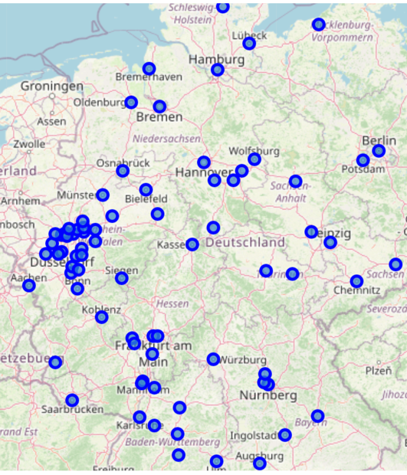
Trip Advisor: Clustering German Cities by Venues
by Tobias (https://github.com/TobiasGuggemos)
May 2020

Slide 2
Clustering German Cities by Venues
Project target:
support decisions about the next spot for a city trip in Germany
choose an appropriate spot for the next city depending on the purpose of the trip and the interest in different venue types
Approach: Cluster the cities based on the venues near to the city centre

Slide 3
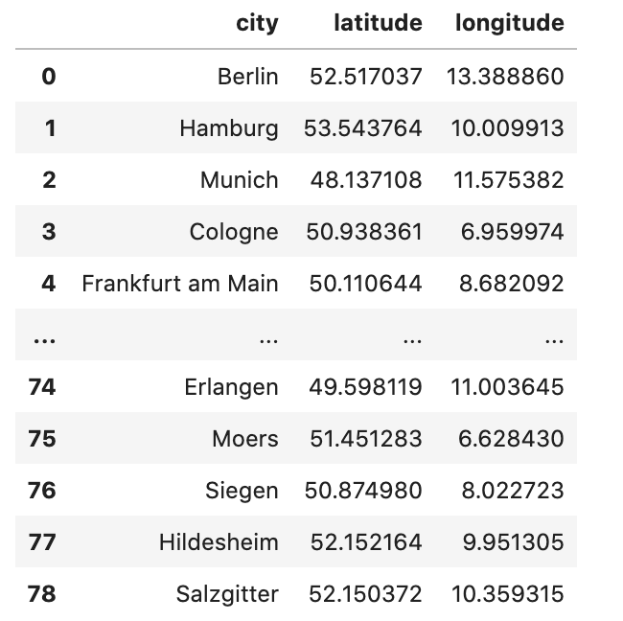
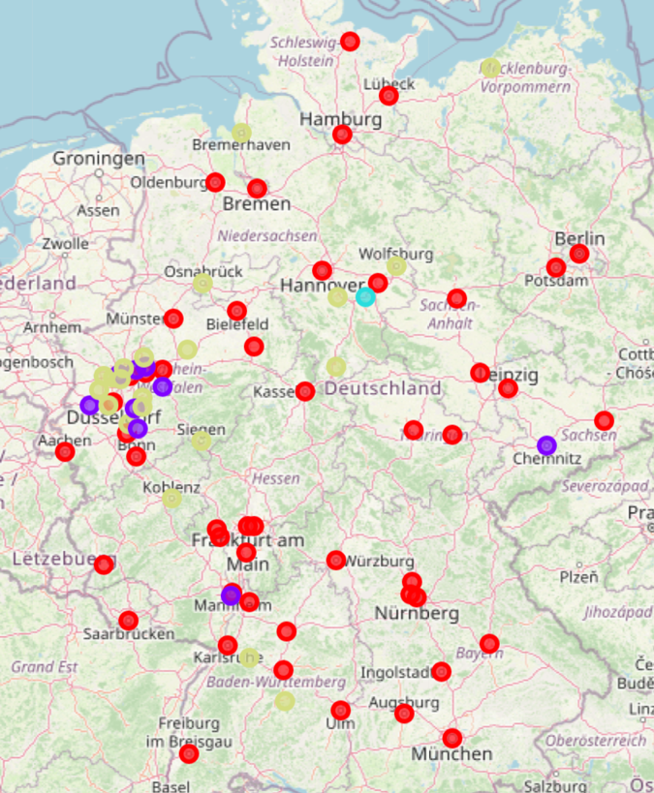
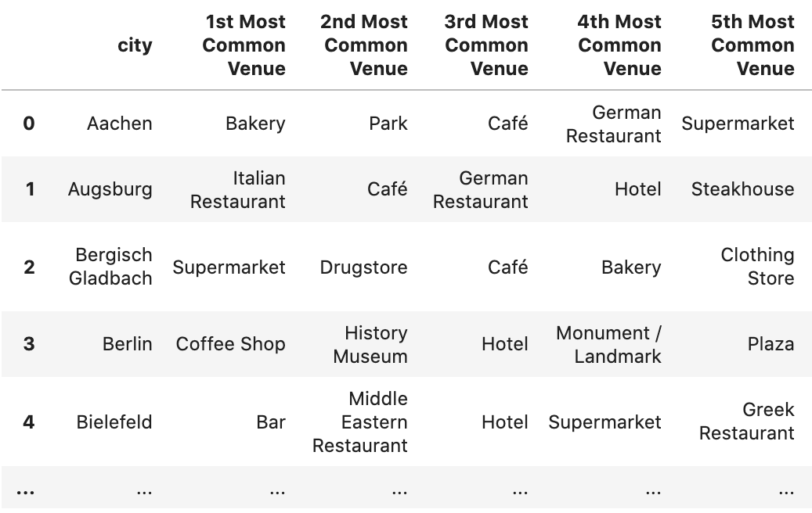
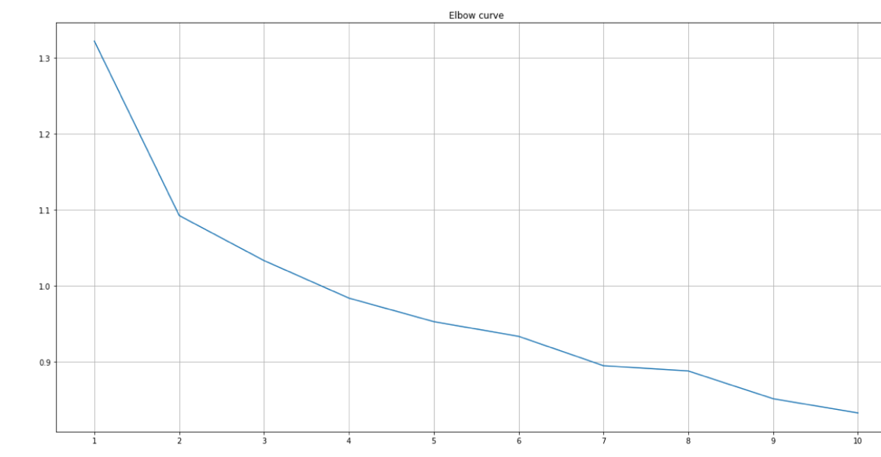
Data & Methodology
&
Cities Venues Clustered Cities
K-Means
Hierarchical clustering

Slide 4
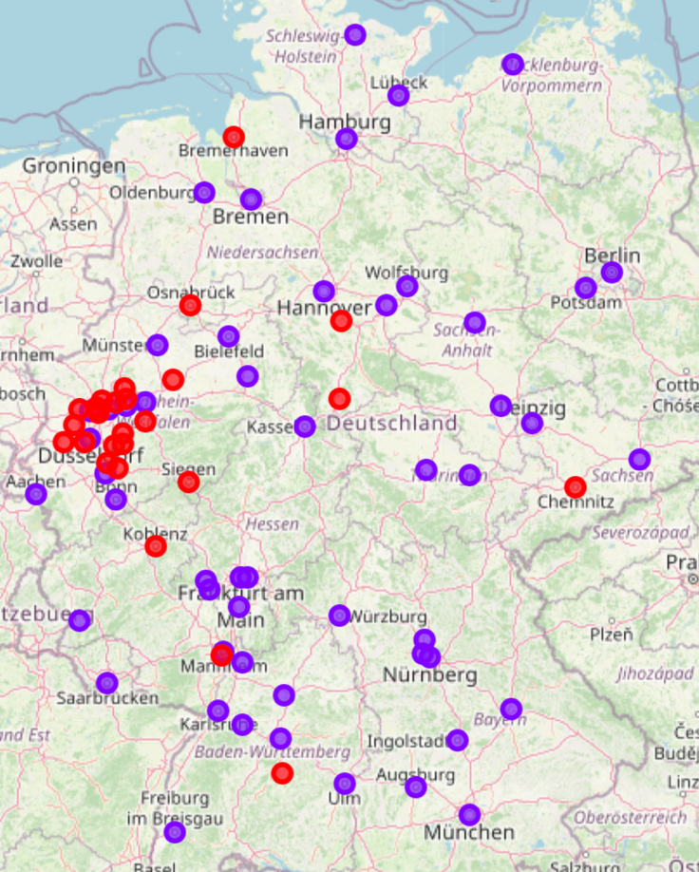
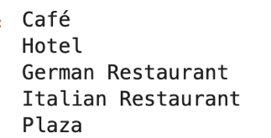
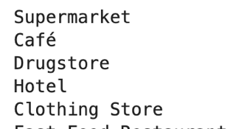
Results
Cluster 1:
Cluster 2:

Slide 5
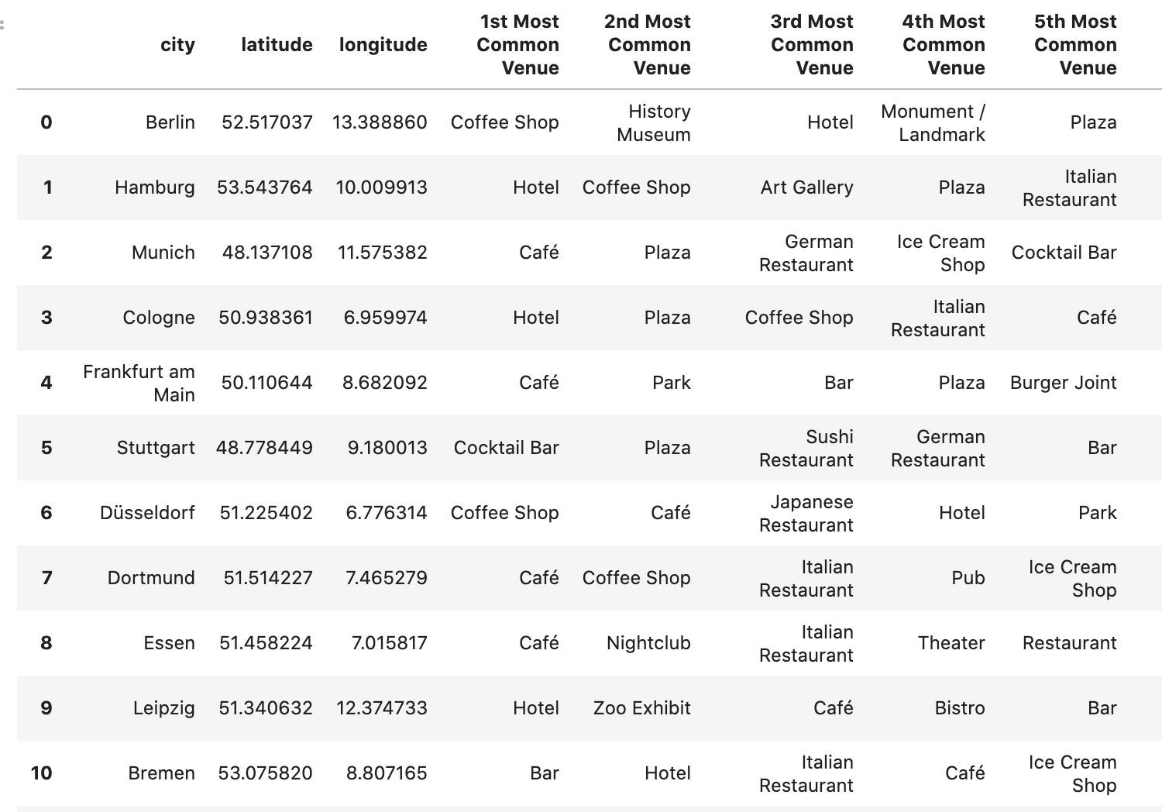
Largest cities of cluster 1:

