Slide 1


Twitter Sentiment Analysis
Random Sample of Tweets
Tobias Hollander

Slide 2


Data Questions
Twitter Sentiment
What types of emotions do Twitter users tweet about more often?
Do users have a wide emotional vocabulary for describing their feelings?
Does the type of emotional expression affect the length of a tweet?

Slide 3


Data
Twitter Sentiment
Used the Twitter API to pull 25,010 tweets.
Before pulling the tweets:
the text was filtered by common words such as ‘of’, ‘to’, ‘be’ and/or ‘have’. Sensitive language and hashtags were also filtered out to avoid pulling certain offensive content.
The tweets had a date and time parameter of April 19th 2021 T12:30:00Z, UTC time zone. Tweets where pulled in reverse chronological order.
The resulting data frame was 25,010 rows and 9 columns

Slide 4

Data Continued
Twitter Sentiment
Web-scrapped for emotional feeling words from psychpage.com:
Reconstructed the scrapped data by words, sub categories, and main categories.
240 feeling words
Originally 16 subcategories
Two main categories

Slide 5


What types of emotions do Twitter users tweet about more often?

Slide 6
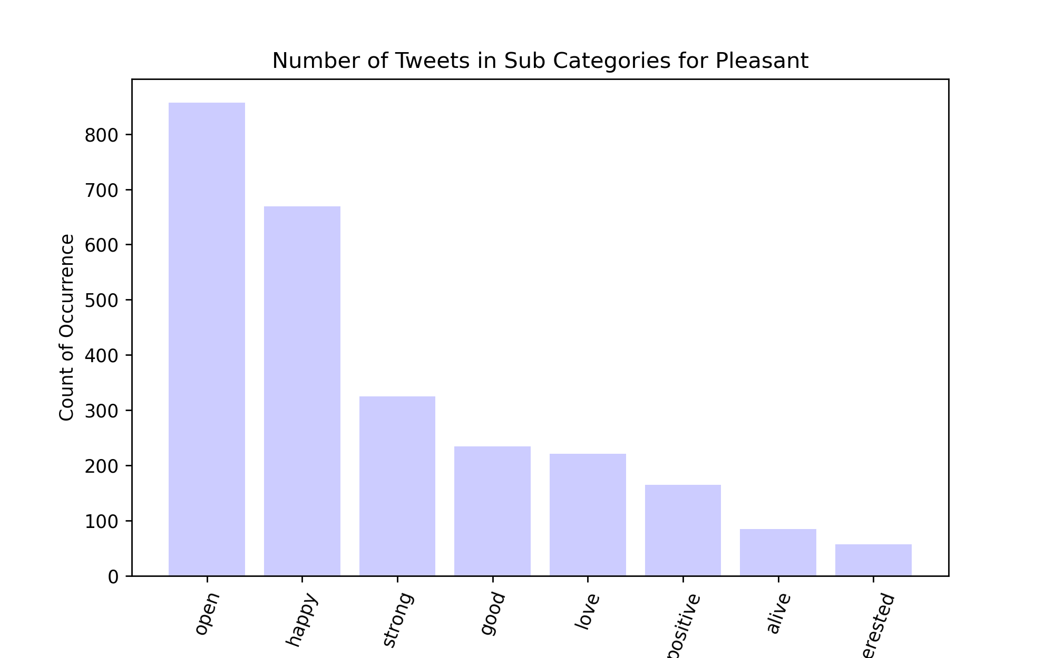
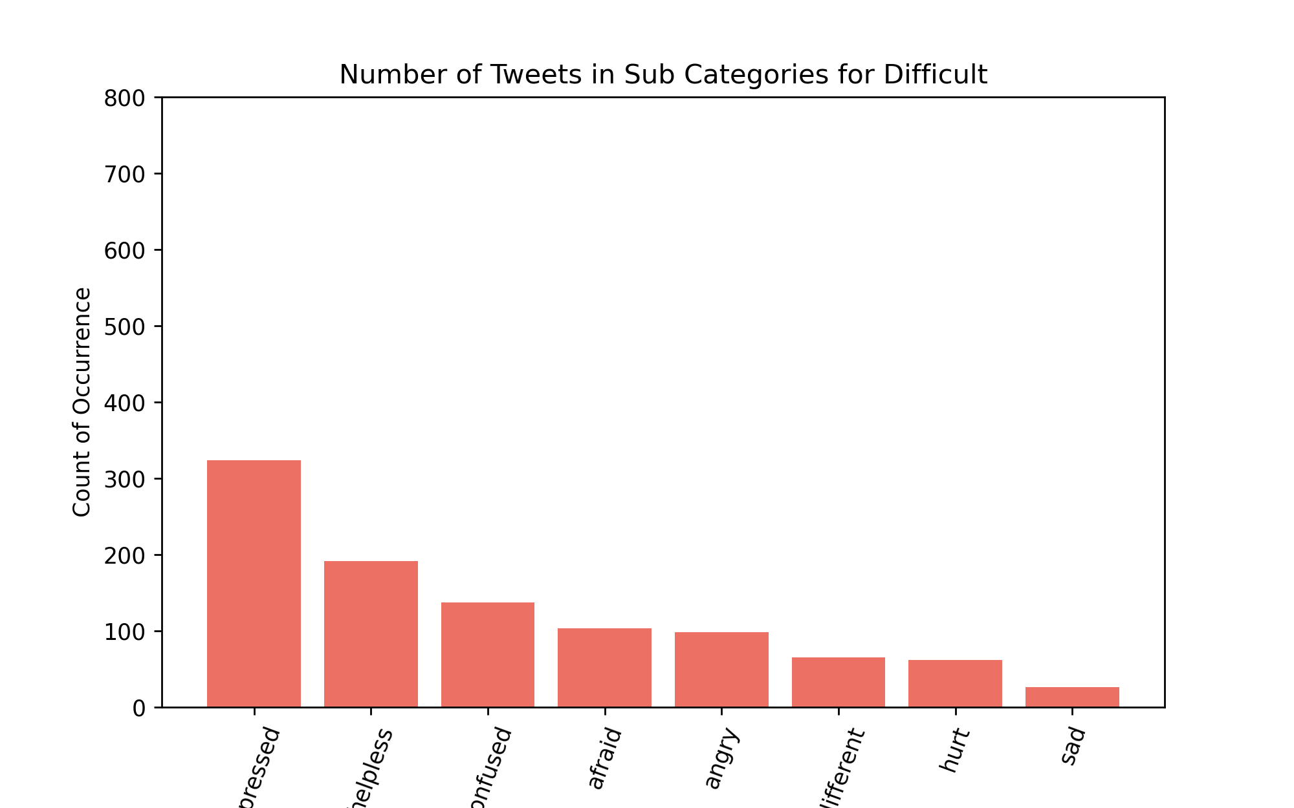
Subcategories
Pleasant vs Difficult
Top Three for Pleasant
Open: 857 | Happy: 669 | Strong: 325
Top Three for Difficult
Depressed: 324 | Helpless: 191 | Confused: 137

Slide 7
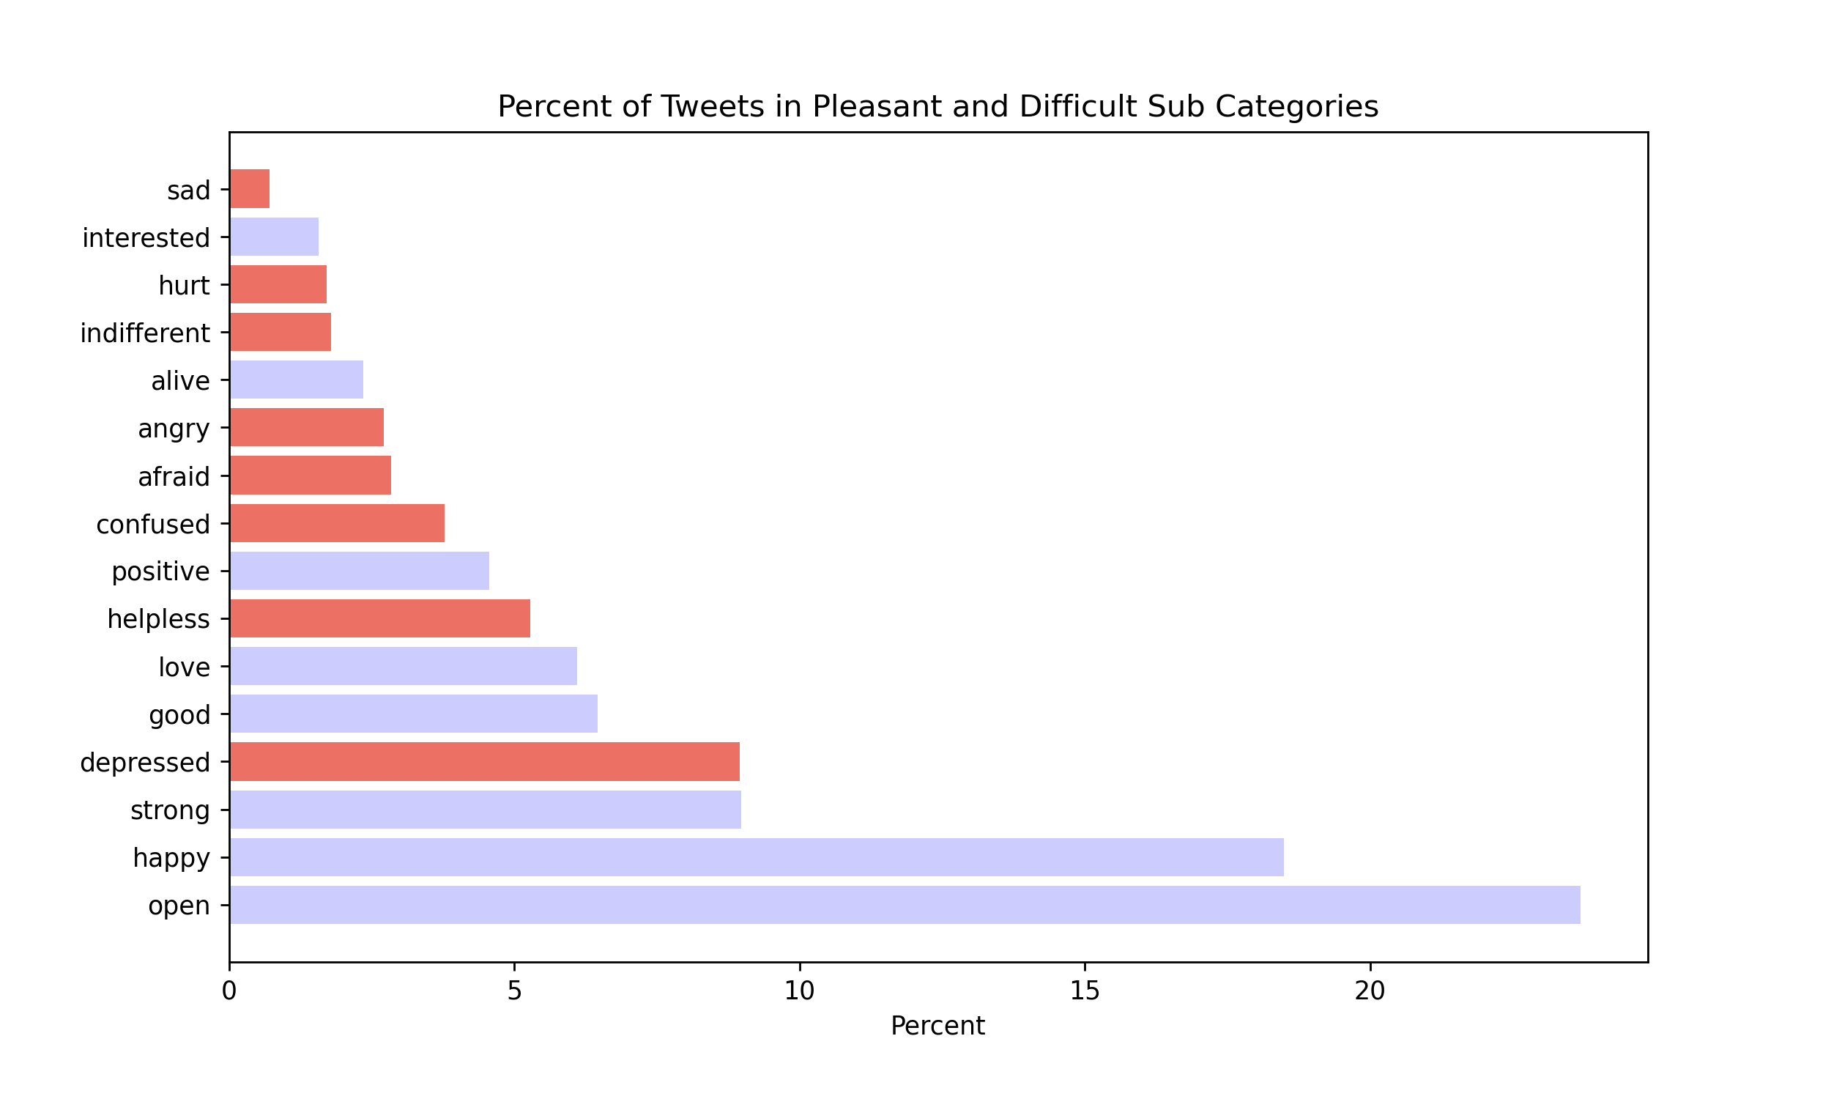
Subcategories
Pleasant vs Difficult
Between Pleasant and Difficult, these two main categories account for 3,619 tweets.
The highest percent of tweets belongs to the open subcategory with 23.6%
Second highest goes to the happy subcategory with 18%
Third highest to the strong subcategory with 8.9%
Overall, the Pleasant category which is represented as the purple bars consist of 72% of the 3,619 tweets.

Slide 8


Do users have a wide emotional vocabulary for describing their feelings?

Slide 9
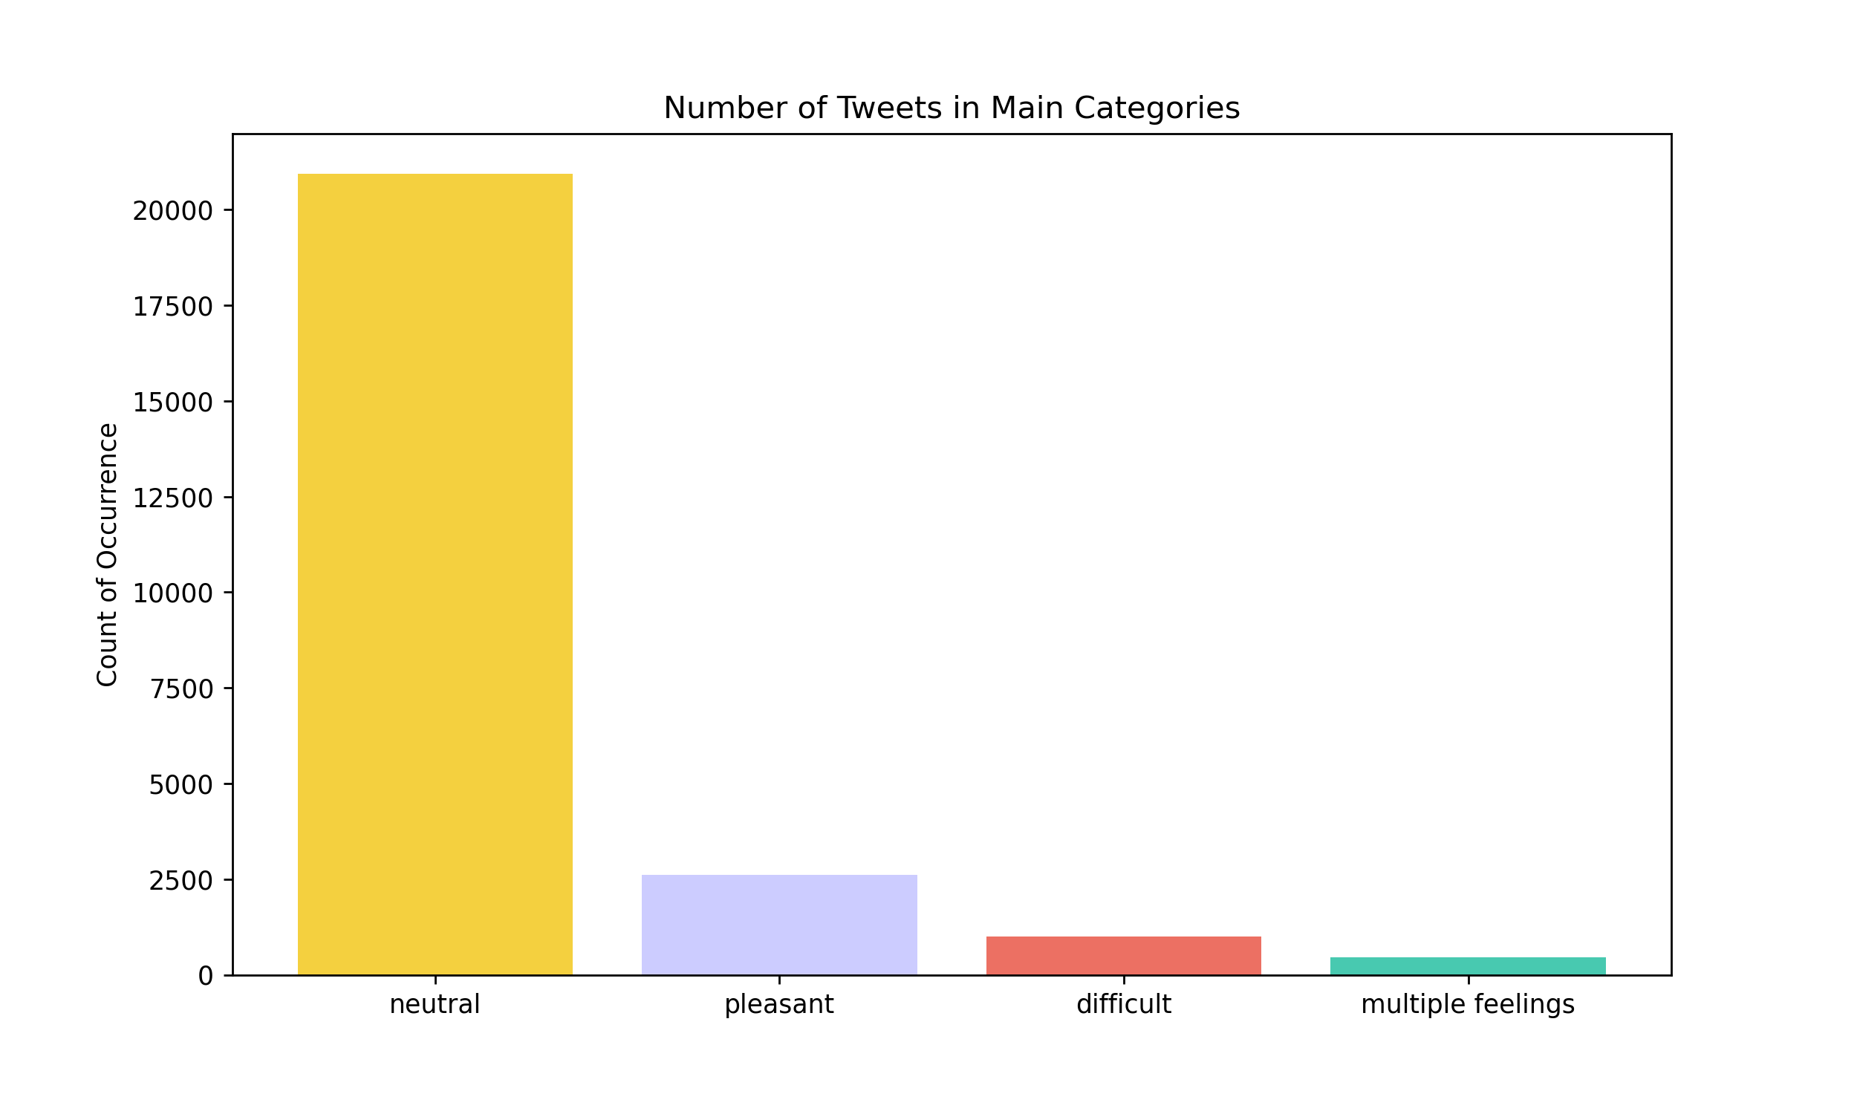
Main Categories
Pleasant | Difficult | Neutral | Multi-Feelings
The neutral category captures all the tweets that didn’t match for any of the 240 feeling words.
The Multi-Feelings category contains various combinations of the 240 feeling words.
Majority of tweets were neutral.
20,936 out of 25,010 tweets

Slide 10
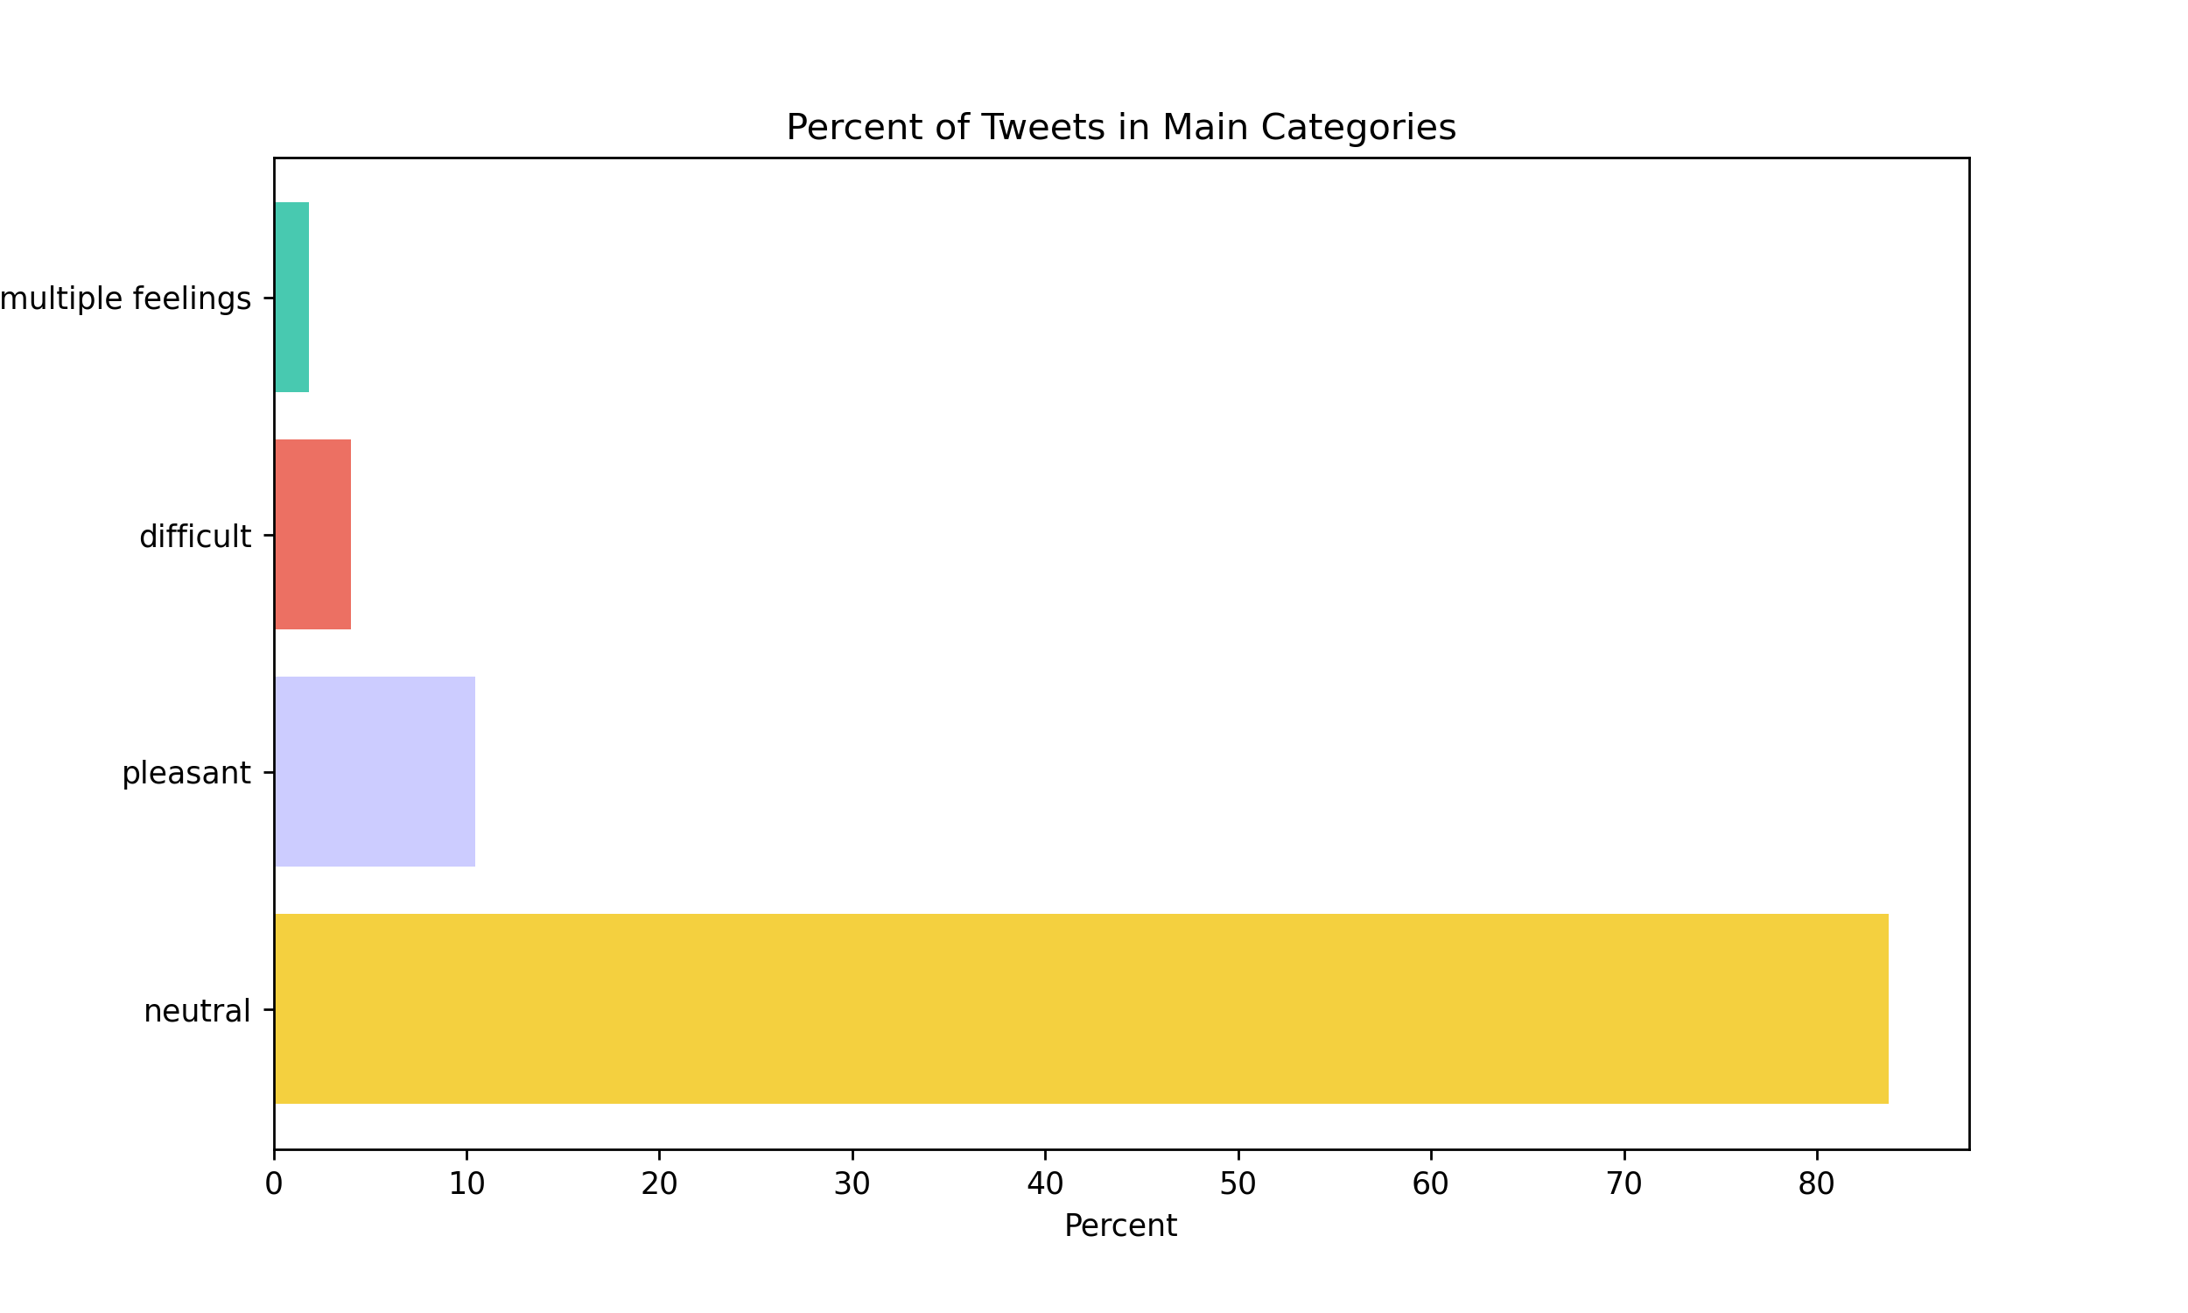
Main Categories
Pleasant | Difficult | Neutral | Multi-Feelings
The neutral category takes up roughly 84% of all tweets
Pleasant category 10%
Difficult category 4%
Multi-Feelings 2%

Slide 11



Does the type of emotional expression affect the length of a tweet?

Slide 12
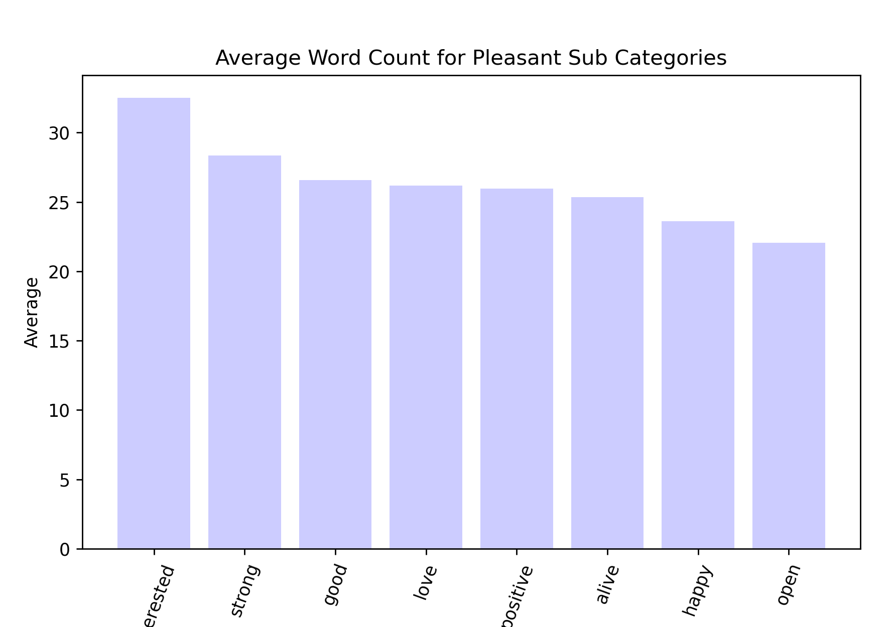
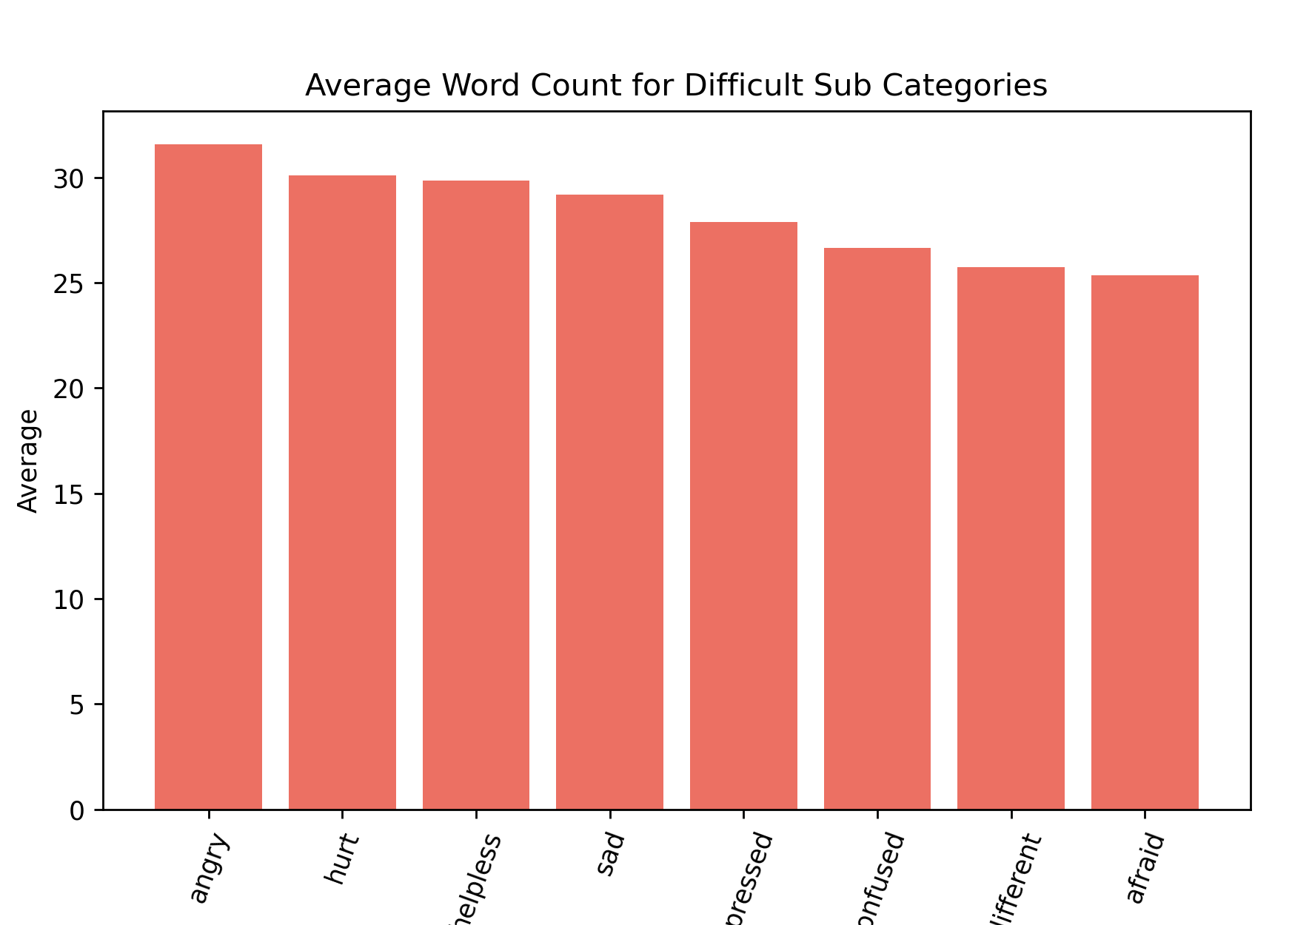
Tweet Length
Pleasant vs Difficult
Top Three for Pleasant
Interested: 32.5 | Strong: 28 | Good: 26.5
Top Three for Difficult
Angry: 31.5 | Hurt: 30 | Helpless: 29.8

Slide 13
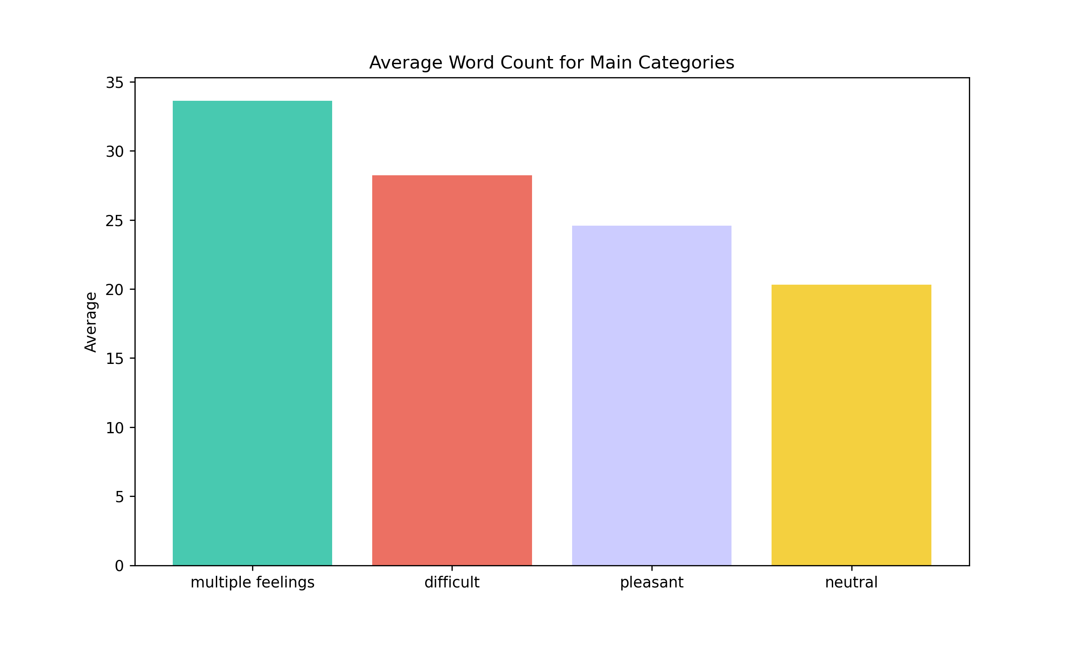
Tweet Length
Main Categories
Despite having only 2% of the overall tweets, the Multi-Feelings category has the highest average of 33.6 words.
The Difficult category has the second highest average of 28 words per tweet.
The Pleasant category is in third with an average of 24.5
Surprisingly, the Neutral category that takes up 84% of tweets has an average of 20 words.

Slide 14
Everything considered
Twitter users often tweet relatively more pleasant messages than difficult ones. It is ambiguous if users have a wide emotional vocabulary for describing their feelings. There are 3,000 English words to express emotions, and only 240 words were used to analyze the tweets. Regarding the lengths of tweets, the type of emotional expression affecting the word count is questionable. However, the Difficult category did have more words per tweet on average than the Pleasant category.

Slide 15

Q&A

