Slide 1
Architecture Constraints
Software Architecture

Slide 2
Architecture Constraints
Constraints | Background and/or motivation
Must use Firebase Hosting | Chosen for scalability and simplicity; aligns with team knowledge and MVP timeline
Frontend must be built in React | Team has prior experience with React; improves productivity and maintainability
Data must not leave the EU | Due to GDPR regulations, all data must be stored and processed within the European Union
No paid third-party libraries | Budget restrictions for MVP phase prohibit use of licensed libraries
Must support mobile-first design | Majority of end-users are expected to access the application from mobile devices
Architects should know exactly where they are free in their design decisions and where they must adhere to constraints. Constraints must always be dealt with; they may be negotiable, though.
Define five constraints that constrains software architects in their freedom of design and implementation decisions or decision about the development process.
Help: https://docs.arc42.org/section-2/ & https://biking.michael-simons.eu/docs/index.html#section-architecture-constraints
Notes:
We are required to use Firebase Hosting, which fits our scalability goals and existing skills. The frontend must be built in React, as our team is familiar with it and it supports fast development. Due to GDPR, we must ensure that user data never leaves the EU. To stay within budget, we cannot use paid third-party libraries. Finally, since most users will be on mobile devices, the UI must follow a mobile-first design approach.

Slide 3
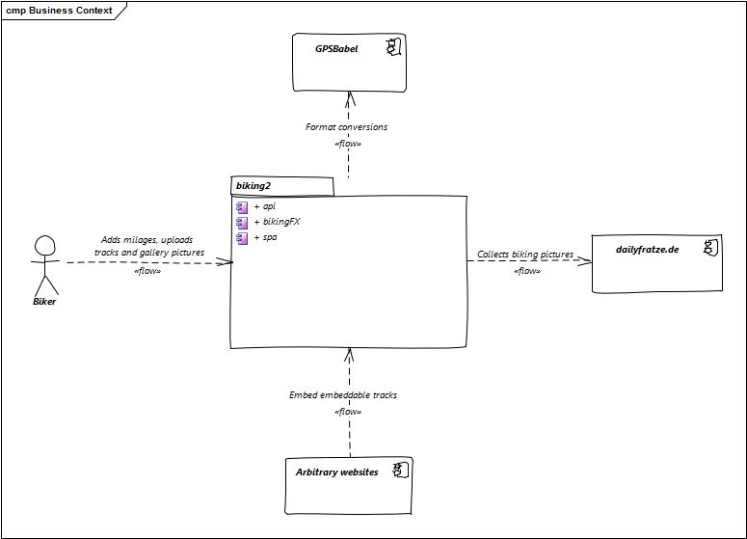
Business Context
The domain interfaces and technical interfaces to communication partners are among your system’s most critical aspects. Make sure that you completely understand them.
Make a business context diagram so all stakeholders understand which data are exchanged with the environment of the system.
Help: https://docs.arc42.org/section-3/ & https://biking.michael-simons.eu/docs/index.html#section-system-scope-and-context
Notes:
This diagram shows the business context of our application. It helps all stakeholders understand how the system interacts with external entities. In our case, the central system is biking2, which connects to services like GPSBabel for format conversions and dailyfratze.de for gallery pictures. Users, represented as bikers, upload tracks and photos. These can also be embedded on arbitrary websites, showing how the system fits into a wider ecosystem.

