Slide 1
Quality
Software Architecture

Slide 2
Quality Goals and Scenarios
Goal: Efficiency
Scenario: A user uploads a high-resolution image and completes editing with Pixlr. The system saves and displays the result within 2 seconds.
Goal: Interoperability
Scenario: A user shares an edited image to Instagram directly via a public share link. The system generates a compatible, mobile-friendly URL.
Goal: Testability
Scenario: The image upload and editing modules are covered by unit and integration tests, and can be tested without requiring access to Pixlr’s live API.
Since quality requirements will have a lot of influence on architectural decisions you should know for every stakeholder what is really important to them, concrete and measurable.
Define three Quality Goals and Scenarios.
Help: https://docs.arc42.org/section-10/ & https://biking.michael-simons.eu/docs/index.html#_evaluation_scenarios
Notes:
We defined three quality goals with clear scenarios: First, Efficiency – image upload and editing with Pixlr should complete within two seconds. Second, Interoperability – shared images must open via mobile-friendly public links. And third, Testability – all core features are tested independently of Pixlr’s live API.

Slide 3
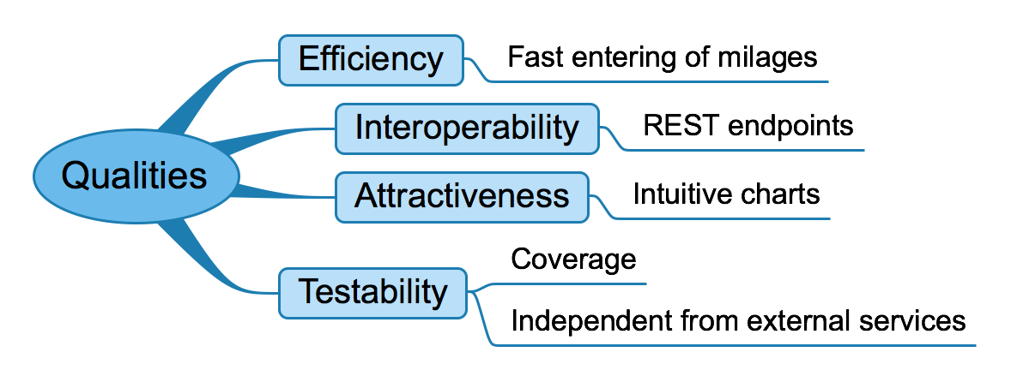
Quality Tree
Since quality requirements will have a lot of influence on architectural decisions you should know for every stakeholder what is really important to them, concrete and measurable.
Define a Quality Tree with at least 5 “arms”.
Help: https://docs.arc42.org/section-10/ & https://biking.michael-simons.eu/docs/index.html#_quality_tree
Notes:
This quality tree visualizes our most important quality requirements. We aim for efficiency, especially during mileage entry. Interoperability is ensured through RESTful endpoints. To improve user experience, attractiveness is achieved with intuitive charts. Finally, we focus heavily on testability — both in terms of test coverage and independence from external services.

