Slide 1
Building Block View
Software Architecture

Slide 2
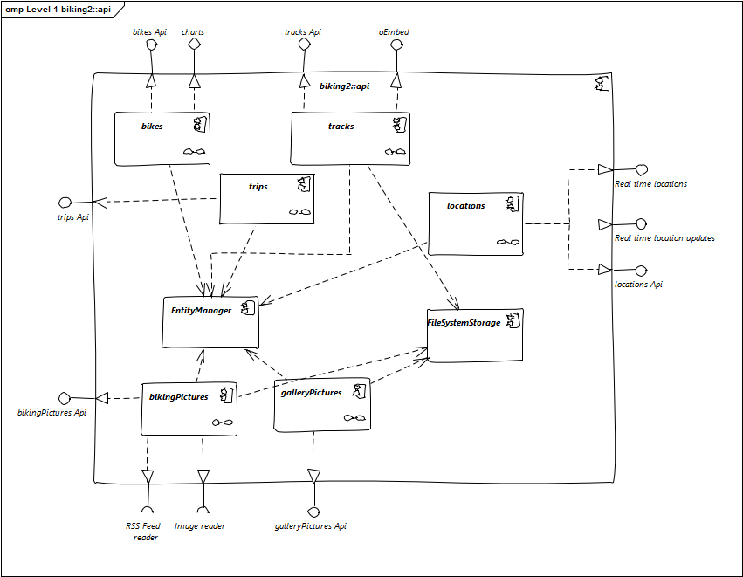
Level 1
Maintain an overview of your source code by making its structure understandable through abstraction.This allows you to communicate with your stakeholder on an abstract level without disclosing implementation details.
Level 1 is the white box description of the overall system together with black box descriptions of all contained building blocks.
Level 2 zooms into some building blocks of level 1. Thus it contains the white box description of selected building blocks of level 1, together with black box descriptions of their internal building blocks.
Level 3 (not shown in the diagram above) zooms into details of selected building blocks of level 2, and so on.
Define three levels of your software. Focus on important components for level 2 and 3.
Help: https://docs.arc42.org/section-5/ & https://biking.michael-simons.eu/docs/index.html#section-building-block-view
Notes:
This diagram gives us a high-level white-box view of the overall system. We see the main components like bikes, tracks, and trips, all orchestrated by the EntityManager. Other components handle image management and storage, such as bikingPictures, galleryPictures, and FileSystemStorage. The system also exposes several APIs — for instance, for bikes, trips, and location data — and integrates external services like image readers and RSS feeds. This level abstracts implementation details to give a clear overview of the system structure.

Slide 3
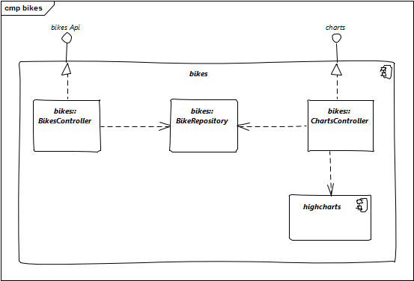
Level 2
Notes:
Here, we zoom into the bikes module. The API requests are handled by the BikesController, which communicates with the BikeRepository. Chart visualizations are managed by the ChartsController, which interacts with the Highcharts library. This level shows how responsibilities are distributed inside the module and how components interact internally.

Slide 4
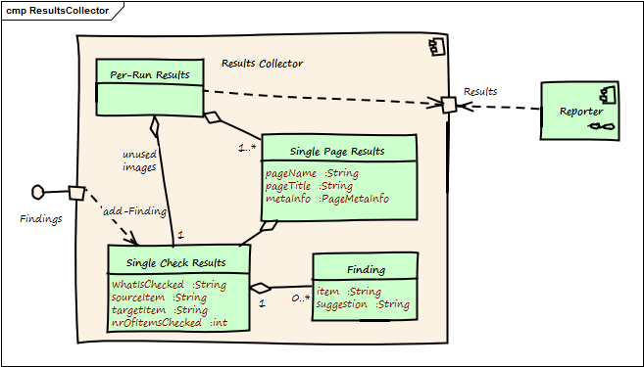
Level 3
Notes:
Finally, we look at the internal structure of the ResultsCollector. It aggregates findings into results across different layers: Per-Run Results, Single Page Results, and Single Check Results. Each check contains detailed metadata like what was checked, source and target items, and how often it was verified. The results are passed to the Reporter for output. This deep level shows class-level structure, data flow, and precise responsibilities, ensuring high transparency for debugging and extension.

