Slide 1
Next Up:
Dr. Tobias Weltner

Slide 2
3
3

Slide 3
2

Slide 4
1

Slide 5
Small, Powerful, and soon your best friend: ScriptBlocks
Dr. Tobias Weltner

Slide 6
What we do:
Looking at ScriptBlocks in action
Code Samples From Zillions of Projects
Identify Common Characteristics
Better Understanding of PowerShell
Fill In Gaps
Solve "Code Mysteries"
Provide Inspiration and Code Samples

Slide 7
Hands-On

Slide 8
Conclusions:
General Strategy
Reusable Functions, no monolytic monster scripts
Do work once, keep your functions narrow and deep
Use Modules, internalize functions in scripts later (if needed)
Use ScriptBlock Functionality Out-of-Band
Better Understanding of PowerShell
Fill In Gaps
Solve "Code Mysteries"
Provide Inspiration and Code Samples

Slide 9

Many thanks to our sponsors:

Slide 10
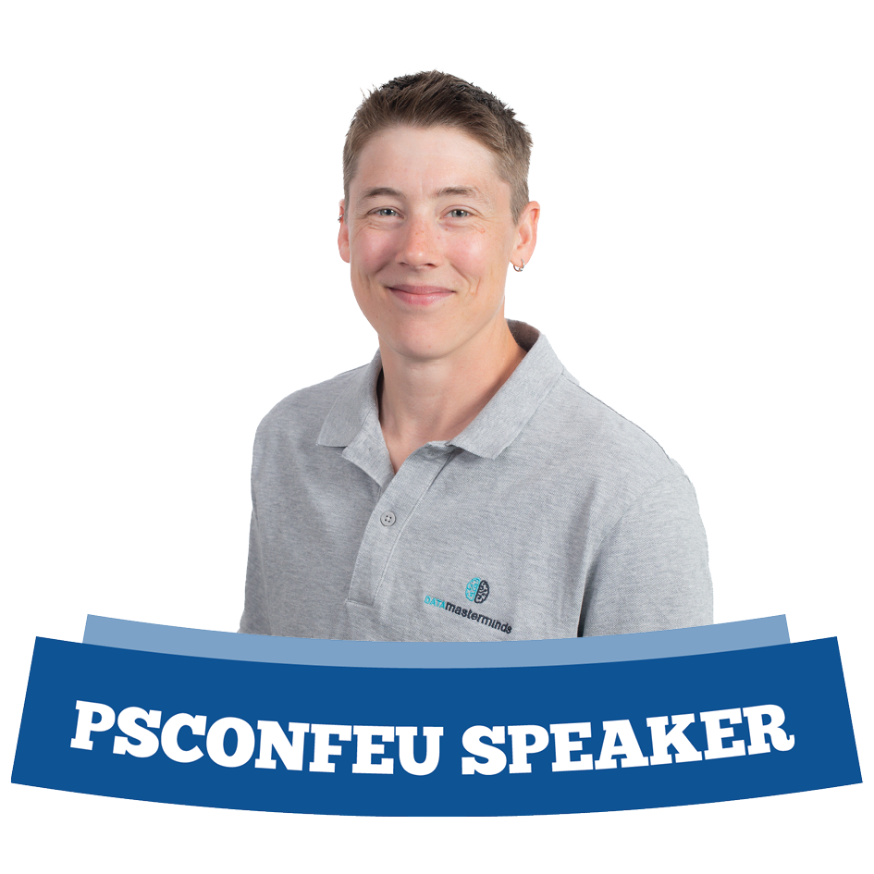
Speaker name
Your bio
You can download your shield here:
Speakers shields
If any problem with you shield, please contact us at contact@psconf.eu

Slide 11
Slide title
Sample text for your PSConf.EU 2025 presentation
We usually prefer demos, use slides with moderation
Think about those at the back of the room, some text might be too small.
Think about accessibility, try to improve the contrast, colours and size of your presentation.

Slide 12
Instructions
Use this template if you want, it’s preferred but not mandatory.
Please make sure our sponsors are mentioned on your first slide after the title.
Do not amend the ratio or the colours of the sponsors’ logo and background.
Update your twitter handle through the master page (see next slides).

Slide 13
Instruction (Continued)
The session is 30 min.
Then 15min Q&A.
At the end of your 45 min, please leave the room to the next speaker.
You’re welcome to continue the discussion in the Foyer area.

Slide 14
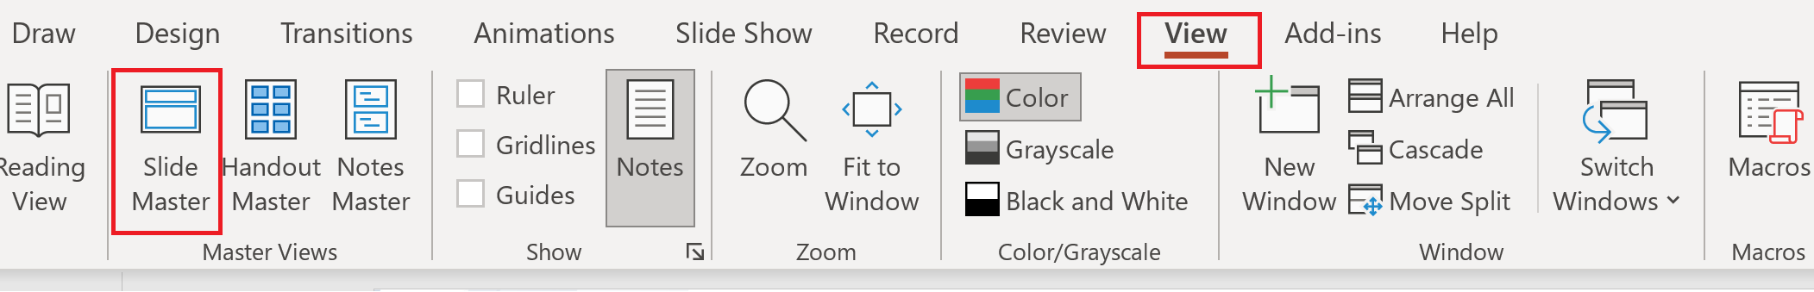
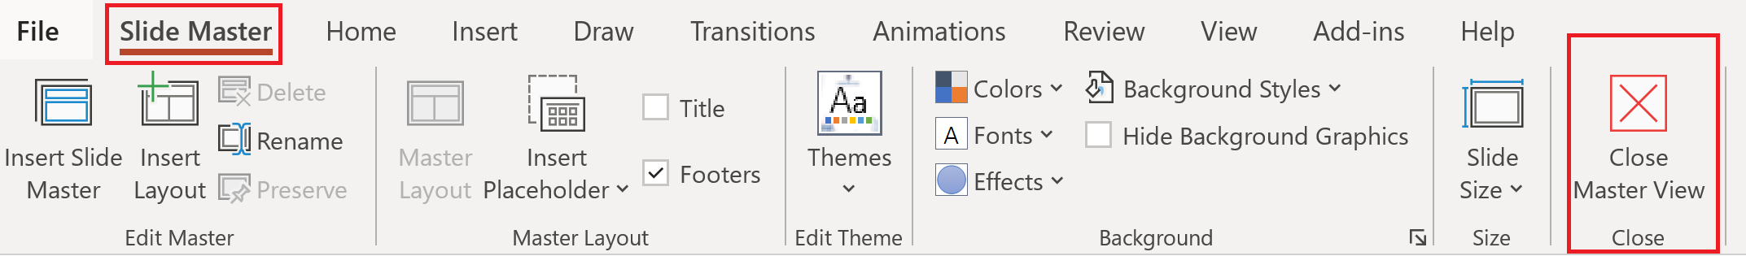
Update the twitter handle on the master slide
To open the slide master:
To close the Master view:
If you need any help, do not hesitate to email us at psconfeu@synedgy.com

Slide 15
Demos
We love Demos!

Slide 16
Q&A
15 minutes

