Slide 1
Module System - Crates and Modules

Slide 2
How to organize Code
Crate: Tree of modules producing a library or executable.
Crate Root is source file that Rust compiler starts from to make up root module of crate
Binary Crates – Crate Root: src/main.rs
Library Crates – Crate Root: src/lib.rs
Package: A bundle of one or more crates
Module: Collection of items like functions, structs, traits and impl blocks
The use keyword creates shortcuts to items
Paths: A way of naming an item to show Rust where to find an item in a module tree
Absolute path – Full path starting from create root
Relative Path – Starts from current module (self, super)
Notes:
Crate: Smalles amount of code Rust compiler considers at a time. Running rustc <single-file>, this file is a crate.
Binary crate compiles to executable and must contain src/main.rs. Library crates do not compile to executable.
Package: Bundle of one or mor crates that provides set of functionality. Package contains Cargo.toml file that describes how to build those crates. Cargo is actually a package that contains the binary crate for the command-line tool. A package can contain as many binary crates, but only one library crate.
Modules: Also allow to control privacy of items. Code within a module is private by default. To make public declare it with pub mod.
Use the use keyword to create shortcuts to items to reduce repetition of long paths
Instead of crate::garden::vegetables::Asparagus create shortcut with use crate::garden::vegetables::Asparagus
Paths: Absolute path begins with the crate name and for code from the current crate, it starts with the literal 'crate'. Paths followed by one or more identifiers separated by double colons (::).

Slide 3
How to organize Code
When declaring a module in crate root (garden module), the compiler looks in these places:
Inline
In src/garden.rs
In src/garden/mod.rs
Submodules: Declare mod vegetables in src/garden.rs
Inline
In src/garden/vegetables.rs
In src/garden/vegetables/mod.rs
Notes:
Declare a module

Slide 4
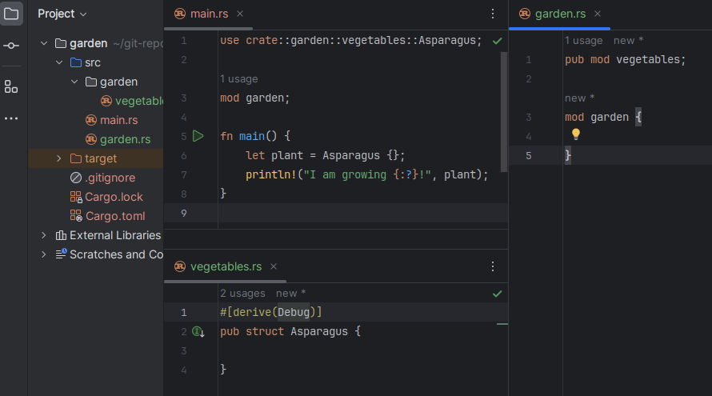
How to organize Code

