Slide 1
Hello Cargo

Slide 2
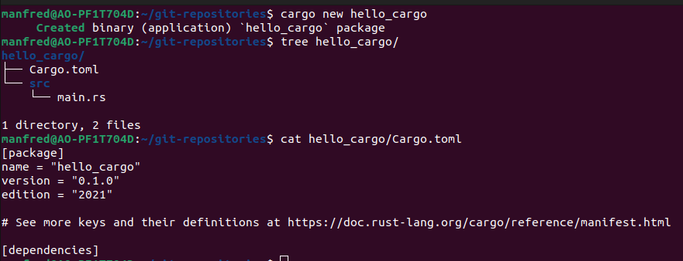
What is Cargo?
Cargo is Rust's build system and package manager
Bundled with Rust installation (cargo --version)
Source files should live in src directory
Notes:
TOML file: Tom's Obious, Minimal Language
[package] section heading that indicates the the following statements configure a package.
The next three lines needed to compile program: name, version and edition of Rust.
[dependencies] List project dependenceis. Packages of code are referred to as crates.
Cargo expects source files to live inside 'src' directory

Slide 3
Building with Cargo
To build a project use cargo build and ./target/debug/hello_cargo to run executable
cargo run can be used to build and run in one step
For finished project use cargo build --release
Notes:
Cargo build –release compiles with optimizations. Executable in target/release instead of target/debug.

Slide 4
Rust editions
Rust language has six-week release cycle – smaller updates more frequently
Every two or three years a new Rust edition is produced
New editions ship as part of the six-week release process
Editions serve different purposes for different people
The edition key in Cargo.toml indicates which edition the compiler should use for code.
All Rust compiler version support any edition that existed prior to that compilers release
Notes:
Small changes more frequently. After a while it is difficult to look back and say "wow between rust 1.10 and rust 1.31 has changed a lot"
Each edition brings together the freatures that have landed into a clear package with fully updated documentation and tooling.
Different purpose:
-Active rust-users: new edition brings together incremental changes into an easy-to-understand package
-non users: new edition signals major advancements, which might make rust worth another look
-rust developers: a new edition provides a rallying point for the project as a whole.

