Slide 1

My first pull request
Tobias Schaffner

Slide 2
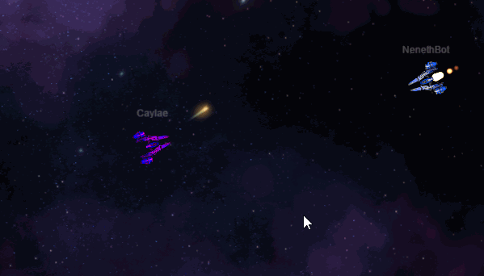
Teaser
Additional models for spaaace
We will support you after the presentation

Slide 3
Agenda
Install git
Register at Github
Get ready for Hacktoberfest
Fork the project
Add your changes
Create the pull request

Slide 4
Install git
Windows:
https://gitforwindows.org/
Debian based Linux:
sudo apt-get install git
Mac (Homebrew):
brew install git

Slide 5
Register at Github
https://github.com/join
Care that the username is case sensitive

Slide 6
Get ready for Hacktoberfest
Use your Github account to register for Hacktoberfest:
https://hacktoberfest.digitalocean.com/

Slide 7

Fork the project
Follow the link to the project and
create a fork with the button in the
top right:
https://github.com/HacktoberfestMunich/spaaace

Slide 8
Clone the project
New shell or git-bash:
git clone https://github.com/<YourGitUserName>/spaaace.git
Change into the repository
cd spaaace
Create a new branch
git checkout -b new_model

Slide 9
Pick a model
Pick a model from:
https://www.iconfinder.com/search/?price=free&license=gte__2
It has to be free and with a license that does not require a link back.

Slide 10
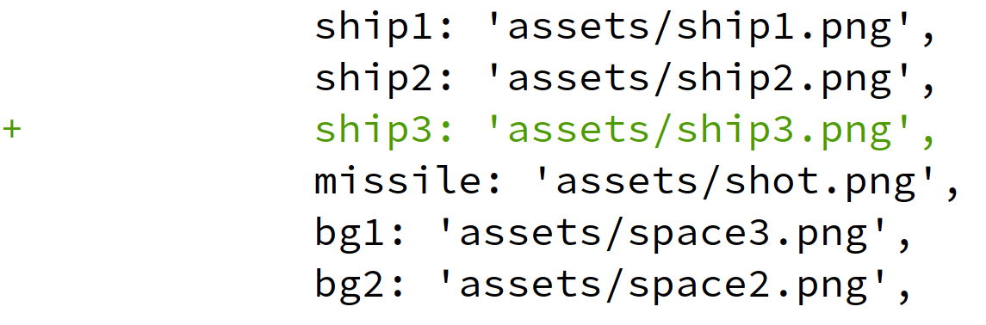
Add the model
Copy the model file to the project:
dist/assets/ship3.png
Add the new asset in the code:
Add line 16 in src/client/SpaaaceRenderer.js:

Slide 11
Commit and push the changes
Copy the model file to the project:
git add .
git commit -m “Add my ship model”
Push the changes:
git push --set-upstream origin new_model

Slide 12
Create the pull request
Have a look at you spaaace fork
https://github.com/<YourGitUserName>/spaaace
Click on the Compare & PR button in the middle and enter a description.

Slide 13
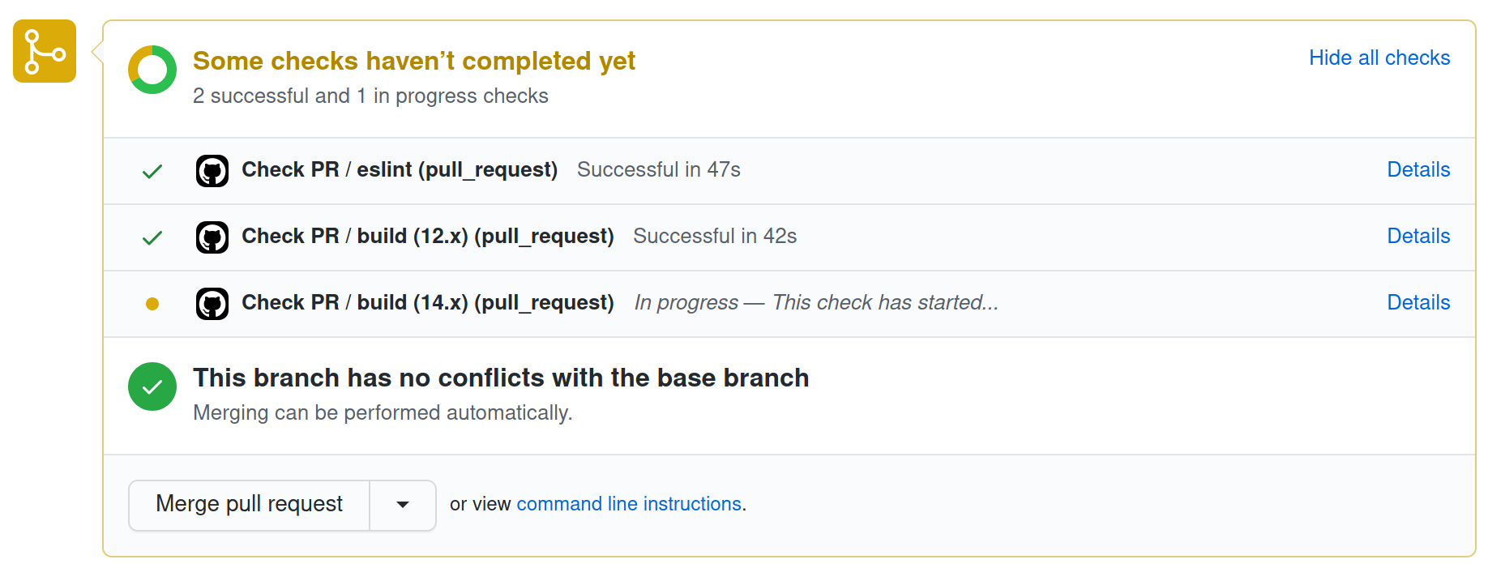
Check your pull request
You will find your PR here:
https://github.com/HacktoberfestMunich/spaaace/pulls

Slide 14
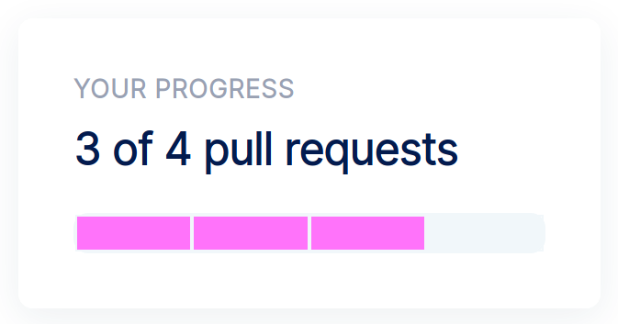
Check your progress
Check your progress after we merged your contribution at:
https://hacktoberfest.digitalocean.com/

Slide 15
Jitsy? https://oberbayern.pixel-group.de/Hacktoberfest2020

