Slide 1
311 Noise Complaints and Building Age
Tobias Du

Slide 2
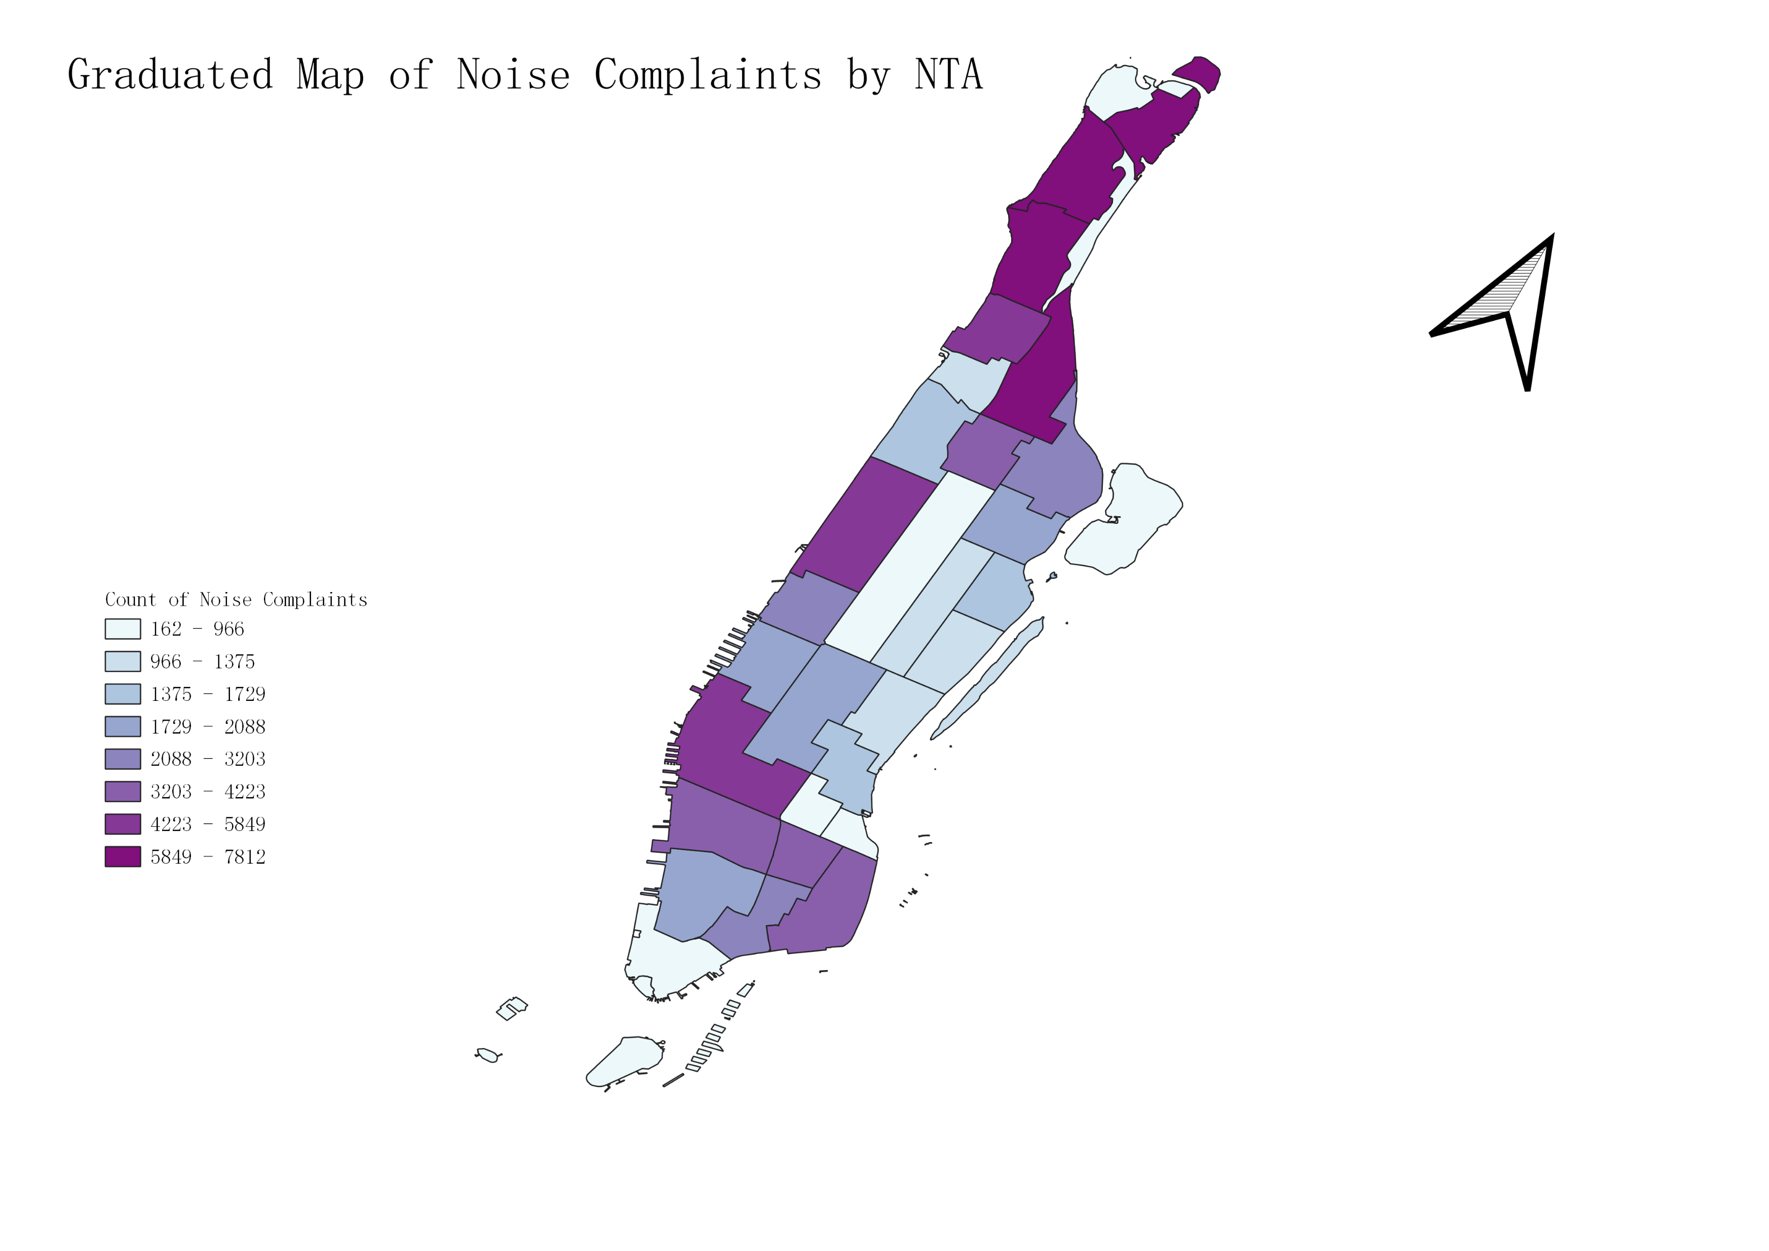
Northern Manhattan: Fort George, Inwood, Upper Manhattan, Upper West Side, and Washington Heights
Other Regions Manhattan: Chelsea, West Village, and SoHo
Reason: Population
Reason: Environment of the Neighborhood

Slide 3
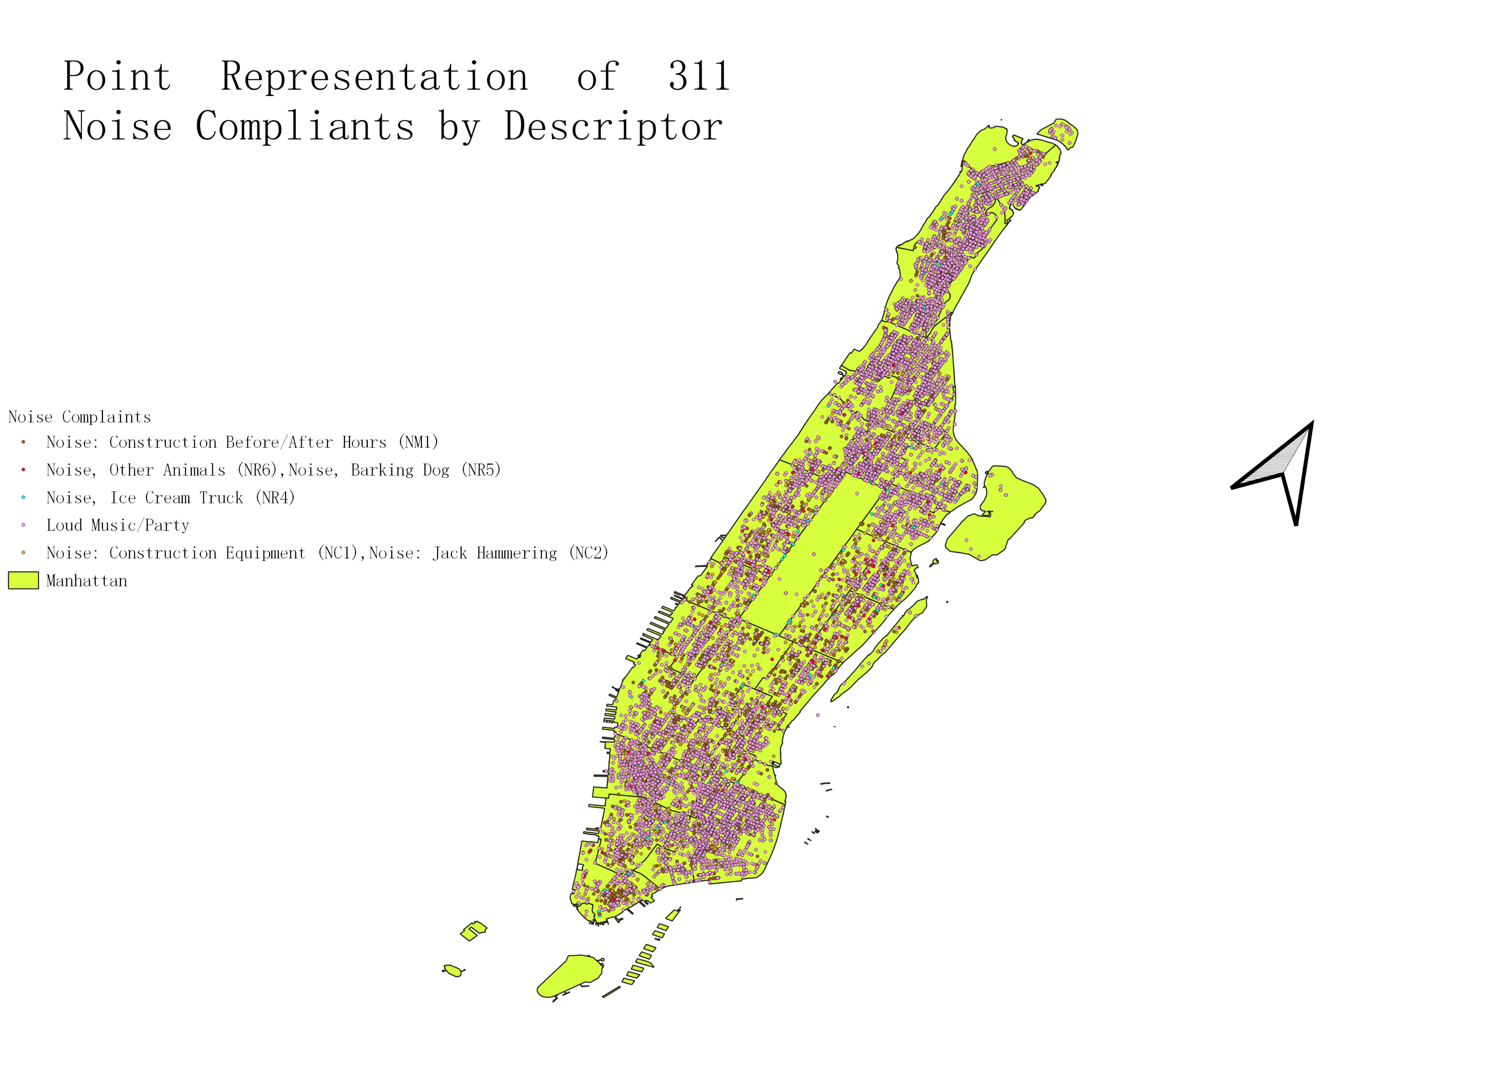
The most common complaints: loud noise complaints and Construction related complaints.
Can be seen through out the city.
Another common type of complaints are barking or animal related complaints.
These complaints are also very common, but they are not as clustered as the other complaints.
Last but not least, Ice Cream Trucks are seen around parks

Slide 4
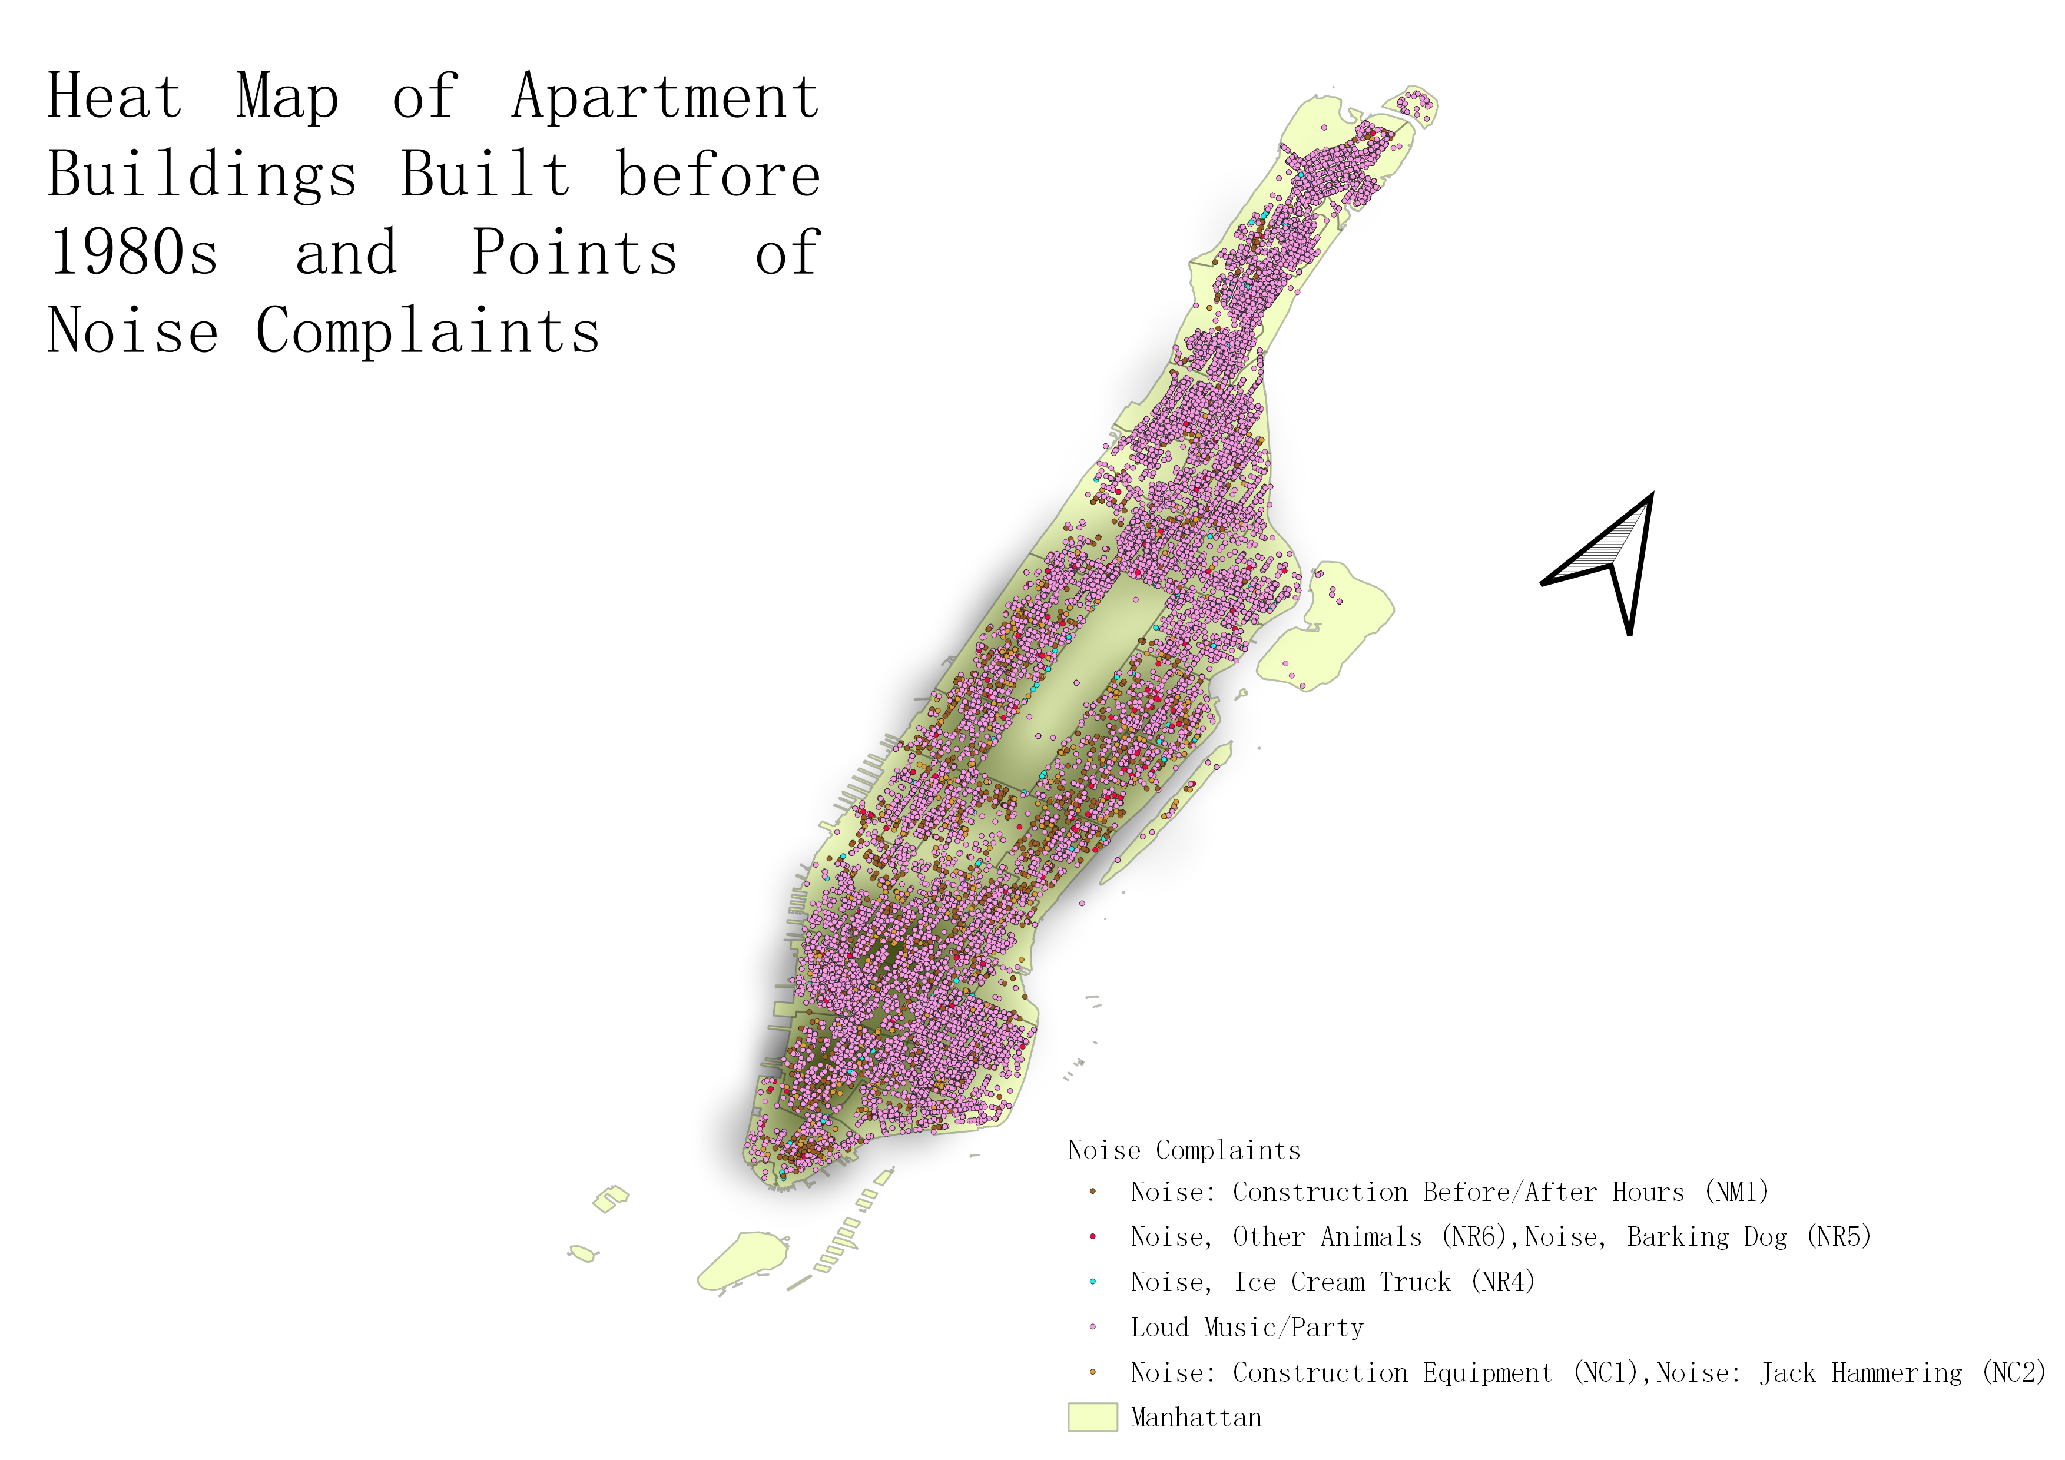
DOF: Condominium Comparable Rental Income – Manhattan – FY 2011/2012
Picked based on my personal experience
Heat Map
Data before 1980s
Account for the majority of noise related issue

Slide 5
Limitation
Data only contains information on Condo,
Lack of data on Townhouse
Lack of data on Co-op
Result only covers Midtown and Downtown

