Slide 1

Predicting MLS Team League Position
By Tobin Mathew

Slide 2
Introduction
What is MLS?
Major League Soccer (MLS) is the professional soccer league in the United States and Canada. Founded in 1993, MLS has grown significantly, becoming a vital part of the North American sports landscape. It consists of teams from both countries and has a structured competition format leading to playoffs and the MLS Cup.
Notes:
Ij’
uo’op’

Slide 3
Project Objectives
Goal: The primary goal of this project is to determine the league position of MLS teams based on statistical analysis.
Why: By leveraging statistical methods and data analysis, we aim to gain deeper insights into the performance metrics of MLS teams. Understanding these metrics can provide valuable information about team standings and performance trends over multiple seasons.

Slide 4
Data Collection, Preprocessing & Tools
Data collection:
Source: Official MLS website (https://www.mlssoccer.com/stats/) - Seasons (2011-2024)
Scope: The dataset includes a wide range of metrics such as goals scored, assists, shots on goal, fouls committed, and various team statistics.
Data Preprocessing:
Cleaning Procedures: Handled missing values,Converted data types as necessary (e.g., numeric, categorical) to facilitate effective data manipulation and analysis
Standardization: Normalized data to ensure consistency in statistical metrics across different seasons. This step is crucial for fair comparisons and accurate analysis of team performance trends.
Tools:
Python, Pandas, Matplot, Seaborn, Sklearn and Dask

Slide 5
Exploratory Data Analysis
Metrics Analysis: Goals, Attack, Defense, and Possession
Goals Metrics:
Features include goals scored, goals conceded, and specific goal types (e.g., penalties, box goals).
Insights into scoring efficiency and defensive vulnerabilities.
Attack Metrics:
Features include total scoring attempts, on-target attempts, and set-piece effectiveness.
Indicates offensive prowess and ability to convert scoring opportunities.
Defense Metrics:
Features include metrics like saves, clean sheets, and interceptions.
Highlights defensive capabilities and resilience against opponent attacks.
Possession Metrics:
Features include possession percentage, pass accuracy, and successful dribbles.
Reflects team control and ability to maintain and utilize possession effectively.

Slide 6
EDA
Correlations Analysis:
Calculated correlation coefficients between each metric and points.
Identified metrics strongly correlated with team performance (points).

Slide 7
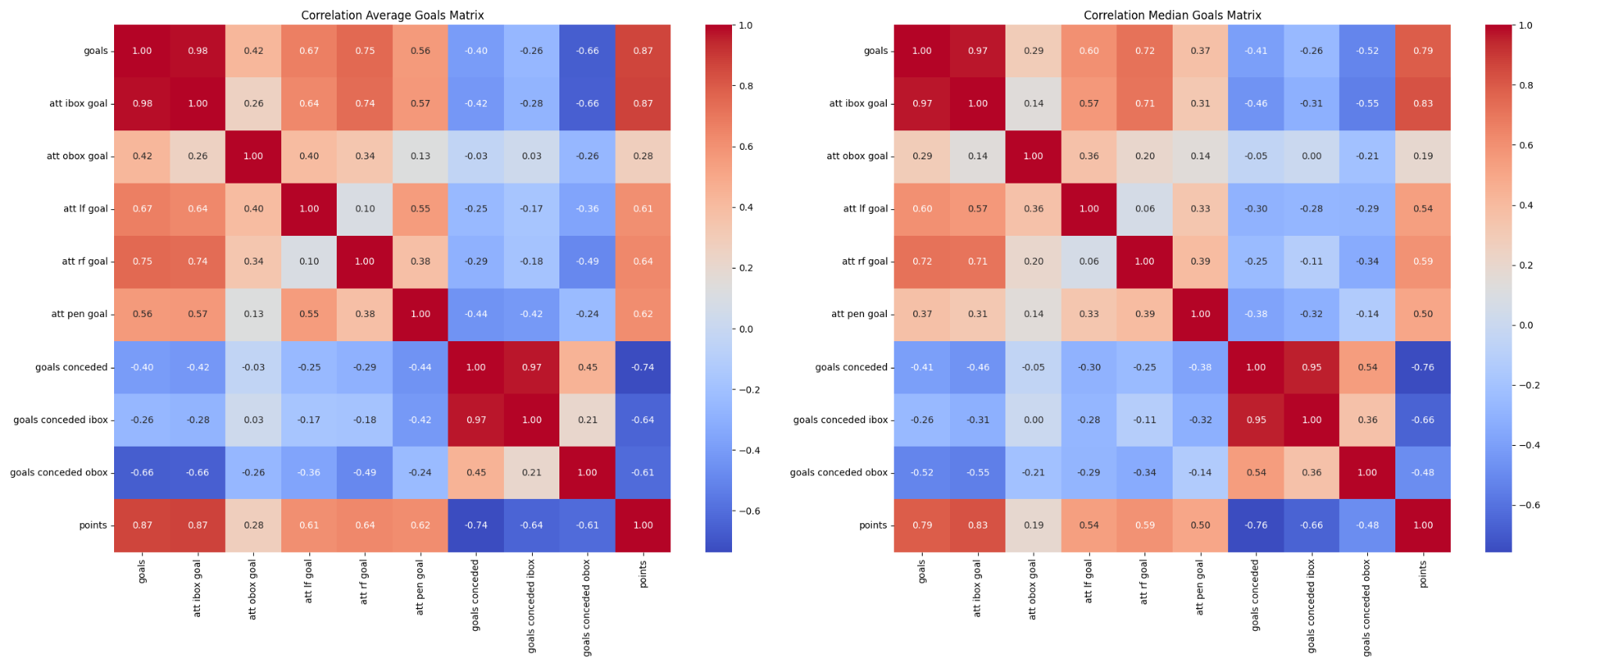
Correlation Goal HeatMaps
Goals METRICS

Slide 8
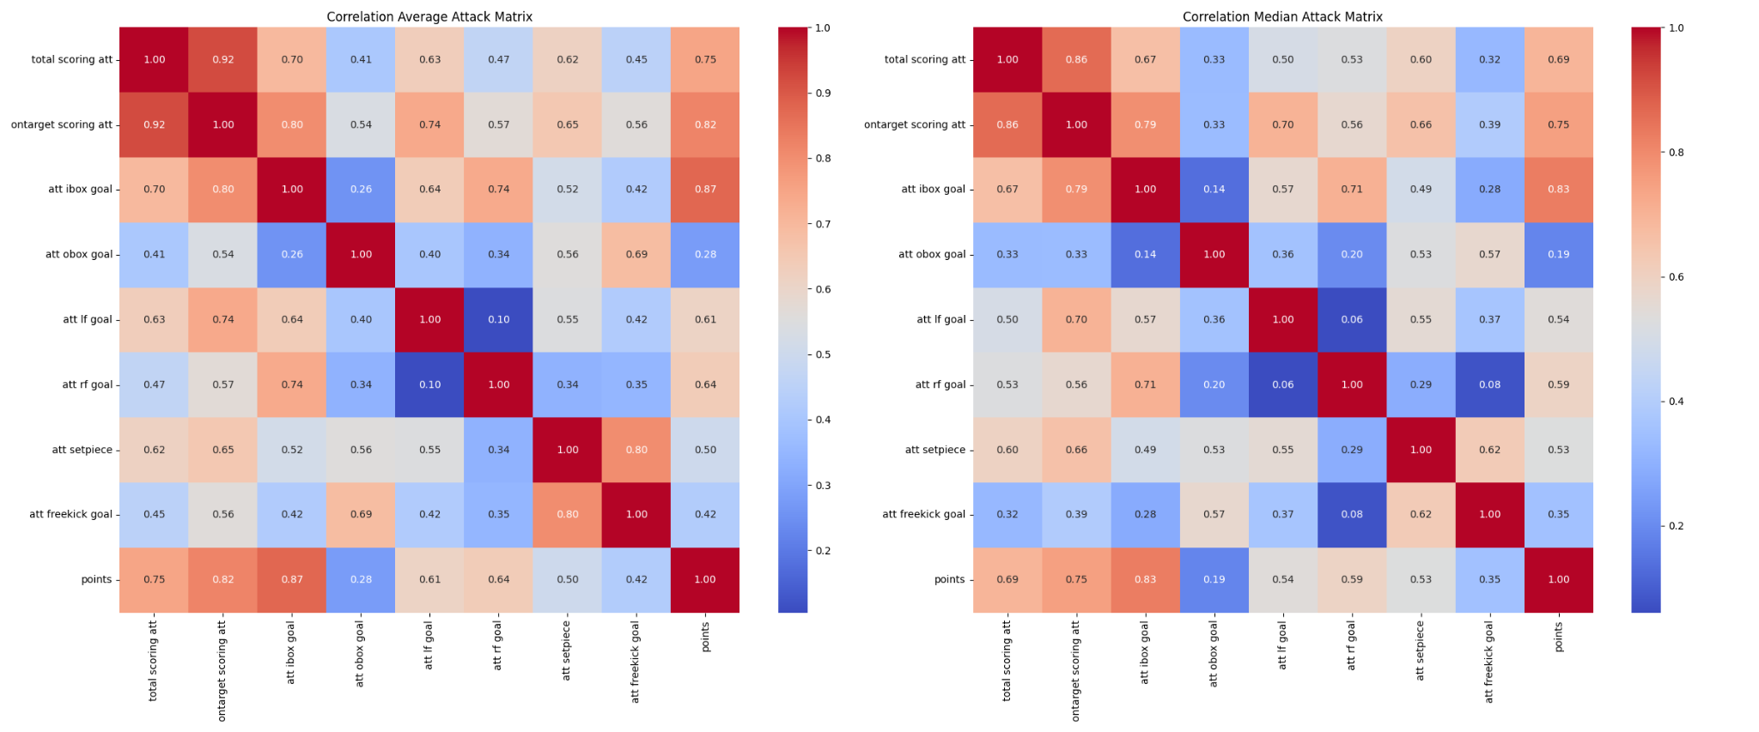
Correlation Attack HeatMaps
ATTACK METRICS

Slide 9
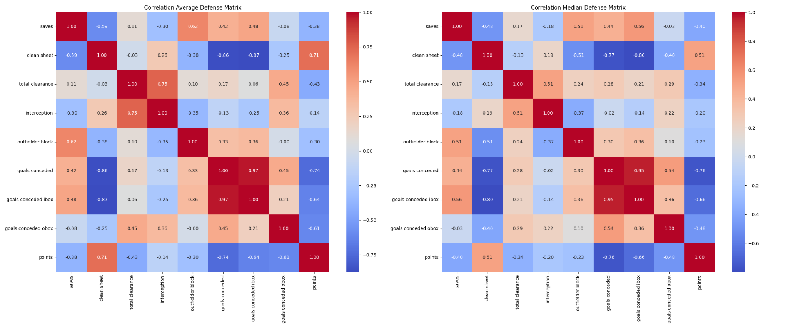
Correlation Defence HeatMaps
Defence METRICS

Slide 10
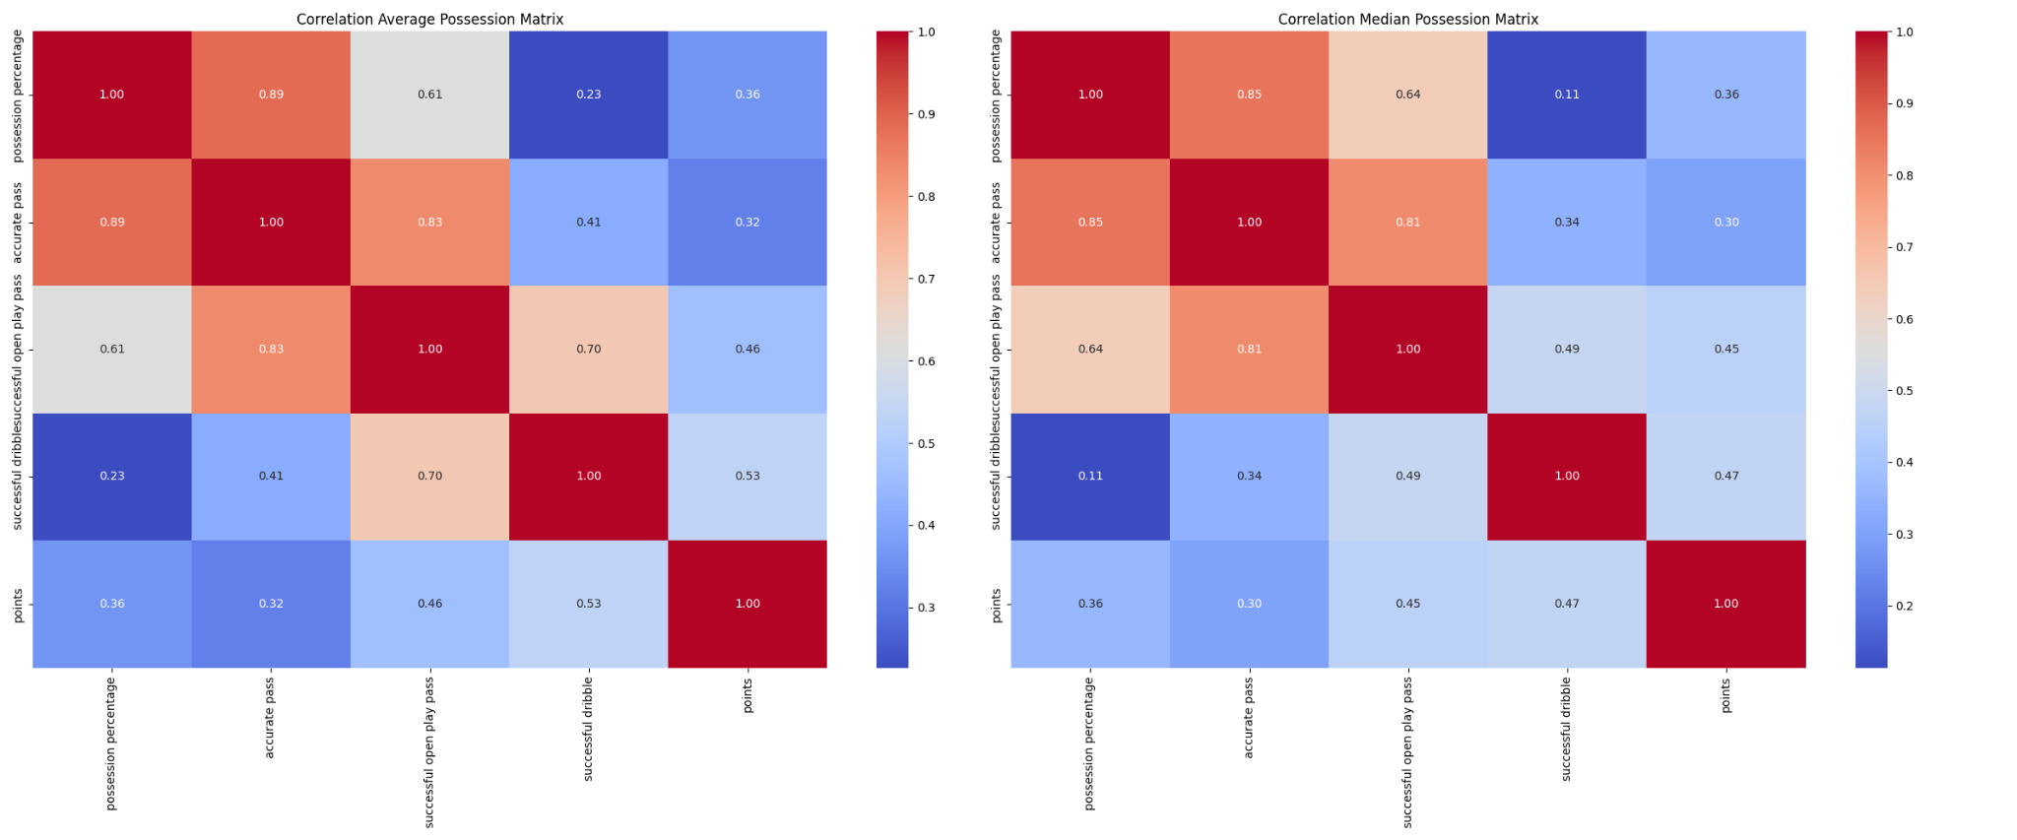
Correlation Possessions HeatMaps
Possessions METRICS

Slide 11
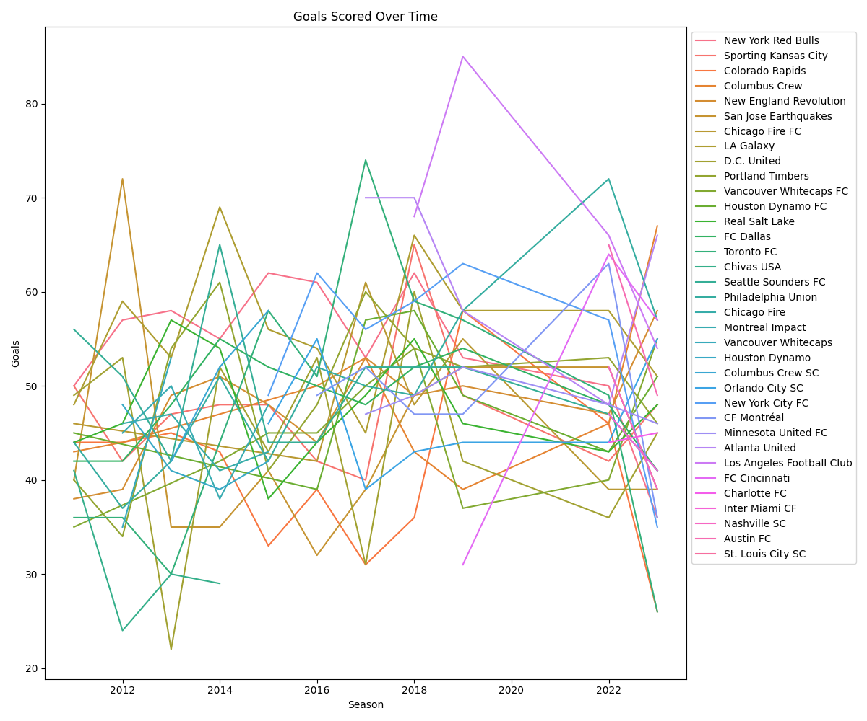
LinePlot

Slide 12
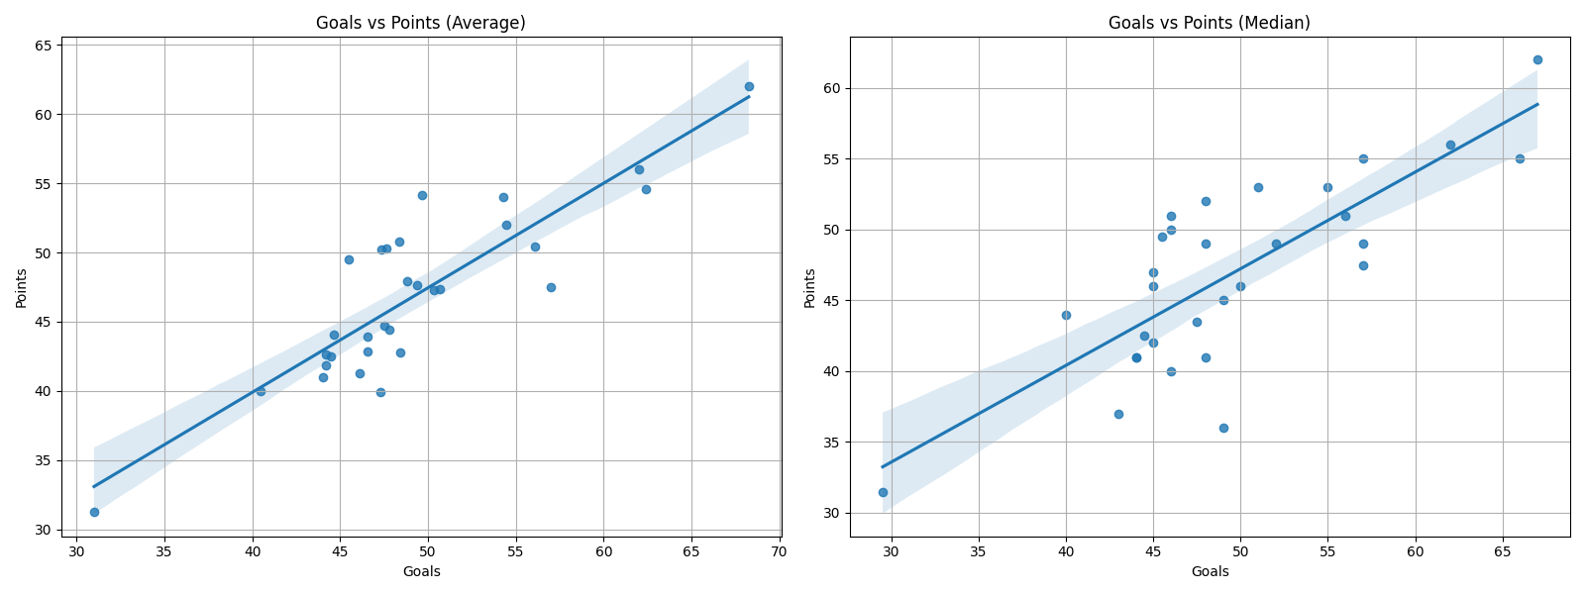
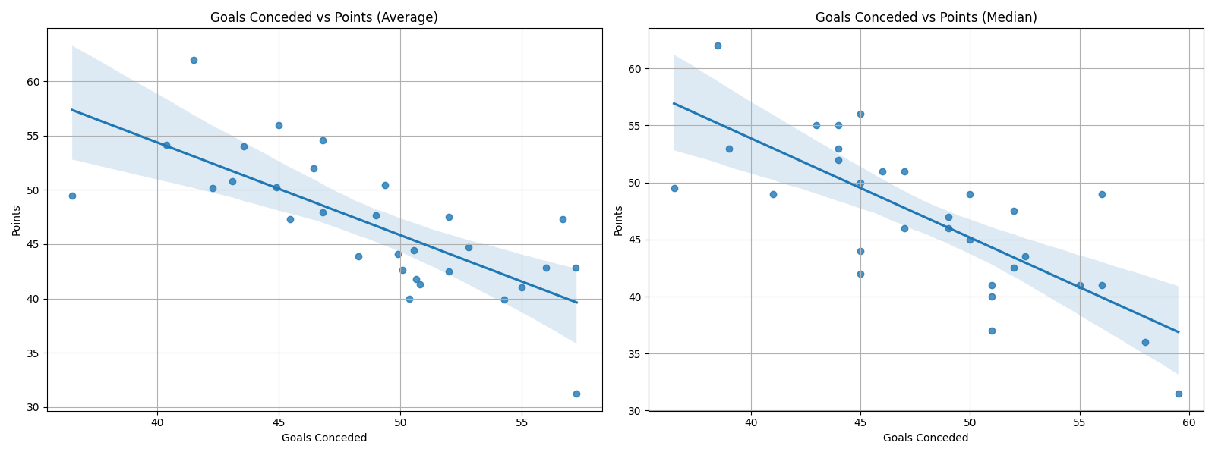
Scatter Plot

Slide 13
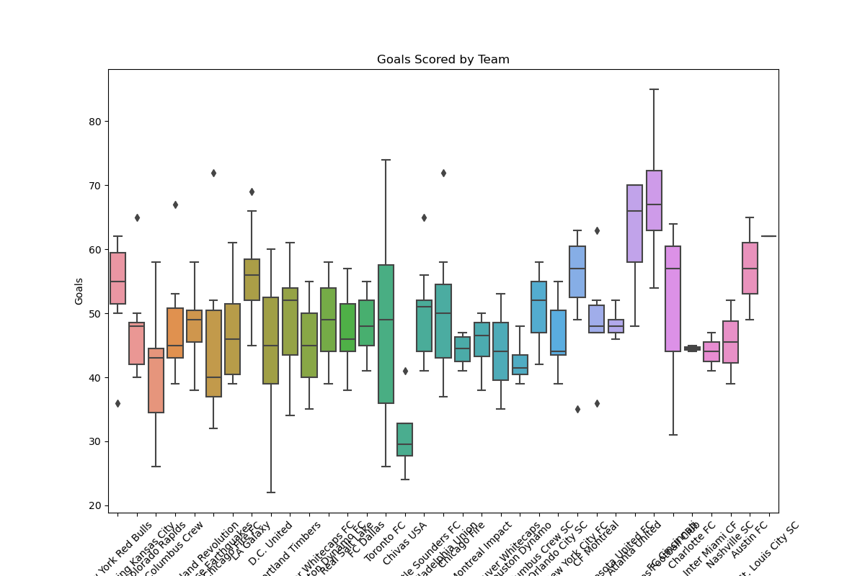
Box Plot

Slide 14
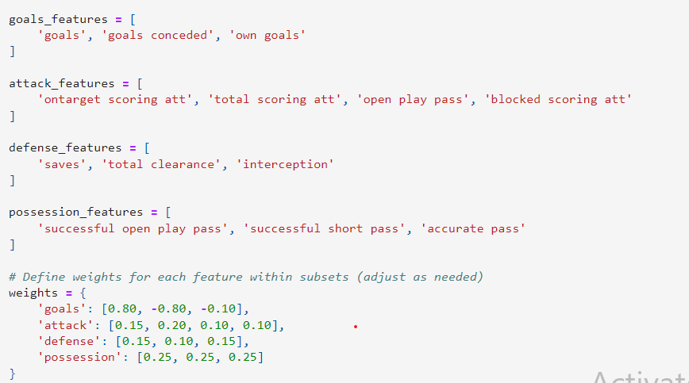
Machine Learning
Linear regression:
Why: linear regression is chosen for its simplicity, interpretability, and ability to provide meaningful insights into the relationship between MLS team performance metrics and their standings
Weight Assignment:
Weights were assigned to metrics within each category (goals, attack, defense, possession) to emphasize their relative importance in predicting team points.
This approach allows for a nuanced analysis where certain metrics contribute more significantly to team success than others

Slide 15
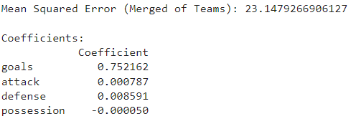
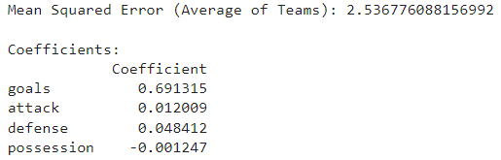
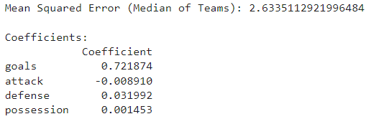
Model Performance Evaluation
Merged Dataset | Team Averages | Team Median

Slide 16
Weighted Score
Goals Metrics:
Features: 'goals', 'goals conceded'
Weights: [0.80, -0.80].
Attack Metrics:
Features: 'ontarget scoring att', 'total scoring att', 'open play pass'
Weights: [0.15, 0.20, 0.10]
Defense Metrics:
Features: 'saves', 'total clearance', 'interception'
Weights: [0.15, 0.10, 0.15]
Possession Metrics:
Features: 'successful open play pass', 'successful short pass', 'accurate pass'
Weights: [0.25, 0.25, 0.25]

Slide 17
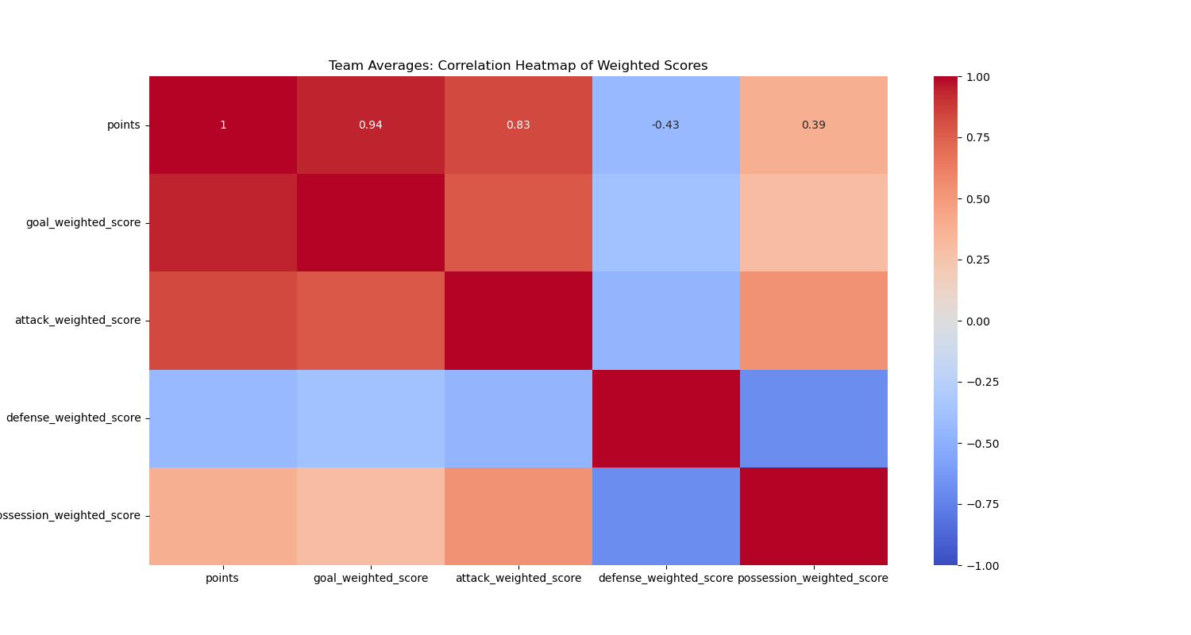
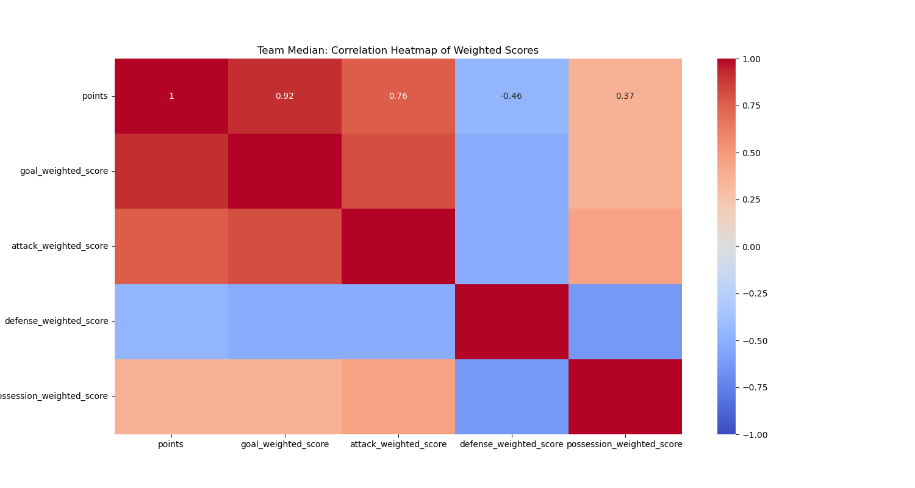
Correlation of Weighted Score

Slide 18


ML with weighted score
Team Median | Team Average

Slide 19
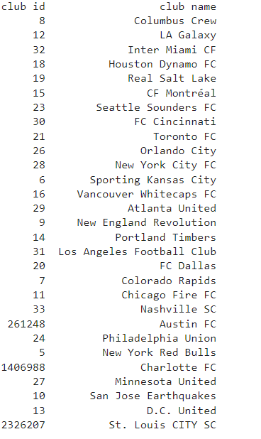
Predicting current season team position in the league based on points
Predicted team position:
Current season data had to be normalized and weighted score for each metric have to be created.
Data as of July 22

Slide 20
Limitations, Roadblock Encountered & Future work
Limitations
Seasonal Predictions: Predictive models are more reliable during ongoing seasons when more matches have been played, providing a larger dataset for analysis and reducing the impact of early-season variability.
Roadblocks Encountered
Performance of Dask: The usage of Dask for data processing was suboptimal due to the dataset size being relatively small for its distributed computing capabilities. This resulted in slower processing compared to more conventional tools like pandas, which could handle the data efficiently within memory.
Future Work
Incorporation of Player Statistics
Consideration of Team Form
Predictive Analytics for Match Outcomes

Slide 21
Q & A

