Slide 1
From power point to presentation
Notes:
Hello everyone, today I’m going do a presentation on how to convert a power point file into a presentation video.

Slide 2
Stages
Image
Audio file
Video file
Notes:
The process take a several stages: turning the power point file into images, turning the speaker note into audio files. Using the images to create a video and finally combine the audio with the video.

Slide 3
Images
Notes:
The Images Stages

Slide 4
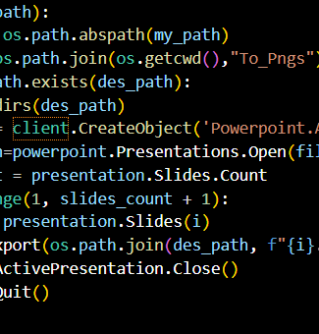
Comtypes
Notes:
For this stages, I’m using comtypes library in python to export each slide as a Png file. The pros is easy to use and the exported pictures are high solution. The cons is this will online work on window and required user to install power point.

Slide 5
Audio
Notes:
The Audio Stages

Slide 6
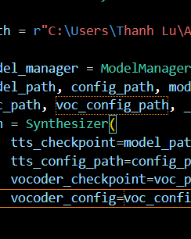
Using AI model to create voice
Notes:
In this step, we actually have many different types of python libraries to support the conversion. At first, I tried google tts but the voice was very stiff, rough and fake. After that, I learned about Py-tts, the male voice is quite good with many improvements such as light accents and being able to customize the reading speed. However, I'd like to find a library with better support and a more human-like voice. I tried tts library by Coqui.ai. By using pre-trained AI models, it can create female voices with clear accents and punctuation. After testing on a few models, I feel most satisfied with tacotron2-DCA. In addition, it also allows users to train their own AI, but that takes a lot of resources and time.

Slide 7
Audiosegment
Extract speaker notes
Turning the notes into audio wav files
Combine all audio file adding 0.5s in each section for transition.
Notes:
First, I used pptx library to extract all speaker notes in each slide. Then, using the AI model to convert texts into audio files. Finally, we combine all of the audio files into a single one using audio segment library.

Slide 8
Video
Notes:
The video Stages

Slide 9
Moviepy
Using moviepy to create image clip for each image
Combine all clips
Edit audio
Export the final version
Notes:
Using the movie-py library, I’m able to create separate clips with different duration for each images. The duration is depended on the corresponding audio file. Then, by combining all the clips, I get the full video. Now, the final step is adding the full audio file into the video and save.

Slide 10
THANK YOU
Thanh Lu
Notes:
Thank you for listening.

