Slide 1
CS 4347 Machine Learning
Simon Beymer and Shervone Mayes

Slide 2
agenda
Introduction
Dataset and Features
Methods
Analysis
Conclusion
Notes:
Refer project report
- Describe the motivation and problem description
Speak to the dataset much of the time.
What it contained (features)
Introduction: Cancer biology. Use project proposal. Previous studies
Genetics behind dataset and features WHY CHOOSE FEATURES
Transition: SM introduce dataset -→ SM HOW ELIMINATE FEATURES will Feature Elimination. Curse of Dimensionality. Feature reduction. Hugo_Symbol
Methods: Why used ANN? – SB to investigate
0 and 1s too sparse. Not conducive to

Slide 3
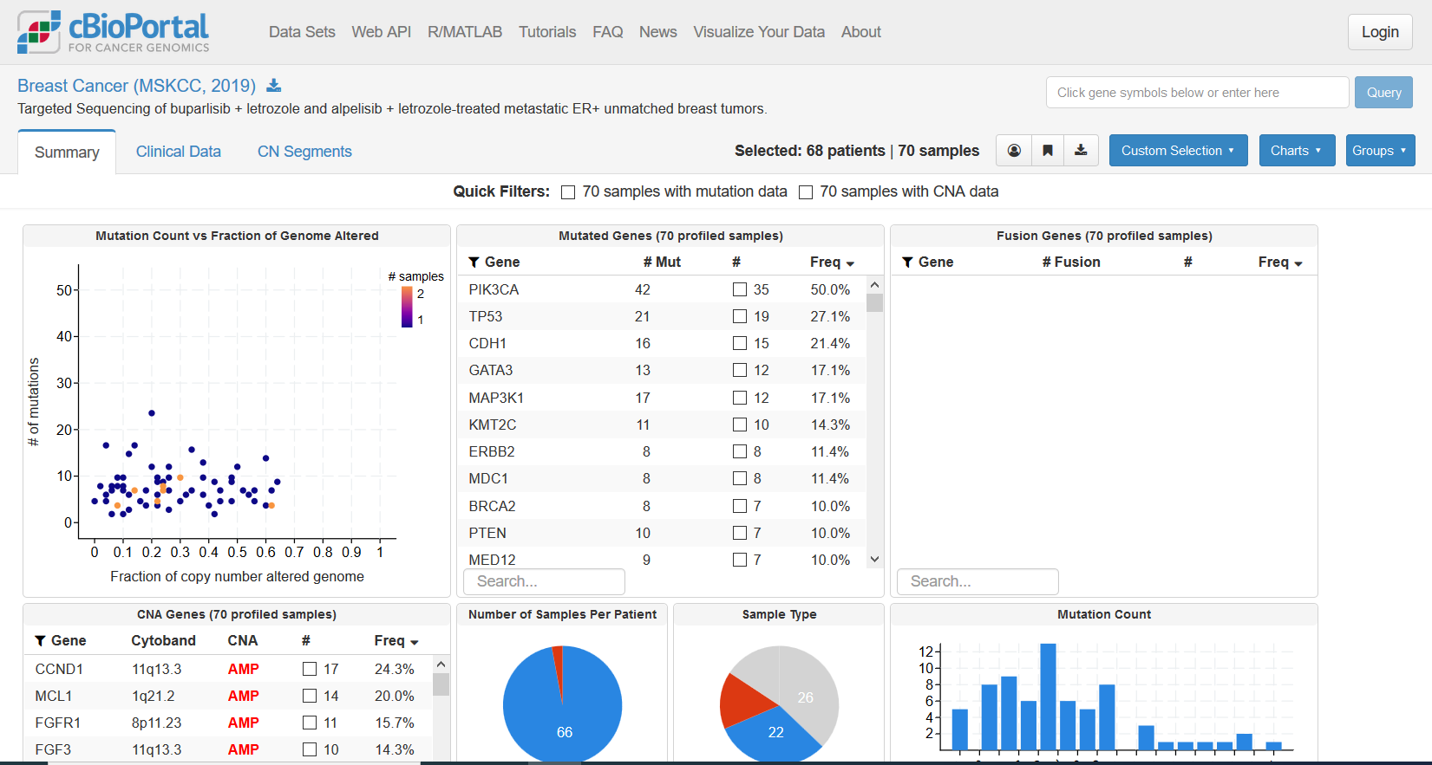
cbioportal
Notes:
Refer project report
- Describe the motivation and problem description
Speak to the dataset much of the time.
What it contained (features)
Introduction: Cancer biology. Use project proposal. Previous studies
Genetics behind dataset and features WHY CHOOSE FEATURES
Transition: SM introduce dataset -→ SM HOW ELIMINATE FEATURES will Feature Elimination. Curse of Dimensionality. Feature reduction. Hugo_Symbol
Methods: Why used ANN? – SB to investigate
0 and 1s too sparse. Not conducive to

Slide 4
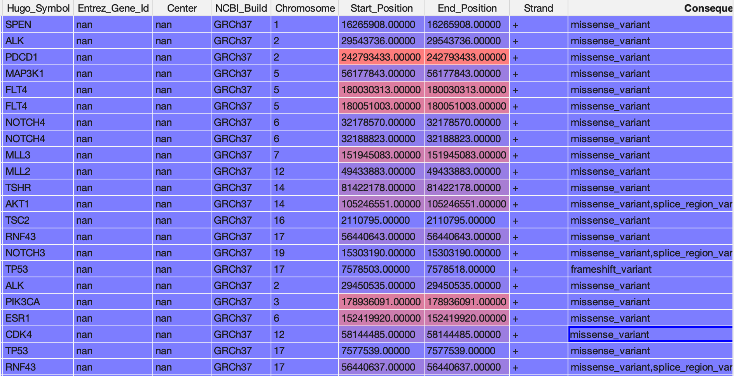
DATASET
Notes:
Refer project report
- Describe the motivation and problem description
Speak to the dataset much of the time.
What it contained (features)
Introduction: Cancer biology. Use project proposal. Previous studies
Genetics behind dataset and features WHY CHOOSE FEATURES
Transition: SM introduce dataset -→ SM HOW ELIMINATE FEATURES will Feature Elimination. Curse of Dimensionality. Feature reduction. Hugo_Symbol
Methods: Why used ANN? – SB to investigate
0 and 1s too sparse. Not conducive to

Slide 5
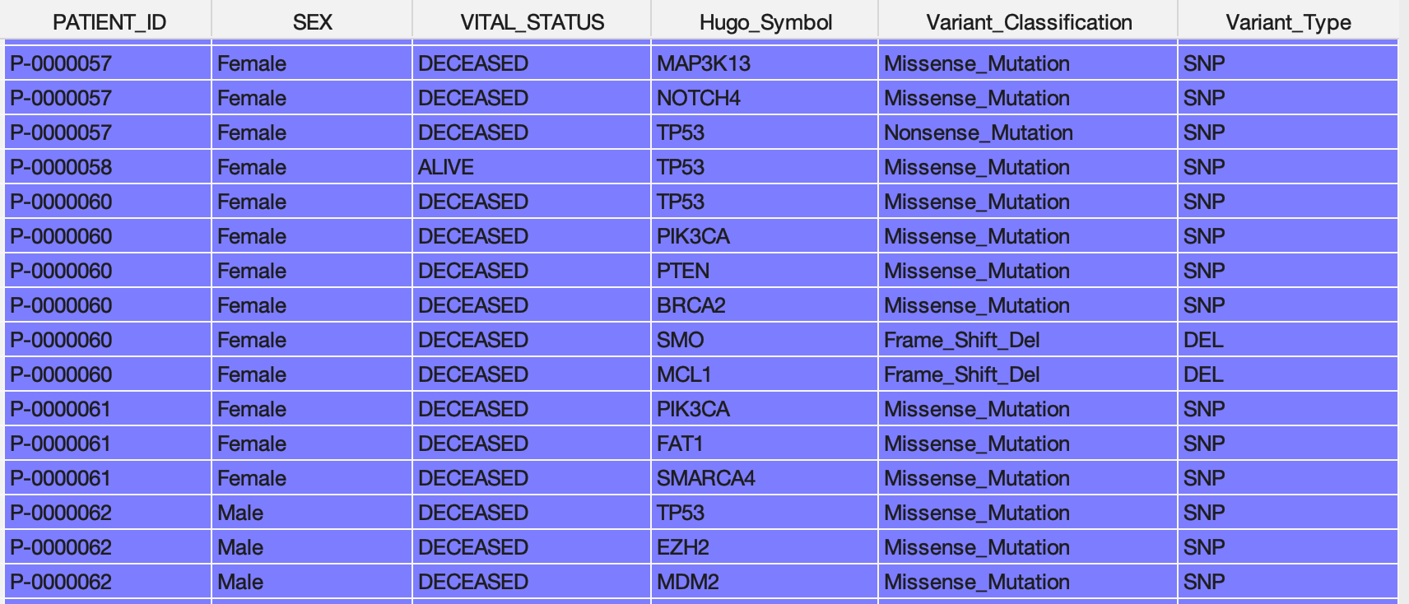
DATASET
Notes:
Refer project report
- Describe the motivation and problem description
Speak to the dataset much of the time.
What it contained (features)
Introduction: Cancer biology. Use project proposal. Previous studies
Genetics behind dataset and features WHY CHOOSE FEATURES
Transition: SM introduce dataset -→ SM HOW ELIMINATE FEATURES will Feature Elimination. Curse of Dimensionality. Feature reduction. Hugo_Symbol
Methods: Why used ANN? – SB to investigate
0 and 1s too sparse. Not conducive to

Slide 6
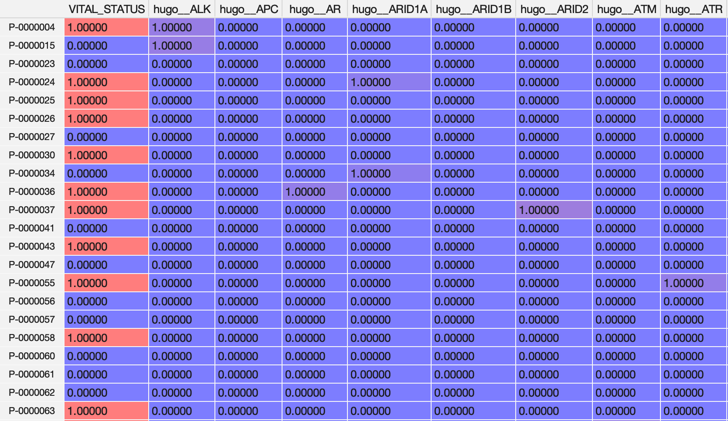
DATASET
Notes:
Refer project report
- Describe the motivation and problem description
Speak to the dataset much of the time.
What it contained (features)
Introduction: Cancer biology. Use project proposal. Previous studies
Genetics behind dataset and features WHY CHOOSE FEATURES
Transition: SM introduce dataset -→ SM HOW ELIMINATE FEATURES will Feature Elimination. Curse of Dimensionality. Feature reduction. Hugo_Symbol
Methods: Why used ANN? – SB to investigate
0 and 1s too sparse. Not conducive to

Slide 7
METHODS
Logistic Regression
Neural Network
****Algorithm Derivations***
Notes:
Insert bonus:
BigO
Derivations
Very high level…

Slide 8
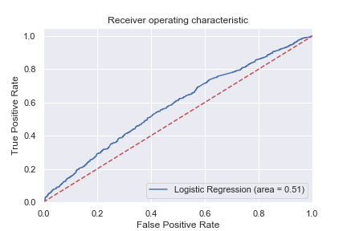
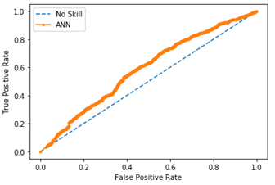
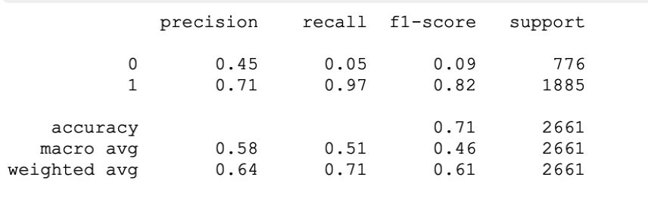
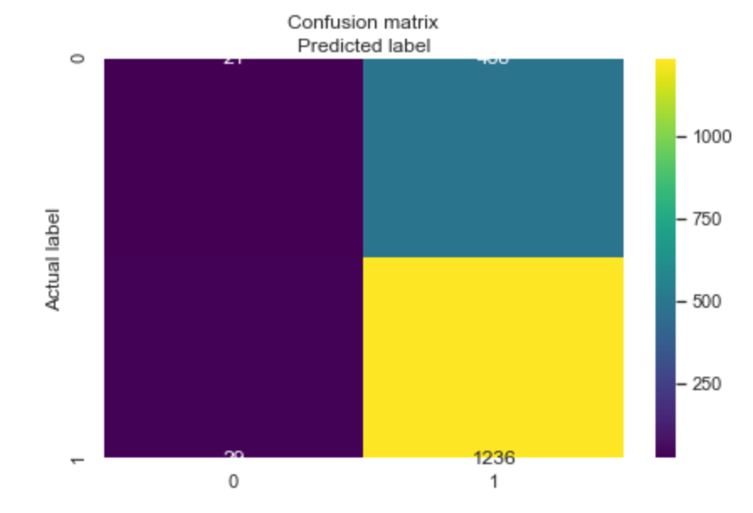
VISUALIZATIONS
Logistic Regression
Neural Network
Notes:
https://towardsdatascience.com/visualizing-artificial-neural-networks-anns-with-just-one-line-of-code-b4233607209e
https://towardsdatascience.com/real-world-implementation-of-logistic-regression-5136cefb8125
Receiver Operating Characteristic(ROC) curve is a plot of the true positive rate(Recall) against the false positive rate. It shows the tradeoff between sensitivity and specificity.
The area under the ROC Curve is an index of accuracy. Higher the area under the curve, better the prediction power of the model.
AUC of a perfect predictive model equals 1.

Slide 9
Optimizers and Loss function
ADAM – Worst Results
RMSPROP –
STOCHASTIC GRADIENT FUNCTION – Need to Run
Notes:
Optimizers and Loss function — There is a myriad of options available for you to choose from. In fact, you could even define your custom loss function if necessary. But the commonly used optimizers are RMSprop, Stochastic Gradient Descent and Adam. These optimizers seem to work for most of the use cases. Commonly used loss functions are categorical cross entropy if your use case is a classification task. If you are performing a regression task, mean squared error is the commonly used loss function. Feel free to experiment with the hyperparameters of these optimizers and also with different optimizers and loss functions.
Shervone: speak generally various optimizers used.

Slide 10
Batch Size & Number of Epochs
Batch Size:
80% training, 20% testing (LR/ANN)
60% training, 40% testing (LR/ANN)
At this point cross validation has not been performed on Logistic Regression Model
Notes:
Batch Size & Number of Epochs — Again, there is no standard value for batch size and epochs that works for all use cases. You have to experiment and try out different ones. In general practice, batch size values are set as either 8, 16, 32… The number of epochs depends on the developer’s preference and the computing power he/she has.

Slide 11
Activation Function
ReLU: no change 70.40
Leaky ReLU: no change 70.40
SoftMax: no change 70.40
Notes:
Activation functions map the non-linear functional inputs to the outputs. Activation functions are highly important and choosing the right activation function helps your model to learn better. Nowadays, Rectified Linear Unit(ReLU) is the most widely used activation function as it solves the problem of vanishing gradients. Earlier Sigmoid and Tanh were the most widely used activation function. But, they suffered from the problem of vanishing gradients, i.e during backpropagation, the gradients diminish in value when they reach the beginning layers. This stopped the neural network from scaling to bigger sizes with more layers. ReLU was able to overcome this problem and hence allowed neural networks to be of large sizes.

Slide 12
ANALYSIS
1. Feature Scaling and/or Normalization
2. Class Imbalance
3. Optimize other scores
4. Hyperparameter Tuning - Grid Search
5. Explore more classifiers
6. Error Analysis
ONE-HOT ENCODING | LABEL ENCODING
NORMALIZATION/NO NORMALIATION | RESAMPLING (SMOTE)
TRADITIONAL LOGISTIC REGRESSION | RANDOM FOREST REGRESSION MODEL
Notes:
https://stackoverflow.com/questions/38077190/how-to-increase-the-model-accuracy-of-logistic-regression-in-scikit-python
including a detailed description of your observations from the experiments
Include bar graph and area under curve.
Observations:
Data too sparse. Only ones and zeroes after get_dummy() applied to handle categorical features. Normalized dataset and reran ANN. Improvements observed: 70.8% to 71.05%. Attempt to train longer. NO changes to Activation Function (70.40) or Batch Size (80:20).
Pre-trained model approach applied for ANN.

Slide 13
Conclusions and future work
Park et al. 2013 76% accuracy with semi-supervised learning model on public data on breast cancer
Xu et al. 2012 97% accuracy using SVM with reduced feature elimination
Limitations with public data
Notes:
REFINE
Mention maybe one or two other models could build
Larger dataset with which to work ideal
Simon: mention 97% accuracy study of survival based on those genes. Looked at gene expression of tumors.
Transition to deviation of SVM:
Why SVM?
BONUS: derive theoretical properties of the algorithms

Slide 14
SOURCES
Park, K., Ali, A., Kim, D., An, Y., Kim, M., & Shin, H. (2013). Robust predictive model for evaluating breast cancer survivability. Engineering Applications of Artificial Intelligence, 26(9), 2194-2205.
Xu, X., Zhang, Y., Zou, L., Wang, M., & Li, A. (2012, October). A gene signature for breast cancer prognosis using support vector machine. In 2012 5th International Conference on BioMedical Engineering and Informatics (pp. 928-931). IEEE.

