Slide 1
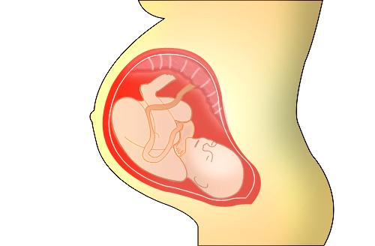
Exploratory Analysis & Prediction of Fetal state
BY OLUWATOBA OYEKANMI

Slide 2
Problem
Cardiotocography is a technical means of recording the fetal heartbeats and contractions during pregnancy.
This project aims to perform en exploratory data analysis on the cardiotocography dataset and predict the fetal state

Slide 3
Datasets
The dataset was retrieved from the UCL Machine Learning database. Data contained 2126 records.
Key features recorded:
Fetal accelerations
Uterine contractions
REM sleep
Active vigilance
Foetal movements
Amongst others

Slide 4
Data Wrangling
Some the data wrangling procedures carried out were:
Irrelevant columns were dropped
Categorical and numerical columns were defined
Duplicated rows and columns were dealt with
Missing values were located and dropped accordingly

Slide 5
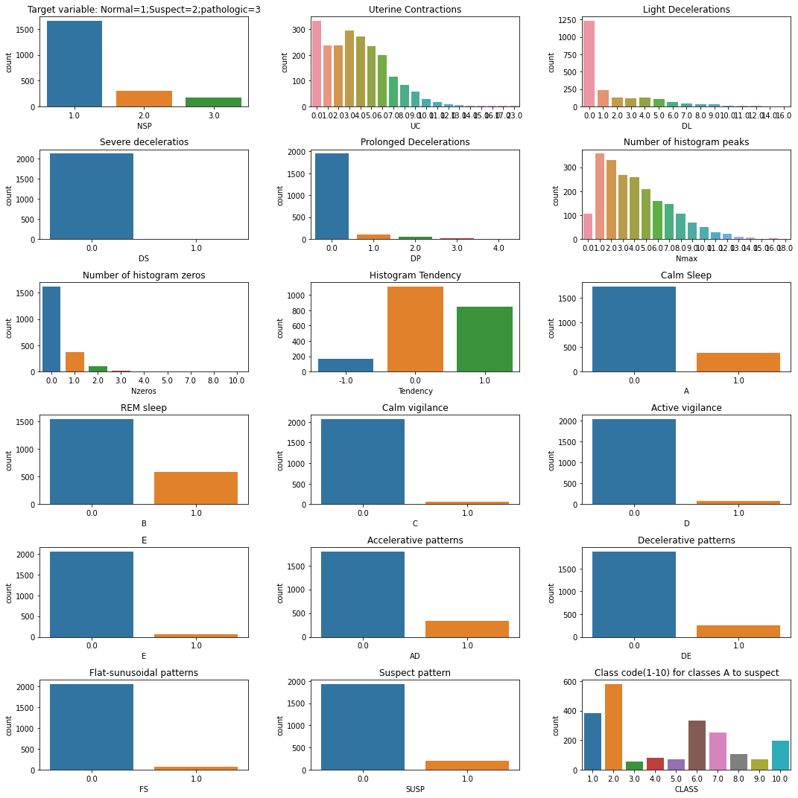
Exploratory Data Analysis
Some features were explored. Our target variable Foetal state(NSP) countplot:
Remarks:
Majority of our foetal state are of normal class and less of suspect and pathologic classes.

Slide 6
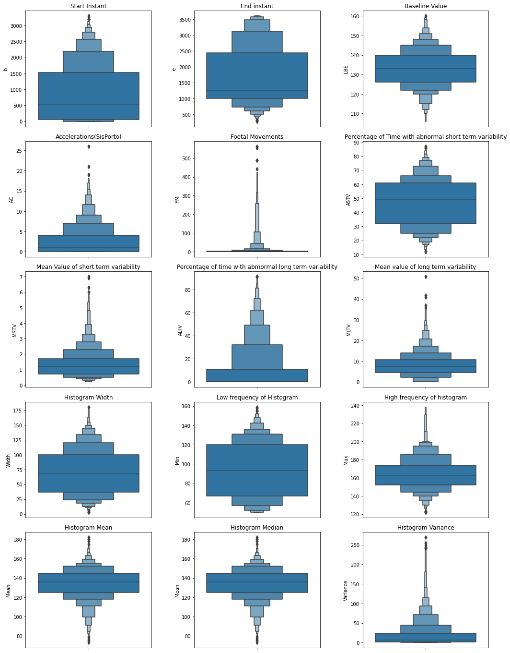
Remarks:
Fetal acceleration ranges between 0 to 20
Outliers acceleration reached 25
The Foetal movements records ranges between 0 and 400, with outliers recording 500.

Slide 7
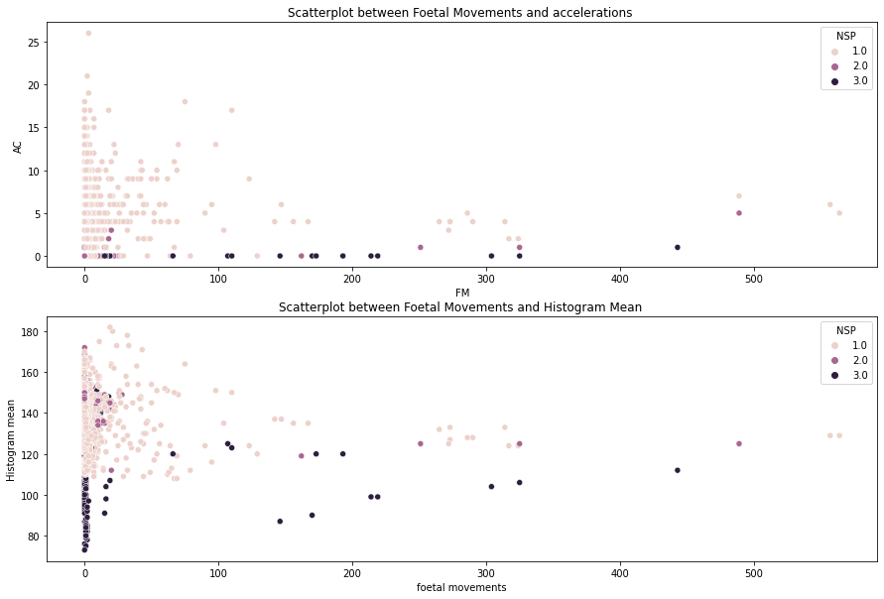
Remarks:
While there is no clear strong correlations there exist clusters of foetal states
Observe that most of fetals in Normal state had high accelerations
Also, observe that low accelerations and high foetal movements does not necessarily imply not Normal foetus state
Pathologic fetal states tends to have higher foetal movements but lower or no accelerations

Slide 8
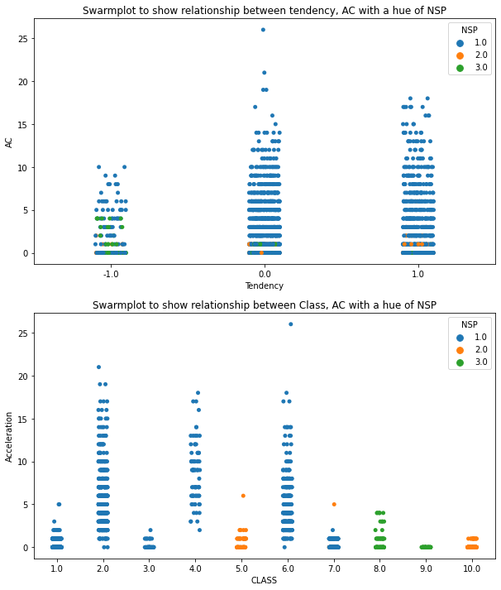
Remarks:
Observe accelerations was low for all but present in all different tendencies for all foetal states
Normal foetal states has the lowest Tendency of -1
Observe Classes 1,2,3,4,6 and 7 has Normal foetal states
Classes 5 and 10 has Suspects foetal states
Classes 8 and 9 has pathologic foetal states

Slide 9
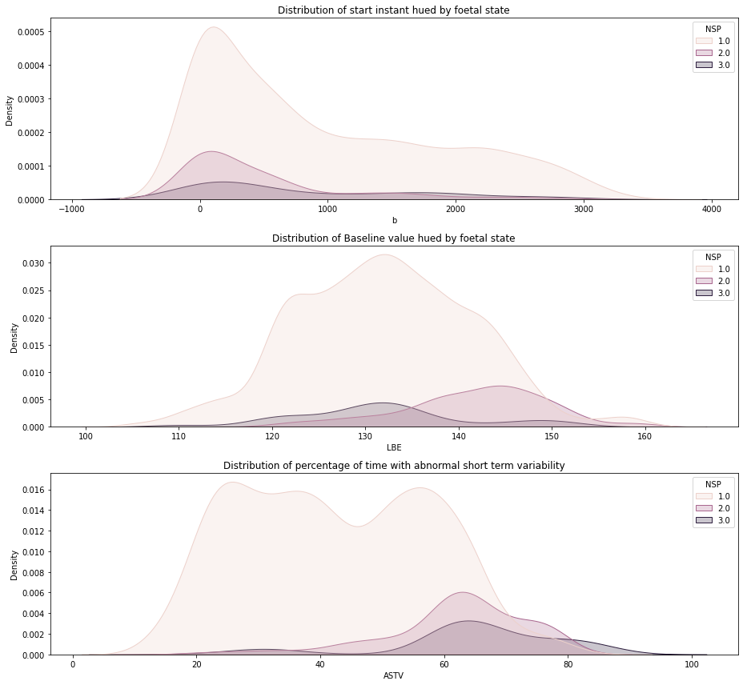
Remarks:
Observe the distributions for all foetal states are skewed to the right
The mean for baseline value differs for each foetal states
Normal State NSP averagely has a lower percentage of time with abnormal short term variability to pathologic and suspect states

Slide 10
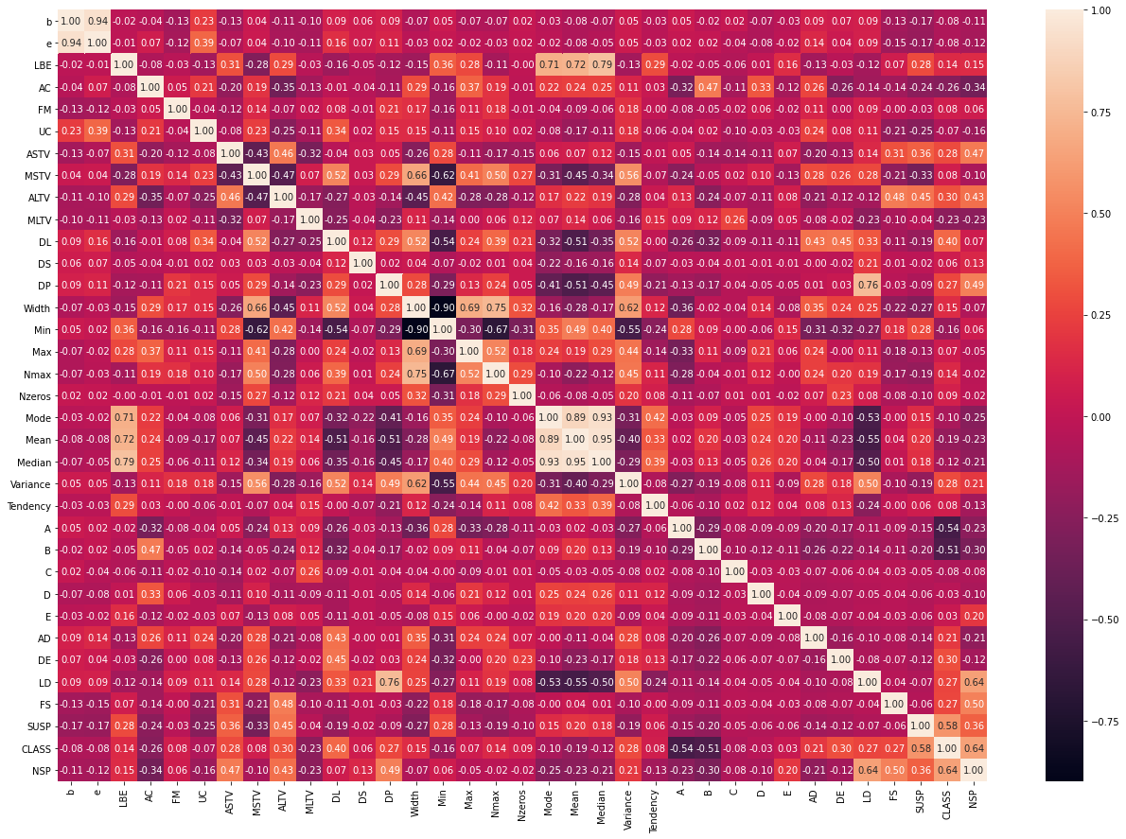
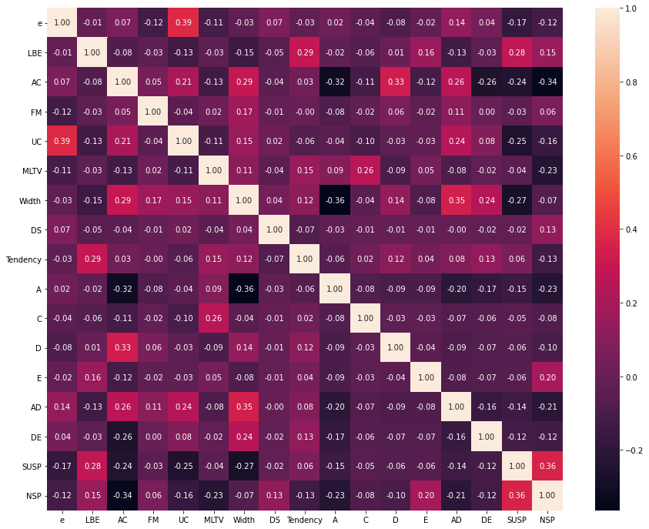
Preprocessing
Managed multicollinearity in database using sklearn’s SelectNonCollinear

Slide 11
Feature importance ranking:
We ranked features importance using SelectKBest. The top and least 4 are;
Top 4 Rank
Lowest 4 Rank
Feature | Rank
SUSP | 242.37
AC | 191.74
A | 81.69
MLTV | 76.81
Feature | Rank
Width | 8.92
C | 8.07
FM | 7.45
NZeros | 1.93

Slide 12
Modelling
Evaluated predictions of models attempted are as follows:
Classifier | Training Score | Accuracy | Recall | F1-Score
Logistic Regression | 0.9751 | 0.9749 | 0.9749 | 0.9742
Decision Tree | 1.0 | 0.9718 | 0.9718 | 0.9714
Random Forest Classifier | 1.0 | 0.9765 | 0.9765 | 0.9760
Gradient Boosting | 0.9987 | 0.9765 | 0.9765 | 0.9761
Neural Network |  | 0.9875 | 0.9873 | 0.9874

Slide 13
Key Takeaway
Recall is a better metric of evaluation because the cost of false negatives is more costly being that false negatives could lead to fetal distress or death
Some ML classifiers overfitted, however Gradient Boosting classifer performed best of all ML classifiers attempted
Our optimised Neural Network model performed even better than Gradient Boosting with results highlighted above

Slide 14
Future Works
Analysis and prediction of the same data used in this project but with a target feature ‘CLASS’
Exploratory analysis and prediction of cardiotocography and fetal ejection
Exploratory analysis of cardiotocography data and maternal mortality and complications in high risk pregnancy

Slide 15
THANK YOU

