Slide 1
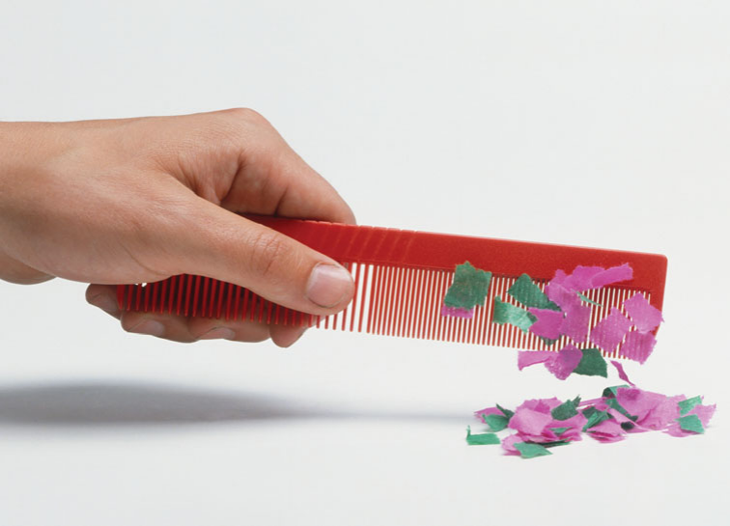
ELECTRIC CHARGES
AND FIELDS

Slide 2
Lecture Overview
Electrostatics; conductors and insulators, Electric charge, methods of charging, Properties of electric charge.
Coulomb’s law; Electric force and Electric field
Capacitance and Dielectrics
Magnetism and magnetic fields
Electromagnetic induction and Maxwell's equations
Current electricity; and currents, Ohm’s law and analysis of DC circuits
AC voltages applied to inductors, capacitors and resistance.

Slide 3
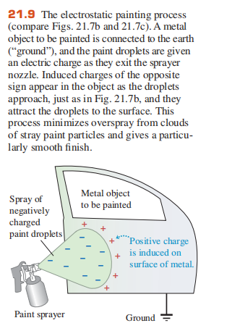
outlines
Electrostatics;
Conductors and insulators,
Electric charge,
Methods of charging,
Properties of electric charge.

Slide 4
ELECTRIC CHARGE
What holds your body together?
What keeps a skyscraper standing?
What holds your car on the road as you round a turn?
What governs the electronic circuitry in your computer or smartphone, or provides the tension in your climbing rope?
What enables a plant to make sugar from sunlight and simple chemicals?
What underlies the awesome beauty of lightning?
The answer, in all cases, is the electric force
With the exception of gravity, all the forces we’ve encountered in mechanics—including tension forces, normal forces, compression forces, and friction—are based on electric interactions; so are the forces responsible for all of chemistry and biology.
The electric force, in turn, involves a fundamental property of matter—namely, electric charge.

Slide 5
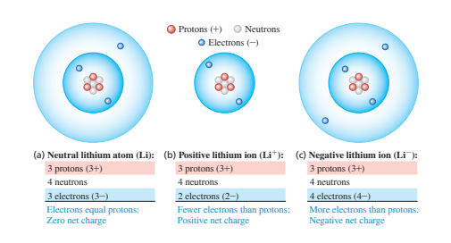
Electric Charge
What is an electric charge?
It is a basic property of matter carried by some elementary particles (electron and proton).
It is a physical property of matter that causes it to experience a force when kept in an electromagnetic field.
Charge is divided into two categories: positive and negative charges.
Charge is a property of particles

Slide 6
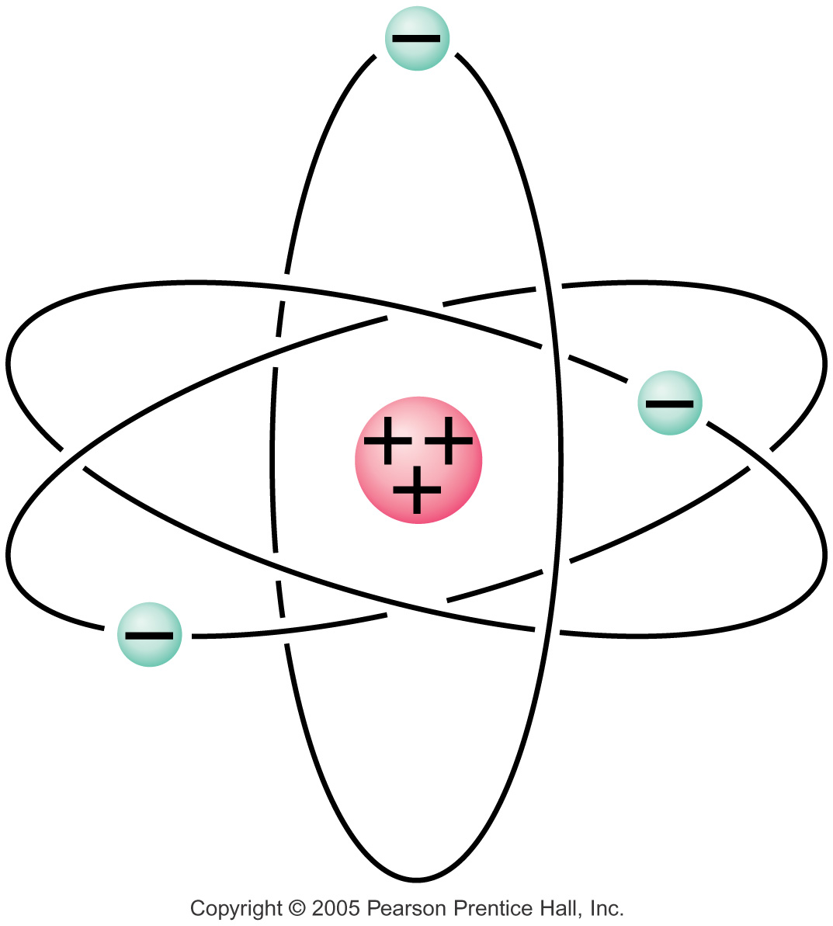
Electric Charge
Atom Basics
Atom is said to be electrically neutral because it has equal number of positive protons and negative electrons.
An Object is said to be charged when it has an unequal electrons, of positive/negative charges.
Only electrons move to create charges.
When an object gains or loses electrons it becomes CHARGED!!!!
When atoms lose electrons, they become positively charged ions
When atoms gains electrons. they become negatively charged ions.

Slide 7
ELECTRIC CHARGE
The ancient Greeks discovered as early as 600 b.c. that after they rubbed amber with wool, the amber could attract other objects. Today we say that the amber has acquired a net electric charge, or has become charged
What is Electrostatics?
It is the branch of physics that studies the nature of charges that is not moving.
It is the branch of physics that studies electric charges at rest. The study of STATIC ELECTRICITY.
Static electricity is electrical charges that can be collected and held in one place.
The word “electric” is derived from the Greek word elektron, meaning amber.

Slide 8
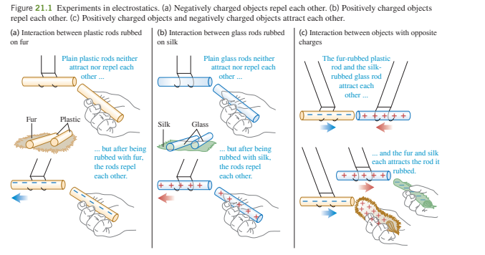
ELECTRIC CHARGE

Slide 9
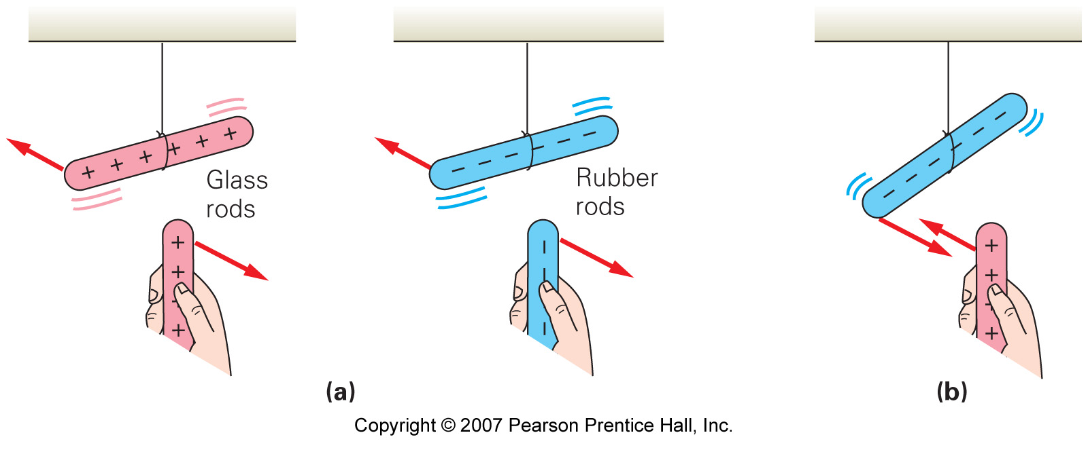
Electric Charge
Fundamental laws of charges
Unlike charges attract while like charges repel.
This force of attraction or repulsion between charged particles is called the ELECTRIC FORCE
And the fact that these + or – particles in matter carry electric charge, this is the basic idea of electricity.

Slide 10
Conductors and Insulators
Conductors
They are materials that permit electrons to flow freely from particle to particle; allows electricity pass through them easily. E.g. copper, iron and steel
An object made of a conducting material will permit charge to be transferred across the entire surface of the object. If charge is transferred to the object at a given location, that charge is quickly distributed across the entire surface of the object. The distribution of charge is the result of electron movement.
Insulators
They are materials that impede the free flow of electrons from atom to atom; do not allow electricity to pass through them. E.g. Plastic, wood, glass and rubber.
If charge is transferred to an insulator at a given location, the excess charge will remain at the initial location of charging. The particles of the insulator do not permit the free flow of electrons; subsequently charge is seldom distributed evenly across the surface of an insulator.

Slide 11
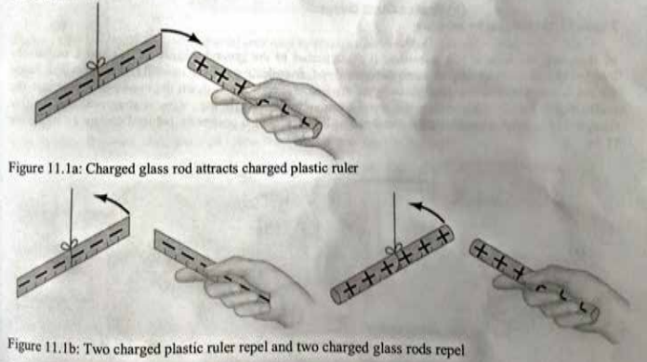
Method of Charging
Charging means gaining or losing electron.
Material losing electron is positively charged while material gaining electron is negatively charged.
The number of electrons gained by a material is equal to the number of electrons lost by the other material.
There are three ways a material can be charged:
charging by friction (rubbing)
charging by contact (conduction) and
charging by induction.

Slide 12
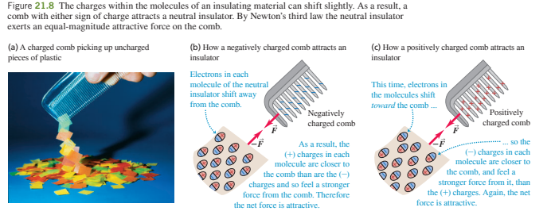
Method of Charging
Charging by Friction (rubbing)
When two neutral objects are rubbed against each other, one object may pull electrons away from the other creating one positive object and one negative object. This is known as charging by friction. This charging takes place in insulators only. Example:
When a glass rod is rubbed with a silk cloth, glass acquires a positive charge and silk cloth acquires a negative charge. Electrons are removed from glass rod and are added to silk cloth.
When an ebonite rod is rubbed with fur cloth, ebonite rod acquires a negative charge and fur cloth acquires a positive charge.

Slide 13
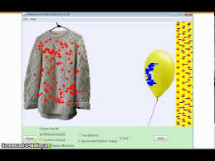
Method of Charging
Charging by Friction
Charging in this case are not evenly distributed all over the surface of the material but concentrated at the area where the rubbing took place, this is because in insulator the electrons are not free to move about easily, they are tightly bound.
rub balloon on your cloth and move it close to a wall; it sticks to the wall. Electrons on the clothe is transferred to the balloon. The clothe is +ve , the balloon is –ve and the wall neutral.

Slide 14
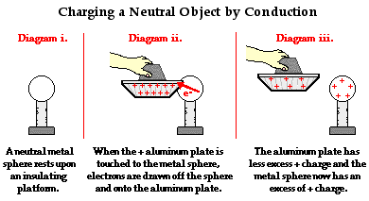
Method of Charging
Charging by Contact (conduction)
Charging by conduction involves the contact of a charged object to a neutral object. Suppose that a positively charged aluminum plate is touched to a neutral metal sphere.
The neutral metal sphere becomes charged as the result of being contacted by the charged aluminum plate.

Slide 15
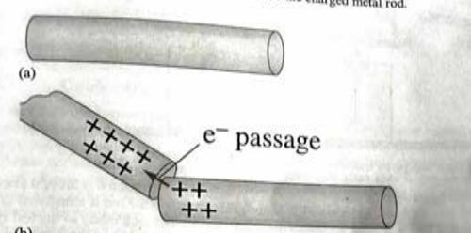
Charging by Contact (conduction)
Charging by conduction involves the contact of a charged object to a neutral object. Suppose that a positively charged aluminum plate is touched to a neutral metal sphere. The neutral metal sphere becomes charged as the result of being contacted by the charged aluminum plate.

Slide 16
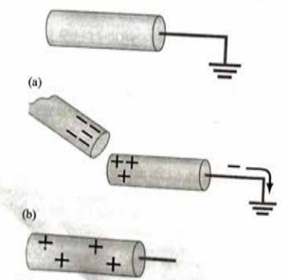
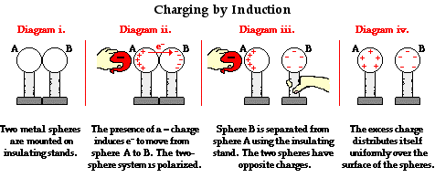
Charging by Induction
Induction charging is a method used to charge an object without actually touching the object to any other charged object.

Slide 17
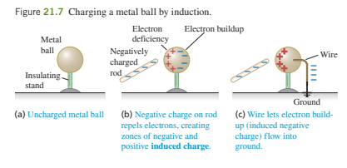
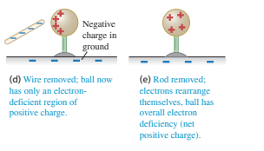
Charging by Induction

Slide 18
Properties of Electric Charges
The charge is a scalar quantity as it has only magnitude and no direction.
As charges are of two types, positive and negative, there are other certain basic properties they follow. If the size of charged bodies is so small, we consider them as point charges.
The basic properties of electric charges are as follows:
Additivity of Charges
Conservation of Charges
Quantization of charge

Slide 19
Conservation of Charges
The charge is a conserved quantity which means charge can neither be created nor be destroyed but can be transferred from one body to another by certain methods like conduction and induction.
As charging involves rubbing two bodies, it is actually a transfer of electrons from one body to another.
The number of electrons gained by one body is equal to the number of electrons lost by the other body. Hence, the total number of charges is the same.
E.g. if 5C is the total charge of the system, then it can be redistributed as 1C, 2C and 2C or in any other possible permutation, but by conservation principle the net charge of system will always be 5C.

Slide 20
Electric Charge and Its Conservation
Electric charge is conserved – the arithmetic sum of the total charge cannot change in any interaction. This is an example of a law that is now well established: the law of conservation of electric charge, which states that:
the net amount of electric charge produced in any process is zero;
or, said another way,
no net electric charge can be created or destroyed.

Slide 21
Quantization of charge
Quantization of charge means that the charge of any object is an integer multiple of the elementary charge (e – charge on one electron). Suppose charge on a body is q, then it can be written as q = ne
where n is an integer and not fraction or irrational number, like ‘n’ can be any positive or negative integer like 1, 2, 3, -5 etc.
Thus, an object's charge can be exactly 0e, 1e, −1e, 2e, etc., but not, say, 1/2 e, or −3.8 e, etc

Slide 22
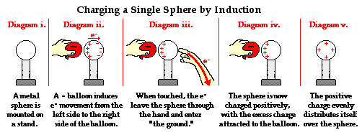
GROUND.
Earthing or Ground
In electricity the “ground” is very important. This is generally a huge body that will be electrically neutral.
The Earth is a great example of “ground.” The human body can also serve as a ground for many cases.
Earthing is the process of sharing charges with the earth or ground. It provides a safety measure for electrical circuits and appliances.
Example: By touching the charged object, you ground it.

Slide 23
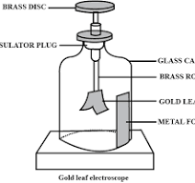
The gold leaf electroscope
This is an instrument for detecting the presence, determining the polarity and magnitude of charges.
A metal disc is connected to a narrow metal plate and a thin piece of gold leaf is fixed to the plate.
The whole of this part of the electroscope is insulated from the body of the instrument.
A glass front prevents air draughts but allows you to watch the behavior of the leaf.

Slide 24
The gold leaf electroscope
a) by contact - a charged rod is touched on the surface of the disc and some of the charge is transferred to the electroscope. This is not a very effective method of charging the electroscope.
(b) by induction - a charged rod is brought up to the disc and then the electroscope is earthed, the rod is then removed. The two methods give the gold leaf opposite charges.
When a charge is put on the disc at the top it spreads down to the plate and leaf. This means that both the leaf and plate will have the same charge. Similar charges repel each other and so the leaf rises away from the plate - the bigger the charge the more the leaf rises. The leaf can be made to fall again by touching the disc - you have earthed the electroscope. An earth terminal prevents the case from becoming live. The electroscope can be charged in two ways

Slide 25
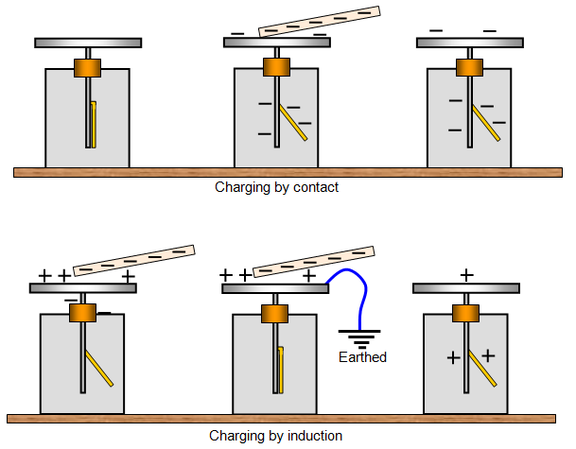
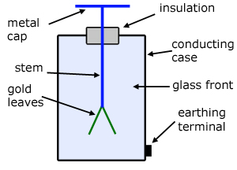
The gold leaf electroscope
The following diagrams show you how the charges spread over the plate and gold leaf in different conditions.

Slide 26
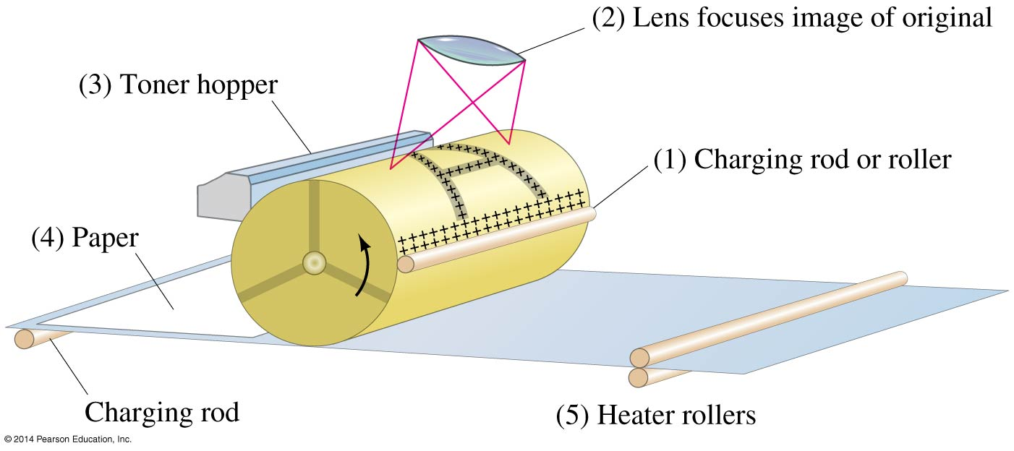
Photocopy Machines and Computer Printers Use Electrostatics

Slide 27
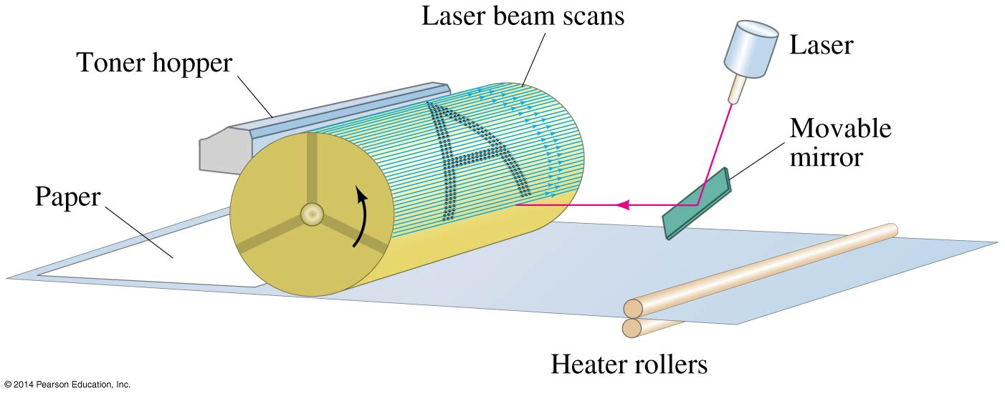
Photocopy Machines and Computer Printers Use Electrostatics
Laser printer is similar, except a computer controls the laser intensity to form the image on the drum

Slide 28
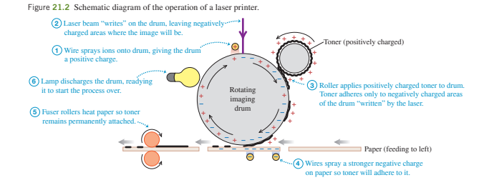
ELECTRIC CHARGE

Slide 29
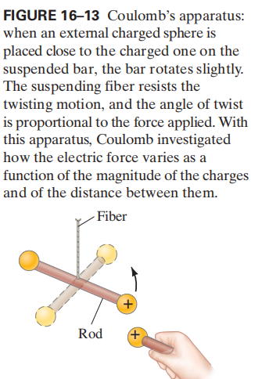
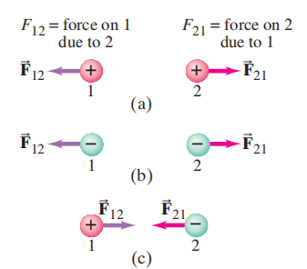
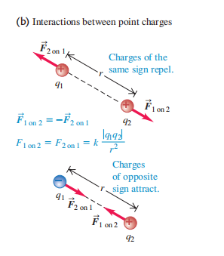
Electric force/coulomb’s law

Slide 30
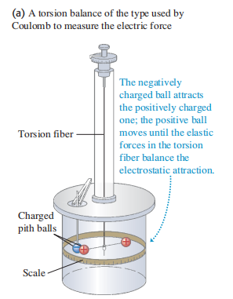
Electric Force
Charles Coulomb (1736-1806) studied the magnitude of this force using a torsion balance.
The torsion balance consists essentially of two small masses at different elevations that are supported at opposite ends of a beam. The latter is suspended from a wire that undergoes torsion because the masses are affected differently by the force of gravity.
Coulomb’s law describes the force between two charges when they are at rest.
Additional forces come into play when charges are in motion. Coulomb’s law gives the electrostatic force

Slide 31
Electric Force
The experiment showed that the electrostatic force is directly proportional to the product of the charges on the metal spheres and inversely proportional to the square of the distance between them. This was the basis of coulomb’s law.
Charles Coulomb observed that when two electric charges are placed close to each other, they experience a force.
He used a torsion balance to measure the repulsive and attractive forces between charged particles.

Slide 32
Coulomb’s law.
Coulomb’s law states that, the force of attraction or repulsion between the two electrically charged particles is directly proportional to the product of their charges and inversely proportional to the square of the distance between two charges, and acts along the line joining the two charges.
Coulomb’s law looks a lot like the law of universal gravitation, which expresses the magnitude of the gravitational force a mass exerts on a mass. Both are inverse square laws
This force of attraction or repulsion between two charges is also depends on the medium in which charges are placed.
If we increase the distance between two-point charges, the force of attraction or repulsion present between them will decrease.
In the similar way, if we decrease the distance between two-point charges, the force of attraction or repulsion present between them will increase.

Slide 33
Coulomb’s law.
For the two-point charges, it depend directly on the product of the magnitude of the charges and inversely on the square of the distance between them:
Force on q₁due to q₂
Force on q₂ due to q₁
q₁
q₂
r
The two Forces F₁₂ and F₂₁ are equal but opposite in direction

Slide 34



Coulomb’s law.
Where ε = ε₀ε_{r}
ε₀ = permittivity of vacuum = 8.854 x 10⁻¹² F/m
ε_{r} = relative permittivity of medium with respect to free space.
For vacuum, the relative permittivity ε_{r} = 1,
Hence ε = ε₀
Therefore, the force of attraction or repulsion between two electric charges that are placed in vacuum and medium is given by

Slide 35
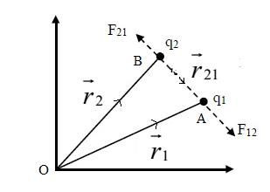
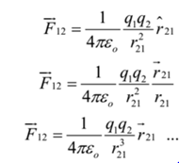


Vector form of Coulomb’s law
Force on q₁due to q₂

Slide 36
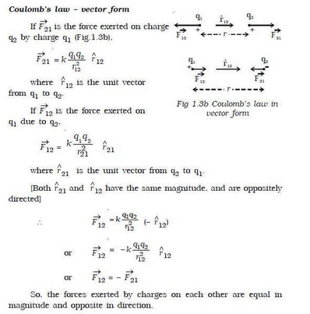

Slide 37
Limitations of Coulomb’s law
Coulomb’s Law is applied to point charges. If charged bodies are of limited dimension such that they can’t be regarded as a point charge, then Coulomb’s Law is not valid. So, Coulomb’s law is not valid for distance less than 10⁻¹⁵
Coulomb’s law obeys inverse square law. It’s only appropriate in those cases where inverse square law is obeyed.
It is only applicable for point charges at rest. If a charge is in motion Coulomb’s law of electrostatics is not valid
It is difficult to apply Coulomb’s law when the charges are in an arbitrary shape. Hence, we cannot determine the value of distance ‘d’ between the charges when they are in an arbitrary shape. Here, the distance, r cannot be resolved correctly as the centers of arbitrarily shaped charged bodies cannot be recognized exactly.

Slide 38

Conclusion from Coulomb’s law
Coulomb’s law agrees with Newton’s third law.
The two Forces F₁₂ and F₂₁ are equal but opposite in direction. “To every action there is equal and opposite reaction”
Like charges repel and unlike charges attract.
Forces on q₂ due to q₁ will act away from each other if the charges are the same and will move towards each other if the charges are not the same.

Slide 39


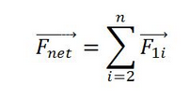
Principle of superposition of charges
It states that the total force on a given charge due to a few other charges is the vector sum of the individual forces acting on that charge by the other charges.
Suppose there are q₁,q₂,q₃,q₄ and q₅.
The force on q₁ due to the other charges is given as
If then,

Slide 40
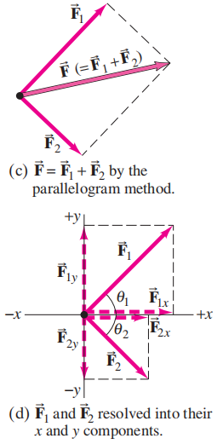
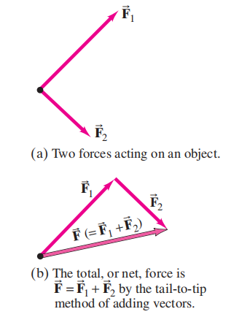
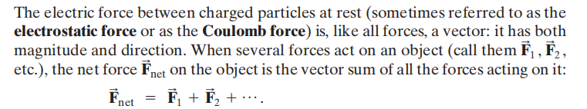
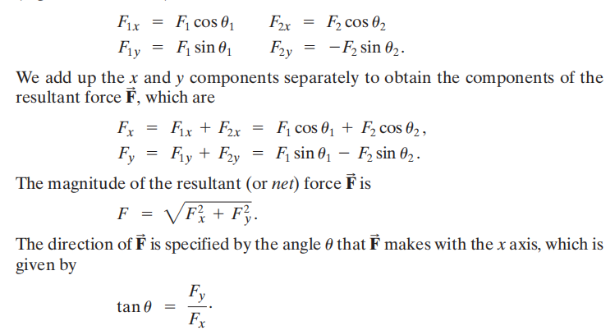
Solving Problems Involving
Coulomb’s Law and Vectors

Slide 41
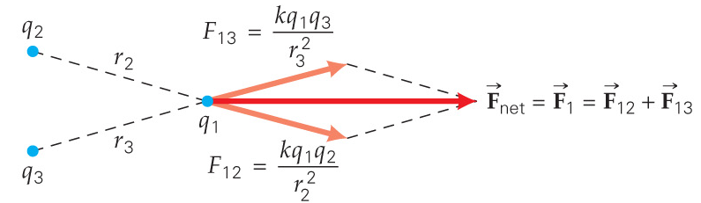
Principle of superposition of charges
If there are multiple point charges, the force vectors must be added to get the net force.

Slide 42
EXAMPLE 1
q₁ = -1nC
F₁₂
F₂₁
q₂ = +2nC
0.3m
(a) Two-point charges of -1.0nC and +2.0nC are separated by a distance of 0.3m, what is the electric force on each particle?
y
q₁ = +2.5nC
(0, +0.3m)
r₃₁
(b) What is the net electric force on q₃ ?
θ
q₃ = +3.0nC
θ
x
(0.4m, 0m)
r₃₂
(0, -0.3m)
q₂ = +2.5nC

Slide 43
Solution:
(a)
y
(b)
q₁ = +2.5nC
F₃₂
θ
F_{net} = F₃
x
θ
F₃₁
q₂ = +2.5nC

Slide 44
Solution:
(b)
r₃₁ = r₃₂ = 0.5m
Taking into account the direction of F₃₁ and F₃₂ is symmetry – then y – components cancel. Thus, F₃ (the net force on q₃) acts along the positive x-axis and has magnitude of

Slide 45
EXAMPLE 2
What is the magnitude of the repulsive electrostatic force between two protons in a nucleus? Taking the distance from center to center of these protons to be 3 x 10⁻¹⁵m.
If the protons were released from rest, how would the magnitude of their initial acceleration compare with that of the acceleration due to gravity on Earth’s surface, g ?

Slide 46
Solution:
Given: r = 3 x 10⁻¹⁵m; q₁=q₂ = +1.6 x 10⁻¹⁹C ; m_{p} = 1.67 x 10⁻²⁷kg
(a) Using Coulomb’s Law;
(b)

Slide 47
Example 3
A positive charge q exerts a force of magnitude - 0.20 N on another charge - 2q. Find the magnitude of each charge if the distance separating them is equal to 50 cm.
The force that q exert on 2q is given by Coulomb's law:
F = k (q) ( - 2q) / r² , r = 0.5 m , F = - 0.20 N ,
- 0.2 = - 2 q² k / 0.5²
q² = 0.2 × 0.5² / (2 k)
q = √ [ (0.2 × 0.5² / (2 × 9 × 10⁹) ] = 1.66 × 10⁻⁶ C
q = 1.66 × 10⁻⁶ C , -2 q = -3.32 × 10⁻⁶ C

Slide 48
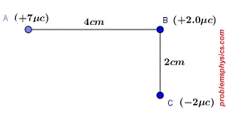
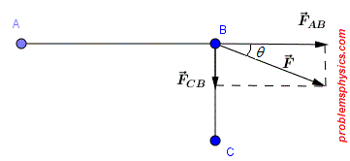
Example 4
What is the net force and its direction that the charges at the vertices A and C of the right triangle ABC exert on the charge in vertex B?

Slide 49
Solution 4
Let F_{BA} be the force of repulsion exerted by the charge at A on the charge at B and F_{BC} be the force exerted by the charge at point C on the charge at point B. The diagram below shows the direction of these two forces. We first use Coulomb's law (F = k q1 q2 / r²) to find the magnitude of these two forces
|F_{BA}| = k (7 × 10⁻⁶)((2× 10⁻⁶) / (4 × 10⁻²)² = 14 × 10⁻¹² k / (16 × 10⁻⁴) = 0.875 k × 10⁻⁸
|F_{BC}| = k (2× 10⁻⁶)(2× 10⁻⁶) / (2 × 10⁻²)² = k × 10⁻⁸
We now use Pythagora's theorem to find the magnitude of the resultant force F = F_{BA} + F_{BC} (a vector sum)
|F| = √(|F_{BA}|² + |F_{BC}|²) = k × 10⁻⁸ √( 0.875² + 1² ) = 9.00 × 10⁹ × 10⁻⁸ √( 0.875² + 1² ) = 1.20 × 10² N
θ = arctan(|F_{BC}|/ |F_{BA}| ) = arctan( k × 10⁻⁸ / 0.875 k × 10⁻⁸) = 48.8°
solution of charges at vertices of right triangle

Slide 50
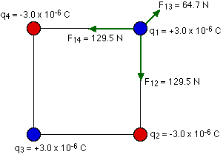
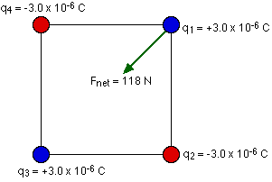
Example 5
Four charges are arranged in a square with sides of length 2.5 cm. The two charges in the top right and bottom left corners are +3.0 x 10⁻⁶ C. The charges in the other two corners are -3.0 x 10⁻⁶ C. What is the net force exerted on the charge in the top right corner by the other three charges?

Slide 51
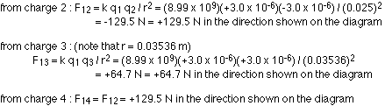
Solution 5
To solve any problem like this, the simplest thing to do is to draw a good diagram showing the forces acting on the charge. You should also let your diagram handle your signs for you. Consider the forces exerted on the charge in the top right by the other three:

Slide 52

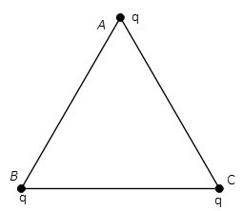
Example 7
Three equal point charges are placed at the vertices of an equilateral triangle of side a. What is the magnitude and direction of the Coulomb force on the charge q at the point AA? (q=10μC and

Slide 53
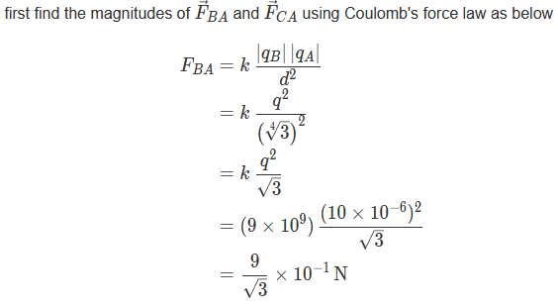
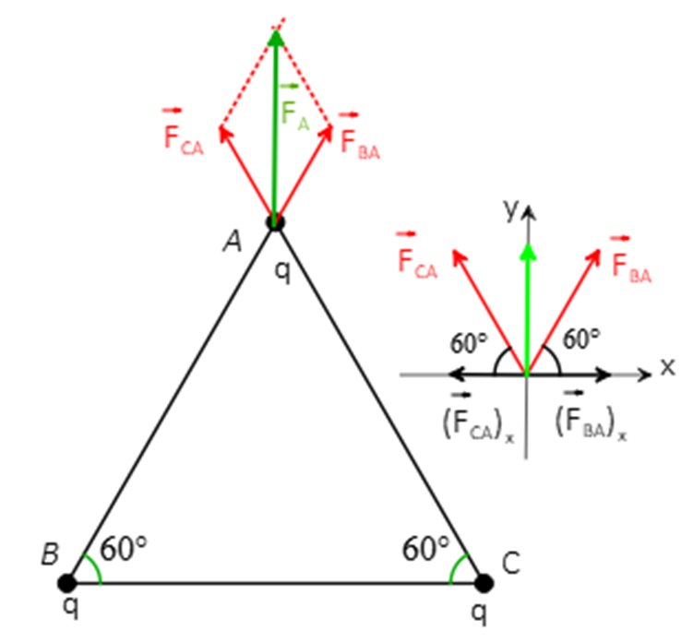
Solution 7
Since the distance to q_{A}​ and the magnitudes of q_{B} and q_{C}​ are the same so F_{BA}=F_{CA}=F

Slide 54
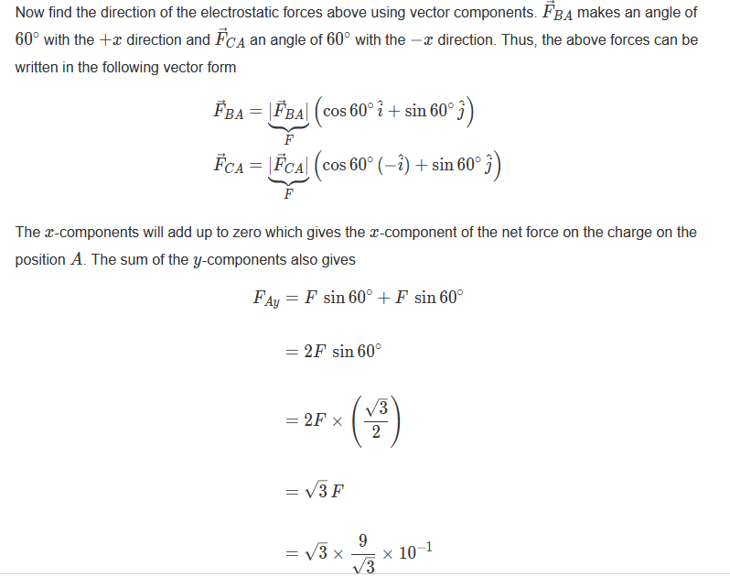
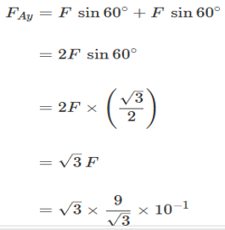


Slide 55
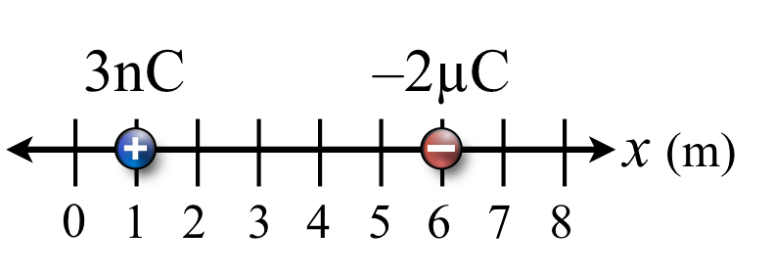
Exercises
1. Consider a positive 3 nC charge and a negative –2 µC charge sitting on the x axis as shown in the figure. Let's find the force on both charges, by allowing each one to be the target in turn.
2. Two charges 1 C and – 3 C are kept at a distance of 3 m. Find the force of attraction between them.
3. Determine the electrical force of attraction between two balloons with separate charges of +3.5 x 10⁻⁸ C and -2.9 x 10⁻⁸ C when separated a distance of 0.65 m.
4. Calculate the electrostatic force and gravitational force between the proton and the electron in a hydrogen atom. They are separated by a distance of 5.3 × 10⁻¹¹ m. The magnitude of charges on the electron and proton are 1.6 × 10⁻¹⁹ C. Mass of the electron is m_{e} = 9.1 × 10⁻³¹ kg and mass of proton is m_{p} = 1.6 × 10⁻²⁷ kg.

Slide 56

Exercise 9
+Q1 = 10 μC, +Q2 = 50 μC and Q3 are separated as shown in the figure below. What is the electrostatic charge on particle 3 if the net electrostatic force on particle 2 is zero.

