Slide 1
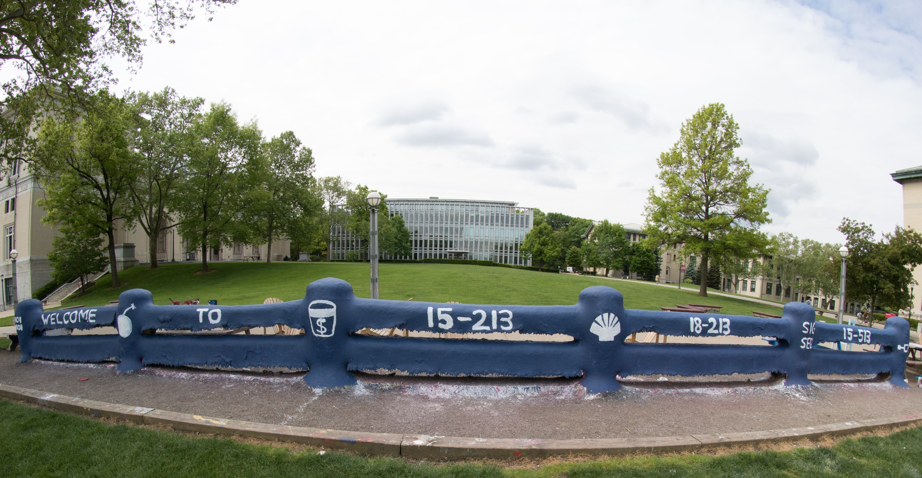
14-513
18-613

Slide 2
Bits, Bytes and Integers – Part 1 15-213/18-213/14-513/15-513/18-613: Introduction to Computer Systems 2nd Lecture, Feb. 4, 2021

Slide 3
Announcements
Linux Boot Camp: Feb. 4 (today), 7-9pm US/Eastern
Details on Piazza
Office Hours: slots are available Sunday through Friday
Details on the course page
Bring your own Zoom meeting ID or link
Written Assignments
First one will be handed out Wed Feb 10, 11:59 pm ET
Lab 0 is available on Autolab.
Due Thu Feb 11, 11:59:59pm ET
No grace days
No late submissions
Just do it!

Slide 4
Logistics
Waitlist
15-213, 15-513: Mary Widom (marwidom@cs.cmu.edu)
18-213, 18-613: ECE Academic services (ece-asc@andrew.cmu.edu)
14-513: INI Enrollment (ini-enrollment@andrew.cmu.edu)
Please don’t contact the instructors with waitlist questions.
Autolab Accounts
Check whether you have one and are registered for this course
We add students in batches once a day; ping us if it’s been more than 24 hours
The clock is ticking on Lab 0!

Slide 5
Today: Bits, Bytes, and Integers
Representing information as bits
Bit-level manipulations
Integers
Representation: unsigned and signed
Conversion, casting
Expanding, truncating
Addition, negation, multiplication, shifting
Summary
Representations in memory, pointers, strings

Slide 6
Before digital there was analog…
Notes:
Analog computations can be very fast and efficient, but noise is a problem

Slide 7
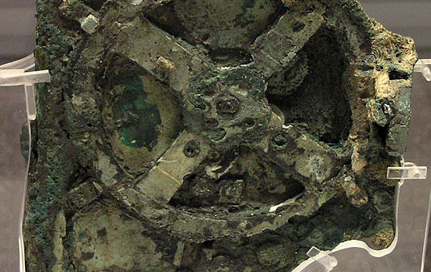
(c. 100 BCE) Antikythera Mechanism
Notes:
The action of turning a hand crank would cause all interlocked gears within the mechanism to rotate, resulting in the simultaneous calculation of the position of the Sun and Moon, the moon phase, eclipse, and calendar cycles, and perhaps the locations of planets. Designed and constructed by Greek scientists and has been variously dated to about 87 BC, or between 150 and 100 BC, or to 205 BC.

Slide 8
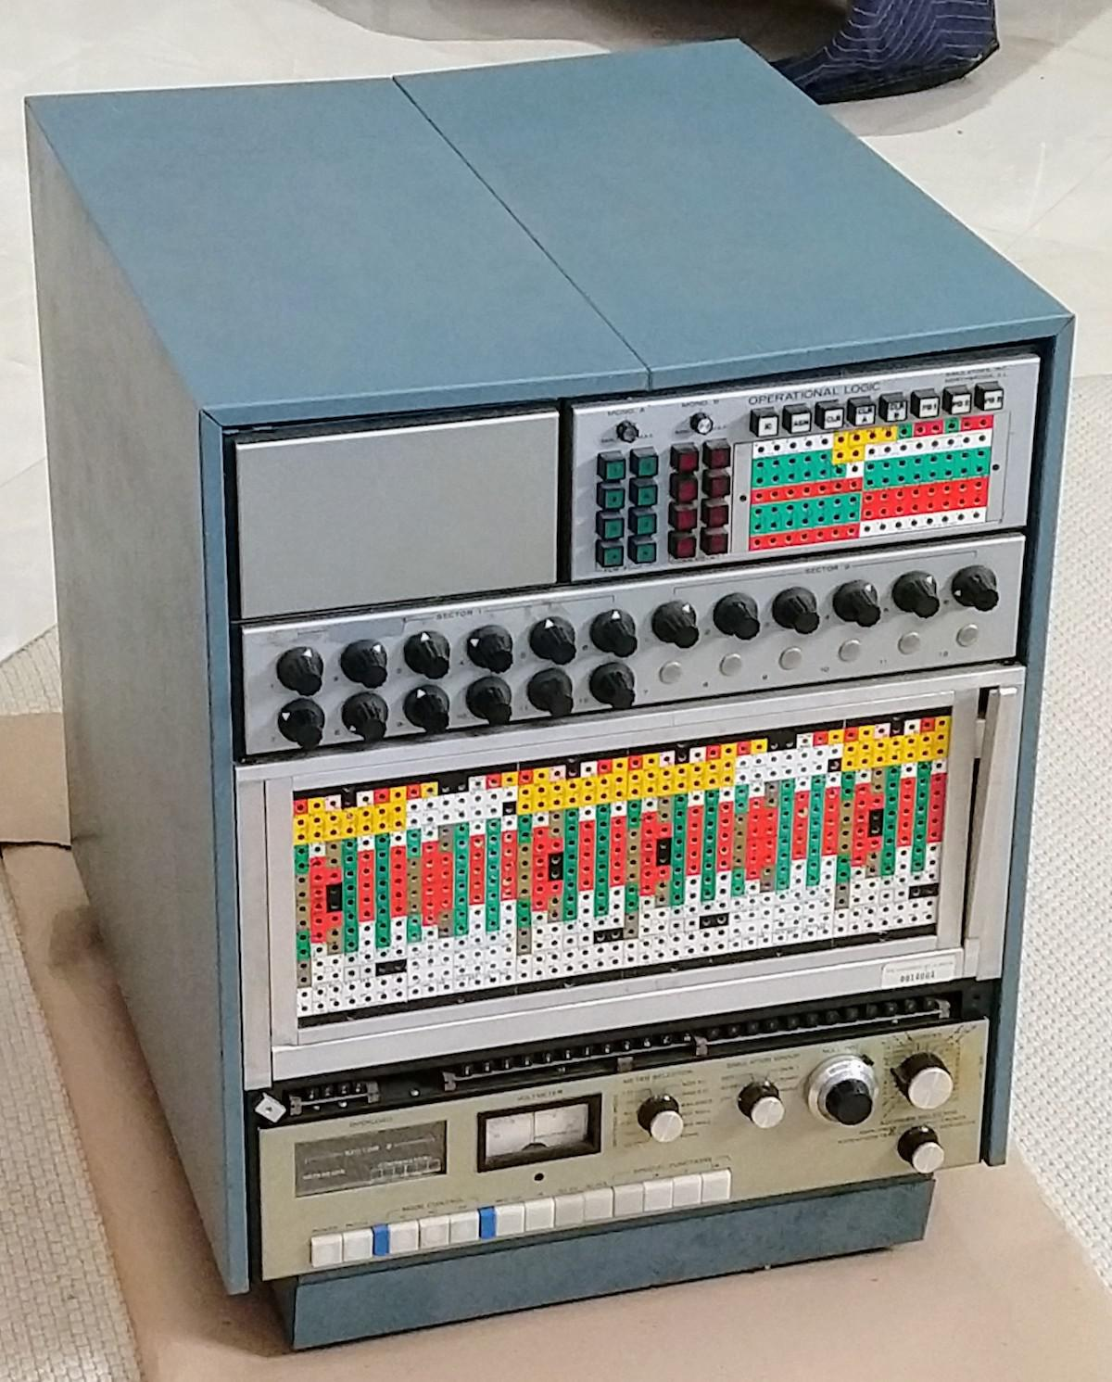
(1969) Simulators Inc. model 240
Notes:
This electronic analog computer solved differential equations, defined by wires plugged into the colorful plugboard in the middle. It used dozens of precision resistors and capacitors and was painfully expensive.

Slide 9
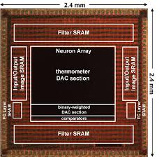
(2018) Digital+Analog AI processor
Bankman et al, “An always-on 3.8μJ/86% CIFAR-10 mixed-signal binary CNN processor with all memory on chip in 28nm CMOS”
Notes:
For an image classification task. Paper reported 4x energy improvement over a synthesized digital implementation.

Slide 10
Everything is bits
Each bit is 0 or 1
By encoding/interpreting sets of bits in various ways
Computers determine what to do (instructions)
… and represent and manipulate numbers, sets, strings, etc…
Why bits? Electronic Implementation
Easy to store with bistable elements
Reliably transmitted on noisy and inaccurate wires
0
1
0
1.1V
0.9V
0.2V
0.0V

Slide 11
For example, can count in binary
Base 2 Number Representation
Represent 15213₁₀ as 11101101101101₂
Represent 1.20₁₀ as 1.0011001100110011[0011]…₂
Represent 1.5213 X 10⁴ as 1.1101101101101₂ X 2¹³

Slide 12
Encoding Byte Values
Decimal
Hex
Binary
Byte = 8 bits
Binary 000000002 to 111111112
Decimal: 010 to 25510
Hexadecimal 0016 to FF16
Base 16 number representation
Use characters ‘0’ to ‘9’ and ‘A’ to ‘F’
Write FA1D37B16 in C as
0xFA1D37B
0xfa1d37b
0
0
0000
1
1
0001
2
2
0010
3
3
0011
4
4
0100
5
5
0101
6
6
0110
7
7
0111
8
8
1000
9
9
1001
A
10
1010
B
11
1011
C
12
1100
D
13
1101
E
14
1110
F
15
1111
15213: 0011 1011 0110 1101
3
B
6
D

Slide 13
Example Data Representations
C Data Type | Typical 32-bit | Typical 64-bit | x86-64
char | 1 | 1 | 1
short | 2 | 2 | 2
int | 4 | 4 | 4
long | 4 | 8 | 8
float | 4 | 4 | 4
double | 8 | 8 | 8
pointer | 4 | 8 | 8

Slide 14
Example Data Representations
C Data Type | Typical 32-bit | Typical 64-bit | x86-64
char | 1 | 1 | 1
short | 2 | 2 | 2
int | 4 | 4 | 4
long | 4 | 8 | 8
float | 4 | 4 | 4
double | 8 | 8 | 8
pointer | 4 | 8 | 8

Slide 15
Today: Bits, Bytes, and Integers
Representing information as bits
Bit-level manipulations
Integers
Representation: unsigned and signed
Conversion, casting
Expanding, truncating
Addition, negation, multiplication, shifting
Summary
Representations in memory, pointers, strings

Slide 16
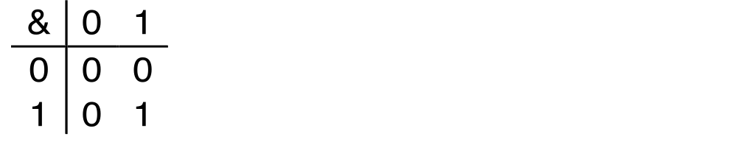
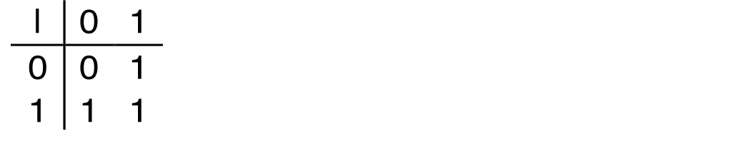
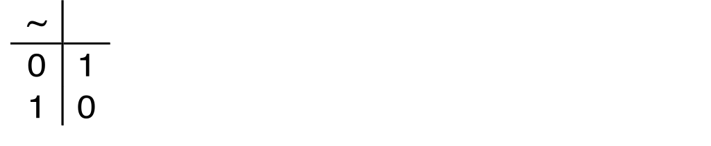
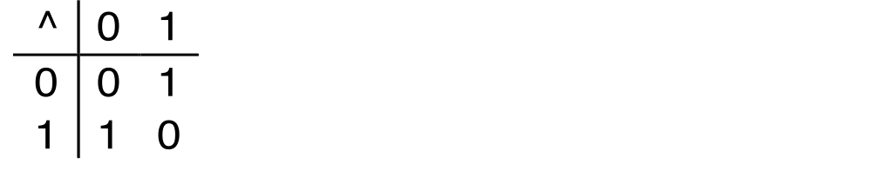
Boolean Algebra
Developed by George Boole in 19th Century
Algebraic representation of logic
Encode “True” as 1 and “False” as 0
And
A&B = 1 when both A=1 and B=1
Or
A|B = 1 when either A=1 or B=1
Not
~A = 1 when A=0
Exclusive-Or (Xor)
A^B = 1 when either A=1 or B=1, but not both

Slide 17
General Boolean Algebras
Operate on Bit Vectors
Operations applied bitwise
All of the Properties of Boolean Algebra Apply
01101001
& 01010101
01000001
01101001
| 01010101
01111101
01101001
^ 01010101
00111100
~ 01010101
10101010
01000001
01111101
00111100
10101010

Slide 18
Example: Representing & Manipulating Sets
Representation
Width w bit vector represents subsets of {0, …, w–1}
a_{j} = 1 if j ∈ A
01101001 { 0, 3, 5, 6 }
76543210
01010101 { 0, 2, 4, 6 }
76543210
Operations
& Intersection 01000001 { 0, 6 }
| Union 01111101 { 0, 2, 3, 4, 5, 6 }
^ Symmetric difference 00111100 { 2, 3, 4, 5 }
~ Complement 10101010 { 1, 3, 5, 7 }

Slide 19
Bit-Level Operations in C
Decimal
Hex
Binary
Operations &, |, ~, ^ Available in C
Apply to any “integral” data type
long, int, short, char, unsigned
View arguments as bit vectors
Arguments applied bit-wise
Examples (Char data type)
~0x41 → 0xBE
~010000012 → 101111102
~0x00 → 0xFF
~000000002 → 111111112
0x69 & 0x55 → 0x41
011010012 & 010101012 → 010000012
0x69 | 0x55 → 0x7D
011010012 | 010101012 → 011111012
0
0
0000
1
1
0001
2
2
0010
3
3
0011
4
4
0100
5
5
0101
6
6
0110
7
7
0111
8
8
1000
9
9
1001
A
10
1010
B
11
1011
C
12
1100
D
13
1101
E
14
1110
F
15
1111

Slide 20
Bit-Level Operations in C
Decimal
Hex
Binary
Operations &, |, ~, ^ Available in C
Apply to any “integral” data type
long, int, short, char, unsigned
View arguments as bit vectors
Arguments applied bit-wise
Examples (Char data type)
~0x41 → 0xBE
~010000012 → 101111102
~0x00 → 0xFF
~000000002 → 111111112
0x69 & 0x55 → 0x41
011010012 & 010101012 → 010000012
0x69 | 0x55 → 0x7D
011010012 | 010101012 → 011111012
Operations &, |, ~, ^ Available in C
Apply to any “integral” data type
long, int, short, char, unsigned
View arguments as bit vectors
Arguments applied bit-wise
Examples (Char data type)
~0x41 → 0xBE
~0100 00012 → 1011 11102
~0x00 → 0xFF
~0000 00002 → 1111 11112
0x69 & 0x55 → 0x41
0110 10012 & 0101 01012 → 0100 00012
0x69 | 0x55 → 0x7D
0110 10012 | 0101 01012 → 0111 11012
0
0
0000
1
1
0001
2
2
0010
3
3
0011
4
4
0100
5
5
0101
6
6
0110
7
7
0111
8
8
1000
9
9
1001
A
10
1010
B
11
1011
C
12
1100
D
13
1101
E
14
1110
F
15
1111

Slide 21
Contrast: Logic Operations in C
Contrast to Bit-Level Operators
Logic Operations: &&, ||, !
View 0 as “False”
Anything nonzero as “True”
Always return 0 or 1
Early termination
Examples (char data type)
!0x41 → 0x00
!0x00 → 0x01
!!0x41→ 0x01
0x69 && 0x55 → 0x01
0x69 || 0x55 → 0x01
p && *p (avoids null pointer access)
Watch out for && vs. & (and || vs. |)…
Super common C programming pitfall!

Slide 22
Shift Operations
Left Shift: x << y
Shift bit-vector x left y positions
Throw away extra bits on left
Fill with 0’s on right
Right Shift: x >> y
Shift bit-vector x right y positions
Throw away extra bits on right
Logical shift
Fill with 0’s on left
Arithmetic shift
Replicate most significant bit on left
Undefined Behavior
Shift amount < 0 or ≥ word size
Argument x
01100010
<< 3
00010000
00010000
00010000
Log. >> 2
00011000
00011000
00011000
Arith. >> 2
00011000
00011000
00011000
Argument x
10100010
<< 3
00010000
00010000
00010000
Log. >> 2
00101000
00101000
00101000
Arith. >> 2
11101000
11101000
11101000

Slide 23
Today: Bits, Bytes, and Integers
Representing information as bits
Bit-level manipulations
Integers
Representation: unsigned and signed
Conversion, casting
Expanding, truncating
Addition, negation, multiplication, shifting
Summary
Representations in memory, pointers, strings
Summary

Slide 24
Encoding Integers
Unsigned
Two’s Complement
short int x = 15213;
short int y = -15213;
Sign Bit
C does not mandate using two’s complement
But, most machines do, and we will assume so
C short 2 bytes long
Sign Bit
For 2’s complement, most significant bit indicates sign
0 for nonnegative
1 for negative

Slide 25
Two-complement: Simple Example
-16 | 8 | 4 | 2 | 1
0 | 1 | 0 | 1 | 0
10 =
8+2 = 10
-16 | 8 | 4 | 2 | 1
1 | 0 | 1 | 1 | 0
-10 =
-16+4+2 = -10

Slide 26
Two-complement Encoding Example (Cont.)
x = 15213: 00111011 01101101
y = -15213: 11000100 10010011

Slide 27
Numeric Ranges
Unsigned Values
UMin = 0
000…0
UMax = 2^{w} – 1
111…1
Two’s Complement Values
TMin = –2^{w–1}
100…0
TMax = 2^{w–1} – 1
011…1
Minus 1
111…1
Values for W = 16

Slide 28
Values for Different Word Sizes
Observations
|TMin | = TMax + 1
Asymmetric range
UMax = 2 * TMax + 1
Question: abs(TMin)?
C Programming
#include <limits.h>
Declares constants, e.g.,
ULONG_MAX
LONG_MAX
LONG_MIN
Values platform specific

Slide 29
Unsigned & Signed Numeric Values
Equivalence
Same encodings for nonnegative values
Uniqueness
Every bit pattern represents unique integer value
Each representable integer has unique bit encoding
⇒ Can Invert Mappings
U2B(x) = B2U⁻¹(x)
Bit pattern for unsigned integer
T2B(x) = B2T⁻¹(x)
Bit pattern for two’s comp integer
X
B2U(X)
B2T(X)
0000
0
0
0001
1
1
0010
2
2
0011
3
3
0100
4
4
0101
5
5
0110
6
6
0111
7
7
1000
8
–8
1001
9
–7
1010
10
–6
1011
11
–5
1100
12
–4
1101
13
–3
1110
14
–2
1111
15
–1

Slide 30
Quiz Time!
Check out:
https://canvas.cmu.edu/courses/20895

Slide 31
Today: Bits, Bytes, and Integers
Representing information as bits
Bit-level manipulations
Integers
Representation: unsigned and signed
Conversion, casting
Expanding, truncating
Addition, negation, multiplication, shifting
Summary
Representations in memory, pointers, strings

Slide 32
Mapping Between Signed & Unsigned
Two’s Complement
Unsigned
T2U
x
T2B
B2U
ux
X
Maintain Same Bit Pattern
Unsigned
U2T
Two’s Complement
ux
U2B
B2T
x
X
Maintain Same Bit Pattern
Mappings between unsigned and two’s complement numbers: Keep bit representations and reinterpret

Slide 33
Mapping Signed ↔ Unsigned
Bits
0000
0001
0010
0011
0100
0101
0110
0111
1000
1001
1010
1011
1100
1101
1110
1111
Signed
0
1
2
3
4
5
6
7
-8
-7
-6
-5
-4
-3
-2
-1
Unsigned
0
1
2
3
4
5
6
7
8
9
10
11
12
13
14
15
T2U
U2T

Slide 34
Mapping Signed ↔ Unsigned
Bits
0000
0001
0010
0011
0100
0101
0110
0111
1000
1001
1010
1011
1100
1101
1110
1111
Signed
0
1
2
3
4
5
6
7
-8
-7
-6
-5
-4
-3
-2
-1
Unsigned
0
1
2
3
4
5
6
7
8
9
10
11
12
13
14
15
=
+/- 16

Slide 35
Relation between Signed & Unsigned
Two’s Complement
Unsigned
T2U
x
T2B
B2U
ux
X
Maintain Same Bit Pattern
w–1
0
ux
+
+
+
• • •
+
+
+
x
-
+
+
• • •
+
+
+
Large negative weight
becomes
Large positive weight

Slide 36
Conversion Visualized
2’s Comp. → Unsigned
Ordering Inversion
Negative → Big Positive
UMax
UMax – 1
TMax + 1
Unsigned
Range
TMax
TMax
2’s Complement Range
0
0
–1
–2
TMin

Slide 37
Signed vs. Unsigned in C
Constants
By default are considered to be signed
Unsigned if have “U” as suffix, or if too big to be signed
0U, 2147483648
Watch out! A leading minus sign is not part of the constant! -2147483648 == 2147483648 on 32-bit machines (why?)
Casting
Explicit casting between signed & unsigned same as U2T and T2U
int tx, ty;
unsigned ux, uy;
tx = (int) ux;
uy = (unsigned) ty;
Implicit casting also occurs via assignments and procedure calls
tx = ux; int fun(unsigned u);
uy = ty; uy = fun(tx);

Slide 38
Casting Surprises
Expression Evaluation
If there is a mix of unsigned and signed in single expression, signed values implicitly cast to unsigned
Including comparison operations <, >, ==, <=, >=
Examples for W = 32: TMIN = -2,147,483,648 , TMAX = 2,147,483,647
Constant₁ Constant₂ Relation Evaluation
0 0U
-1 0
-1 0U
2147483647 -2147483647-1
2147483647U -2147483647-1
-1 -2
(unsigned)-1 -2
2147483647 2147483648U
2147483647 (int) 2147483648U
0 0U == unsigned
-1 0 < signed
-1 0U > unsigned
2147483647 -2147483648 > signed
2147483647U -2147483648 < unsigned
-1 -2 > signed
(unsigned) -1 -2 > unsigned
2147483647 2147483648U < unsigned
2147483647 (int) 2147483648U > signed

Slide 39
Unsigned vs. Signed: Easy to Make Mistakes
unsigned i;
for (i = cnt-2; i >= 0; i--)
a[i] += a[i+1];
Can be very subtle
#define DELTA sizeof(int)
int i;
for (i = CNT; i-DELTA >= 0; i-= DELTA)
. . .

Slide 40
Summary Casting Signed ↔ Unsigned: Basic Rules
Bit pattern is maintained
But reinterpreted
Can have unexpected effects: adding or subtracting 2^{w}
Expression containing signed and unsigned int
int is cast to unsigned!!

Slide 41
Today: Bits, Bytes, and Integers
Representing information as bits
Bit-level manipulations
Integers
Representation: unsigned and signed
Conversion, casting
Expanding, truncating
Addition, negation, multiplication, shifting
Summary
Representations in memory, pointers, strings

Slide 42
Sign Extension
Task:
Given w-bit signed integer x
Convert it to w+k-bit integer with same value
Rule:
Make k copies of sign bit:
X ′ = x_{w–1} ,…, x_{w–1} , x_{w–1} , x_{w–2} ,…, x₀
k copies of MSB
w
X
• • •
• • •
X ′
• • •
• • •
k
w

Slide 43
Sign Extension: Simple Example
Positive number
Negative number
-16 | 8 | 4 | 2 | 1
0 | 1 | 0 | 1 | 0
-16 | 8 | 4 | 2 | 1
1 | 0 | 1 | 1 | 0
10 =
-10 =
-32 | 16 | 8 | 4 | 2 | 1
0 | 0 | 1 | 0 | 1 | 0
-32 | 16 | 8 | 4 | 2 | 1
1 | 1 | 0 | 1 | 1 | 0
10 =
-10 =

Slide 44
Larger Sign Extension Example
short int x = 15213;
int ix = (int) x;
short int y = -15213;
int iy = (int) y;
Decimal
Hex
Binary
x
15213
3B 6D
00111011 01101101
ix
15213
00 00 3B 6D
00000000 00000000 00111011 01101101
y
-15213
C4 93
11000100 10010011
iy
-15213
FF FF C4 93
11111111 11111111 11000100 10010011
Converting from smaller to larger integer data type
C automatically performs sign extension

Slide 45
Truncation
Task:
Given k+w-bit signed or unsigned integer X
Convert it to w-bit integer X’ with same value for “small enough” X
Rule:
Drop top k bits:
X ′ = x_{w–1} , x_{w–2} ,…, x₀
k
w
X
• • •
• • •
• • •
X ′
• • •
w

Slide 46
Truncation: Simple Example
No sign change
Sign change
-16 | 8 | 4 | 2 | 1
0 | 0 | 0 | 1 | 0
-16 | 8 | 4 | 2 | 1
0 | 1 | 0 | 1 | 0
2 =
10 =
 | -8 | 4 | 2 | 1
 | 0 | 0 | 1 | 0
 | -8 | 4 | 2 | 1
 | 1 | 0 | 1 | 0
2 =
-6 =
2 mod 16 = 2
10 mod 16 = 10U mod 16 = 10U = -6
-16 | 8 | 4 | 2 | 1
1 | 1 | 0 | 1 | 0
-16 | 8 | 4 | 2 | 1
1 | 0 | 1 | 1 | 0
-6 =
-10 =
 | -8 | 4 | 2 | 1
 | 1 | 0 | 1 | 0
 | -8 | 4 | 2 | 1
 | 0 | 1 | 1 | 0
-6 =
6 =
-6 mod 16 = 26U mod 16 = 10U = -6
-10 mod 16 = 22U mod 16 = 6U = 6

Slide 47
Summary: Expanding, Truncating: Basic Rules
Expanding (e.g., short int to int)
Unsigned: zeros added
Signed: sign extension
Both yield expected result
Truncating (e.g., unsigned to unsigned short)
Unsigned/signed: bits are truncated
Result reinterpreted
Unsigned: mod operation
Signed: similar to mod
For small (in magnitude) numbers yields expected behavior

Slide 48
Summary of Today: Bits, Bytes, and Integers
Representing information as bits
Bit-level manipulations
Integers
Representation: unsigned and signed
Conversion, casting
Expanding, truncating
Addition, negation, multiplication, shifting
Representations in memory, pointers, strings
Summary

