Slide 1

14-513
18-613

Slide 2
Floating Point 15-213/18-213/14-513/15-513/18-613: Introduction to Computer Systems 4th Lecture, Sept. 10, 2020

Slide 3
Announcements
Lab 0 due today 11:59 pm ET
Lab 1 went out on Tuesday, due 2/18
Puzzles can be tricky, so start early
Written Assignment 1 released yesterday, due 2/17
Available on canvas. Hand-in via canvas
Small Group Meetings Have Begun
Attendance is mandatory
If you don’t know your group assignment, ask a private question on Piazza

Slide 4
Today: Floating Point
Background: Fractional binary numbers
IEEE floating point standard: Definition
Example and properties
Rounding, addition, multiplication
Floating point in C
Summary

Slide 5
Fractional binary numbers
What is 00101.110₂?

Slide 6
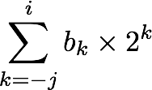
Fractional Binary Numbers
2^{i}
2^{i-1}
4
2
1
• • •
bi | bi-1 | ••• | b2 | b1 | b0 | b-1 | b-2 | b-3 | ••• | b-j
1/2
1/4
1/8
2^{-j}
• • •
Representation
Bits to right of “binary point” represent fractional powers of 2
Represents rational number:
Notes:
Latex source for equation: \sum_{k=-j}^i b_k \times 2^k

Slide 7
Fractional Binary Numbers: Examples
Value Representation
23 10111.000₂ = 16 + 4 + 2 + 1
11 1/2 = 23/2 01011.100₂ = 8 + 2 + 1 + 1/2
5 3/4 = 23/4 00101.1102 = 4 + 1 + 1/2 + 1/4
2 7/8 = 23/8 00010.1112 = 2 + 1/2 + 1/4 + 1/8
Observations
Divide by 2 by shifting right (unsigned)
Multiply by 2 by shifting left
Numbers of form 0.111111…2 are just below 1.0
1/2 + 1/4 + 1/8 + … + 1/2^{i} + … ➙ 1.0
Use notation 1.0 – ε

Slide 8
Representable Numbers
Limitation #1
Can only exactly represent numbers of the form x/2^{k}
Other rational numbers have repeating bit representations
Value Representation
1/3 0.0101010101[01]…2
1/5 0.001100110011[0011]…2
1/10 0.0001100110011[0011]…2
Limitation #2
Just one setting of binary point within the w bits
Limited range of numbers (very small values? very large?)

Slide 9
(Binary) Scientific Notation
What are the parts of a number in scientific notation?
What value does the significand always begin with in scientific notation?
1.1101101101101₂ x 2¹³
Exponent
Significand

Slide 10
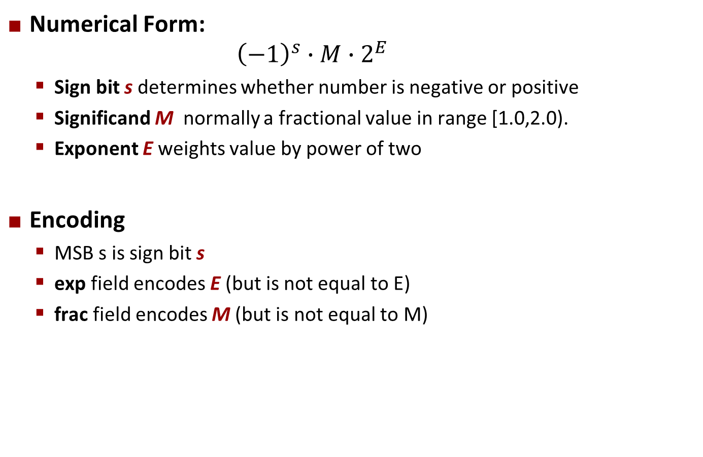
Floating Point Representation
Example: 15213₁₀ = (-1)⁰ x 1.1101101101101₂ x 2¹³
Numerical Form: ${\left(−1\right)}^{s}∙M∙2^{E}$
Sign bit s determines whether number is negative or positive
Significand M normally a fractional value in range [1.0,2.0).
Exponent E weights value by power of two
Encoding
MSB s is sign bit s
exp field encodes E (but is not equal to E)
frac field encodes M (but is not equal to M)
s | exp | frac

Slide 11
Floats can’t represent all real numbers!
Ariane 5 explodes on maiden voyage: $500 MILLION dollars lost
64-bit floating point number assigned to 16-bit integer (1996)
Legacy code from Ariane 4 with a lower top speed
Causes rocket to get incorrect value of horizontal velocity and crash
Patriot Missile defense system misses scud – 28 people die
System tracks time in tenths of second
Converted from integer to floating point number.
Accumulated rounding error causes drift. 20% drift over 8 hours.
Eventually (on 2/25/1991 system was on for 100 hours) causes range mis-estimation sufficiently large to miss incoming missiles.

Slide 12
Today: Floating Point
Background: Fractional binary numbers
IEEE floating point standard: Definition
Example and properties
Rounding, addition, multiplication
Floating point in C
Summary

Slide 13
IEEE Floating Point
IEEE Standard 754
Established in 1985 as uniform standard for floating point arithmetic
Before that, many idiosyncratic formats
Supported by all major CPUs
Some CPUs don’t implement IEEE 754 in full e.g., early GPUs, Cell BE processor
Driven by numerical concerns
Nice standards for rounding, overflow, underflow
Hard to make fast in hardware
Numerical analysts predominated over hardware designers in defining standard

Slide 14
Precision options
Single precision: 32 bits ≈ 7 decimal digits, 10^{±38}
Double precision: 64 bits ≈ 16 decimal digits, 10^{±308}
Other formats: half precision, quad precision
s | exp | frac
1 | 8-bits | 23-bits
s | exp | frac
1 | 11-bits | 52-bits

Slide 15
Three “kinds” of floating point numbers
s | exp | frac
1 | e-bits | f-bits
00…00
exp ≠ 0 and exp ≠ 11…11
11…11
denormalized
normalized
special

Slide 16
“Normalized” Values
v = (–1)^{s} M 2E
When: exp ≠ 000…0 and exp ≠ 111…1
Exponent coded as a biased value: E = exp – Bias
exp: unsigned value of exp field
Bias = 2^{k-1} - 1, where k is number of exponent bits
Single precision: 127 (exp: 1…254, E: -126…127)
Double precision: 1023 (exp: 1…2046, E: -1022…1023)
Significand coded with implied leading 1: M = 1.xxx…x2
xxx…x: bits of frac field
Minimum when frac=000…0 (M = 1.0)
Maximum when frac=111…1 (M = 2.0 – ε)
Get extra leading bit for “free”

Slide 17
Normalized Encoding Example
v = (–1)^{s} M 2E
E = exp – Bias
Value: float F = 15213.0;
15213₁₀ = 11101101101101₂
= 1.1101101101101₂ x 2¹³
Significand
M = 1.1101101101101₂
frac = 11011011011010000000000₂
Exponent
E = 13
Bias = 127
exp = 140 = 10001100₂
Result: 0 10001100 11011011011010000000000
s
exp
frac

Slide 18
Denormalized Values
v = (–1)^{s} M 2E
E = 1 – Bias
Condition: exp = 000…0
Exponent value: E = 1 – Bias (instead of exp – Bias) (why?)
Significand coded with implied leading 0: M = 0.xxx…x2
xxx…x: bits of frac
Cases
exp = 000…0, frac = 000…0
Represents zero value
Note distinct values: +0 and –0 (why?)
exp = 000…0, frac ≠ 000…0
Numbers closest to 0.0
Equispaced

Slide 19
Special Values
Condition: exp = 111…1
Case: exp = 111…1, frac = 000…0
Represents value ∞ (infinity)
Operation that overflows
Both positive and negative
E.g., 1.0/0.0 = −1.0/−0.0 = +∞, 1.0/−0.0 = −∞
Case: exp = 111…1, frac ≠ 000…0
Not-a-Number (NaN)
Represents case when no numeric value can be determined
E.g., sqrt(–1), ∞ − ∞, ∞ × 0

Slide 20
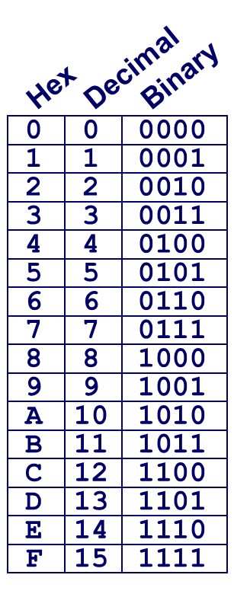
C float Decoding Example
v = (–1)^{s} M 2E
E = exp – Bias
float: 0xC0A00000
Bias = 2^{k-1} – 1 = 127
binary:
1 | 8-bits | 23-bits
E = 129
S = 1 -> negative number
M = 1.010 0000 0000 0000 0000 0000
M = 1 + 1/4 = 1.25
v = (–1)^{s} M 2E =

Slide 21
C float Decoding Example #1
v = (–1)^{s} M 2E
E = exp – Bias
float: 0xC0A00000
binary: 1100 0000 1010 0000 0000 0000 0000 0000
1 | 1000 0001 | 010 0000 0000 0000 0000 0000
1 | 8-bits | 23-bits
E = 129
S = 1 -> negative number
M = 1.010 0000 0000 0000 0000 0000
M = 1 + 1/4 = 1.25
v = (–1)^{s} M 2E =

Slide 22
C float Decoding Example #1
v = (–1)^{s} M 2E
E = exp – Bias
float: 0xC0A00000
Bias = 2^{k-1} – 1 = 127
binary: 1100 0000 1010 0000 0000 0000 0000 0000
1 | 1000 0001 | 010 0000 0000 0000 0000 0000
1 | 8-bits | 23-bits
E = exp – Bias = 129 – 127 = 2 (decimal)
S = 1 -> negative number
M = 1.010 0000 0000 0000 0000 0000
M = 1 + 1/4 = 1.25
v = (–1)^{s} M 2E = (-1)¹ * 1.25 * 2² = -5

Slide 23
C float Decoding Example #2
v = (–1)^{s} M 2E
E = 1 – Bias
float: 0x001C0000
binary: 0000 0000 0001 1100 0000 0000 0000 0000
0 | 0000 0000 | 001 1100 0000 0000 0000 0000
1 | 8-bits | 23-bits
E = 129
S = 1 -> negative number
M = 0.010 0000 0000 0000 0000 0000
M = 1 + 1/4 = 1.25
v = (–1)^{s} M 2E =

Slide 24
C float Decoding Example #2
v = (–1)^{s} M 2E
E = 1 – Bias
float: 0x001C0000
Bias = 2^{k-1} – 1 = 127
binary: 0000 0000 0001 1100 0000 0000 0000 0000
0 | 0000 0000 | 001 1100 0000 0000 0000 0000
1 | 8-bits | 23-bits
E = 1 – Bias = 1 – 127 = –126 (decimal)
S = 0 -> positive number
M = 0.001 1100 0000 0000 0000 0000
M = 1/8 + 1/16 + 1/32 = 7/32 = 7*2^{–5}
v = (–1)^{s} M 2E = (-1)⁰ * 7*2^{–5} * 2^{–126} = 7*2^{–131}
v ≈ 2.571393892 X 10^{–39}

Slide 25
Visualization: Floating Point Encodings
−∞
+∞
−Normalized
−Denorm
+Denorm
+Normalized
NaN
NaN
−0
+0

Slide 26
Today: Floating Point
Background: Fractional binary numbers
IEEE floating point standard: Definition
Example and properties
Rounding, addition, multiplication
Floating point in C
Summary

Slide 27
Tiny Floating Point Example
s | exp | frac
1 | 4-bits | 3-bits
8-bit Floating Point Representation
the sign bit is in the most significant bit
the next four bits are the exp, with a bias of 7
the last three bits are the frac
Same general form as IEEE Format
normalized, denormalized
representation of 0, NaN, infinity

Slide 28
Dynamic Range (s=0 only)
v = (–1)^{s} M 2E
norm: E = exp – Bias
denorm: E = 1 – Bias
s exp frac E Value
0 0000 000 -6 0
0 0000 001 -6 1/8*1/64 = 1/512
0 0000 010 -6 2/8*1/64 = 2/512
…
0 0000 110 -6 6/8*1/64 = 6/512
0 0000 111 -6 7/8*1/64 = 7/512
0 0001 000 -6 8/8*1/64 = 8/512
0 0001 001 -6 9/8*1/64 = 9/512
…
0 0110 110 -1 14/8*1/2 = 14/16
0 0110 111 -1 15/8*1/2 = 15/16
0 0111 000 0 8/8*1 = 1
0 0111 001 0 9/8*1 = 9/8
0 0111 010 0 10/8*1 = 10/8
…
0 1110 110 7 14/8*128 = 224
0 1110 111 7 15/8*128 = 240
0 1111 000 n/a inf
closest to zero
Denormalized
numbers
(-1)⁰(0+1/4)*2⁻⁶
largest denorm
smallest norm
(-1)⁰(1+1/8)*2⁻⁶
closest to 1 below
Normalized
numbers
closest to 1 above
largest norm

Slide 29
Distribution of Values
6-bit IEEE-like format
e = 3 exponent bits
f = 2 fraction bits
Bias is 2³⁻¹-1 = 3
Notice how the distribution gets denser toward zero.
s | exp | frac
1 | 3-bits | 2-bits
8 values

Slide 30
Distribution of Values (close-up view)
6-bit IEEE-like format
e = 3 exponent bits
f = 2 fraction bits
Bias is 3
s | exp | frac
1 | 3-bits | 2-bits

Slide 31
Special Properties of the IEEE Encoding
FP Zero Same as Integer Zero
All bits = 0
Can (Almost) Use Unsigned Integer Comparison
Must first compare sign bits
Must consider −0 = 0
NaNs problematic
Will be greater than any other values
What should comparison yield? The answer is complicated.
Otherwise OK
Denorm vs. normalized
Normalized vs. infinity

Slide 32
Quiz Time!
Check out:
https://canvas.cmu.edu/courses/17808

Slide 33
Today: Floating Point
Background: Fractional binary numbers
IEEE floating point standard: Definition
Example and properties
Rounding, addition, multiplication
Floating point in C
Summary

Slide 34
Floating Point Operations: Basic Idea
x +f y = Round(x + y)
x ×f y = Round(x × y)
Basic idea
First compute exact result
Make it fit into desired precision
Possibly overflow if exponent too large
Possibly round to fit into frac

Slide 35
Rounding
Rounding Modes (illustrate with $ rounding)
$1.40 $1.60 $1.50 $2.50 –$1.50
Towards zero $1 $1 $1 $2 –$1
Round down (−∞) $1 $1 $1 $2 –$2
Round up (+∞) $2 $2 $2 $3 –$1
Nearest Even* (default) $1 $2 $2 $2 –$2
*Round to nearest, but if half-way in-between then round to nearest even

Slide 36
Closer Look at Round-To-Even
Default Rounding Mode
Hard to get any other kind without dropping into assembly
C99 has support for rounding mode management
All others are statistically biased
Sum of set of positive numbers will consistently be over- or under- estimated
Applying to Other Decimal Places / Bit Positions
When exactly halfway between two possible values
Round so that least significant digit is even
E.g., round to nearest hundredth
7.8949999 7.89 (Less than half way)
7.8950001 7.90 (Greater than half way)
7.8950000 7.90 (Half way—round up)
7.8850000 7.88 (Half way—round down)

Slide 37
Rounding Binary Numbers
Binary Fractional Numbers
“Even” when least significant bit is 0
“Half way” when bits to right of rounding position = 100…2
Examples
Round to nearest 1/4 (2 bits right of binary point)
Value Binary Rounded Action Rounded Value
2 3/32 10.000112 10.002 (<1/2—down) 2
2 3/16 10.001102 10.012 (>1/2—up) 2 1/4
2 7/8 10.111002 11.002 ( 1/2—up) 3
2 5/8 10.101002 10.102 ( 1/2—down) 2 1/2

Slide 38
Rounding
1.BBGRXXX
Guard bit: LSB of result
Sticky bit: OR of remaining bits
Round bit: 1st bit removed
Round up conditions
Round = 1, Sticky = 1 ➙ > 0.5
Guard = 1, Round = 1, Sticky = 0 ➙ Round to even
Fraction GRS Incr? Rounded
1.0000000 000 N 1.000
1.1010000 100 N 1.101
1.0001000 010 N 1.000
1.0011000 110 Y 1.010
1.0001010 011 Y 1.001
1.1111100 111 Y 10.000

Slide 39
FP Multiplication
(–1)^{s1} M1 2^{E1} x (–1)^{s2} M2 2^{E2}
Exact Result: (–1)^{s} M 2E
Sign s: s1 ^ s2
Significand M: M1 x M2
Exponent E: E1 + E2
Fixing
If M ≥ 2, shift M right, increment E
If E out of range, overflow
Round M to fit frac precision
Implementation
Biggest chore is multiplying significands
4 bit significand: 1.010*2² x 1.110*2³ = 10.0011*2⁵
= 1.00011*2⁶ = 1.001*2⁶

Slide 40
Floating Point Addition
(–1)^{s1} M1 2^{E1} + (-1)^{s2} M2 2^{E2}
Assume E1 > E2
Exact Result: (–1)^{s} M 2E
Sign s, significand M:
Result of signed align & add
Exponent E: E1
Fixing
If M ≥ 2, shift M right, increment E
if M < 1, shift M left k positions, decrement E by k
Overflow if E out of range
Round M to fit frac precision
Get binary points lined up
E1–E2
(–1)^{s1} M1
+
(–1)^{s2} M2
(–1)^{s} M
1.010*2² + 1.110*2³ = (0.1010 + 1.1100)*2³
= 10.0110 * 2³ = 1.00110 * 2⁴ = 1.010 * 2⁴

Slide 41
Mathematical Properties of FP Add
Compare to those of Abelian Group
Closed under addition?
But may generate infinity or NaN
Commutative?
Associative?
Overflow and inexactness of rounding
(3.14+1e10)-1e10 = 0, 3.14+(1e10-1e10) = 3.14
0 is additive identity?
Every element has additive inverse?
Yes, except for infinities & NaNs
Monotonicity
a ≥ b ⇒ a+c ≥ b+c?
Except for infinities & NaNs
Yes
Yes
No
Yes
Almost
Almost

Slide 42
Mathematical Properties of FP Mult
Compare to Commutative Ring
Closed under multiplication?
But may generate infinity or NaN
Multiplication Commutative?
Multiplication is Associative?
Possibility of overflow, inexactness of rounding
Ex: (1e20*1e20)*1e-20= inf, 1e20*(1e20*1e-20)= 1e20
1 is multiplicative identity?
Multiplication distributes over addition?
Possibility of overflow, inexactness of rounding
1e20*(1e20-1e20)= 0.0, 1e20*1e20 – 1e20*1e20 = NaN
Monotonicity
a ≥ b & c ≥ 0 ⇒ a * c ≥ b *c?
Except for infinities & NaNs
Yes
Yes
No
Yes
No
Almost

Slide 43
Today: Floating Point
Background: Fractional binary numbers
IEEE floating point standard: Definition
Example and properties
Rounding, addition, multiplication
Floating point in C
Summary

Slide 44
Floating Point in C
C Guarantees Two Levels
float single precision
double double precision
Conversions/Casting
Casting between int, float, and double changes bit representation
double/float → int
Truncates fractional part
Like rounding toward zero
Not defined when out of range or NaN: Generally sets to TMin
int → double
Exact conversion, as long as int has ≤ 53 bit word size
int → float
Will round according to rounding mode

Slide 45


Floating Point Puzzles
For each of the following C expressions, either:
Argue that it is true for all argument values
Explain why not true
x == (int)(float) x
x == (int)(double) x
f == (float)(double) f
d == (double)(float) d
f == -(-f);
2/3 == 2/3.0
d < 0.0 ⇒ ((d*2) < 0.0)
d > f ⇒ -f > -d
d * d >= 0.0
(d+f)-d == f
int x = …;
float f = …;
double d = …;
Assume neither
d nor f is NaN

Slide 46
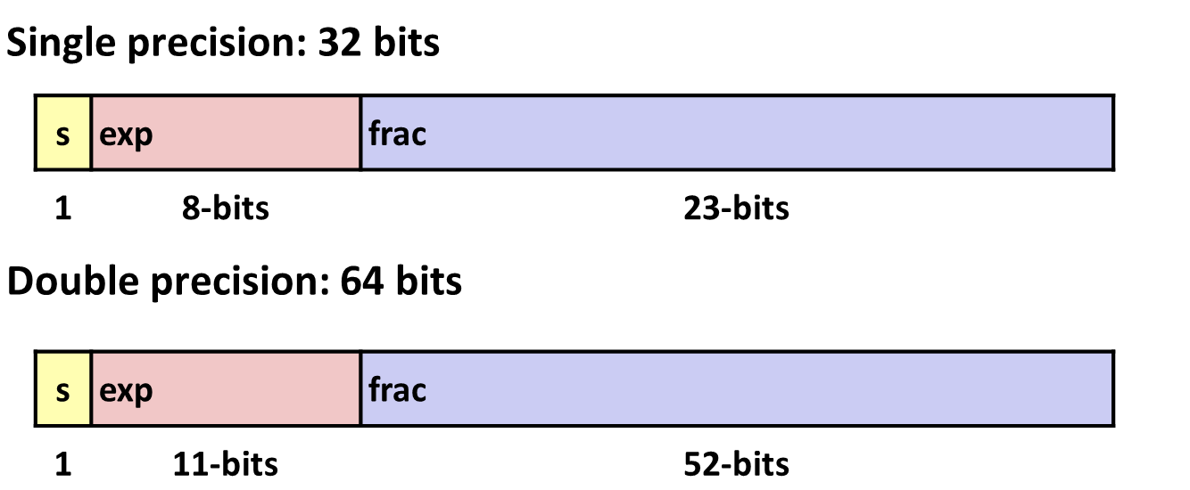
Summary
IEEE Floating Point has clear mathematical properties
Represents numbers of form M x 2E
One can reason about operations independent of implementation
As if computed with perfect precision and then rounded
Not the same as real arithmetic
Violates associativity/distributivity
Makes life difficult for compilers & serious numerical applications programmers

Slide 47
Additional Slides

Slide 48
Creating Floating Point Number
Steps
Normalize to have leading 1
Round to fit within fraction
Postnormalize to deal with effects of rounding
Case Study
Convert 8-bit unsigned numbers to tiny floating point format
Example Numbers
128 10000000
15 00001101
33 00010001
35 00010011
138 10001010
63 00111111
s | exp | frac
1 | 4-bits | 3-bits

Slide 49
Normalize
s | exp | frac
1 | 4-bits | 3-bits
Requirement
Set binary point so that numbers of form 1.xxxxx
Adjust all to have leading one
Decrement exponent as shift left
Value Binary Fraction Exponent
128 10000000 1.0000000 7
15 00001101 1.1010000 3
17 00010001 1.0001000 4
19 00010011 1.0011000 4
138 10001010 1.0001010 7
63 00111111 1.1111100 5

Slide 50
Postnormalize
Issue
Rounding may have caused overflow
Handle by shifting right once & incrementing exponent
Value Rounded Exp Adjusted Numeric Result
128 1.000 7 128
15 1.101 3 15
17 1.000 4 16
19 1.010 4 20
138 1.001 7 134
63 10.000 5 1.000/6 64

Slide 51
Interesting Numbers
{single,double}
Description exp frac Numeric Value
Zero 00…00 00…00 0.0
Smallest Pos. Denorm. 00…00 00…01 2^{– {23,52}} x 2^{– {126,1022}}
Single ≈ 1.4 x 10^{–45}
Double ≈ 4.9 x 10^{–324}
Largest Denormalized 00…00 11…11 (1.0 – ε) x 2^{– {126,1022}}
Single ≈ 1.18 x 10^{–38}
Double ≈ 2.2 x 10^{–308}
Smallest Pos. Normalized 00…01 00…00 1.0 x 2^{– {126,1022}}
Just larger than largest denormalized
One 01…11 00…00 1.0
Largest Normalized 11…10 11…11 (2.0 – ε) x 2^{{127,1023}}
Single ≈ 3.4 x 10³⁸
Double ≈ 1.8 x 10³⁰⁸

