Slide 1
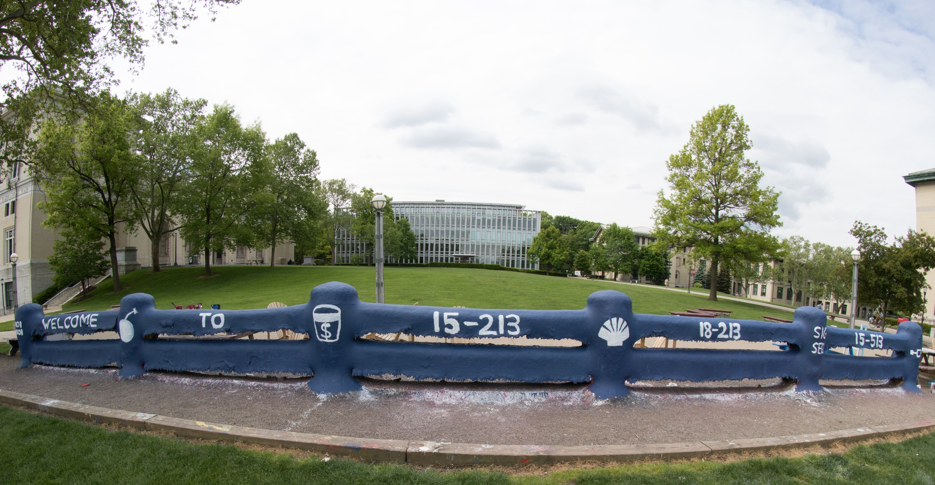
14-513
18-613

Slide 2
Machine-Level Programming III: Procedures 15-213/18-213/14-513/15-513/18-613: Introduction to Computer Systems 7th Lecture, February 25, 2021

Slide 3
Today
Overflow from lecture 6
Switch Statements and Jump Tables
Procedures
Mechanisms
Stack Structure
Calling Conventions
Passing control
Passing data
Managing local data
Illustration of Recursion

Slide 4
If you’re struggling with assembly
Chapter 3 of the textbook is your friend
More detailed explanations of everything in these lectures
Work through the practice problems
Ask for help with the practice problems
Today’s lecture will take us to the end of 3.7
Lots of tips, tricks, and guides have been posted on Piazza
Talk it out with a friend
“Help me understand what jmp *.L32(,%rdx,8) does in general” is an OK discussion to have; not an AIV
“Help me understand what jmp *.L32(,%rdx,8) does in phase 8 of this binary bomb”, on the other hand, is an AIV
If you haven’t got a friend handy, try a rubber duck. Really!

Slide 5
Switch Statement Example
long my_switch
(long x, long y, long z)
{
long w = 1;
switch(x) {
case 1:
w = y*z;
break;
case 2:
w = y/z;
/* Fall Through */
case 3:
w += z;
break;
case 5:
case 6:
w -= z;
break;
default:
w = 2;
}
return w;
}
Multiple case labels
Here: 5 & 6
Fall through cases
Here: 2
Missing cases
Here: 4

Slide 6
Switch Implemented with Jump Table
Switch Form
Jump Table
Jump Targets
switch(x) {
case val_0:
Block 0
case val_1:
Block 1
• • •
case val_n-1:
Block n–1
}
jtab:
Targ0
Targ0:
Code Block
0
Targ1
Targ2
Targ1:
Code Block
1
•
•
•
Targ2:
Code Block
2
Targn-1
•
•
•
Translation (Extended C)
goto *JTab[x];
Targn-1:
Code Block
n–1

Slide 7
Switch Statement Example
long my_switch
(long x, long y, long z)
{
long w = 1;
switch(x) {
case 1:
w = y*z;
break;
case 2:
w = y/z;
/* Fall Through */
case 3:
w += z;
break;
case 5:
case 6:
w -= z;
break;
default:
w = 2;
}
return w;
}
my_switch:
cmpq $6, %rdi # x:6
ja .L8 # if x > 6 jump # to default
jmp *.L4(,%rdi,8)
.L3:
.L5:
.L9:
.L7:
.L8:
.section .rodata
.align 8
.L4:
.quad .L8 # x = 0
.quad .L3 # x = 1
.quad .L5 # x = 2
.quad .L9 # x = 3
.quad .L8 # x = 4
.quad .L7 # x = 5
.quad .L7 # x = 6

Slide 8
Switch Statement Example
long my_switch(long x, long y, long z)
{
long w = 1;
switch(x) {
. . .
}
return w;
}
Setup
Register | Use(s)
%rdi | Argument x
%rsi | Argument y
%rdx | Argument z
%rax | Return value
my_switch:
movq %rdx, %rcx
cmpq $6, %rdi # x:6
ja .L8
jmp *.L4(,%rdi,8)
What range of values takes default?
Note that w not initialized here
Notes:
Cmpq 6 rdi → go to default if above all case values
W not initialized until it is sure to be used.

Slide 9
Switch Statement Example
long my_switch(long x, long y, long z)
{
long w = 1;
switch(x) {
. . .
}
return w;
}
Jump table
.section .rodata
.align 8
.L4:
.quad .L8 # x = 0
.quad .L3 # x = 1
.quad .L5 # x = 2
.quad .L9 # x = 3
.quad .L8 # x = 4
.quad .L7 # x = 5
.quad .L7 # x = 6
Setup
Setup
my_switch:
movq %rdx, %rcx
cmpq $6, %rdi # x:6
ja .L8 # use default
jmp *.L4(,%rdi,8) # goto *Jtab[x]
Indirect jump
Notes:
*.L4(,rdi,8) is L4 + rdi * addrsize → go to *Jtab[x], with x in rdi

Slide 10
Assembly Setup Explanation
Table Structure
Each target requires 8 bytes
Base address at .L4
Jumping
Direct: jmp .L8
Jump target is denoted by label .L8
Indirect: jmp *.L4(,%rdi,8)
Start of jump table: .L4
Must scale by factor of 8 (addresses are 8 bytes)
Fetch target from effective Address .L4 + x*8
Only for 0 ≤ x ≤ 6
Jump table
.section .rodata
.align 8
.L4:
.quad .L8 # x = 0
.quad .L3 # x = 1
.quad .L5 # x = 2
.quad .L9 # x = 3
.quad .L8 # x = 4
.quad .L7 # x = 5
.quad .L7 # x = 6

Slide 11
Jump Table
switch(x) {
case 1: // .L3
w = y*z;
break;
case 2: // .L5
w = y/z;
/* Fall Through */
case 3: // .L9
w += z;
break;
case 5:
case 6: // .L7
w -= z;
break;
default: // .L8
w = 2;
}
.section .rodata
.align 8
.L4:
.quad .L8 # x = 0
.quad .L3 # x = 1
.quad .L5 # x = 2
.quad .L9 # x = 3
.quad .L8 # x = 4
.quad .L7 # x = 5
.quad .L7 # x = 6

Slide 12
Code Blocks (x == 1)
switch(x) {
case 1: // .L3
w = y*z;
break;
. . .
}
.L3:
movq %rsi, %rax # y
imulq %rdx, %rax # y*z
ret
Register | Use(s)
%rdi | Argument x
%rsi | Argument y
%rdx | Argument z
%rax | Return value

Slide 13
Handling Fall-Through
long w = 1;
. . .
switch(x) {
. . .
case 2:
w = y/z;
/* Fall Through */
case 3:
w += z;
break;
. . .
}
case 2:
w = y/z;
goto merge;
case 3:
w = 1;
merge:
w += z;

Slide 14
Code Blocks (x == 2, x == 3)
.L5: # Case 2
movq %rsi, %rax
cqto # sign extend
# rax to rdx:rax
idivq %rcx # y/z
jmp .L6 # goto merge
.L9: # Case 3
movl $1, %eax # w = 1
.L6: # merge:
addq %rcx, %rax # w += z
ret
long w = 1;
. . .
switch(x) {
. . .
case 2:
w = y/z;
/* Fall Through */
case 3:
w += z;
break;
. . .
}
Register | Use(s)
%rdi | Argument x
%rsi | Argument y
%rcx | z
%rax | Return value

Slide 15
Code Blocks (x == 5, x == 6, default)
switch(x) {
. . .
case 5: // .L7
case 6: // .L7
w -= z;
break;
default: // .L8
w = 2;
}
.L7: # Case 5,6
movl $1, %eax # w = 1
subq %rdx, %rax # w -= z
ret
.L8: # Default:
movl $2, %eax # 2
ret
Register | Use(s)
%rdi | Argument x
%rsi | Argument y
%rdx | Argument z
%rax | Return value

Slide 16
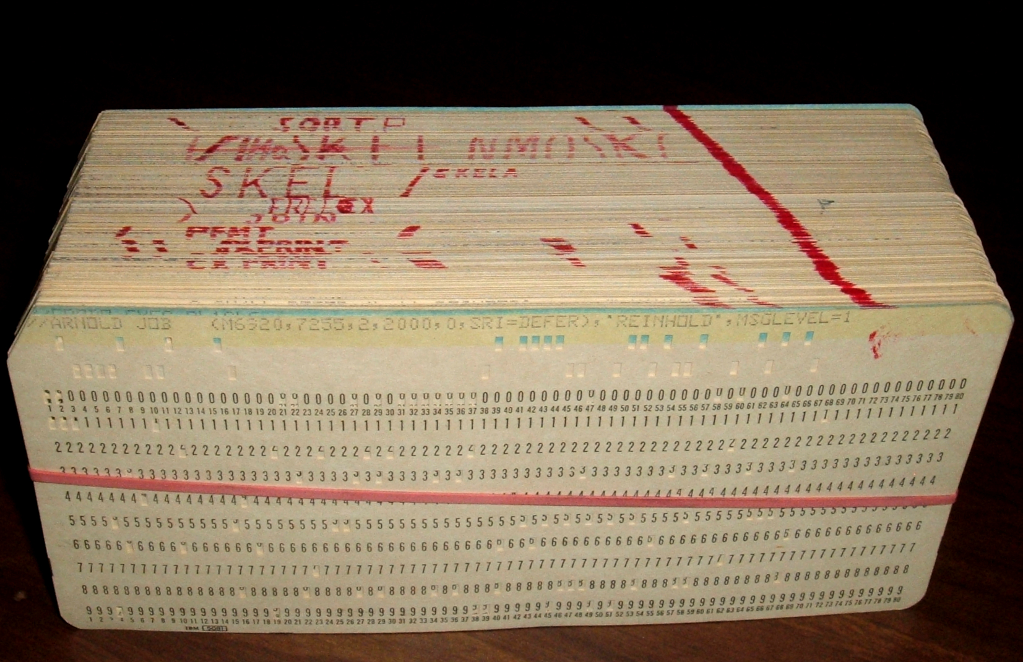
Procedures

Slide 17
Mechanisms in Procedures
P(…) {
•
•
y = Q(x);
print(y)
•
}
Passing control
To beginning of procedure code
Back to return point
Passing data
Procedure arguments
Return value
Memory management
Allocate during procedure execution
Deallocate upon return
Mechanisms all implemented with machine instructions
x86-64 implementation of a procedure uses only those mechanisms required
int Q(int i)
{
int t = 3*i;
int v[10];
•
•
return v[t];
}

Slide 18
Mechanisms in Procedures
P(…) {
•
•
y = Q(x);
print(y)
•
}
Passing control
To beginning of procedure code
Back to return point
Passing data
Procedure arguments
Return value
Memory management
Allocate during procedure execution
Deallocate upon return
Mechanisms all implemented with machine instructions
x86-64 implementation of a procedure uses only those mechanisms required
int Q(int i)
{
int t = 3*i;
int v[10];
•
•
return v[t];
}

Slide 19
Mechanisms in Procedures
P(…) {
•
•
y = Q(x);
print(y)
•
}
Passing control
To beginning of procedure code
Back to return point
Passing data
Procedure arguments
Return value
Memory management
Allocate during procedure execution
Deallocate upon return
Mechanisms all implemented with machine instructions
x86-64 implementation of a procedure uses only those mechanisms required
int Q(int i)
{
int t = 3*i;
int v[10];
•
•
return v[t];
}

Slide 20
Mechanisms in Procedures
P(…) {
•
•
y = Q(x);
print(y)
•
}
Passing control
To beginning of procedure code
Back to return point
Passing data
Procedure arguments
Return value
Memory management
Allocate during procedure execution
Deallocate upon return
Mechanisms all implemented with machine instructions
x86-64 implementation of a procedure uses only those mechanisms required
int Q(int i)
{
int t = 3*i;
int v[10];
•
•
return v[t];
}

Slide 21
Mechanisms in Procedures
P(…) {
•
•
y = Q(x);
print(y)
•
}
Machine instructions implement the mechanisms, but the choices are determined by designers. These choices make up the Application Binary Interface (ABI).
Passing control
To beginning of procedure code
Back to return point
Passing data
Procedure arguments
Return value
Memory management
Allocate during procedure execution
Deallocate upon return
Mechanisms all implemented with machine instructions
x86-64 implementation of a procedure uses only those mechanisms required
int Q(int i)
{
int t = 3*i;
int v[10];
•
•
return v[t];
}

Slide 22
Today
Procedures
Mechanisms
Stack Structure
Calling Conventions
Passing control
Passing data
Managing local data
Illustration of Recursion

Slide 23
x86-64 Stack
Carnegie Mellon
Region of memory managed with stack discipline
Memory viewed as array of bytes.
Different regions have different purposes.
(Like ABI, a policy decision)
stack
memory
code

Slide 24
x86-64 Stack
Carnegie Mellon
Stack “Bottom”
Region of memory managed with stack discipline
stack
code
Stack Pointer: %rsp
Stack “Top”

Slide 25
x86-64 Stack
Region of memory managed with stack discipline
Grows toward lower addresses
Register %rsp contains lowest stack address
address of “top” element
Stack “Bottom”
Increasing
Addresses
Stack Grows
Down
(toward lower addresses)
Stack Pointer: %rsp
Stack “Top”

Slide 26
x86-64 Stack: Push
pushq Src
Fetch operand at Src
Decrement %rsp by 8
Write operand at address given by %rsp
Stack “Bottom”
val
Increasing
Addresses
Stack Grows
Down
Stack Pointer: %rsp
Stack “Top”

Slide 27
x86-64 Stack: Push
pushq Src
Fetch operand at Src
Decrement %rsp by 8
Write operand at address given by %rsp
Stack “Bottom”
val
Increasing
Addresses
Stack Grows
Down
Stack Pointer: %rsp
-8
Stack “Top”

Slide 28
x86-64 Stack: Pop
Carnegie Mellon
popq Dest
Read value at address given by %rsp
Increment %rsp by 8
Store value at Dest (usually a register)
Stack “Bottom”
Increasing
Addresses
Stack Grows
Down
Stack Pointer: %rsp
val
Stack “Top”

Slide 29
x86-64 Stack: Pop
popq Dest
Read value at address given by %rsp
Increment %rsp by 8
Store value at Dest (usually a register)
Stack “Bottom”
Increasing
Addresses
val
Stack Grows
Down
Stack Pointer: %rsp
+8
Stack “Top”

Slide 30
x86-64 Stack: Pop
popq Dest
Read value at address given by %rsp
Increment %rsp by 8
Store value at Dest (usually a register)
Stack “Bottom”
Increasing
Addresses
Stack Grows
Down
Stack Pointer: %rsp
val
(The memory doesn’t change, only the value of %rsp)
Stack “Top”

Slide 31
Today
Procedures
Mechanisms
Stack Structure
Calling Conventions
Passing control
Passing data
Managing local data
Illustration of Recursion

Slide 32
Code Examples
void multstore(long x, long y, long *dest)
{
long t = mult2(x, y);
*dest = t;
}
0000000000400540 <multstore>:
400540: push %rbx # Save %rbx
400541: mov %rdx,%rbx # Save dest
400544: callq 400550 <mult2> # mult2(x,y)
400549: mov %rax,(%rbx) # Save at dest
40054c: pop %rbx # Restore %rbx
40054d: retq # Return
long mult2(long a, long b)
{
long s = a * b;
return s;
}
0000000000400550 <mult2>:
400550: mov %rdi,%rax # a
400553: imul %rsi,%rax # a * b
400557: retq # Return

Slide 33
Procedure Control Flow
Use stack to support procedure call and return
Procedure call: call label
Push return address on stack
Jump to label
Return address:
Address of the next instruction right after call
Example from disassembly
Procedure return: ret
Pop address from stack
Jump to address

Slide 34
Control Flow Example #1
•
•
•
0x130
0000000000400540 <multstore>:
•
•
400544: callq 400550 <mult2>
400549: mov %rax,(%rbx)
•
•
0x128
0x120
%rsp
0x120
%rip
0x400544
0000000000400550 <mult2>:
400550: mov %rdi,%rax
•
•
400557: retq

Slide 35
Control Flow Example #2
•
•
•
0x130
0000000000400540 <multstore>:
•
•
400544: callq 400550 <mult2>
400549: mov %rax,(%rbx)
•
•
0x128
0x120
0x118
0x400549
%rsp
0x118
%rip
0x400550
0000000000400550 <mult2>:
400550: mov %rdi,%rax
•
•
400557: retq
Notes:
0x120-0x118 = 8

Slide 36
Control Flow Example #3
•
•
•
0x130
0000000000400540 <multstore>:
•
•
400544: callq 400550 <mult2>
400549: mov %rax,(%rbx)
•
•
0x128
0x120
0x118
0x400549
%rsp
0x118
%rip
0x400557
0000000000400550 <mult2>:
400550: mov %rdi,%rax
•
•
400557: retq

Slide 37
Control Flow Example #4
•
•
•
0x130
0000000000400540 <multstore>:
•
•
400544: callq 400550 <mult2>
400549: mov %rax,(%rbx)
•
•
0x128
0x120
%rsp
0x120
%rip
0x400549
0000000000400550 <mult2>:
400550: mov %rdi,%rax
•
•
400557: retq

Slide 38
Today
Procedures
Mechanisms
Stack Structure
Calling Conventions
Passing control
Passing data
Managing local data
Illustrations of Recursion & Pointers

Slide 39
Procedure Data Flow
Registers
Stack
First 6 integer arguments
Return value
• • •
%rdi
%rsi
Arg n
%rdx
• • •
%rcx
%r8
Arg 8
%r9
Arg 7
%rax
Only allocate stack space when needed

Slide 40
Data Flow Examples
void multstore
(long x, long y, long *dest) {
long t = mult2(x, y);
*dest = t;
}
0000000000400540 <multstore>:
# x in %rdi, y in %rsi, dest in %rdx
• • •
400541: mov %rdx,%rbx # Save dest
400544: callq 400550 <mult2> # mult2(x,y)
# t in %rax
400549: mov %rax,(%rbx) # Save at dest
• • •
long mult2
(long a, long b)
{
long s = a * b;
return s;
}
0000000000400550 <mult2>:
# a in %rdi, b in %rsi
400550: mov %rdi,%rax # a
400553: imul %rsi,%rax # a * b
# s in %rax
400557: retq # Return
Notes:
Rdi, rsi outer => x,y; rdi,rsi inner => a,b. Change names without moving data.
Mov rdx, rbx => defer until caller/callee save

Slide 41
Today
Procedures
Mechanisms
Stack Structure
Calling Conventions
Passing control
Passing data
Managing local data
Illustration of Recursion

Slide 42
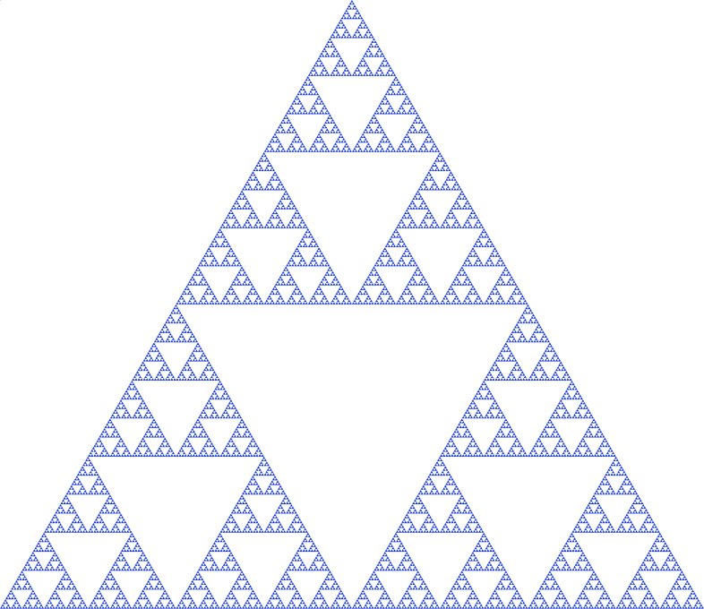
Stack-Based Languages
Languages that support recursion
e.g., C, Pascal, Java
Code must be “Reentrant”
Multiple simultaneous instantiations of single procedure
Need some place to store state of each instantiation
Arguments
Local variables
Return address
Stack discipline
State for given procedure needed for limited time
From when called to when return
Callee returns before caller does
Stack allocated in Frames
state for single procedure instantiation

Slide 43
Call Chain Example
Example
Call Chain
yoo(…)
{
•
•
who();
•
•
}
yoo
who(…)
{
• • •
amI();
• • •
amI();
• • •
}
who
amI(…)
{
•
•
amI();
•
•
}
amI
amI
amI
amI
Procedure amI() is recursive

Slide 44
Stack Frames
Previous Frame
Frame for proc
Contents
Return information
Local storage (if needed)
Temporary space (if needed)
Management
Space allocated when enter procedure
“Set-up” code
Includes push by call instruction
Deallocated when return
“Tear-down” code
Includes pop by ret instruction
Frame Pointer: %rbp
(Optional) x
Stack Pointer: %rsp
Stack “Top”
Notes:
When rbp not optional? Variable arity argument passing – need to track extents of args on stack to allow deallocation during tear-down

Slide 45
Example
Stack
yoo
yoo(…)
{
•
•
who();
•
•
}
yoo
%rbp
yoo
who
%rsp
amI
amI
amI
amI

Slide 46
Example
Stack
yoo
who
yoo(…)
{
•
•
who();
•
•
}
yoo
who(…)
{
• • •
amI();
• • •
amI();
• • •
}
yoo
who
%rbp
amI
amI
%rsp
amI
amI

Slide 47
Example
Stack
yoo
who
amI
yoo(…)
{
•
•
who();
•
•
}
yoo
who(…)
{
• • •
amI();
• • •
amI();
• • •
}
yoo
amI(…)
{
•
•
amI();
•
•
}
who
amI
amI
%rbp
amI
%rsp
amI

Slide 48
Example
Stack
yoo
who
amI
amI
yoo(…)
{
•
•
who();
•
•
}
yoo
who(…)
{
• • •
amI();
• • •
amI();
• • •
}
yoo
amI(…)
{
•
•
amI();
•
•
}
who
amI(…)
{
•
•
amI();
•
•
}
amI
amI
amI
%rbp
amI
%rsp

Slide 49
Example
Stack
yoo
who
amI
amI
amI
yoo(…)
{
•
•
who();
•
•
}
yoo
who(…)
{
• • •
amI();
• • •
amI();
• • •
}
yoo
amI(…)
{
•
•
amI();
•
•
}
who
amI(…)
{
•
•
amI();
•
•
}
amI
amI
amI(…)
{
•
•
amI();
•
•
}
amI
amI
%rbp
%rsp

Slide 50
Example
Stack
yoo
who
amI
amI
yoo(…)
{
•
•
who();
•
•
}
yoo
who(…)
{
• • •
amI();
• • •
amI();
• • •
}
yoo
amI(…)
{
•
•
amI();
•
•
}
who
amI(…)
{
•
•
amI();
•
•
}
amI
amI
amI
%rbp
amI
%rsp

Slide 51
Example
Stack
yoo
who
amI
yoo(…)
{
•
•
who();
•
•
}
yoo
who(…)
{
• • •
amI();
• • •
amI();
• • •
}
yoo
amI(…)
{
•
•
amI();
•
•
}
who
amI
amI
%rbp
amI
%rsp
amI

Slide 52
Example
Stack
yoo
who
yoo(…)
{
•
•
who();
•
•
}
yoo
who(…)
{
• • •
amI();
• • •
amI();
• • •
}
yoo
who
%rbp
amI
amI
%rsp
amI
amI

Slide 53
Example
Stack
yoo
who
amI
yoo(…)
{
•
•
who();
•
•
}
yoo
who(…)
{
• • •
amI();
• • •
amI();
• • •
}
yoo
amI(…)
{
•
•
amI();
•
•
}
who
amI
amI
%rbp
amI
%rsp
amI

Slide 54
Example
Stack
yoo
who
yoo(…)
{
•
•
who();
•
•
}
yoo
who(…)
{
• • •
amI();
• • •
amI();
• • •
}
yoo
who
%rbp
amI
amI
%rsp
amI
amI

Slide 55
Example
Stack
yoo
yoo
yoo(…)
{
•
•
who();
•
•
}
%rbp
yoo
who
%rsp
amI
amI
amI
amI

Slide 56
x86-64/Linux Stack Frame
Current Stack Frame (“Top” to Bottom)
“Argument build:” Parameters for function about to call
Local variables If can’t keep in registers
Saved register context
Old frame pointer (optional)
Caller Stack Frame
Return address
Pushed by call instruction
Arguments for this call
Caller
Frame
Arguments
7+
Frame pointer %rbp
Return Addr
Old %rbp
(Optional)
Saved
Registers
+
Local
Variables
Argument
Build
(Optional)
Stack pointer
%rsp

Slide 57
Example: incr
long incr(long *p, long val) {
long x = *p;
long y = x + val;
*p = y;
return x;
}
incr:
movq (%rdi), %rax
addq %rax, %rsi
movq %rsi, (%rdi)
ret
Register | Use(s)
%rdi | Argument p
%rsi | Argument val, y
%rax | x, Return value

Slide 58
Example: Calling incr #1
Initial Stack Structure
long call_incr() {
long v1 = 15213;
long v2 = incr(&v1, 3000);
return v1+v2;
}
. . .
Rtn address
%rsp
call_incr:
subq $16, %rsp
movq $15213, 8(%rsp)
movl $3000, %esi
leaq 8(%rsp), %rdi
call incr
addq 8(%rsp), %rax
addq $16, %rsp
ret
Resulting Stack Structure
. . .
Rtn address
15213
%rsp+8
Unused
%rsp
Notes:
Why the unused bytes? Could be alignment. Or space to spill something later.

Slide 59
Example: Calling incr #2
Stack Structure
long call_incr() {
long v1 = 15213;
long v2 = incr(&v1, 3000);
return v1+v2;
}
. . .
Rtn address
15213
%rsp+8
Unused
%rsp
call_incr:
subq $16, %rsp
movq $15213, 8(%rsp)
movl $3000, %esi
leaq 8(%rsp), %rdi
call incr
addq 8(%rsp), %rax
addq $16, %rsp
ret
Register | Use(s)
%rdi | &v1
%rsi | 3000
Notes:
Leaq: stash known address of “15213” for use in function. Will be safely there until return to call_incr

Slide 60
Example: Calling incr #2
Stack Structure
long call_incr() {
long v1 = 15213;
long v2 = incr(&v1, 3000);
return v1+v2;
}
. . .
Rtn address
15213
%rsp+8
Aside 1: movl $3000, %esi
Note: movl -> %exx zeros out high order 32 bits.
Why use movl instead of movq? 1 byte shorter.
Unused
%rsp
call_incr:
subq $16, %rsp
movq $15213, 8(%rsp)
movl $3000, %esi
leaq 8(%rsp), %rdi
call incr
addq 8(%rsp), %rax
addq $16, %rsp
ret
Register | Use(s)
%rdi | &v1
%rsi | 3000

Slide 61
Example: Calling incr #2
Stack Structure
long call_incr() {
long v1 = 15213;
long v2 = incr(&v1, 3000);
return v1+v2;
}
. . .
Rtn address
15213
%rsp+8
Unused
%rsp
Aside 2: leaq 8(%rsp), %rdi
Computes %rsp+8
Actually, used for what it is meant!
call_incr:
subq $16, %rsp
movq $15213, 8(%rsp)
movl $3000, %esi
leaq 8(%rsp), %rdi
call incr
addq 8(%rsp), %rax
addq $16, %rsp
ret
Register | Use(s)
%rdi | &v1
%rsi | 3000

Slide 62
Example: Calling incr #2
Stack Structure
long call_incr() {
long v1 = 15213;
long v2 = incr(&v1, 3000);
return v1+v2;
}
. . .
Rtn address
15213
%rsp+8
Unused
%rsp
call_incr:
subq $16, %rsp
movq $15213, 8(%rsp)
movl $3000, %esi
leaq 8(%rsp), %rdi
call incr
addq 8(%rsp), %rax
addq $16, %rsp
ret
Register | Use(s)
%rdi | &v1
%rsi | 3000

Slide 63
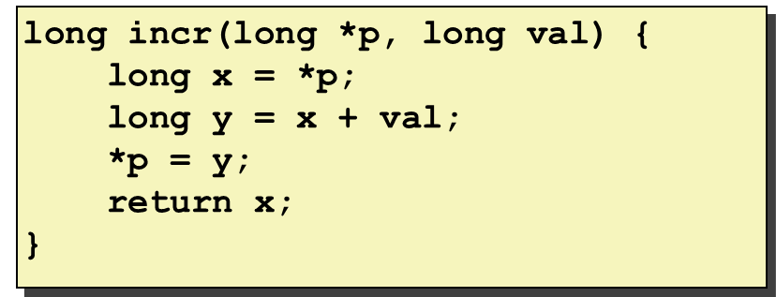
Example: Calling incr #3a
Stack Structure
long call_incr() {
long v1 = 15213;
long v2 = incr(&v1, 3000);
return v1+v2;
}
. . .
Rtn address
15213
%rsp+8
Unused
%rsp
call_incr:
subq $16, %rsp
movq $15213, 8(%rsp)
movl $3000, %esi
leaq 8(%rsp), %rdi
call incr
addq 8(%rsp), %rax
addq $16, %rsp
ret
Register | Use(s)
%rdi | &v1
%rsi | 3000

Slide 64
Example: Calling incr #3b
Stack Structure
long call_incr() {
long v1 = 15213;
long v2 = incr(&v1, 3000);
return v1+v2;
}
. . .
Rtn address
18213
%rsp+8
Unused
%rsp
call_incr:
subq $16, %rsp
movq $15213, 8(%rsp)
movl $3000, %esi
leaq 8(%rsp), %rdi
call incr
addq 8(%rsp), %rax
addq $16, %rsp
ret
Register | Use(s)
%rdi | &v1
%rsi | 3000

Slide 65
Example: Calling incr #4
Stack Structure
long call_incr() {
long v1 = 15213;
long v2 = incr(&v1, 3000);
return v1+v2;
}
. . .
Rtn address
18213
%rsp+8
Unused
%rsp
call_incr:
subq $16, %rsp
movq $15213, 8(%rsp)
movl $3000, %esi
leaq 8(%rsp), %rdi
call incr
addq 8(%rsp), %rax
addq $16, %rsp
ret
Register | Use(s)
%rax | Return value, 15213

Slide 66
Example: Calling incr #5a
Stack Structure
long call_incr() {
long v1 = 15213;
long v2 = incr(&v1, 3000);
return v1+v2;
}
. . .
Rtn address
18213
%rsp+8
Unused
%rsp
call_incr:
subq $16, %rsp
movq $15213, 8(%rsp)
movl $3000, %esi
leaq 8(%rsp), %rdi
call incr
addq 8(%rsp), %rax
addq $16, %rsp
ret
Register | Use(s)
%rax | Return value
Updated Stack Structure
. . .
Rtn address
%rsp

Slide 67
Example: Calling incr #5b
Updated Stack Structure
long call_incr() {
long v1 = 15213;
long v2 = incr(&v1, 3000);
return v1+v2;
}
. . .
Rtn address
%rsp
call_incr:
subq $16, %rsp
movq $15213, 8(%rsp)
movl $3000, %esi
leaq 8(%rsp), %rdi
call incr
addq 8(%rsp), %rax
addq $16, %rsp
ret
Register | Use(s)
%rax | Return value
Final Stack Structure
. . .
%rsp

Slide 68
Register Saving Conventions
When procedure yoo calls who:
yoo is the caller
who is the callee
Can a register be used for temporary storage?
Contents of register %rdx overwritten by who
If a callee clobbers your register, its value is lost!
Need coordination between caller/callee
yoo:
• • •
movq $15213, %rdx
call who
addq %rdx, %rax
• • •
ret
who:
• • •
subq $18213, %rdx
• • •
ret

Slide 69
Register Saving Conventions
When procedure yoo calls who:
yoo is the caller
who is the callee
Can register be used for temporary storage?
Conventions
“Caller Saved”
Caller must save values in its stack frame before call
“Callee Saved”
Callee saves values in its frame before using
Callee restores values before returning

Slide 70
x86-64 Linux Register Usage #1
%rax
Return value
Also caller-saved
Can be modified by procedure
%rdi, ..., %r9
Integer arguments
Also caller-saved
Can be modified by procedure
%r10, %r11
Caller-saved
Can be modified by procedure
Caller-saved
Return value
%rax
%rdi
%rsi
%rdx
Caller-saved
Arguments
%rcx
%r8
%r9
%r10
Caller-saved
Temporaries
%r11

Slide 71
x86-64 Linux Register Usage #2
%rbx, %r12, %r13, %r14
Callee-saved
Callee must save & restore
%rbp
Callee-saved
Callee must save & restore
May be used as frame pointer
Compiler decides use of rbp
%rsp
Special form of callee save
Restored to original value upon exit from procedure
%rbx
%r12
Callee-saved
Temporaries
%r13
%r14
%rbp
Special
%rsp

Slide 72
Quiz Time!
Check out:
https://canvas.cmu.edu/courses/17808

Slide 73
Callee-Saved Example #1
Initial Stack Structure
long call_incr2(long x) {
long v1 = 15213;
long v2 = incr(&v1, 3000);
return x+v2;
}
. . .
Rtn address
%rsp
x comes in register %rdi.
We need %rdi for the call to incr.
Where should be put x, so we can use it after the call to incr?

Slide 74
Callee-Saved Example #2
Initial Stack Structure
long call_incr2(long x) {
long v1 = 15213;
long v2 = incr(&v1, 3000);
return x+v2;
}
. . .
Rtn address
%rsp
call_incr2:
pushq %rbx
subq $16, %rsp
movq %rdi, %rbx
movq $15213, 8(%rsp)
movl $3000, %esi
leaq 8(%rsp), %rdi
call incr
addq %rbx, %rax
addq $16, %rsp
popq %rbx
ret
Resulting Stack Structure
. . .
Rtn address
Saved %rbx
%rsp
Notes:
We are a callee, must save %rbx (to stack)

Slide 75
Callee-Saved Example #3
Initial Stack Structure
long call_incr2(long x) {
long v1 = 15213;
long v2 = incr(&v1, 3000);
return x+v2;
}
. . .
Rtn address
Saved %rbx
%rsp
call_incr2:
pushq %rbx
subq $16, %rsp
movq %rdi, %rbx
movq $15213, 8(%rsp)
movl $3000, %esi
leaq 8(%rsp), %rdi
call incr
addq %rbx, %rax
addq $16, %rsp
popq %rbx
ret
Resulting Stack Structure
. . .
Rtn address
Saved %rbx
%rsp+8
%rsp

Slide 76
Callee-Saved Example #4
Stack Structure
long call_incr2(long x) {
long v1 = 15213;
long v2 = incr(&v1, 3000);
return x+v2;
}
. . .
Rtn address
Saved %rbx
%rsp+8
call_incr2:
pushq %rbx
subq $16, %rsp
movq %rdi, %rbx
movq $15213, 8(%rsp)
movl $3000, %esi
leaq 8(%rsp), %rdi
call incr
addq %rbx, %rax
addq $16, %rsp
popq %rbx
ret
%rsp
x is saved in %rbx, a callee saved register
Notes:
Rdi is x;

Slide 77
Callee-Saved Example #5
Stack Structure
long call_incr2(long x) {
long v1 = 15213;
long v2 = incr(&v1, 3000);
return x+v2;
}
. . .
Rtn address
Saved %rbx
15213
%rsp+8
call_incr2:
pushq %rbx
subq $16, %rsp
movq %rdi, %rbx
movq $15213, 8(%rsp)
movl $3000, %esi
leaq 8(%rsp), %rdi
call incr
addq %rbx, %rax
addq $16, %rsp
popq %rbx
ret
Unused
%rsp
x is saved in %rbx, a callee saved register

Slide 78
Callee-Saved Example #6
Stack Structure
long call_incr2(long x) {
long v1 = 15213;
long v2 = incr(&v1, 3000);
return x+v2;
}
. . .
Rtn address
Saved %rbx
18213
%rsp+8
call_incr2:
pushq %rbx
subq $16, %rsp
movq %rdi, %rbx
movq $15213, 8(%rsp)
movl $3000, %esi
leaq 8(%rsp), %rdi
call incr
addq %rbx, %rax
addq $16, %rsp
popq %rbx
ret
Unused
%rsp
Upon return from incr:
x safe in %rbx
Return val v2 in %rax
Compute x+v2: addq %rbx, %rax
Notes:
If incr() used rbx, it had to restore call_incr2()’s rbx value before returning

Slide 79
Callee-Saved Example #7
Stack Structure
long call_incr2(long x) {
long v1 = 15213;
long v2 = incr(&v1, 3000);
return x+v2;
}
. . .
Rtn address
Saved %rbx
%rsp
18213
call_incr2:
pushq %rbx
subq $16, %rsp
movq %rdi, %rbx
movq $15213, 8(%rsp)
movl $3000, %esi
leaq 8(%rsp), %rdi
call incr
addq %rbx, %rax
addq $16, %rsp
popq %rbx
ret
Unused
Return result in %rax

Slide 80
Callee-Saved Example #8
Initial Stack Structure
long call_incr2(long x) {
long v1 = 15213;
long v2 = incr(&v1, 3000);
return x+v2;
}
. . .
Rtn address
Saved %rbx
%rsp
18213
call_incr2:
pushq %rbx
subq $16, %rsp
movq %rdi, %rbx
movq $15213, 8(%rsp)
movl $3000, %esi
leaq 8(%rsp), %rdi
call incr
addq %rbx, %rax
addq $16, %rsp
popq %rbx
ret
Unused
final Stack Structure
. . .
Rtn address
%rsp
Saved %rbx
18213
Unused
Notes:
Remember: we saved %rbx onto stack earlier. Need to restore.

Slide 81
Callee-Saved Example #2
Resulting Stack Structure
long call_incr2(long x) {
long v1 = 15213;
long v2 = incr(&v1, 3000);
return x+v2;
}
. . .
Rtn address
Saved %rbx
15213
%rsp+8
call_incr2:
pushq %rbx
subq $16, %rsp
movq %rdi, %rbx
movq $15213, 8(%rsp)
movl $3000, %esi
leaq 8(%rsp), %rdi
call incr
addq %rbx, %rax
addq $16, %rsp
popq %rbx
ret
Unused
%rsp
Pre-return Stack Structure
. . .
Rtn address
%rsp

Slide 82
Today
Procedures
Mechanisms
Stack Structure
Calling Conventions
Passing control
Passing data
Managing local data
Illustration of Recursion

Slide 83
Recursive Function
/* Recursive popcount */
long pcount_r(unsigned long x) {
if (x == 0)
return 0;
else
return (x & 1)
+ pcount_r(x >> 1);
}
pcount_r:
movl $0, %eax
testq %rdi, %rdi
je .L6
pushq %rbx
movq %rdi, %rbx
andl $1, %ebx
shrq %rdi
call pcount_r
addq %rbx, %rax
popq %rbx
.L6:
rep; ret

Slide 84
Recursive Function Terminal Case
/* Recursive popcount */
long pcount_r(unsigned long x) {
if (x == 0)
return 0;
else
return (x & 1)
+ pcount_r(x >> 1);
}
pcount_r:
movl $0, %eax
testq %rdi, %rdi
je .L6
pushq %rbx
movq %rdi, %rbx
andl $1, %ebx
shrq %rdi
call pcount_r
addq %rbx, %rax
popq %rbx
.L6:
rep; ret
Register | Use(s) | Type
%rdi | x | Argument
%rax | Return value | Return value
Notes:
Load up 0 return, test rdi for 0, jump to L6. rep;ret -> no-op padding that is more efficient than actual nop.

Slide 85
Recursive Function Register Save
pcount_r:
movl $0, %eax
testq %rdi, %rdi
je .L6
pushq %rbx
movq %rdi, %rbx
andl $1, %ebx
shrq %rdi
call pcount_r
addq %rbx, %rax
popq %rbx
.L6:
rep; ret
/* Recursive popcount */
long pcount_r(unsigned long x) {
if (x == 0)
return 0;
else
return (x & 1)
+ pcount_r(x >> 1);
}
Register | Use(s) | Type
%rdi | x | Argument
. . .
Rtn address
Saved %rbx
%rsp

Slide 86
Recursive Function Call Setup
/* Recursive popcount */
long pcount_r(unsigned long x) {
if (x == 0)
return 0;
else
return (x & 1)
+ pcount_r(x >> 1);
}
pcount_r:
movl $0, %eax
testq %rdi, %rdi
je .L6
pushq %rbx
movq %rdi, %rbx
andl $1, %ebx
shrq %rdi
call pcount_r
addq %rbx, %rax
popq %rbx
.L6:
rep; ret
Register | Use(s) | Type
%rdi | x >> 1 | Recursive argument
%rbx | x & 1 | Callee-saved
Notes:
Put x into rbx; (safe – caller-saved) and with 1 to get addend, shift rdi to make new arg.

Slide 87
Recursive Function Call
/* Recursive popcount */
long pcount_r(unsigned long x) {
if (x == 0)
return 0;
else
return (x & 1)
+ pcount_r(x >> 1);
}
pcount_r:
movl $0, %eax
testq %rdi, %rdi
je .L6
pushq %rbx
movq %rdi, %rbx
andl $1, %ebx
shrq %rdi
call pcount_r
addq %rbx, %rax
popq %rbx
.L6:
rep; ret
Register | Use(s) | Type
%rbx | x & 1 | Callee-saved
%rax | Recursive call return value

Slide 88
Recursive Function Result
/* Recursive popcount */
long pcount_r(unsigned long x) {
if (x == 0)
return 0;
else
return (x & 1)
+ pcount_r(x >> 1);
}
pcount_r:
movl $0, %eax
testq %rdi, %rdi
je .L6
pushq %rbx
movq %rdi, %rbx
andl $1, %ebx
shrq %rdi
call pcount_r
addq %rbx, %rax
popq %rbx
.L6:
rep; ret
Register | Use(s) | Type
%rbx | x & 1 | Callee-saved
%rax | Return value
Notes:
Remember rbx is save because the callee had to restore it before returning.

Slide 89
Recursive Function Completion
/* Recursive popcount */
long pcount_r(unsigned long x) {
if (x == 0)
return 0;
else
return (x & 1)
+ pcount_r(x >> 1);
}
pcount_r:
movl $0, %eax
testq %rdi, %rdi
je .L6
pushq %rbx
movq %rdi, %rbx
andl $1, %ebx
shrq %rdi
call pcount_r
addq %rbx, %rax
popq %rbx
.L6:
rep; ret
Register | Use(s) | Type
%rax | Return value | Return value
. . .
%rsp

Slide 90
Observations About Recursion
Handled Without Special Consideration
Stack frames mean that each function call has private storage
Saved registers & local variables
Saved return pointer
Register saving conventions prevent one function call from corrupting another’s data
Unless the C code explicitly does so (e.g., buffer overflow in Lecture 9)
Stack discipline follows call / return pattern
If P calls Q, then Q returns before P
Last-In, First-Out
Also works for mutual recursion
P calls Q; Q calls P

Slide 91
x86-64 Procedure Summary
Important Points
Stack is the right data structure for procedure call/return
If P calls Q, then Q returns before P
Recursion (& mutual recursion) handled by normal calling conventions
Can safely store values in local stack frame and in callee-saved registers
Put function arguments 7+ at top of stack
Result return in %rax
Pointers are addresses of values
On stack or global
Caller
Frame
Arguments
7+
Return Addr
%rbp
(Optional)
Old %rbp
Saved
Registers
+
Local
Variables
Argument
Build
%rsp

Slide 92
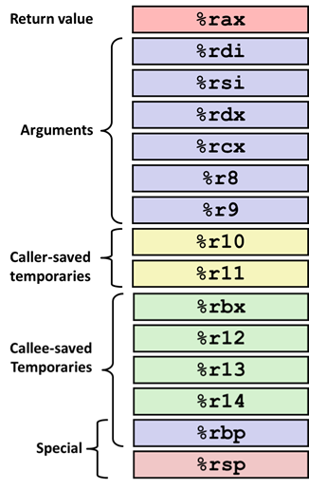
Small Exercise
long add5(long b0, long b1, long b2, long b3, long b4) {
return b0+b1+b2+b3+b4;
}
long add10(long a0, long a1, long a2, long a3, long a4, long a5,
long a6, long a7, long a8, long a9) {
return add5(a0, a1, a2, a3, a4)+
add5(a5, a6, a7, a8, a9);
}
Where are a0,…, a9 passed?
rdi, rsi, rdx, rcx, r8, r9, stack
Where are b0,…, b4 passed?
rdi, rsi, rdx, rcx, r8
Which registers do we need to save?
Ill-posed question. Need assembly.
Notes:
1)Rdi, rsi, rdx, rcx, r8, r9, stack
2)rdi,rsi,rdx,rcx,r8, r9

Slide 93
Small Exercise
long add5(long b0, long b1, long b2, long b3, long b4) {
return b0+b1+b2+b3+b4;
}
long add10(long a0, long a1, long a2, long a3, long a4, long a5,
long a6, long a7, long a8, long a9) {
return add5(a0, a1, a2, a3, a4)+
add5(a5, a6, a7, a8, a9);
}
add10:
pushq %rbp
pushq %rbx
movq %r9, %rbp
call add5
movq %rax, %rbx
movq 48(%rsp), %r8
movq 40(%rsp), %rcx
movq 32(%rsp), %rdx
movq 24(%rsp), %rsi
movq %rbp, %rdi
call add5
addq %rbx, %rax
popq %rbx
popq %rbp
ret
add5:
addq %rsi, %rdi
addq %rdi, %rdx
addq %rdx, %rcx
leaq (%rcx,%r8), %rax
ret

