Slide 1
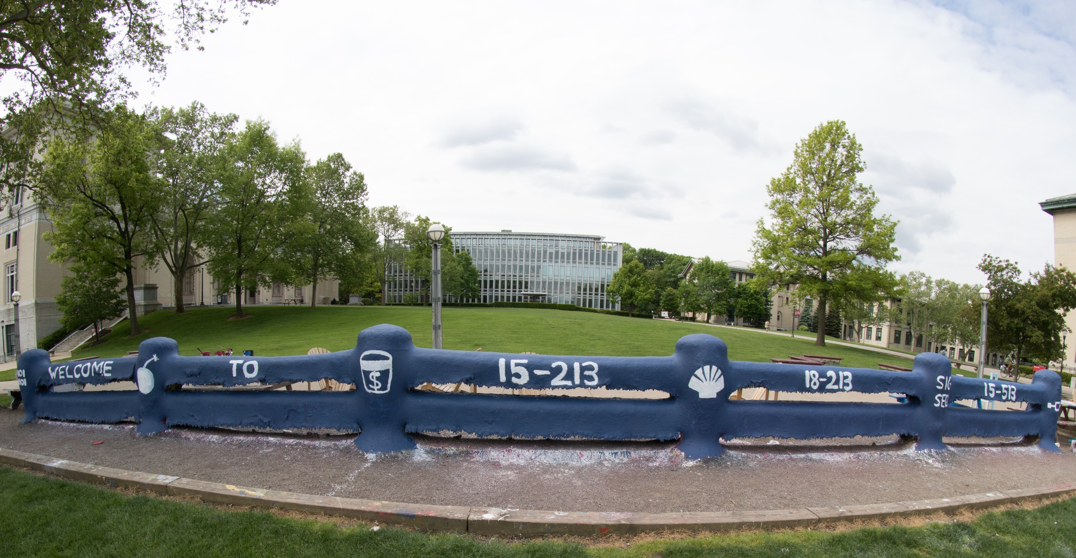
14-513
18-613

Slide 2
Machine-Level Programming V: Advanced Topics 15-213/18-213/14-513/15-513/18-613: Introduction to Computer Systems 9th Lecture, March 4, 2021

Slide 3
Today
Memory Layout
Buffer Overflow
Vulnerability
Protection
Unions

Slide 4
x86-64 Linux Memory Layout
not drawn to scale
00007FFFFFFFFFFF
(= 2⁴⁷–1)
Shared
Libraries
Stack
Runtime stack (8MB limit)
E. g., local variables
Heap
Dynamically allocated as needed
When call malloc(), calloc(), new()
Data
Statically allocated data
E.g., global vars, static vars, string constants
Text / Shared Libraries
Executable machine instructions
Read-only
00007FFFF0000000
Stack
8MB
Heap
Data
Text
Hex Address
400000
000000

Slide 5
Memory Allocation Example
not drawn to scale
00007FFFFFFFFFFF
Shared
Libraries
char big_array[1L<<24]; /* 16 MB */
char huge_array[1L<<31]; /* 2 GB */
int global = 0;
int useless() { return 0; }
int main ()
{
void *phuge1, *psmall2, *phuge3, *psmall4;
int local = 0;
phuge1 = malloc(1L << 28); /* 256 MB */
psmall2 = malloc(1L << 8); /* 256 B */
phuge3 = malloc(1L << 32); /* 4 GB */
psmall4 = malloc(1L << 8); /* 256 B */
/* Some print statements ... */
}
Stack
Heap
Data
Text
Where does everything go?

Slide 6
x86-64 Example Addresses
not drawn to scale
Shared
Libraries
address range ~2⁴⁷
Stack
local 0x00007ffe4d3be87c
phuge1 0x00007f7262a1e010
phuge3 0x00007f7162a1d010
psmall4 0x000000008359d120
psmall2 0x000000008359d010
big_array 0x0000000080601060
huge_array 0x0000000000601060
main() 0x000000000040060c
useless() 0x0000000000400590
Heap
Heap
(Exact values can vary)
Data
Text
000000

Slide 7
Runaway Stack Example
not drawn to scale
00007FFFFFFFFFFF
Shared
Libraries
int recurse(int x) {
int a[1<<15]; // 4*2^15 = 128 KiB
printf("x = %d. a at %p\n", x, a);
a[0] = (1<<14)-1;
a[a[0]] = x-1;
if (a[a[0]] == 0)
return -1;
return recurse(a[a[0]]) - 1;
}
Stack
8MB
Functions store local data on stack in stack frame
Recursive functions cause deep nesting of frames
./runaway 67
x = 67. a at 0x7ffd18aba930
x = 66. a at 0x7ffd18a9a920
x = 65. a at 0x7ffd18a7a910 x = 64. a at 0x7ffd18a5a900
. . .
x = 4. a at 0x7ffd182da540
x = 3. a at 0x7ffd182ba530
x = 2. a at 0x7ffd1829a520
Segmentation fault (core dumped)

Slide 8
Today
Memory Layout
Buffer Overflow
Vulnerability
Protection
Unions

Slide 9
Recall: Memory Referencing Bug Example
typedef struct {
int a[2];
double d;
} struct_t;
double fun(int i) {
volatile struct_t s;
s.d = 3.14;
s.a[i] = 1073741824; /* Possibly out of bounds */
return s.d;
}
fun(0) -> 3.1400000000
fun(1) -> 3.1400000000
fun(2) -> 3.1399998665
fun(3) -> 2.0000006104
fun(6) -> Stack smashing detected
fun(8) -> Segmentation fault
Result is system specific

Slide 10
Memory Referencing Bug Example
typedef struct {
int a[2];
double d;
} struct_t;
fun(0) -> 3.1400000000
fun(1) -> 3.1400000000
fun(2) -> 3.1399998665
fun(3) -> 2.0000006104
fun(4) -> Segmentation fault
fun(8) -> 3.1400000000
??? | 8
Critical State | 7
Critical State | 6
Critical State | 5
Critical State | 4
d7 ... d4 | 3
d3 ... d0 | 2
a[1] | 1
a[0] | 0
Explanation:
Location accessed by fun(i)
struct_t

Slide 11
Such problems are a BIG deal
Generally called a “buffer overflow”
when exceeding the memory size allocated for an array
Why a big deal?
It’s the #1 technical cause of security vulnerabilities
What is #1 overall cause?
social engineering / user ignorance
Most common form
Unchecked lengths on string inputs
Particularly for bounded character arrays on the stack
sometimes referred to as stack smashing

Slide 12
Exploits Based on Buffer Overflows
Buffer overflow bugs can allow remote machines to execute arbitrary code on victim machines
Distressingly common in real programs
Programmers keep making the same mistakes ☹
Recent measures make these attacks much more difficult
Examples across the decades
Original “Internet worm” (1988)
“IM wars” (1999)
Twilight hack on Wii (2000s)
… and many, many more
You will learn some of the tricks in attacklab
Hopefully to convince you to never leave such holes in your programs!!

Slide 13
Example: the original Internet worm (1988)
Exploited a few vulnerabilities to spread
Early versions of the finger server (fingerd) used gets() to read the argument sent by the client:
finger droh@cs.cmu.edu
Worm attacked fingerd server by sending phony argument:
finger “exploit-code padding new-return-address”
exploit code: executed a root shell on the victim machine with a direct TCP connection to the attacker.
Once on a machine, scanned for other machines to attack
invaded ~6000 computers in hours (10% of the Internet ☺ )
see June 1989 article in Comm. of the ACM
the young author of the worm was prosecuted…
and CERT was formed… still homed at CMU

Slide 14
Example 2: IM War
July, 1999
Microsoft launches MSN Messenger (instant messaging system).
Messenger clients can access popular AOL Instant Messaging Service (AIM) servers
AIM
client
MSN
server
MSN
client
AIM
server
AIM
client

Slide 15
IM War (cont.)
August 1999
Mysteriously, Messenger clients can no longer access AIM servers
Microsoft and AOL begin the IM war:
AOL changes server to disallow Messenger clients
Microsoft makes changes to clients to defeat AOL changes
At least 13 such skirmishes
What was really happening?
AOL had discovered a buffer overflow bug in their own AIM clients
They exploited it to detect and block Microsoft: the exploit code returned a 4-byte signature (the bytes at some location in the AIM client) to server
When Microsoft changed code to match signature, AOL changed signature location

Slide 16
Date: Wed, 11 Aug 1999 11:30:57 -0700 (PDT)
From: Phil Bucking <philbucking@yahoo.com>
Subject: AOL exploiting buffer overrun bug in their own software!
To: rms@pharlap.com
Mr. Smith,
I am writing you because I have discovered something that I think you
might find interesting because you are an Internet security expert with
experience in this area. I have also tried to contact AOL but received
no response.
I am a developer who has been working on a revolutionary new instant
messaging client that should be released later this year.
...
It appears that the AIM client has a buffer overrun bug. By itself
this might not be the end of the world, as MS surely has had its share.
But AOL is now *exploiting their own buffer overrun bug* to help in
its efforts to block MS Instant Messenger.
....
Since you have significant credibility with the press I hope that you
can use this information to help inform people that behind AOL's
friendly exterior they are nefariously compromising peoples' security.
Sincerely,
Phil Bucking
Founder, Bucking Consulting
philbucking@yahoo.com
It was later determined that this email originated from within Microsoft!

Slide 17
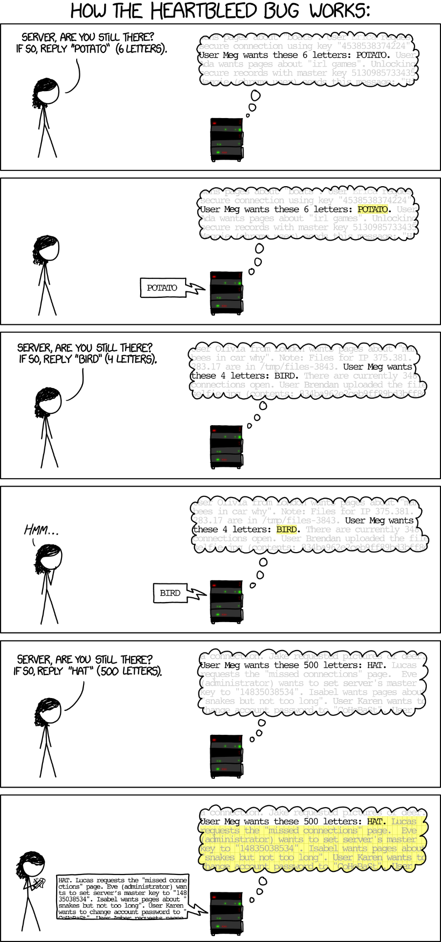
Programmers keep making these mistakes…
https://xkcd.com/1354/

Slide 18
Aside: Worms and Viruses
Worm: A program that
Can run by itself
Can propagate a fully working version of itself to other computers
Virus: Code that
Adds itself to other programs
Does not run independently
Both are (usually) designed to spread among computers and to wreak havoc

Slide 19
String Library Code
Implementation of Unix function gets()
No way to specify limit on number of characters to read
Similar problems with other library functions
strcpy, strcat: Copy strings of arbitrary length
scanf, fscanf, sscanf, when given %s conversion specification
/* Get string from stdin */
char *gets(char *dest) { int c = getchar();
char *p = dest;
while (c != EOF && c != '\n') {
*p++ = c;
c = getchar();
}
*p = '\0';
return dest;
}

Slide 20
Vulnerable Buffer Code
/* Echo Line */ void echo() { char buf[4]; /* Way too small! */ gets(buf); puts(buf); }
btw, how big
is big enough?
void call_echo() {
echo();
}
unix>./bufdemo-nsp
Type a string:01234567890123456789012
01234567890123456789012
unix>./bufdemo-nsp
Type a string:012345678901234567890123
012345678901234567890123
Segmentation Fault

Slide 21
Buffer Overflow Disassembly
echo:
000000000040069c <echo>:
40069c: 48 83 ec 18 sub $0x18,%rsp
4006a0: 48 89 e7 mov %rsp,%rdi
4006a3: e8 a5 ff ff ff callq 40064d <gets>
4006a8: 48 89 e7 mov %rsp,%rdi
4006ab: e8 50 fe ff ff callq 400500 <puts@plt>
4006b0: 48 83 c4 18 add $0x18,%rsp
4006b4: c3 retq
call_echo:
4006b5: 48 83 ec 08 sub $0x8,%rsp
4006b9: b8 00 00 00 00 mov $0x0,%eax
4006be: e8 d9 ff ff ff callq 40069c <echo>
4006c3: 48 83 c4 08 add $0x8,%rsp
4006c7: c3 retq

Slide 22
Buffer Overflow Stack Example
Before call to gets
Stack Frame
for call_echo
/* Echo Line */ void echo() { char buf[4]; /* Way too small! */ gets(buf); puts(buf); }
Return Address
(8 bytes)
20 bytes unused
[3]
[2]
[1]
[0]
buf
%rsp
echo:
subq $0x18, %rsp
movq %rsp, %rdi
call gets
. . .

Slide 23
Buffer Overflow Stack Example
Before call to gets
void echo() { char buf[4];
gets(buf); . . . }
echo:
subq $0x18, %rsp
movq %rsp, %rdi
call gets
. . .
Stack Frame
for call_echo
Return Address
(8 bytes)
00
00
00
00
00
40
06
c3
20 bytes unused
call_echo:
. . .
4006be: callq 4006cf <echo>
4006c3: add $0x8,%rsp
. . .
[3]
[2]
[1]
[0]
buf
%rsp

Slide 24
Buffer Overflow Stack Example #1
After call to gets
void echo() { char buf[4];
gets(buf); . . . }
echo:
subq $0x18, %rsp
movq %rsp, %rdi
call gets
. . .
Stack Frame
for call_echo
Return Address
(8 bytes)
00
00
00
00
00
40
06
c3
00
32
31
30
call_echo:
20 bytes unused
39
38
37
36
. . .
4006be: callq 4006cf <echo>
4006c3: add $0x8,%rsp
. . .
35
34
33
32
31
30
39
38
37
36
35
34
33
32
31
30
buf
%rsp
unix>./bufdemo-nsp
Type a string:01234567890123456789012
01234567890123456789012
“01234567890123456789012\0”
Overflowed buffer, but did not corrupt state

Slide 25
Buffer Overflow Stack Example #2
After call to gets
void echo() { char buf[4];
gets(buf); . . . }
echo:
subq $0x18, %rsp
movq %rsp, %rdi
call gets
. . .
Stack Frame
for call_echo
Return Address
(8 bytes)
00
00
00
00
00
40
06
00
33
32
31
30
call_echo:
20 bytes unused
39
38
37
36
. . .
4006be: callq 4006cf <echo>
4006c3: add $0x8,%rsp
. . .
35
34
33
32
31
30
39
38
37
36
35
34
33
32
31
30
buf
%rsp
unix>./bufdemo-nsp
Type a string:012345678901234567890123
012345678901234567890123
Segmentation fault
Program “returned” to 0x0400600, and then crashed.

Slide 26
Stack Smashing Attacks
void P(){
Q();
...
}
Stack after call to gets()
return
address
A
P stack frame
int Q() {
char buf[64];
gets(buf);
...
return ...;
}
A
A → S
A B
pad
data written
by gets()
Q stack frame
void S(){
/* Something
unexpected */
...
}
Overwrite normal return address A with address of some other code S
When Q executes ret, will jump to other code
Notes:
Jump from text to stack
Show string and code on stack

Slide 27
Crafting Smashing String
int echo() {
char buf[4];
gets(buf);
...
return ...;
}
Stack Frame
for call_echo
Return Address
(8 bytes)
00
00
07
FF
00
00
00
00
00
40
06
c3
FF
FF
AB
80
%rsp
Target Code
33
32
31
30
20 bytes unused
void smash() {
printf("I've been smashed!\n");
exit(0);
}
39
38
37
36
35
34
33
32
24 bytes
31
30
39
38
37
36
35
34
33
32
31
30
00000000004006c8 <smash>:
4006c8: 48 83 ec 08
Attack String (Hex)
30 31 32 33 34 35 36 37 38 39 30 31 32 33 34 35 36 37 38 39 30 31 32 33 c8 06 40 00 00 00 00 00

Slide 28
Smashing String Effect
Stack Frame
for call_echo
Return Address
(8 bytes)
00
00
07
FF
00
00
00
00
00
40
06
c8
FF
FF
AB
80
%rsp
Target Code
33
32
31
30
20 bytes unused
void smash() {
printf("I've been smashed!\n");
exit(0);
}
39
38
37
36
35
34
33
32
31
30
39
38
37
36
35
34
33
32
31
30
00000000004006c8 <smash>:
4006c8: 48 83 ec 08
Attack String (Hex)
30 31 32 33 34 35 36 37 38 39 30 31 32 33 34 35 36 37 38 39 30 31 32 33 c8 06 40 00 00 00 00 00

Slide 29
Performing Stack Smash
linux> cat smash-hex.txt
30 31 32 33 34 35 36 37 38 39 30 31 32 33 34 35 36 37 38 39 30 31 32 33 c8 06 40 00 00 00 00 00
linux> cat smash-hex.txt | ./hexify | ./bufdemo-nsp
Type a string:012345678901234567890123?@
I've been smashed!
Put hex sequence in file smash-hex.txt
Use hexify program to convert hex digits to characters
Some of them are non-printing
Provide as input to vulnerable program
void smash() {
printf("I've been smashed!\n");
exit(0);
}
30 31 32 33 34 35 36 37 38 39 30 31 32 33 34 35 36 37 38 39 30 31 32 33 c8 06 40 00 00 00 00 00

Slide 30
Code Injection Attacks
Stack after call to gets()
void P(){
Q();
...
}
P stack frame
return
address
A
A
B
A B
pad
int Q() {
char buf[64];
gets(buf);
...
return ...;
}
data written
by gets()
exploit
code
Q stack frame
B
Input string contains byte representation of executable code
Overwrite return address A with address of buffer B
When Q executes ret, will jump to exploit code
Notes:
Jump from text to stack
Show string and code on stack

Slide 31
How Does The Attack Code Execute?
rip
Stack
rsp
…
void P(){
Q();
...
}
rsp
A
B
A B
rsp
pad
rip
ret
ret
exploit
code
int Q() {
char buf[64];
gets(buf); // A->B
...
return ...;
}
Shared
Libraries
rip
Heap
Data
rip
Text
rip

Slide 32
What To Do About Buffer Overflow Attacks
Avoid overflow vulnerabilities
Employ system-level protections
Have compiler use “stack canaries”
Lets talk about each…

Slide 33
1. Avoid Overflow Vulnerabilities in Code (!)
/* Echo Line */ void echo() { char buf[4]; fgets(buf, 4, stdin); puts(buf); }
For example, use library routines that limit string lengths
fgets instead of gets
strncpy instead of strcpy
Don’t use scanf with %s conversion specification
Use fgets to read the string
Or use %ns where n is a suitable integer

Slide 34
2. System-Level Protections can help
Randomized stack offsets
At start of program, allocate random amount of space on stack
Shifts stack addresses for entire program
Makes it difficult for hacker to predict beginning of inserted code
E.g.: 5 executions of memory allocation code
Stack repositioned each time program executes
Stack base
Random
allocation
main
Application
Code
B?
pad
exploit
code
B?

Slide 35
2. System-Level Protections can help
Stack after call to gets()
Nonexecutable code segments
In traditional x86, can mark region of memory as either “read-only” or “writeable”
Can execute anything readable
x86-64 added explicit “execute” permission
Stack marked as non-executable
P stack frame
B
pad
data written
by gets()
exploit
code
Q stack frame
B
Any attempt to execute this code will fail

Slide 36
3. Stack Canaries can help
Idea
Place special value (“canary”) on stack just beyond buffer
Check for corruption before exiting function
GCC Implementation
-fstack-protector
Now the default (disabled earlier)
unix>./bufdemo-sp
Type a string:0123456
0123456
unix>./bufdemo-sp
Type a string:012345678
*** stack smashing detected ***

Slide 37
Protected Buffer Disassembly
echo:
Aside: %fs:0x28
Read from memory using segmented addressing
Segment is read-only
Value generated randomly every time program runs
40072f: sub $0x18,%rsp
400733: mov %fs:0x28,%rax
40073c: mov %rax,0x8(%rsp)
400741: xor %eax,%eax
400743: mov %rsp,%rdi
400746: callq 4006e0 <gets>
40074b: mov %rsp,%rdi
40074e: callq 400570 <puts@plt>
400753: mov 0x8(%rsp),%rax
400758: xor %fs:0x28,%rax
400761: je 400768 <echo+0x39>
400763: callq 400580 <__stack_chk_fail@plt>
400768: add $0x18,%rsp
40076c: retq

Slide 38
Setting Up Canary
Before call to gets
Stack Frame
for call_echo
/* Echo Line */ void echo() { char buf[4]; /* Way too small! */ gets(buf); puts(buf); }
Return Address
(8 bytes)
20 bytes unused
Canary
(8 bytes)
[3]
[2]
[1]
[0]
buf
%rsp
echo:
. . .
mov %fs:0x28, %rax # Get canary
mov %rax, 0x8(%rsp) # Place on stack
xor %eax, %eax # Erase register
. . .

Slide 39
Checking Canary
After call to gets
/* Echo Line */ void echo() { char buf[4]; /* Way too small! */ gets(buf); puts(buf); }
Stack Frame
for main
Return Address
(8 bytes)
Return Address
Saved %ebp
20 bytes unused
Saved %ebx
Some systems:
LSB of canary is 0x00
Allows input 01234567
Canary
(8 bytes)
Input: 0123456
Canary
[3]
[2]
[1]
[0]
00
36
35
34
33
32
31
30
buf
%rsp
echo:
. . .
mov 0x8(%rsp),%rax # Retrieve from stack
xor %fs:0x28,%rax # Compare to canary
je .L6 # If same, OK
call __stack_chk_fail # FAIL

Slide 40
Quiz Time!
Check out:
https://canvas.cmu.edu/courses/20895

Slide 41
Return-Oriented Programming Attacks
Challenge (for hackers)
Stack randomization makes it hard to predict buffer location
Marking stack nonexecutable makes it hard to insert binary code
Alternative Strategy
Use existing code
E.g., library code from stdlib
String together fragments to achieve overall desired outcome
Does not overcome stack canaries
Construct program from gadgets
Sequence of instructions ending in ret
Encoded by single byte 0xc3
Code positions fixed from run to run
Code is executable

Slide 42
Gadget Example #1
long ab_plus_c
(long a, long b, long c) {
return a*b + c;
}
00000000004004d0 <ab_plus_c>:
4004d0: 48 0f af fe imul %rsi,%rdi
4004d4: 48 8d 04 17 lea (%rdi,%rdx,1),%rax
4004d8: c3 retq
rax ← rdi + rdx
Gadget address = 0x4004d4
Use tail end of existing functions

Slide 43
Gadget Example #2
void setval(unsigned *p) {
*p = 3347663060u;
}
Encodes movq %rax, %rdi
<setval>:
4004d9: c7 07 d4 48 89 c7 movl $0xc78948d4,(%rdi)
4004df: c3 retq
rdi ← rax
Gadget address = 0x4004dc
Repurpose byte codes

Slide 44
ROP Execution
Stack
Gadget n code
c3
•
•
•
Gadget 2 code
c3
%rsp
Gadget 1 code
c3
Trigger with ret instruction
Will start executing Gadget 1
Final ret in each gadget will start next one
ret: pop address from stack and jump to that address

Slide 45
Crafting an ROP Attack String
Stack Frame
for call_echo
00
00
00
00
Return Address
(8 bytes)
Gadget #1
0x4004d4 rax ← rdi + rdx
Gadget #2
0x4004dc rdi ← rax
Combination
rdi ← rdi + rdx
00
40
04
dc
Return Address
(8 bytes)
00
00
00
00
00
40
04
d0
d4
%rsp
33
32
31
30
20 bytes unused
39
38
37
36
35
34
33
32
31
30
39
38
37
36
35
34
33
32
31
30
buf
Attack String (Hex)
30 31 32 33 34 35 36 37 38 39 30 31 32 33 34 35 36 37 38 39 30 31 32 33 d4 04 40 00 00 00 00 00 dc 04 40 00 00 00 00 00
Multiple gadgets will corrupt stack upwards

Slide 46
What Happens when echo returns?
Stack Frame
for call_echo
00
00
00
00
Return Address
(8 bytes)
Echo executes ret
Starts Gadget #1
Gadget #1 executes ret
Starts Gadget #2
Gadget #2 executes ret
Goes off somewhere ...
00
40
04
dc
Return Address
(8 bytes)
00
00
00
00
00
00
00
00
00
40
04
00
40
04
d4
%rsp
33
32
31
30
20 bytes unused
39
38
37
36
35
34
33
32
31
30
39
38
37
36
35
34
33
32
31
30
buf
Multiple gadgets will corrupt stack upwards

Slide 47
Today
Memory Layout
Buffer Overflow
Vulnerability
Protection
Unions

Slide 48
Union Allocation
Allocate according to largest element
Can only use one field at a time
union U1 {
char c;
int i[2];
double v;
} *up;
 | c
 | i[0] |  |  |  | i[1]
 | v
up+0 |  |  | up+4 |  |  |  |  | up+8
struct S1 {
char c;
int i[2];
double v;
} *sp;
 | c | 3 bytes |  |  | i[0] |  |  |  | i[1] |  |  |  | 4 bytes |  |  | v
sp+0 |  |  |  | sp+4 |  |  |  | sp+8 |  |  |  |  |  |  | sp+16 |  |  |  |  |  | sp+24

Slide 49
Using Union to Access Bit Patterns
typedef union {
float f;
unsigned u;
} bit_float_t;
 | u
 | f
0 |  |  |  | 4
float bit2float(unsigned u) {
bit_float_t arg;
arg.u = u;
return arg.f;
}
unsigned float2bit(float f) {
bit_float_t arg;
arg.f = f;
return arg.u;
}
Same as (float) u ?
Same as (unsigned) f ?

Slide 50
Byte Ordering Revisited
Idea
Short/long/quad words stored in memory as 2/4/8 consecutive bytes
Which byte is most (least) significant?
Can cause problems when exchanging binary data between machines
Big Endian
Most significant byte has lowest address
Sparc, Internet
Little Endian
Least significant byte has lowest address
Intel x86, ARM Android and IOS
Bi Endian
Can be configured either way
ARM

Slide 51
Byte Ordering Example
union {
unsigned char c[8];
unsigned short s[4];
unsigned int i[2];
unsigned long l[1];
} dw;
How are the bytes inside short/int/long stored?
Memory addresses growing
32-bit
c[0] | c[1] | c[2] | c[3] | c[4] | c[5] | c[6] | c[7]
s[0] |  | s[1] |  | s[2] |  | s[3]
i[0] |  |  |  | i[1]
l[0]
64-bit
c[0] | c[1] | c[2] | c[3] | c[4] | c[5] | c[6] | c[7]
s[0] |  | s[1] |  | s[2] |  | s[3]
i[0] |  |  |  | i[1]
l[0]

Slide 52
Byte Ordering Example (Cont).
int j;
for (j = 0; j < 8; j++)
dw.c[j] = 0xf0 + j;
printf("Characters 0-7 == [0x%x,0x%x,0x%x,0x%x,0x%x,0x%x,0x%x,0x%x]\n",
dw.c[0], dw.c[1], dw.c[2], dw.c[3],
dw.c[4], dw.c[5], dw.c[6], dw.c[7]);
printf("Shorts 0-3 == [0x%x,0x%x,0x%x,0x%x]\n",
dw.s[0], dw.s[1], dw.s[2], dw.s[3]);
printf("Ints 0-1 == [0x%x,0x%x]\n",
dw.i[0], dw.i[1]);
printf("Long 0 == [0x%lx]\n",
dw.l[0]);

Slide 53
Byte Ordering on IA32
Little Endian
f0 | f1 | f2 | f3 | f4 | f5 | f6 | f7
c[0] | c[1] | c[2] | c[3] | c[4] | c[5] | c[6] | c[7]
s[0] |  | s[1] |  | s[2] |  | s[3]
i[0] |  |  |  | i[1]
l[0]
LSB
MSB
LSB
MSB
Print
Output:
Characters 0-7 == [0xf0,0xf1,0xf2,0xf3,0xf4,0xf5,0xf6,0xf7]
Shorts 0-3 == [0xf1f0,0xf3f2,0xf5f4,0xf7f6]
Ints 0-1 == [0xf3f2f1f0,0xf7f6f5f4]
Long 0 == [0xf3f2f1f0]

Slide 54
Byte Ordering on Sun
Big Endian
f0 | f1 | f2 | f3 | f4 | f5 | f6 | f7
c[0] | c[1] | c[2] | c[3] | c[4] | c[5] | c[6] | c[7]
s[0] |  | s[1] |  | s[2] |  | s[3]
i[0] |  |  |  | i[1]
l[0]
MSB
LSB
MSB
LSB
Print
Output on Sun:
Characters 0-7 == [0xf0,0xf1,0xf2,0xf3,0xf4,0xf5,0xf6,0xf7]
Shorts 0-3 == [0xf0f1,0xf2f3,0xf4f5,0xf6f7]
Ints 0-1 == [0xf0f1f2f3,0xf4f5f6f7]
Long 0 == [0xf0f1f2f3]

Slide 55
Byte Ordering on x86-64
Little Endian
f0 | f1 | f2 | f3 | f4 | f5 | f6 | f7
c[0] | c[1] | c[2] | c[3] | c[4] | c[5] | c[6] | c[7]
s[0] |  | s[1] |  | s[2] |  | s[3]
i[0] |  |  |  | i[1]
l[0]
LSB
MSB
Print
Output on x86-64:
Characters 0-7 == [0xf0,0xf1,0xf2,0xf3,0xf4,0xf5,0xf6,0xf7]
Shorts 0-3 == [0xf1f0,0xf3f2,0xf5f4,0xf7f6]
Ints 0-1 == [0xf3f2f1f0,0xf7f6f5f4]
Long 0 == [0xf7f6f5f4f3f2f1f0]

Slide 56
Summary of Compound Types in C
Arrays
Contiguous allocation of memory
Aligned to satisfy every element’s alignment requirement
Pointer to first element
No bounds checking
Structures
Allocate bytes in order declared
Pad in middle and at end to satisfy alignment
Unions
Overlay declarations
Way to circumvent type system

Slide 57
Summary
Memory Layout
Buffer Overflow
Vulnerability
Protection
Code Injection Attack
Return Oriented Programming
Unions

