Slide 1
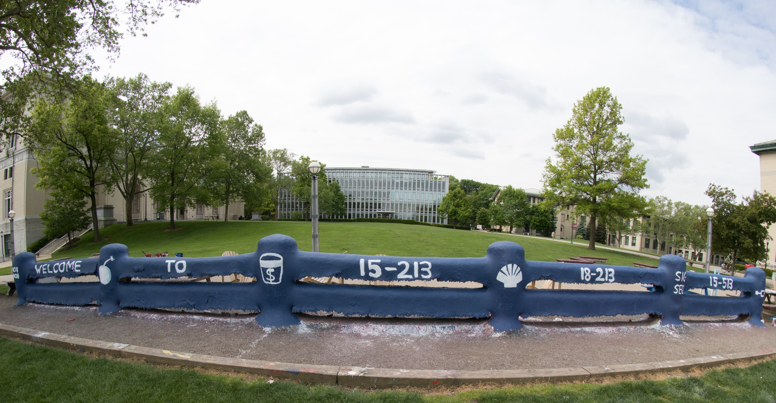
14-513
18-613

Slide 2
The Memory Hierarchy 15-213/18-213/15-513/18-613: Introduction to Computer Systems 10th Lecture, March 9th, 2021

Slide 3
Announcements
Midterm Exam Logistics (Tentative)
Available Tuesday the 16th – Thursday the 18th
3 hours, download through upload
The exam is what we’d typically give in 80 minutes, but we are allowing extra time to handle technical issues and because, in this mode, we aren’t rushed by class changes.
Extra time, etc, provided according to accommodations
Via Gradescope
Permitted resources:
Materials the course staff has supplied to you, e.g. via the official course Web page, Canvas, or Autolab, including directly linked materials, and the suggested/required textbooks. Additionally, those books suggested by course staff on Piazza are allowed.
Self-proctored
Taking a break is okay, but it counts toward the 3 hour time limit and you must avoid exposure to all but allowed resources during the break.

Slide 4
Exam Scope 1/4
Bits, Bytes, and Ints: Student should be able to convert among 2s complement, regular binary, hexadecimal, and decimal representations; do arithmetic; recognize and manage overflow and underflow and the numerical consequences; be able to recognize and write out important bit patterns; articulate limits; as well as be able to use C’s casting rules and do datalab-style problems.
Floats: Student should be able to recognize and translate numbers from into and out of IEEE-style representations, both normalized and denormalized; do arithmetic upon IEEE-style numbers, including that which crosses over the norm/denorm boundary and results in special numbers, e.g. NaN, infinity; recognize and articulate special bit patterns; round numbers; cast and compare among float and non-float types using C’s rules; and do datalab style puzzles.

Slide 5
Exam Scope 2/4
Machine programming: Students should be able to read and write basic assembly, similar to the in class example, including that which requires if statements, and loops (for, while, do). Students should be careful to understand the behavior of mov operations from smaller into larger registers, e.g. %edx to %rax, set operations and movzbl and similar, and lea vs mov. Students should also be familiar with the condition flags, how and when they are set, and how they are used.
Stack and calling convention: Students should understand the calling convention, including how registers are used to pass arguments, how caller- and callee- saved registers are managed across function calls, and how the stack is layed, for example, w.r.t. How, where, and in which stack frame (caller vs callee) allocations occur and what it looks like in assembly, e.g. local variables, arguments, and return address.

Slide 6
Exam Scope 3/4
Data representation: Students should understand how arrays (dynamic and static) are represented in memory, how they are accessed in C and assembly, and what row-major ordering is and that it is used. They should understand how structs are organized in memory and how they are accessed in C and assembly. They should understand alignment, the alignment rules, and how this affects data, especially structs. They should understand to use sizeof() in C and why. They should be able to read and write code, in assembly and C, to access complex types, e.g. arrays of structs or structs containing arrays, or even arrays containing structs containing arrays. Students should be cautions about type sizes, e.g. statically allocated arrays vs pointers vs scalar types.

Slide 7
Exam Scope 4/4
Caching: Students should understand the organization of direct and set-associative caches and be able to draw a figure representing the cache organization from the parameters. Given all but one of the parameters for a cache, students should be able to derive the missing parameter. Given a cache configuration and a set of memory accesses, students should be able to simulate the accesses to identify the hits, misses, and associated rates. Given C or assembly code which accesses memory within one or more loops, possibly nested, students should be able to estimate the hit or miss rate. Students should understand why the miss rate is a more intuitive metric than the hit rate. Given cache performance parameters, e.g. miss rates, and access times, students should be able to compute the effective memory access time.

Slide 8
Today
The memory abstraction
RAM : main memory building block
Locality of reference
The memory hierarchy
Storage technologies and trends

Slide 9
Writing & Reading Memory
Write
Transfer data from CPU to memory movq %rax, 8(%rsp)
“Store” operation
Read
Transfer data from memory to CPU movq 8(%rsp), %rax
“Load” operation
From 5th lecture

Slide 10
Traditional Bus Structure Connecting CPU and Memory
A bus is a collection of parallel wires that carry address, data, and control signals.
Buses are typically shared by multiple devices.
CPU chip
Register file
ALU
System bus
Memory bus
Main
memory
Bus interface
I/O
bridge

Slide 11
Memory Read Transaction (1)
CPU places address A on the memory bus.
CPU chip
Register file
Load operation: movq A, %rax
ALU
%rax
Main memory
I/O bridge
A
0
Bus interface
x
A

Slide 12
Memory Read Transaction (2)
Main memory reads A from the memory bus, retrieves word x, and places it on the bus.
Register file
Load operation: movq A, %rax
ALU
%rax
Main memory
I/O bridge
x
0
Bus interface
x
A

Slide 13
Memory Read Transaction (3)
CPU read word x from the bus and copies it into register %rax.
Register file
Load operation: movq A, %rax
ALU
%rax
x
Main memory
I/O bridge
0
Bus interface
x
A

Slide 14
Memory Write Transaction (1)
CPU places address A on bus. Main memory reads it and waits for the corresponding data word to arrive.
Register file
Store operation: movq %rax, A
ALU
%rax
y
Main memory
I/O bridge
A
0
Bus interface
A

Slide 15
Memory Write Transaction (2)
CPU places data word y on the bus.
Register file
Store operation: movq %rax, A
ALU
%rax
y
Main memory
I/O bridge
y
0
Bus interface
A

Slide 16
Memory Write Transaction (3)
Main memory reads data word y from the bus and stores it at address A.
Register file
Store operation: movq %rax, A
ALU
%rax
y
Main memory
I/O bridge
0
Bus interface
y
A

Slide 17
Today
The memory abstraction
RAM : main memory building block
Locality of reference
The memory hierarchy
Storage technologies and trends

Slide 18
Random-Access Memory (RAM)
Key features
RAM is traditionally packaged as a chip.
or embedded as part of processor chip
Basic storage unit is normally a cell (one bit per cell).
Multiple RAM chips form a memory.
RAM comes in two varieties:
SRAM (Static RAM)
DRAM (Dynamic RAM)

Slide 19
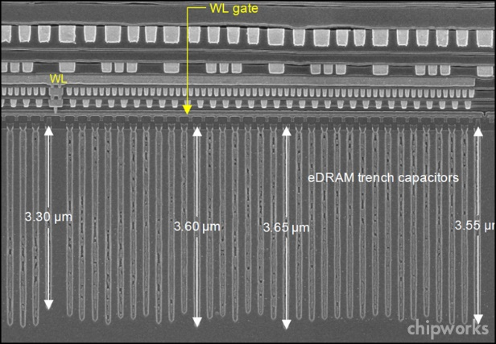
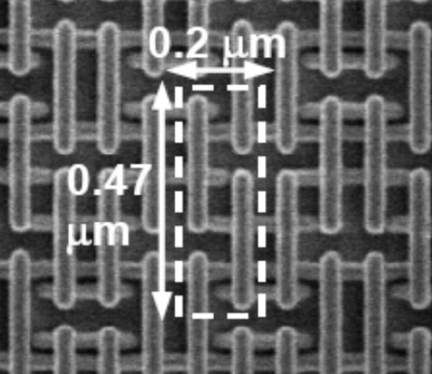
RAM Technologies
DRAM
1 Transistor + 1 capacitor / bit
Capacitor oriented vertically
Must refresh state periodically
SRAM
6 transistors / bit
Holds state indefinitely (but will still lose data on power loss)

Slide 20
SRAM vs DRAM Summary
Trans. Access Needs Needs
per bit time refresh? EDC? Cost Applications
SRAM 6 or 8 1x No Maybe 100x Cache memories
DRAM 1 10x Yes Yes 1x Main memories,
frame buffers
EDC: Error detection and correction
Trends
SRAM scales with semiconductor technology
Reaching its limits
DRAM scaling limited by need for minimum capacitance
Aspect ratio limits how deep can make capacitor
Also reaching its limits

Slide 21
Enhanced DRAMs
Operation of DRAM cell has not changed since its invention
Commercialized by Intel in 1970.
DRAM cores with better interface logic and faster I/O :
Synchronous DRAM (SDRAM)
Uses a conventional clock signal instead of asynchronous control
Double data-rate synchronous DRAM (DDR SDRAM)
Double edge clocking sends two bits per cycle per pin
Different types distinguished by size of small prefetch buffer:
DDR (2 bits), DDR2 (4 bits), DDR3 (8 bits), DDR4 (16 bits)
By 2010, standard for most server and desktop systems
Intel Core i7 supports DDR3 and DDR4 SDRAM

Slide 22
Conventional DRAM Organization
d x w DRAM:
d⋅ w total bits organized as d supercells of size w bits
16 x 8 DRAM chip (toy example)
cols
Memory
controller
0
1
2
3
2 bits
/
0
addr
1
rows
2
supercell
(2,1)
(to/from CPU)
3
8 bits
/
data
Internal row buffer
Notes:
~8kB rowbuffer

Slide 23
Reading DRAM Supercell (2,1)
Step 1(a): Row access strobe (RAS) selects row 2.
Step 1(b): Row 2 copied from DRAM array to row buffer.
16 x 8 DRAM chip
Cols
Memory
controller
RAS = 2
0
1
2
3
2
/
0
addr
1
Rows
2
8
/
3
data
Internal row buffer

Slide 24
Reading DRAM Supercell (2,1)
Step 2(a): Column access strobe (CAS) selects column 1.
Step 2(b): Supercell (2,1) copied from buffer to data lines, and eventually back to the CPU.
Step 3: All data written back to row to provide refresh
16 x 8 DRAM chip
Cols
Memory
controller
CAS = 1
0
1
2
3
2
/
0
addr
To CPU
1
Rows
2
supercell
(2,1)
3
8
/
data
supercell
(2,1)
Internal row buffer

Slide 25
Memory Modules
addr (row = i, col = j)
: supercell (i,j)
DRAM 0
64 MB
memory module
consisting of
eight 8Mx8 DRAMs
DRAM 7
bits
56-63
bits
48-55
bits
40-47
bits
32-39
bits
24-31
bits
16-23
bits
8-15
bits
0-7
63
63
56
56
55
55
48
48
47
47
40
40
39
39
32
32
31
31
24
24
23
23
16
16
15
15
8
8
7
7
0
0
Memory
controller
64-bit word main memory address A
64-bit word

Slide 26
Today
The memory Abstraction
DRAM : main memory building block
Locality of reference
The memory hierarchy
Storage technologies and trends

Slide 27
The CPU-Memory Gap
The gap widens between DRAM, disk, and CPU speeds.
Disk
SSD
DRAM
CPU
Effective CPU cycle time: accounts for parallelism within CPU (e.g., multiple cores per CPU)

Slide 28
Locality to the Rescue!
The key to bridging this CPU-Memory gap is a fundamental property of computer programs known as locality.

Slide 29
Locality
Principle of Locality: Programs tend to use data and instructions with addresses near or equal to those they have used recently
Temporal locality:
Recently referenced items are likely to be referenced again in the near future
Spatial locality:
Items with nearby addresses tend to be referenced close together in time

Slide 30
Locality Example
sum = 0;
for (i = 0; i < n; i++)
sum += a[i];
return sum;
Spatial or Temporal
Locality?
Data references
Reference array elements in succession (stride-1 reference pattern).
Reference variable sum each iteration.
Instruction references
Reference instructions in sequence.
Cycle through loop repeatedly.
spatial
temporal
spatial
temporal

Slide 31
Qualitative Estimates of Locality
Claim: Being able to look at code and get a qualitative sense of its locality is a key skill for a professional programmer.
Question: Does this function have good locality with respect to array a?
int sum_array_rows(int a[M][N])
{
int i, j, sum = 0;
for (i = 0; i < M; i++)
for (j = 0; j < N; j++)
sum += a[i][j];
return sum;
}
Hint: array layout is row-major order
Answer: yes
Stride-1 reference
pattern
• • •
a
[0]
[0]
a
[0]
[N-1]
• • •
a
[1]
[0]
a
[1]
[N-1]
• • •
• • •
a
[M-1]
[0]
a
[M-1]
[N-1]

Slide 32
Locality Example
Question: Does this function have good locality with respect to array a?
int sum_array_cols(int a[M][N])
{
int i, j, sum = 0;
for (j = 0; j < N; j++)
for (i = 0; i < M; i++)
sum += a[i][j];
return sum;
}
Answer: no
Stride N reference
pattern
Note: If M is very small
then good locality. Why?
• • •
a
[0]
[0]
a
[0]
[N-1]
• • •
a
[1]
[0]
a
[1]
[N-1]
• • •
• • •
a
[M-1]
[0]
a
[M-1]
[N-1]

Slide 33
Locality Example
Question: Can you permute the loops so that the function scans the 3-d array a with a stride-1 reference pattern (and thus has good spatial locality)?
int sum_array_3d(int a[M][N][N])
{
int i, j, k, sum = 0;
for (i = 0; i < N; i++)
for (j = 0; j < N; j++)
for (k = 0; k < M; k++)
sum += a[k][i][j];
return sum;
}
$ time ./loopijk
real 0m2.765s
user 0m2.328s
sys 0m0.422s
$ time ./loopkij
real 0m1.651s
user 0m1.234s
sys 0m0.422s
Answer: make j the inner loop

Slide 34
Today
The memory abstraction
DRAM : main memory building block
Locality of reference
The memory hierarchy
Storage technologies and trends

Slide 35
Memory Hierarchies
Some fundamental and enduring properties of hardware and software:
Fast storage technologies cost more per byte, have less capacity, and require more power (heat!).
The gap between CPU and main memory speed is widening.
Well-written programs tend to exhibit good locality.
These fundamental properties complement each other beautifully.
They suggest an approach for organizing memory and storage systems known as a memory hierarchy.

Slide 36
Example Memory Hierarchy
L0:
Regs
CPU registers hold words retrieved from the L1 cache.
Smaller,
faster,
and
costlier
(per byte)
storage
devices
L1:
L1 cache
(SRAM)
L1 cache holds cache lines retrieved from the L2 cache.
L2:
L2 cache
(SRAM)
L2 cache holds cache lines
retrieved from L3 cache.
L3:
L3 cache
(SRAM)
L3 cache holds cache lines
retrieved from main memory.
Larger,
slower,
and
cheaper
(per byte)
storage
devices
L4:
Main memory
(DRAM)
Main memory holds disk blocks retrieved from local disks.
L5:
Local secondary storage
(local disks)
Local disks hold files retrieved from disks
on remote servers.
L6:
Remote secondary storage
(e.g., Web servers)

Slide 37
Caches
Cache: A smaller, faster storage device that acts as a staging area for a subset of the data in a larger, slower device.
Fundamental idea of a memory hierarchy:
For each k, the faster, smaller device at level k serves as a cache for the larger, slower device at level k+1.
Why do memory hierarchies work?
Because of locality, programs tend to access the data at level k more often than they access the data at level k+1.
Thus, the storage at level k+1 can be slower, and thus larger and cheaper per bit.
Big Idea (Ideal): The memory hierarchy creates a large pool of storage that costs as much as the cheap storage near the bottom, but that serves data to programs at the rate of the fast storage near the top.

Slide 38
General Cache Concepts
Smaller, faster, more expensive
memory caches a subset of
the blocks
Cache
8
4
9
14
10
3
Data is copied in block-sized transfer units
4
10
Larger, slower, cheaper memory
viewed as partitioned into “blocks”
Memory
0
1
2
3
4
4
5
6
7
8
9
10
10
11
12
13
14
15

Slide 39
General Cache Concepts: Hit
Request: 14
Data in block b is needed
Block b is in cache:
Hit!
Cache
8
9
14
3
14
Memory
0
1
2
3
4
5
6
7
8
9
10
11
12
13
14
15

Slide 40
General Cache Concepts: Miss
Request: 12
Data in block b is needed
Block b is not in cache:
Miss!
Cache
8
9
14
3
12
Block b is fetched from
memory
12
Request: 12
Block b is stored in cache
Placement policy: determines where b goes
Replacement policy: determines which block gets evicted (victim)
Memory
0
1
2
3
4
5
6
7
8
9
10
11
12
12
13
14
15
Impact of spatial locality on number of misses?

Slide 41
General Caching Concepts: 3 Types of Cache Misses
Cold (compulsory) miss
Cold misses occur because the cache starts empty and this is the first reference to the block.
Capacity miss
Occurs when the set of active cache blocks (working set) is larger than the cache.
Conflict miss
Most caches limit blocks at level k+1 to a small subset (sometimes a singleton) of the block positions at level k.
E.g. Block i at level k+1 must be placed in block (i mod 4) at level k.
Conflict misses occur when the level k cache is large enough, but multiple data objects all map to the same level k block.
E.g. Referencing blocks 0, 8, 0, 8, 0, 8, ... would miss every time.

Slide 42
Examples of Caching in the Mem. Hierarchy
Cache Type
What is Cached?
Where is it Cached?
Latency (cycles)
Managed By
Registers
4-8 byte words
CPU core
0
Compiler
TLB
Address translations
On-Chip TLB
0
Hardware MMU
L1 cache
64-byte blocks
On-Chip L1
4
Hardware
L2 cache
64-byte blocks
On-Chip L2
10
Hardware
Virtual Memory
4-KB pages
Main memory
100
Hardware + OS
Buffer cache
Parts of files
Main memory
100
OS
Disk cache
Disk sectors
Disk controller
100,000
Disk firmware
Network buffer cache
Parts of files
Local disk
10,000,000
NFS client
Browser cache
Web pages
Local disk
10,000,000
Web browser
Web cache
Web pages
Remote server disks
1,000,000,000
Web proxy server

Slide 43
Quiz Time!
Check out:
https://canvas.cmu.edu/courses/20895

Slide 44
Today
The memory abstraction
RAM : main memory building block
Locality of reference
The memory hierarchy
Storage technologies and trends

Slide 45
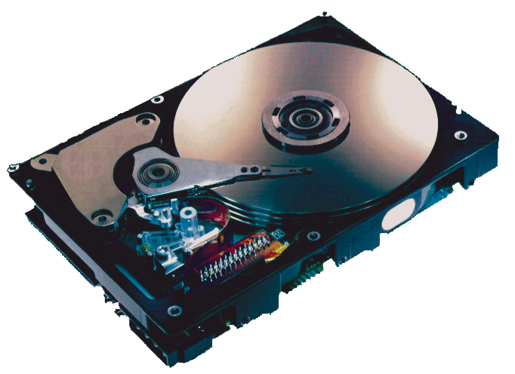
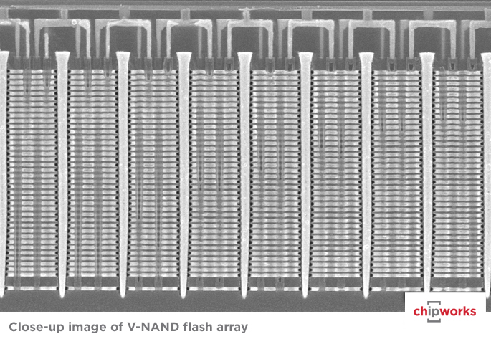
Storage Technologies
Magnetic Disks
Store on magnetic medium
Electromechanical access
Nonvolatile (Flash) Memory
Store as persistent charge
Implemented with 3-D structure
100+ levels of cells
3 bits data per cell

Slide 46
What’s Inside A Disk Drive?
Spindle
Arm
Platters
Actuator
Electronics
(including a
processor
and memory!)
SCSI
connector
Image courtesy of Seagate Technology

Slide 47
Disk Geometry
Disks consist of platters, each with two surfaces.
Each surface consists of concentric rings called tracks.
Each track consists of sectors separated by gaps.
Tracks
Surface
Track k
Gaps
Spindle
Sectors

Slide 48
Disk Capacity
Capacity: maximum number of bits that can be stored.
Vendors express capacity in units of gigabytes (GB) or terabytes (TB), where 1 GB = 10⁹ Bytes and 1 TB = 10¹² Bytes
Capacity is determined by these technology factors:
Recording density (bits/in): number of bits that can be squeezed into a 1 inch segment of a track.
Track density (tracks/in): number of tracks that can be squeezed into a 1 inch radial segment.
Areal density (bits/in²): product of recording and track density.
Tracks

Slide 49
Disk Operation (Single-Platter View)
The disk surface
spins at a fixed
rotational rate
The read/write head
is attached to the end
of the arm and flies over
the disk surface on
a thin cushion of air.
spindle
spindle
spindle
spindle
spindle
By moving radially, the arm can position the read/write head over any track.

Slide 50
Disk Operation (Multi-Platter View)
Read/write heads
move in unison
from cylinder to cylinder
Arm
Spindle

Slide 51
Disk Access – Service Time Components
After BLUE read
Seek for RED
Rotational latency
After RED read
Data transfer
Seek
Rotational
latency
Data transfer
Notes:
Goal:
Show the inefficeincy of current disk requests.
Conveyed Ideas:
Rotational latency is wasted time that can be used to service tasks
Background Information:
None.
Slide Background:
None.
Kill text and arrows

Slide 52
Disk Access Time
Average time to access some target sector approximated by:
T_{access} = T_{avg seek} + T_{avg rotation} + T_{avg transfer}
Seek time (T_{avg seek})
Time to position heads over cylinder containing target sector.
Typical T_{avg seek} is 3—9 ms
Rotational latency (T_{avg rotation})
Time waiting for first bit of target sector to pass under r/w head.
T_{avg rotation} = 1/2 x 1/RPMs x 60 sec/1 min
Typical rotational rate = 7,200 RPMs
Transfer time (T_{avg transfer})
Time to read the bits in the target sector.
T_{avg transfer} = 1/RPM x 1/(avg # sectors/track) x 60 secs/1 min
time for one rotation (in minutes)
fraction of a rotation to be read

Slide 53
Disk Access Time Example
Given:
Rotational rate = 7,200 RPM
Average seek time = 9 ms
Avg # sectors/track = 400
Derived:
T_{avg rotation} = 1/2 x (60 secs/7200 RPM) x 1000 ms/sec = 4 ms
T_{avg transfer} = 60/7200 x 1/400 x 1000 ms/sec = 0.02 ms
T_{access} = 9 ms + 4 ms + 0.02 ms
Important points:
Access time dominated by seek time and rotational latency.
First bit in a sector is the most expensive, the rest are free.
SRAM access time is about 4 ns/doubleword, DRAM about 60 ns
Disk is about 40,000 times slower than SRAM,
2,500 times slower than DRAM.

Slide 54
I/O Bus
CPU chip
Register file
ALU
System bus
Memory bus
Main
memory
Bus interface
I/O
bridge
I/O bus
Expansion slots for
other devices such
as network adapters.
USB
controller
Graphics
adapter
Disk
controller
Mouse
Keyboard
Monitor
Disk

Slide 55
Reading a Disk Sector (1)
CPU chip
CPU initiates a disk read by writing a command, logical block number, and destination memory address to a port (address) associated with disk controller.
Register file
ALU
Main
memory
Bus interface
I/O bus
USB
controller
Graphics
adapter
Disk
controller
mouse
keyboard
Monitor
Disk

Slide 56
Reading a Disk Sector (2)
CPU chip
Register file
Disk controller reads the sector and performs a direct memory access (DMA) transfer into main memory.
ALU
Main
memory
Bus interface
I/O bus
USB
controller
Graphics
adapter
Disk
controller
Mouse
Keyboard
Monitor
Disk

Slide 57
Reading a Disk Sector (3)
CPU chip
When the DMA transfer completes, the disk controller notifies the CPU with an interrupt (i.e., asserts a special “interrupt” pin on the CPU).
Register file
ALU
Main
memory
Bus interface
I/O bus
USB
controller
Graphics
adapter
Disk
controller
Mouse
Keyboard
Monitor
Disk

Slide 58
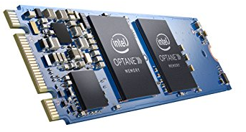
Nonvolatile Memories
DRAM and SRAM are volatile memories
Lose information if powered off.
Nonvolatile memories retain value even if powered off
Read-only memory (ROM): programmed during production
Electrically eraseable PROM (EEPROM): electronic erase capability
Flash memory: EEPROMs, with partial (block-level) erase capability
Wears out after about 100,000 erasings
3D XPoint (Intel Optane) & emerging NVMs
New materials
Uses for Nonvolatile Memories
Firmware programs stored in a ROM (BIOS, controllers for disks, network cards, graphics accelerators, security subsystems,…)
Solid state disks (replacing rotating disks)
Disk caches

Slide 59
Solid State Disks (SSDs)
I/O bus
Requests to read and
write logical disk blocks
Solid State Disk (SSD)
Flash
translation layer
DRAM
Buffer
Flash memory
Block 0
Block B-1
…
…
…
Page 0
Page 1
Page P-1
Page 0
Page 1
Page P-1
Pages: 512KB to 4KB, Blocks: 32 to 128 pages
Data read/written in units of pages.
Page can be written only after its block has been erased.
A block wears out after about 100,000 repeated writes.

Slide 60
SSD Performance Characteristics
Benchmark of Samsung 940 EVO Plus
Sequential access faster than random access
Common theme in the memory hierarchy
Random writes are somewhat slower
Erasing a block takes a long time (~1 ms).
Modifying a block page requires all other pages to be copied to new block.
Flash translation layer allows accumulating series of small writes before doing block write.
https://ssd.userbenchmark.com/SpeedTest/711305/Samsung-SSD-970-EVO-Plus-250GB
Sequential read throughput 2,126 MB/s Sequential write tput 1,880 MB/s
Random read throughput 140 MB/s Random write tput 59 MB/s

Slide 61
SSD Tradeoffs vs Rotating Disks
Advantages
No moving parts → faster, less power, more rugged
Disadvantages
Have the potential to wear out
Mitigated by “wear leveling logic” in flash translation layer
E.g. Samsung 940 EVO Plus guarantees 600 writes/byte of writes before they wear out
Controller migrates data to minimize wear level
In 2019, about 4 times more expensive per byte
And, relative cost will keep dropping
Applications
Smartphones, laptops
Increasingly common in desktops and servers

Slide 62
Summary
The speed gap between CPU, memory and mass storage continues to widen.
Well-written programs exhibit a property called locality.
Memory hierarchies based on caching close the gap by exploiting locality.
Flash memory progress outpacing all other memory and storage technologies (DRAM, SRAM, magnetic disk)
Able to stack cells in three dimensions

Slide 63
Supplemental slides

Slide 64
Storage Trends
SRAM
Metric 1985 1990 1995 2000 2005 2010 2015 2015:1985
$/MB 2,900 320 256 100 75 60 320 116
access (ns) 150 35 15 3 2 1.5 200 115
DRAM
Metric 1985 1990 1995 2000 2005 2010 2015 2015:1985
$/MB 880 100 30 1 0.1 0.06 0.02 44,000
access (ns) 200 100 70 60 50 40 20 10
typical size (MB) 0.256 4 16 64 2,000 8,000 16.000 62,500
Disk
Metric 1985 1990 1995 2000 2005 2010 2015 2015:1985
$/GB 100,000 8,000 300 10 5 0.3 0.03 3,333,333
access (ms) 75 28 10 8 5 3 3 25
typical size (GB) 0.01 0.16 1 20 160 1,500 3,000 300,000

Slide 65
CPU Clock Rates
Inflection point in computer history
when designers hit the “Power Wall”
1985 1990 1995 2003 2005 2010 2015 2015:1985
CPU 80286 80386 Pentium P-4 Core 2 Core i7(n) Core i7(h)
Clock
rate (MHz) 6 20 150 3,300 2,000 2,500 3,000 500
Cycle
time (ns) 166 50 6 0.30 0.50 0.4 0.33 500
Cores 1 1 1 1 2 4 4 4
Effective
cycle 166 50 6 0.30 0.25 0.10 0.08 2,075
time (ns)
(n) Nehalem processor
(h) Haswell processor

