Slide 1
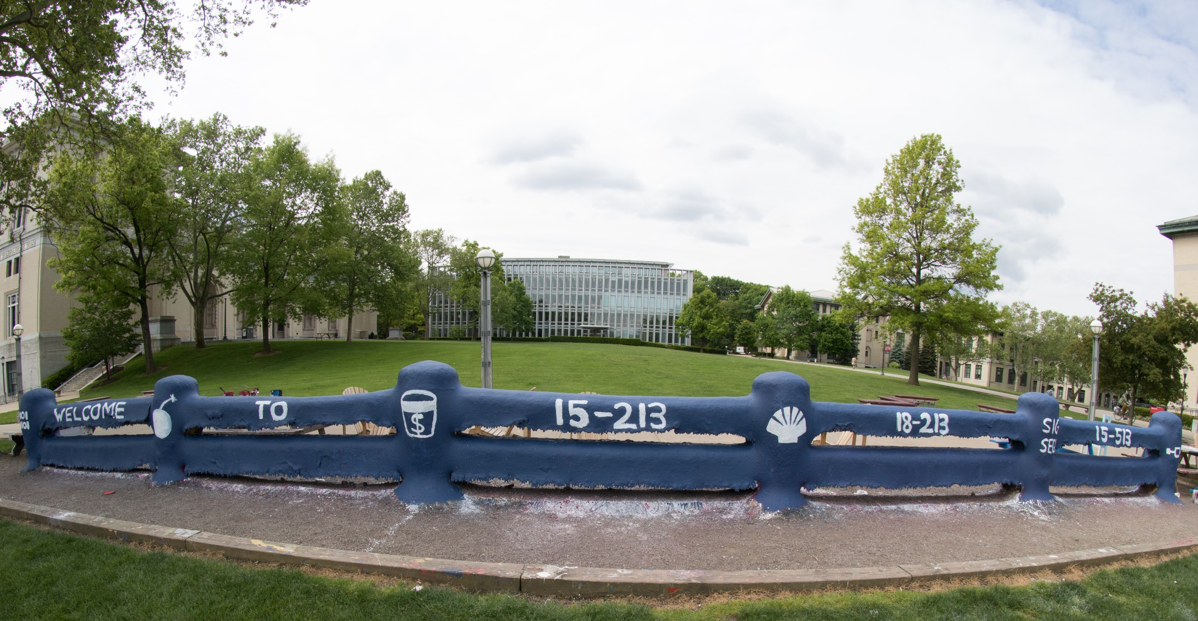
14-513
18-613

Slide 3
Today
Cache organization and operation
Performance impact of caches
The memory mountain
Rearranging loops to improve spatial locality
Using blocking to improve temporal locality

Slide 4
The Memory Mountain
Read throughput (read bandwidth)
Number of bytes read from memory per second (MB/s)
Memory mountain: Measured read throughput as a function of spatial and temporal locality.
Compact way to characterize memory system performance.

Slide 5
Memory Mountain Test Function
long data[MAXELEMS]; /* Global array to traverse */
/* test - Iterate over first "elems" elements of
* array "data" with stride of "stride“,
* using 4x4 loop unrolling.
*/
int test(int elems, int stride) {
long i, sx2=stride*2, sx3=stride*3, sx4=stride*4;
long acc0 = 0, acc1 = 0, acc2 = 0, acc3 = 0;
long length = elems, limit = length - sx4;
/* Combine 4 elements at a time */
for (i = 0; i < limit; i += sx4) {
acc0 = acc0 + data[i];
acc1 = acc1 + data[i+stride];
acc2 = acc2 + data[i+sx2];
acc3 = acc3 + data[i+sx3];
}
/* Finish any remaining elements */
for (; i < length; i++) {
acc0 = acc0 + data[i];
}
return ((acc0 + acc1) + (acc2 + acc3));
}
Call test() with many combinations of elems
and stride.
For each elems and stride:
1. Call test() once to warm up the caches.
2. Call test() again and measure the read throughput(MB/s)
mountain/mountain.c

Slide 6
The Memory Mountain
Core i7 Haswell
2.1 GHz
32 KB L1 d-cache
256 KB L2 cache
8 MB L3 cache
64 B block size
Aggressive prefetching
L1
Ridges
of temporal locality
L2
L3
Slopes
of spatial locality
Mem
Notes:
Slopes of spatial locality – increase stride, degrade throughput because burn through blocks faster
Ridges of temporal – As increase size, can’t fit in level of cache any more, drop to next one down. Data in cache because of warm up before test run.
Prefetching – do better than we expect.

Slide 7
Today
Cache organization and operation
Performance impact of caches
The memory mountain
Rearranging loops to improve spatial locality
Using blocking to improve temporal locality

Slide 8
Matrix Multiplication Example
Description:
Multiply N x N matrices
Matrix elements are doubles (8 bytes)
O(N³) total operations
N reads per source element
N values summed per destination
but may be able to hold in register
Variable sum
held in register
/* ijk */
for (i=0; i<n; i++) {
for (j=0; j<n; j++) {
sum = 0.0;
for (k=0; k<n; k++)
sum += a[i][k] * b[k][j];
c[i][j] = sum;
}
}
matmult/mm.c

Slide 9
Miss Rate Analysis for Matrix Multiply
Assume:
Block size = 32B (big enough for four doubles)
Matrix dimension (N) is very large
Approximate 1/N as 0.0
Cache is not even big enough to hold multiple rows
Analysis Method:
Look at access pattern of inner loop
j
k
j
=
x
i
i
k
C
A
B

Slide 10
Layout of C Arrays in Memory (review)
C arrays allocated in row-major order
each row in contiguous memory locations
Stepping through columns in one row:
for (i = 0; i < N; i++)
sum += a[0][i];
accesses successive elements
if block size (B) > sizeof(a_{ij}) bytes, exploit spatial locality
miss rate = sizeof(a_{ij}) / B
Stepping through rows in one column:
for (i = 0; i < n; i++)
sum += a[i][0];
accesses distant elements
no spatial locality!
miss rate = 1 (i.e. 100%)

Slide 11
Matrix Multiplication (ijk)
/* ijk */
for (i=0; i<n; i++) {
for (j=0; j<n; j++) {
sum = 0.0;
for (k=0; k<n; k++)
sum += a[i][k] * b[k][j];
c[i][j] = sum;
}
}
Inner loop:
(*,j)
(i,j)
(i,*)
A
B
C
matmult/mm.c
Row-wise
Column-
wise
Fixed
Miss rate for inner loop iterations:
A B C
0.25 1.0 0.0
Block size = 32B (four doubles)

Slide 12
Matrix Multiplication (kij)
/* kij */
for (k=0; k<n; k++) {
for (i=0; i<n; i++) {
r = a[i][k];
for (j=0; j<n; j++)
c[i][j] += r * b[k][j];
}
}
Inner loop:
(i,k)
(k,*)
(i,*)
A
B
C
matmult/mm.c
Fixed
Row-wise
Row-wise
Miss rate for inner loop iterations:
A B C
0.0
0.25
0.25
Block size = 32B (four doubles)

Slide 13
Matrix Multiplication (jki)
Inner loop:
/* jki */
for (j=0; j<n; j++) {
for (k=0; k<n; k++) {
r = b[k][j];
for (i=0; i<n; i++)
c[i][j] += a[i][k] * r;
}
}
(*,k)
(*,j)
(k,j)
A
B
C
matmult/mm.c
Column-
wise
Fixed
Column-
wise
Miss rate for inner loop iterations:
A B C
0.0
1.0
1.0
Block size = 32B (four doubles)

Slide 14
Summary of Matrix Multiplication
for (i=0; i<n; i++) {
for (j=0; j<n; j++) {
sum = 0.0;
for (k=0; k<n; k++)
sum += a[i][k] * b[k][j];
c[i][j] = sum;
}
}
ijk (& jik):
2 loads, 0 stores
avg misses/iter = 1.25
for (k=0; k<n; k++) {
for (i=0; i<n; i++) {
r = a[i][k];
for (j=0; j<n; j++)
c[i][j] += r * b[k][j];
}
}
kij (& ikj):
2 loads, 1 store
avg misses/iter = 0.5
for (j=0; j<n; j++) {
for (k=0; k<n; k++) {
r = b[k][j];
for (i=0; i<n; i++)
c[i][j] += a[i][k] * r;
}
}
jki (& kji):
2 loads, 1 store
avg misses/iter = 2.0

Slide 15
Core i7 Matrix Multiply Performance
Cycles per inner loop iteration
jki / kji (2.0)
ijk / jik (1.25)
kij / ikj (0.5)

Slide 16
Today
Cache organization and operation
Performance impact of caches
The memory mountain
Rearranging loops to improve spatial locality
Using blocking to improve temporal locality

Slide 17
Example: Matrix Multiplication
c = (double *) calloc(sizeof(double), n*n);
/* Multiply n x n matrices a and b */
void mmm(double *a, double *b, double *c, int n) {
int i, j, k;
for (i = 0; i < n; i++)
for (j = 0; j < n; j++)
for (k = 0; k < n; k++)
c[i*n + j] += a[i*n + k] * b[k*n + j];
}
j
c
a
b
=
x
i

Slide 18
Cache Miss Analysis
Assume:
Matrix elements are doubles
Cache line = 8 doubles
Cache size C << n (much smaller than n)
First iteration:
n/8 + n = 9n/8 misses
Afterwards in cache: (schematic)
n
=
x
=
x
8 wide
Notes:
n/8 – comes from taking n and doing it in chunks of 8 that fit in a cache line, with perfect stride 1 accesses across the row
N – comes from missing on everything but the 1 double needed going down a column

Slide 19
Cache Miss Analysis
Assume:
Matrix elements are doubles
Cache line = 8 doubles
Cache size C << n (much smaller than n)
Second iteration:
Again: n/8 + n = 9n/8 misses
Total misses:
9n/8 n² = (9/8) n³
n
=
x
8 wide

Slide 20
Blocked Matrix Multiplication
c = (double *) calloc(sizeof(double), n*n);
/* Multiply n x n matrices a and b */
void mmm(double *a, double *b, double *c, int n) {
int i, j, k;
for (i = 0; i < n; i+=L)
for (j = 0; j < n; j+=L)
for (k = 0; k < n; k+=L)
/* L x L mini matrix multiplications */
for (i1 = i; i1 < i+L; i1++)
for (j1 = j; j1 < j+L; j1++)
for (k1 = k; k1 < k+L; k1++)
c[i1*n+j1] += a[i1*n + k1]*b[k1*n + j1];
}
matmult/bmm.c
j1
c
a
b
c
=
x
+
i1
Block size L x L

Slide 21
Cache Miss Analysis
Assume:
Cache line = 8 doubles. Blocking size L ≥ 8
Cache size C << n (much smaller than n)
Three blocks fit into cache: 3L² < C
First (block) iteration:
Misses per block: L²/8
Blocks per Iteration: 2n/L
(omitting matrix c)
Misses per Iteration:
2n/L x L²/8 = nL/4
Afterwards in cache (schematic)
n/L blocks
=
x
Block size L x L
=
x
Notes:
2n/L comes from doing n/L blocks of size L^2 in each source matrix
L^2 / 8 comes from taking L^2 bytes per block and perfectly caching them 8 doubles at a time.

Slide 22
Cache Miss Analysis
Assume:
Cache line = 8 doubles. Blocking size L ≥ 8
Cache size C << n (much smaller than n)
Three blocks fit into cache: 3L² < C
Second (block) iteration:
Same misses as
first iteration
2n/L x L²/8 = nL/4
Total misses:
nL/4 misses per iteration x (n/L)² iterations = n³/(4L) misses
n/L blocks
=
x
Block size L x L
Notes:
n/L is the dimension of the matrix in blocks. (n/L)^2 is the number of iterations.
nL/4 is the misses per iteration. N^3/4L is the total miss count.

Slide 23
Blocking Summary
No blocking: (9/8) n³ misses
Blocking: (1/(4L)) n³ misses
Use largest block size L, such that L satisfies 3L² < C
Fit three blocks in cache! Two input, one output.
Reason for dramatic difference:
Matrix multiplication has inherent temporal locality:
Input data: 3n², computation 2n³
Every array elements used O(n) times!
But program has to be written properly
Notes:
3L^2 to accommodate M3 = M1 x M2, with M1,2,3 all supplying blocks of dim L^2

Slide 24
Cache Summary
Cache memories can have significant performance impact
You can write your programs to exploit this!
Focus on the inner loops, where bulk of computations and memory accesses occur.
Try to maximize spatial locality by reading data objects sequentially with stride 1.
Try to maximize temporal locality by using a data object as often as possible once it’s read from memory.

Slide 25
Supplemental slides

Slide 26
The Memory Mountain
Core i5 Haswell
3.1 GHz
32 KB L1 d-cache
256 KB L2 cache
8 MB L3 cache
64 B block size
Aggressive prefetching
L1
Ridges
of temporal locality
L2
L3
Slopes
of spatial locality
Mem

Slide 27
Cache Capacity Effects from Memory Mountain
Core i7 Haswell
3.1 GHz
32 KB L1 d-cache
256 KB L2 cache
8 MB L3 cache
64 B block size
Main Memory
L3
L2
L1
Slice through memory mountain with stride=8

Slide 28
Cache Block Size Effects from Memory Mountain
Core i7 Haswell
2.26 GHz
32 KB L1 d-cache
256 KB L2 cache
8 MB L3 cache
64 B block size
Miss rate = s/8
Miss rate = 1.0
Stride s

Slide 29
Modeling Block Size Effects from Memory Mountain
Core i7 Haswell
2.26 GHz
32 KB L1 d-cache
256 KB L2 cache
8 MB L3 cache
64 B block size
Stride s

Slide 30
2008 Memory Mountain
Core 2 Duo
2.4 GHz
32 KB L1 d-cache
6MB L2 cache
64 B block size
No prefetching

Slide 31
Matrix Multiplication (jik)
/* jik */
for (j=0; j<n; j++) {
for (i=0; i<n; i++) {
sum = 0.0;
for (k=0; k<n; k++)
sum += a[i][k] * b[k][j];
c[i][j] = sum
}
}
Inner loop:
(*,j)
(i,j)
(i,*)
A
B
C
matmult/mm.c
Row-wise
Column-
wise
Fixed
Misses per inner loop iteration:
A B C
0.25 1.0 0.0
Block size = 32B (four doubles)

Slide 32
Matrix Multiplication (ikj)
/* ikj */
for (i=0; i<n; i++) {
for (k=0; k<n; k++) {
r = a[i][k];
for (j=0; j<n; j++)
c[i][j] += r * b[k][j];
}
}
Inner loop:
(i,k)
(k,*)
(i,*)
A
B
C
matmult/mm.c
Fixed
Row-wise
Row-wise
Misses per inner loop iteration:
A B C
0.0 0.25 0.25
Block size = 32B (four doubles)

Slide 33
Matrix Multiplication (kji)
/* kji */
for (k=0; k<n; k++) {
for (j=0; j<n; j++) {
r = b[k][j];
for (i=0; i<n; i++)
c[i][j] += a[i][k] * r;
}
}
Inner loop:
(*,k)
(*,j)
(k,j)
A
B
C
matmult/mm.c
Column-
wise
Fixed
Column-
wise
Misses per inner loop iteration:
A B C
1.0 0.0 1.0
Block size = 32B (four doubles)

Slide 34
Cache and Memory Wrap-Up 15-213/18-213/15-513/18-613: Introduction to Computer Systems 16 March 2021

Slide 35
Design and Debugging 15-213/18-213/15-513/18-613: Introduction to Computer Systems 16 March 2021

Slide 36
After this lecture
You will be able to:
Describe the steps to debug complex code failures
Identify ways to manage the complexity when programming
State guidelines for communicating the intention of the code

Slide 37
Outline
Debugging
Defects and Failures
Scientific Debugging
Tools
Design
Managing complexity
Communication
Naming
Comments

Slide 38
Defects and Infections
1. The programmer creates a defect
2. The defect causes an infection
3. The infection propagates
4. The infection causes a failure

Slide 39
Curse of Debugging
Not every defect causes a failure!
Testing can only show the presence of errors – not their absence. (Dijkstra 1972)

Slide 40
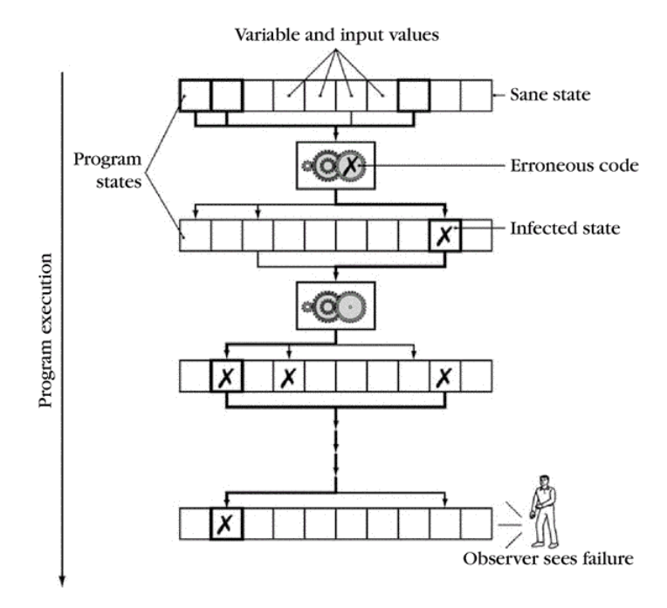
Defects to Failures
Code with defects will introduce erroneous or “infected” state
Correct code may propagate this state
Eventually an erroneous state is observed
Some executions will not trigger the defect
Others will not propagate “infected” state
Debugging sifts through the code to find the defect

Slide 41
Explicit Debugging
Stating the problem
Describe the problem aloud or in writing
A.k.a. “Rubber duck” or “teddy bear” method
Often a comprehensive problem description is sufficient to solve the failure
Notes:
Explain the problem to your teddy bear

Slide 42
Scientific Debugging
Before debugging, you need to construct a hypothesis as to the defect
Propose a possible defect and why it explains the failure conditions
Ockham’s Razor – given several hypotheses, pick the simplest / closest to current work
Hypothesis
Problem Description
Code
Failing Runs
Other Runs

Slide 43
Scientific Debugging
Make predictions based on your hypothesis
What do you expect to happen under new conditions
What data could confirm or refute your hypothesis
How can I collect that data?
What experiments?
What collection mechanism?
Does the data refute the hypothesis?
Refine the hypothesis based on the new inputs
Prediction
Observation & Conclusion
Hypothesis
Experiment

Slide 44
Scientific Debugging
A set of experiments has confirmed the hypothesis
This is the diagnosis of the defect
Develop a fix for the defect
Run experiments to confirm the fix
Otherwise, how do you know that it is fixed?
Conclusion
Diagnosis
Fix
Confirm

Slide 45
Code with a Bug
int fib(int n)
{
int f, f0 = 1, f1 = 1;
while (n > 1) {
n = n - 1;
f = f0 + f1;
f0 = f1;
f1 = f;
}
return f;
} int main(..) { .. for (i = 9; i > 0; i--) printf(“fib(%d)=%d\n”, i, fib(i));
$ gcc -o fib fib.c fib(9)=55 fib(8)=34 ... fib(2)=2 fib(1)=134513905
A defect has caused a failure.
Notes:
Simple example to illustrate techniques.
Students do not need to know the code or find the bug.

Slide 46
Constructing a Hypothesis
Specification defined the first Fibonacci number as 1
We have observed working runs (e.g., fib(2))
We have observed a failing run
We then read the code
fib(1) failed // Hypothesis
Code | Hypothesis
for (i = 9; …) | Result depends on order of calls
while (n > 1) { | Loop check is incorrect
int f; | f is uninitialized
Notes:
What is the input to the hypothesis?
Propose three possible hypotheses from the code.

Slide 47
Prediction
Propose a new condition or conditions
What will logically happen if your hypothesis is correct?
What data can be
fib(1) failed // Hypothesis
// Result depends on order of calls
If fib(1) is called first, it will return correctly.
// Loop check is incorrect
Change to n >= 1 and run again.
// f is uninitialized
Change to int f = 1;

Slide 48
Experiment
Identical to the conditions of a prior run
Except with one condition changed
Conditions
Program input, using a debugger, altering the code
fib(1) failed // Hypothesis
If fib(1) is called first, it will return correctly.
Fails.
Change to n >= 1
fib(1)=2
fib(0)=...
Change to int f = 1;
Works. Sometimes a prediction can be a fix.

Slide 49
Observation
What is the observed result?
Factual observation, such as “Calling fib(1) will return 1.”
The conclusion will interpret the observation(s)
Don’t interfere.
printf() can interfere
Like quantum physics, sometimes observations are part of the experiment
Proceed systematically.
Update the conditions incrementally so each observation relates to a specific change

Slide 50

Debugging Tools
Observing program state can require a variety of tools
Debugger (e.g., gdb)
What state is in local / global variables (if known)
What path through the program was taken
Valgrind
Does execution depend on uninitialized variables
Are memory accesses ever out-of-bounds
Notes:
Image: https://thumbs.dreamstime.com/m/sherlock-holmes-cartoon-vector-14725610.jpg (from a search for pubic domain images)

Slide 51
Diagnosis
A scientific hypothesis that explains current observations and makes future predictions becomes a theory
We’ll call this a diagnosis
Use the diagnosis to develop a fix for the defect
Avoid “post hoc, ergo propter hoc” fallacy
Latin for: “After this, therefore because of this”
Or correlation does not imply causation
Understand why the defect and fix relate
Once there was a program that only worked on Wednesday…
Notes:
Fallacy commonly seen in malloc lab. If I add a printf to this code, then it works at –O3. Actual problem is that there is undefined behavior and the printf function call reduced the optimization space.
Story: “Once there was a program that only worked on Wednesday. The spec had declared that days are at most 8 characters long. Wednesday is 9 (+ NULL). The NULL was initializing another field so the program would only then operate correctly.”

Slide 52
Fix and Confirm
Confirm that the fix resolves the failure
If you fix multiple perceived defects, which fix was for the failure?
Be systematic

Slide 53
Learn
Common failures and insights
Why did the code fail?
What are my common defects?
Assertions and invariants
Add checks for expected behavior
Extend checks to detect the fixed failure
Testing
Every successful set of conditions is added to the test suite
Notes:
- Prof Railing says, “I don’t use certain C syntax in my code as I know I am prone to errors if I do.”
- Are there internal conditions to check for (invariants)? External (tests)?

Slide 54
Quick and Dirty
Not every problem needs scientific debugging
Set a time limit: (for example)
0 – 10 minutes – Informal Debugging
10 – 60 minutes – Scientific Debugging
> 60 minutes – Take a break / Ask for help

Slide 55
Code Smells
Common ways in which code is likely to have bugs,
either already or in the future
Use of uninitialized variables
Unused values
Unreachable code
Duplicated code
Bloated functions/methods
Memory leaks
Interface misuse
Null pointers
Etc
Notes:
Common bugs, many of which can be detected by compilers or existing tools.

Slide 56
Quiz Time!
Check out:
https://canvas.cmu.edu/courses/10968

Slide 57
Outline
Debugging
Defects and Failures
Scientific Debugging
Tools
Design
Managing complexity
Communication
Naming
Comments

Slide 58
Design
A good design needs to achieve many things:
Performance
Availability
Modifiability, portability
Scalability
Security
Testability
Usability
Cost to build, cost to operate
Notes:
From these many objectives, we will summarize into two points.

Slide 59
Design
Good Design does:
Complexity Management &
Communication
Notes:
If a design does these things and solves the problem, then it can also achieve (or be extended to achieve) the other objectives

Slide 60
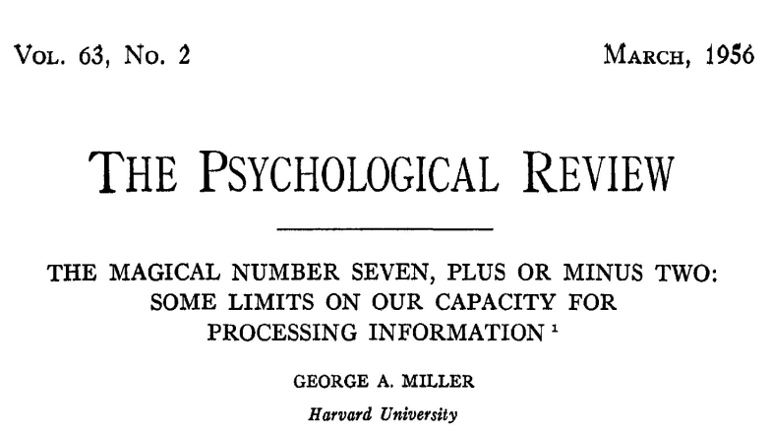
Complexity
There are well known limits to how much complexity a human can manage easily.

Slide 61
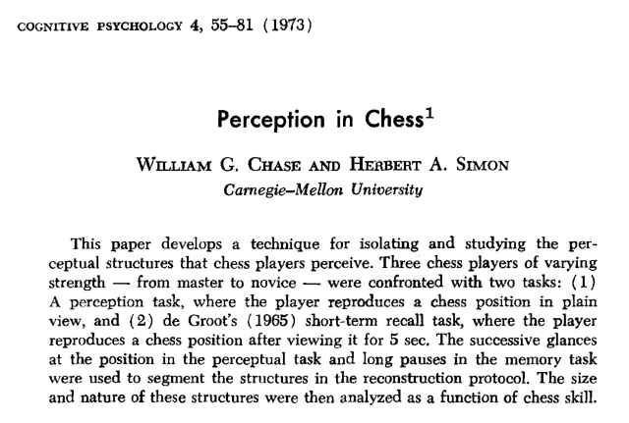
Complexity Management
However, patterns can be very helpful...

Slide 62
Complexity Management
Many techniques have been developed to help manage complexity:
Separation of concerns
Modularity
Reusability
Extensibility
DRY
Abstraction
Information Hiding
...
Notes:
This is a lot and the list is beyond the scope of the course. Next slide is the 200-level suggestion(s)
DRY=Don’t Repeat Yourself. The DRY principle is stated as, "Every piece of knowledge or logic must have a single, unambiguous representation within a system.”

Slide 63
Managing Complexity
Given the many ways to manage complexity
Design code to be testable
Try to reuse testable chunks
Notes:
To start managing complexity, split

Slide 64
Complexity Example
Split a cache access into three+ testable components
State all of the steps that a cache access requires
Convert address into tag, set index, block offset
Look up the set using the set index
Check if the tag matches any line in the set
If so, hit
If not a match, miss, then
Find the LRU block
Evict the LRU block
Read in the new line from memory
Update LRU
Update dirty if the access was a store
Which steps depend on the operation being a load or a store?
Notes:
I would have students talk to their neighbors for a few minutes about these steps

Slide 65
Complexity Example
Split a cache access into three+ testable components
State all of the steps that a cache access requires
Convert address into tag, set index, block offset
Look up the set using the set index
Check if the tag matches any line in the set
If so, hit
If not a match, miss, then
Find the LRU block
Evict the LRU block
Read in the new line from memory
Update LRU
Update dirty if the access was a store
Which steps depend on the operation being a load or a store?
Notes:
I would have students talk to their neighbors for a few minutes about these steps
Convert address can also be multiple steps
This is just one example sequence

Slide 66
Designs need to be testable
Testable design
Testing versus Contracts
These are complementary techniques
Testing and Contracts are
Acts of design more than verification
Acts of documentation
Notes:
Design by contract, also known as contract programming, programming by contract and design-by-contract programming, is an approach for designing software. It prescribes that software designers should define formal, precise and verifiable interface specifications for software components, which extend the ordinary definition of abstract data types with preconditions, postconditions and invariants. These specifications are referred to as "contracts", in accordance with a conceptual metaphor with the conditions and obligations of business contracts.

Slide 67
Testing Example
For your cache simulator, you can write your own traces
Write a trace to test for a cache hit
L 50, 1 L 50, 1
Write a trace to test dirty bytes in cache
S 100, 1

Slide 68
Communication
When writing code, the author is communicating with:
The machine
Other developers of the system
Code reviewers
Their future self
Notes:
We communicate with different audiences.

Slide 69
Communication
There are many techniques that have been developed around code communication:
Tests
Naming
Comments
Commit Messages
Code Review
Design Patterns
...
Notes:
We communicate through many means

Slide 70
Naming

Slide 71
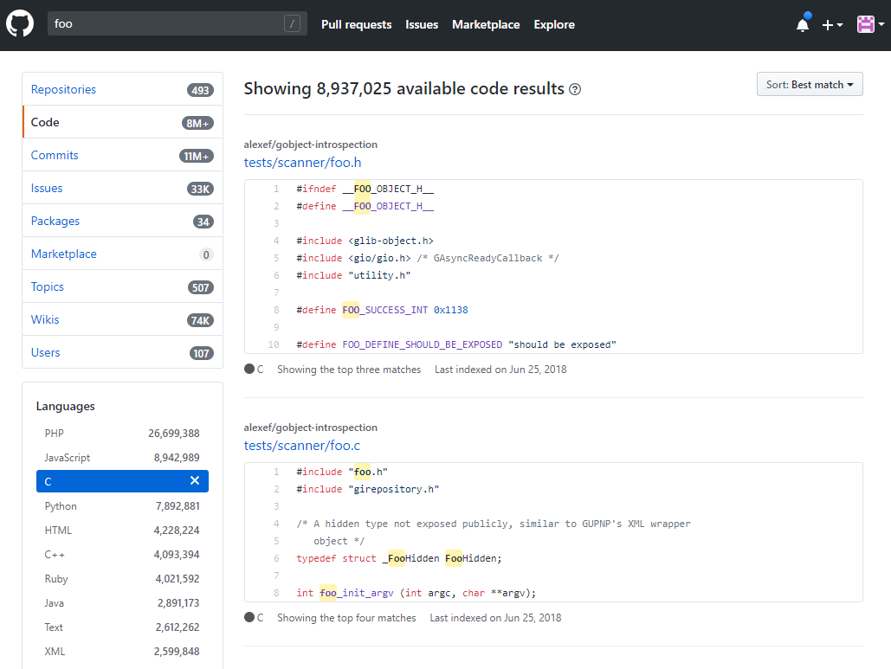
Avoid deliberately meaningless names:

Slide 72
Naming is understanding
“If you don’t know what a thing should be called, you cannot know what it is.
If you don’t know what it is, you cannot sit down and write the code.” - Sam Gardiner

Slide 73
Better naming practices
Start with meaning and intention
Use words with precise meanings (avoid “data”, “info”, “perform”)
Prefer fewer words in names
Avoid abbreviations in names
Use code review to improve names
Read the code out loud to check that it sounds okay
Actually rename things
Notes:
Yes, the 213 course-staff is guilty of transgressing many of these suggestions

Slide 74
Naming guidelines – Use dictionary words
Only use dictionary words and abbreviations that appear in a dictionary.
For example: FileCpy -> FileCopy
Avoid vague abbreviations such as acc, mod, auth, etc..

Slide 75
Avoid using single-letter names
Single letters are unsearchable
Give no hints as to the variable’s usage
Exceptions are loop counters
Especially if you know why i, j, etc were originally used
Notes:
See https://en.wikibooks.org/wiki/Fortran/Fortran_variables

Slide 76
Limit name character length
“Good naming limits individual name length, and reduces the need for specialized vocabulary” – Philip Relf

Slide 77
Limit name word count
Keep names to a four word maximum
Limit names to the number of words that people can read at a glance.
Which of each pair do you prefer?
a1) arraysOfSetsOfLinesOfBlocks
a2) cache
b1) evictedData
b2) evictedDataBytes
Notes:
Bpr: “My friend wrote the following line in C++. This data structure tracked the coherence state in a simulator. I still wonder if he could have done better
map<uint, map<ContextId, map<ContextId, map<uint, uint> > > > theDataStructureWhichShallNotBeNamed;”

Slide 78
Describe Meaning
Use descriptive names.
Avoid names with no meaning: a, foo, blah, tmp, etc
There are reasonable exceptions:
void swap(int* a, int* b) {
int tmp = *a;
*a = *b;
*b = tmp;
}
Notes:
Tmp is fine when it really is short-lived and temporary.

Slide 79
Use a large vocabulary
Be more specific when possible:
Person -> Employee
What is size in this binaryTree?
struct binaryTree {
int size;
…
};
Notes:
Discuss size. Could be height of tree, number of nodes, memory usage, etc.

Slide 80
Use problem domain terms
Use the correct term in the problem domain’s language.
Hint: as a student, consider the terms in the assignment
In cachelab, consider the following:
line
element

Slide 81
Use opposites precisely
Consistently use opposites in standard pairs
first/end -> first/last

Slide 82
Comments

Slide 83
Don’t Comments
Don’t say what the code does
because the code already says that
Don’t explain awkward logic
improve the code to make it clear
Don’t add too many comments
it’s messy, and they get out of date

Slide 84
Awkward Code
Imagine someone (TA, employer, etc) has to read your code
Would you rather rewrite or comment the following?
How about?
Both lines update program state in the same way.
(*(void **)((*(void **)(bp)) + DSIZE)) = (*(void **)(bp + DSIZE));
bp->prev->next = bp->next;
Notes:
Old malloc example, published in SIGCSE by Railing and Bryant.

Slide 85
Do Comments
Answer the question: why the code exists
When should I use this code?
When shouldn’t I use it?
What are the alternatives to this code?

Slide 86
Why does this exist?
Explain why a magic number is what it is.
When should this code be used? Is there an alternative?
// Each address is 64-bit, which is 16 + 1 hex characters
const int MAX_ADDRESS_LENGTH = 17;
unsigned power2(unsigned base, unsigned expo){
unsigned i;
unsigned result = 1;
for(i=0;i<expo;i++){
result+=result;
}
return result;
}
Notes:
The power2 code is from a student’s submission.

Slide 87
How to write good comments
Write short comments of what the code will do.
Single line comments
Example: Write four one-line comments for quick sort
// Initialize locals
// Pick a pivot value
// Reorder array around the pivot
// Recurse
Notes:
Students are notorious for writing comments last, so emphasize that brief comments of the design comes before implementation.

Slide 88
How to write good comments
Write short comments of what the code will do.
Single line comments
Example: Write four one-line comments for quick sort
Write that code.
Revise comments / code
If the code or comments are awkward or complex
Join / Split comments as needed
Maintain code and comments

Slide 89
How to write good comments
Try to write good code first
Try to write a one-sentence comment
Refactor the code until the comment is easy to write
Now write a good comment
Maintain your code AND your comments
Notes:
Original good comment strategy

Slide 90
Commit Messages
Committing code to a source repository is a vital part of development
Protects against system failures and typos:
cat foo.c versus cat > foo.c
The commit messages are your record of your work
Communicating to your future self
Describe in one line what you did
“Parses command line arguments”
“fix bug in unique tests, race condition not solved”
“seg list finished, performance is …”
Notes:
The cat example will silently truncate the file to be empty.

Slide 91
Summary
Programs have defects
Be systematic about finding them
Programs are more complex than humans can manage
Write code to be manageable
Programming is not solitary, even if you are communicating with a grader or a future self
Be understandable in your communication

Slide 92
Acknowledgements
Some debugging content derived from:
http://www.whyprogramsfail.com/slides.php
Some code examples for design are based on:
“The Art of Readable Code”. Boswell and Foucher. 2011.
Lecture originally written by
Michael Hilton and Brian Railing

