Slide 1

14-513
18-613

Slide 2
Please take 10-15 minutes now to provide feedback on the course
Anonymous survey is at:
https://www.cs.cmu.edu/~213/external/survey

Slide 3
Dynamic Memory Allocation: Advanced Concepts 15-213/18-213/14-513/15-513/18-613: Introduction to Computer Systems 14th Lecture, March 25, 2021

Slide 4
Review: Dynamic Memory Allocation
Memory
invisible to
user code
Application
Kernel virtual memory
Dynamic Memory Allocator
User stack
(created at runtime)
Heap
%rsp
(stack
pointer)
Programmers use dynamic memory allocators (such as malloc) to acquire virtual memory (VM) at run time.
for data structures whose size is only known at runtime
Dynamic memory allocators manage an area of process VM known as the heap.
Memory-mapped region for
shared libraries
brk
Run-time heap
(created by malloc)
Read/write segment
(.data, .bss)
Loaded
from
the
executable
file
Read-only segment
(.init, .text, .rodata)
0x400000
Unused
0

Slide 5
Review: Keeping Track of Free Blocks
Method 1: Implicit list using length—links all blocks
Method 2: Explicit list among the free blocks using pointers
Method 3: Segregated free list
Different free lists for different size classes
Method 4: Blocks sorted by size
Can use a balanced tree (e.g. Red-Black tree) with pointers within each free block, and the length used as a key
Need to tag
each block as
allocated/free
Unused
32
48
32
16
Need space
for pointers
32
48
32
16

Slide 6
Review: Implicit Lists Summary
Implementation: very simple
Allocate cost:
linear time worst case
Free cost:
constant time worst case
even with coalescing
Memory Overhead:
Depends on placement policy
Strategies include first fit, next fit, and best fit
Not used in practice for malloc/free because of linear-time allocation
used in many special purpose applications
However, the concepts of splitting and boundary tag coalescing are general to all allocators

Slide 7
Today
Explicit free lists
Segregated free lists
Memory-related perils and pitfalls

Slide 8
Keeping Track of Free Blocks
Method 1: Implicit list using length—links all blocks
Method 2: Explicit list among the free blocks using pointers
Method 3: Segregated free list
Different free lists for different size classes
Method 4: Blocks sorted by size
Can use a balanced tree (e.g. Red-Black tree) with pointers within each free block, and the length used as a key
Unused
32
48
32
16
32
48
32
16

Slide 9
Explicit Free Lists
Allocated (as before)
Free
Size
a
Size
a
Payload and
padding
Next
Prev
Optional
Size
a
Size
a
Maintain list(s) of free blocks, not all blocks
Luckily we track only free blocks, so we can use payload area
The “next” free block could be anywhere
So we need to store forward/back pointers, not just sizes
Still need boundary tags for coalescing
To find adjacent blocks according to memory order

Slide 10
Explicit Free Lists
Logically:
Physically: blocks can be in any order
A
B
C
Forward (next) links
A
B
32
32
32
32
48
48
32
32
32
32
C
Back (prev) links

Slide 11
Allocating From Explicit Free Lists
conceptual graphic
Before
After
(with splitting)
= malloc(…)

Slide 12
Freeing With Explicit Free Lists
Insertion policy: Where in the free list do you put a newly freed block?
Unordered
LIFO (last-in-first-out) policy
Insert freed block at the beginning of the free list
FIFO (first-in-first-out) policy
Insert freed block at the end of the free list
Pro: simple and constant time
Con: studies suggest fragmentation is worse than address ordered
Address-ordered policy
Insert freed blocks so that free list blocks are always in address order: addr(prev) < addr(curr) < addr(next)
Con: requires search
Pro: studies suggest fragmentation is lower than LIFO/FIFO

Slide 13
Freeing With a LIFO Policy (Case 1)
Allocated
Allocated
conceptual graphic
Before
free( )
Root
Insert the freed block at the root of the list
After
Root

Slide 14
Freeing With a LIFO Policy (Case 2)
Allocated
Free
conceptual graphic
Before
free( )
Root
Splice out adjacent successor block, coalesce both memory blocks, and insert the new block at the root of the list
After
Root

Slide 15
Freeing With a LIFO Policy (Case 3)
Free
Allocated
conceptual graphic
Before
free( )
Root
Splice out adjacent predecessor block, coalesce both memory blocks, and insert the new block at the root of the list
After
Root

Slide 16
Freeing With a LIFO Policy (Case 4)
Free
Free
conceptual graphic
Before
free( )
Root
Splice out adjacent predecessor and successor blocks, coalesce all 3 blocks, and insert the new block at the root of the list
After
Root

Slide 17
Some Advice: An Implementation Trick
LIFO Insertion
Point
FIFO Insertion
Point
A
B
C
D
Free
Pointer
Next fit
Use circular, doubly-linked list
Support multiple approaches with single data structure
First-fit vs. next-fit
Either keep free pointer fixed or move as search list
LIFO vs. FIFO
Insert as next block (LIFO), or previous block (FIFO)

Slide 18
Explicit List Summary
Comparison to implicit list:
Allocate is linear time in number of free blocks instead of all blocks
Much faster when most of the memory is full
Slightly more complicated allocate and free because need to splice blocks in and out of the list
Some extra space for the links (2 extra words needed for each block)
Does this increase internal fragmentation?

Slide 19
Today
Explicit free lists
Segregated free lists
Memory-related perils and pitfalls

Slide 20
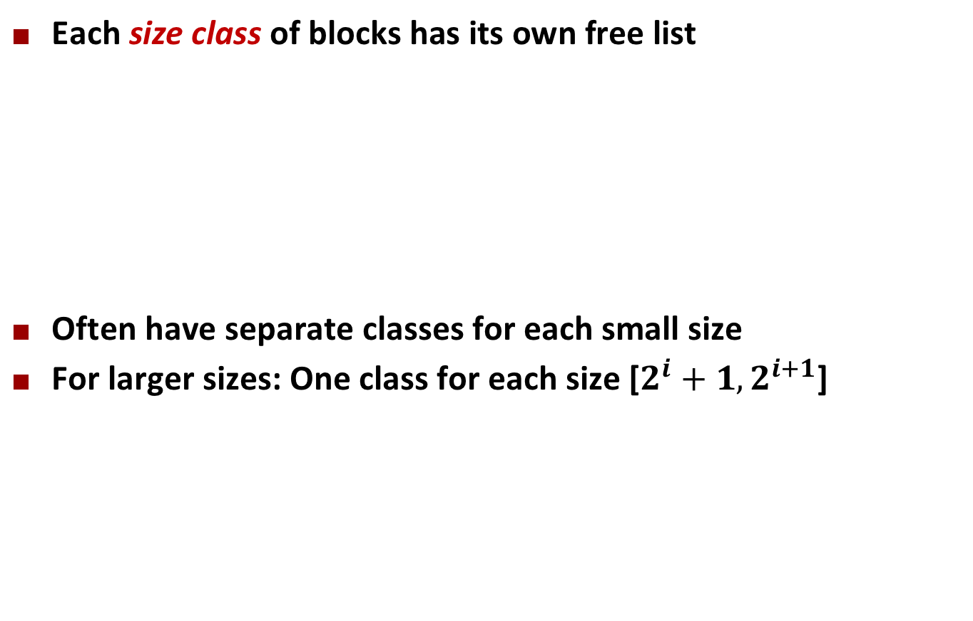
Segregated List (Seglist) Allocators
Each size class of blocks has its own free list
Often have separate classes for each small size
For larger sizes: One class for each size [$2^{i}+1,2^{i+1}$]
16
32-48
64–inf

Slide 21
Seglist Allocator
Given an array of free lists, each one for some size class
To allocate a block of size n:
Search appropriate free list for block of size m > n (i.e., first fit)
If an appropriate block is found:
Split block and place fragment on appropriate list
If no block is found, try next larger class
Repeat until block is found
If no block is found:
Request additional heap memory from OS (using sbrk())
Allocate block of n bytes from this new memory
Place remainder as a single free block in appropriate size class.

Slide 22
Seglist Allocator (cont.)
To free a block:
Coalesce and place on appropriate list
Advantages of seglist allocators vs. non-seglist allocators (both with first-fit)
Higher throughput
log time for power-of-two size classes vs. linear time
Better memory utilization
First-fit search of segregated free list approximates a best-fit search of entire heap.
Extreme case: Giving each block its own size class is equivalent to best-fit.

Slide 23
More Info on Allocators
D. Knuth, The Art of Computer Programming, vol 1, 3rd edition, Addison Wesley, 1997
The classic reference on dynamic storage allocation
Wilson et al, “Dynamic Storage Allocation: A Survey and Critical Review”, Proc. 1995 Int’l Workshop on Memory Management, Kinross, Scotland, Sept, 1995.
Comprehensive survey
Available from CS:APP student site (csapp.cs.cmu.edu)

Slide 24
Quiz Time!
Check out:
https://canvas.cmu.edu/courses/20895

Slide 25
Today
Explicit free lists
Segregated free lists
Memory-related perils and pitfalls

Slide 26
Memory-Related Perils and Pitfalls
Dereferencing bad pointers
Reading uninitialized memory
Overwriting memory
Referencing nonexistent variables
Freeing blocks multiple times
Referencing freed blocks
Failing to free blocks

Slide 27
Dereferencing Bad Pointers
The classic scanf bug
int val;
...
scanf("%d", val);
Should be &val

Slide 28
Reading Uninitialized Memory
Assuming that heap data is initialized to zero
Can avoid by using calloc
/* return y = Ax */
int *matvec(int **A, int *x) {
int *y = malloc(N*sizeof(int));
int i, j;
for (i=0; i<N; i++)
for (j=0; j<N; j++)
y[i] += A[i][j]*x[j];
return y;
}
y[i] does not
start out at zero

Slide 29
Overwriting Memory
Allocating the (possibly) wrong sized object
Can you spot the bug?
int **p;
p = malloc(N*sizeof(int));
for (i=0; i<N; i++) {
p[i] = malloc(M*sizeof(int));
}
Should be int*

Slide 30
Overwriting Memory
Off-by-one errors
char **p;
p = malloc(N*sizeof(int *));
for (i=0; i<=N; i++) {
p[i] = malloc(M*sizeof(int));
}
Should be <
char *p;
p = malloc(strlen(s));
strcpy(p,s);
Need one more byte for terminator

Slide 31
Overwriting Memory
Not checking the max string size
Basis for classic buffer overflow attacks
char s[8];
int i;
gets(s); /* reads “123456789” from stdin */
Should be fgets(s, sizeof s, stdin)

Slide 32
Overwriting Memory
Misunderstanding pointer arithmetic
int *search(int *p, int val) {
while (p && *p != val)
p += sizeof(int);
return p;
}

Slide 33
Overwriting Memory
Referencing a pointer instead of the object it points to
What gets decremented?
(See next slide)
int *BinheapDelete(int **binheap, int *size) {
int *packet;
packet = binheap[0];
binheap[0] = binheap[*size - 1];
*size--;
Heapify(binheap, *size, 0);
return(packet);
}

Slide 34
C operators
Postfix
Operators Associativity
() [] -> . ++ -- left to right
! ~ ++ -- + - * & (type) sizeof right to left
* / % left to right
+ - left to right
<< >> left to right
< <= > >= left to right
== != left to right
& left to right
^ left to right
| left to right
&& left to right
|| left to right
?: right to left
= += -= *= /= %= &= ^= != <<= >>= right to left
, left to right
Unary
Unary
Binary
Prefix
Binary
->, (), and [] have high precedence, with * and & just below
Unary +, -, and * have higher precedence than binary forms
Source: K&R page 53, updated

Slide 35
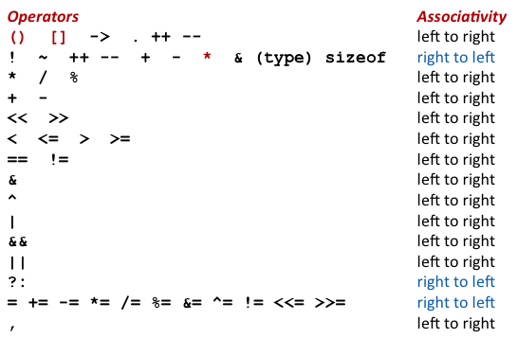
Overwriting Memory
Referencing a pointer instead of the object it points to
Same effect as
size--;
Rewrite as
(*size)--;
int *BinheapDelete(int **binheap, int *size) {
int *packet;
packet = binheap[0];
binheap[0] = binheap[*size - 1];
*size--;
Heapify(binheap, *size, 0);
return(packet);
}

Slide 36
Referencing Nonexistent Variables
Forgetting that local variables disappear when a function returns
int *foo () {
int val;
return &val;
}

Slide 37
Freeing Blocks Multiple Times
Nasty!
x = malloc(N*sizeof(int));
<manipulate x>
free(x);
y = malloc(M*sizeof(int));
<manipulate y>
free(x);

Slide 38
Referencing Freed Blocks
Evil!
x = malloc(N*sizeof(int));
<manipulate x>
free(x);
...
y = malloc(M*sizeof(int));
for (i=0; i<M; i++)
y[i] = x[i]++;

Slide 39
Failing to Free Blocks (Memory Leaks)
Slow, long-term killer!
foo() {
int *x = malloc(N*sizeof(int));
...
return;
}

Slide 40
Failing to Free Blocks (Memory Leaks)
Freeing only part of a data structure
struct list {
int val;
struct list *next;
};
foo() {
struct list *head = malloc(sizeof(struct list));
head->val = 0;
head->next = NULL;
<create and manipulate the rest of the list>
...
free(head);
return;
}

Slide 41
Dealing With Memory Bugs
Debugger: gdb
Good for finding bad pointer dereferences
Hard to detect the other memory bugs
Data structure consistency checker
Runs silently, prints message only on error
Use as a probe to zero in on error
Binary translator: valgrind
Powerful debugging and analysis technique
Rewrites text section of executable object file
Checks each individual reference at runtime
Bad pointers, overwrites, refs outside of allocated block
glibc malloc contains checking code
setenv MALLOC_CHECK_ 3

Slide 42
Supplemental slides

Slide 43
Today
Explicit free lists
Segregated free lists
Garbage collection
Memory-related perils and pitfalls

Slide 44
Implicit Memory Management: Garbage Collection
Garbage collection: automatic reclamation of heap-allocated storage—application never has to explicitly free memory
Common in many dynamic languages:
Python, Ruby, Java, Perl, ML, Lisp, Mathematica
Variants (“conservative” garbage collectors) exist for C and C++
However, cannot necessarily collect all garbage
void foo() {
int *p = malloc(128);
return; /* p block is now garbage */
}

Slide 45
Garbage Collection
How does the memory manager know when memory can be freed?
In general we cannot know what is going to be used in the future since it depends on conditionals
But we can tell that certain blocks cannot be used if there are no pointers to them
Must make certain assumptions about pointers
Memory manager can distinguish pointers from non-pointers
All pointers point to the start of a block
Cannot hide pointers (e.g., by coercing them to an int, and then back again)

Slide 46
Memory as a Graph
We view memory as a directed graph
Each block is a node in the graph
Each pointer is an edge in the graph
Locations not in the heap that contain pointers into the heap are called root nodes (e.g. registers, locations on the stack, global variables)
Root nodes
Heap nodes
reachable
Not-reachable (garbage)
A node (block) is reachable if there is a path from any root to that node.
Non-reachable nodes are garbage (cannot be needed by the application)

Slide 47
Classical GC Algorithms
Mark-and-sweep collection (McCarthy, 1960)
Does not move blocks (unless you also “compact”)
Reference counting (Collins, 1960)
Does not move blocks (not discussed)
Copying collection (Minsky, 1963)
Moves blocks (not discussed)
Generational Collectors (Lieberman and Hewitt, 1983)
Collection based on lifetimes
Most allocations become garbage very soon
So focus reclamation work on zones of memory recently allocated
For more information: Jones and Lin, “Garbage Collection: Algorithms for Automatic Dynamic Memory”, John Wiley & Sons, 1996.

Slide 48
Mark and Sweep Collecting
Can build on top of malloc/free package
Allocate using malloc until you “run out of space”
When out of space:
Use extra mark bit in the head of each block
Mark: Start at roots and set mark bit on each reachable block
Sweep: Scan all blocks and free blocks that are not marked
root
Note: arrows here denote memory refs, not free list ptrs.
Before mark
After mark
Mark bit set
After sweep
free
free

Slide 49
Assumptions For a Simple Implementation
Application
new(n): returns pointer to new block with all locations cleared
read(b,i): read location i of block b into register
write(b,i,v): write v into location i of block b
Each block will have a header word
addressed as b[-1], for a block b
Used for different purposes in different collectors
Instructions used by the Garbage Collector
is_ptr(p): determines whether p is a pointer
length(b): returns the length of block b, not including the header
get_roots(): returns all the roots

Slide 50
Mark and Sweep Pseudocode
Mark using depth-first traversal of the memory graph
ptr mark(ptr p) {
if (!is_ptr(p)) return; // if not pointer -> do nothing
if (markBitSet(p)) return; // if already marked -> do nothing
setMarkBit(p); // set the mark bit
for (i=0; i < length(p); i++) // recursively call mark on all words
mark(p[i]); // in the block
return;
}

Slide 51
Mark and Sweep Pseudocode
Mark using depth-first traversal of the memory graph
ptr mark(ptr p) {
if (!is_ptr(p)) return; // if not pointer -> do nothing
if (markBitSet(p)) return; // if already marked -> do nothing
setMarkBit(p); // set the mark bit
for (i=0; i < length(p); i++) // recursively call mark on all words
mark(p[i]); // in the block
return;
}

Slide 52
Mark and Sweep Pseudocode
Mark using depth-first traversal of the memory graph
ptr mark(ptr p) {
if (!is_ptr(p)) return; // if not pointer -> do nothing
if (markBitSet(p)) return; // if already marked -> do nothing
setMarkBit(p); // set the mark bit
for (i=0; i < length(p); i++) // recursively call mark on all words
mark(p[i]); // in the block
return;
}

Slide 53
Mark and Sweep Pseudocode
Mark using depth-first traversal of the memory graph
ptr mark(ptr p) {
if (!is_ptr(p)) return; // if not pointer -> do nothing
if (markBitSet(p)) return; // if already marked -> do nothing
setMarkBit(p); // set the mark bit
for (i=0; i < length(p); i++) // recursively call mark on all words
mark(p[i]); // in the block
return;
}

Slide 54
Mark and Sweep Pseudocode
Mark using depth-first traversal of the memory graph
ptr mark(ptr p) {
if (!is_ptr(p)) return; // if not pointer -> do nothing
if (markBitSet(p)) return; // if already marked -> do nothing
setMarkBit(p); // set the mark bit
for (i=0; i < length(p); i++) // for each word in p’s block
mark(p[i]);
return;
}

Slide 55
Mark and Sweep Pseudocode
Mark using depth-first traversal of the memory graph
ptr mark(ptr p) {
if (!is_ptr(p)) return; // if not pointer -> do nothing
if (markBitSet(p)) return; // if already marked -> do nothing
setMarkBit(p); // set the mark bit
for (i=0; i < length(p); i++) // for each word in p’s block
mark(p[i]); // make recursive call
return;
}

Slide 56
Mark and Sweep Pseudocode
Mark using depth-first traversal of the memory graph
ptr mark(ptr p) {
if (!is_ptr(p)) return; // if not pointer -> do nothing
if (markBitSet(p)) return; // if already marked -> do nothing
setMarkBit(p); // set the mark bit
for (i=0; i < length(p); i++) // for each word in p’s block
mark(p[i]); // make recursive call
return;
}
Sweep using lengths to find next block
ptr sweep(ptr p, ptr end) {
while (p < end) { // for entire heap
if markBitSet(p) clearMarkBit();
else if (allocateBitSet(p))
free(p);
p += length(p+1);
}

Slide 57
Mark and Sweep Pseudocode
Mark using depth-first traversal of the memory graph
ptr mark(ptr p) {
if (!is_ptr(p)) return; // if not pointer -> do nothing
if (markBitSet(p)) return; // if already marked -> do nothing
setMarkBit(p); // set the mark bit
for (i=0; i < length(p); i++) // for each word in p’s block
mark(p[i]); // make recursive call
return;
}
Sweep using lengths to find next block
ptr sweep(ptr p, ptr end) {
while (p < end) { // for entire heap
if markBitSet(p) // did we reach this block? clearMarkBit();
else if (allocateBitSet(p))
free(p);
p += length(p+1);
}

Slide 58
Mark and Sweep Pseudocode
Mark using depth-first traversal of the memory graph
ptr mark(ptr p) {
if (!is_ptr(p)) return; // if not pointer -> do nothing
if (markBitSet(p)) return; // if already marked -> do nothing
setMarkBit(p); // set the mark bit
for (i=0; i < length(p); i++) // for each word in p’s block
mark(p[i]); // make recursive call
return;
}
Sweep using lengths to find next block
ptr sweep(ptr p, ptr end) {
while (p < end) { // for entire heap
if markBitSet(p) // did we reach this block? clearMarkBit(); // yes -> so just clear mark bit
else if (allocateBitSet(p))
free(p);
p += length(p+1);
}

Slide 59
Mark and Sweep Pseudocode
Mark using depth-first traversal of the memory graph
ptr mark(ptr p) {
if (!is_ptr(p)) return; // if not pointer -> do nothing
if (markBitSet(p)) return; // if already marked -> do nothing
setMarkBit(p); // set the mark bit
for (i=0; i < length(p); i++) // for each word in p’s block
mark(p[i]); // make recursive call
return;
}
Sweep using lengths to find next block
ptr sweep(ptr p, ptr end) {
while (p < end) { // for entire heap
if markBitSet(p) // did we reach this block? clearMarkBit(); // yes -> so just clear mark bit
else if (allocateBitSet(p)) // never reached: is it allocated?
free(p);
p += length(p+1);
}

Slide 60
Mark and Sweep Pseudocode
Mark using depth-first traversal of the memory graph
ptr mark(ptr p) {
if (!is_ptr(p)) return; // if not pointer -> do nothing
if (markBitSet(p)) return; // if already marked -> do nothing
setMarkBit(p); // set the mark bit
for (i=0; i < length(p); i++) // for each word in p’s block
mark(p[i]); // make recursive call
return;
}
Sweep using lengths to find next block
ptr sweep(ptr p, ptr end) {
while (p < end) { // for entire heap
if markBitSet(p) // did we reach this block? clearMarkBit(); // yes -> so just clear mark bit
else if (allocateBitSet(p)) // never reached: is it allocated?
free(p); // yes -> its garbage, free it
p += length(p+1);
}

Slide 61
Mark and Sweep Pseudocode
Mark using depth-first traversal of the memory graph
ptr mark(ptr p) {
if (!is_ptr(p)) return; // if not pointer -> do nothing
if (markBitSet(p)) return; // if already marked -> do nothing
setMarkBit(p); // set the mark bit
for (i=0; i < length(p); i++) // for each word in p’s block
mark(p[i]); // make recursive call
return;
}
Sweep using lengths to find next block
ptr sweep(ptr p, ptr end) {
while (p < end) { // for entire heap
if markBitSet(p) // did we reach this block? clearMarkBit(); // yes -> so just clear mark bit
else if (allocateBitSet(p)) // never reached: is it allocated?
free(p); // yes -> its garbage, free it
p += length(p+1); // goto next block
}

Slide 62
Conservative Mark & Sweep in C
A “conservative garbage collector” for C programs
is_ptr() determines if a word is a pointer by checking if it points to an allocated block of memory
But, in C pointers can point to the middle of a block
To mark header, need to find the beginning of the block
Can use a balanced binary tree to keep track of all allocated blocks (key is start-of-block)
Balanced-tree pointers can be stored in header (use two additional words)
ptr
Header
Assumes ptr in middle can be
used to reach anywhere in the block, but no other block
Head
Data
Size
Left: smaller addresses
Right: larger addresses
Left
Right

Slide 63
C Pointer Declarations: Test Yourself!
int *p
int *p[13]
int *(p[13])
int **p
int (*p)[13]
int *f()
int (*f)()
int (*(*x[3])())[5]
p is a pointer to int
p is an array[13] of pointer to int
p is an array[13] of pointer to int
p is a pointer to a pointer to an int
p is a pointer to an array[13] of int
f is a function returning a pointer to int
f is a pointer to a function returning int
x is an array[3] of pointers to functions
returning pointers to array[5] of ints
Source: K&R Sec 5.12

Slide 64
C Pointer Declarations: Test Yourself!
int *p
int *p[13]
int *(p[13])
int **p
int (*p)[13]
int *f()
int (*f)()
int (*(*x[3])())[5]
int (*(*f())[13])()
p is a pointer to int
p is an array[13] of pointer to int
p is an array[13] of pointer to int
p is a pointer to a pointer to an int
p is a pointer to an array[13] of int
f is a function returning a pointer to int
f is a pointer to a function returning int
x is an array[3] of pointers to functions
returning pointers to array[5] of ints
f is a function returning ptr to an array[13]
of pointers to functions returning int
Source: K&R Sec 5.12

Slide 65
Parsing: int (*(*f())[13])()
int (*(*f())[13])()
f
int (*(*f())[13])()
f is a function
int (*(*f())[13])()
f is a function
that returns a ptr
int (*(*f())[13])()
f is a function
that returns a ptr to an array of 13
int (*(*f())[13])()
f is a function that returns
a ptr to an array of 13 ptrs
int (*(*f())[13])()
f is a function that returns a ptr to an array of 13 ptrs to functions returning an int

