Slide 1
COVID-19
GLOBAL ANALYSIS
2020 – 2023
Data Visualization & Dashboarding — Week 4
AnalystLab Africa Data Analytics Internship
Tobiloba Osikoya

Slide 2
SLIDE 2
Dataset Overview
Source
CSSE COVID-19 time-series data (Johns Hopkins), pulled directly from GitHub.
Confirmed
Deaths
Recovered
Daily cumulative case counts by country
Daily cumulative death counts by country
Daily cumulative recoveries (discontinued Aug 2021)
Timeframe
January 22, 2020 – March 9, 2023, across 190+ countries and territories.
Preparation
Unpivoted from wide to long format in Power Query, then joined into a single fact table on Country/Region + Date.
2

Slide 3
SLIDE 3
Business Problem
Global health data is scattered across separate files and difficult to interpret at a glance.
Goal
Build a single interactive dashboard that lets a decision-maker:
See global spread patterns at a glance
Compare country-level outcomes side by side
Identify high-impact waves and turning points
Do all of this without digging through raw CSV files
3

Slide 4
SLIDE 4
KPIs Defined
Total Confirmed
Total Deaths
Total Recovered
Death Rate %
Recovery Rate %
Daily New Cases
Daily New Cases doubles as the wave-detection metric — it's the clearest signal of when transmission accelerated.
4

Slide 5
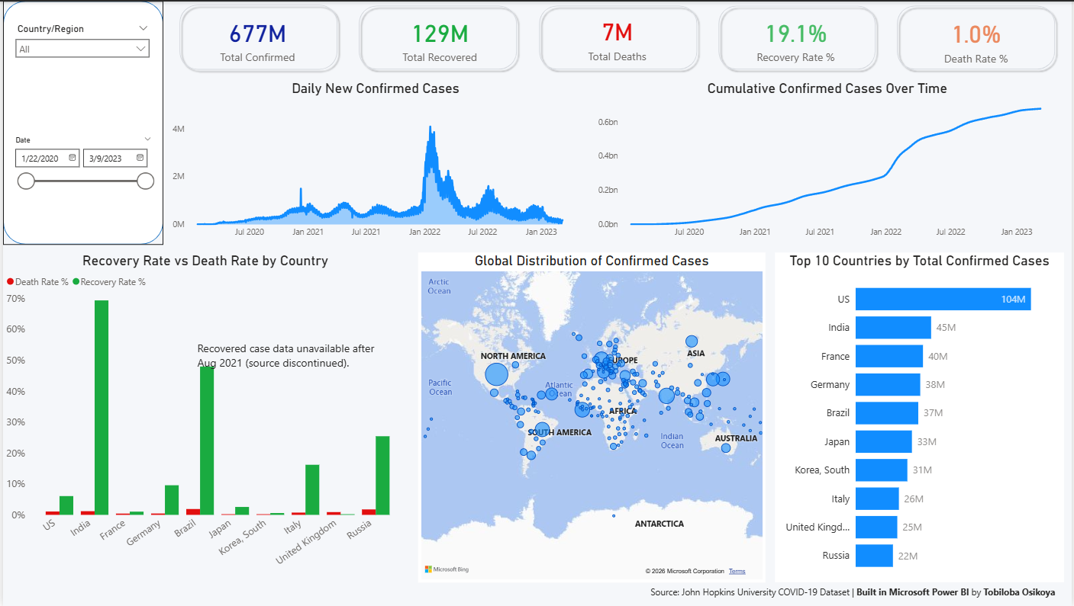
SLIDE 5
Dashboard Overview
PASTE FULL DASHBOARD SCREENSHOT HERE
5

Slide 6
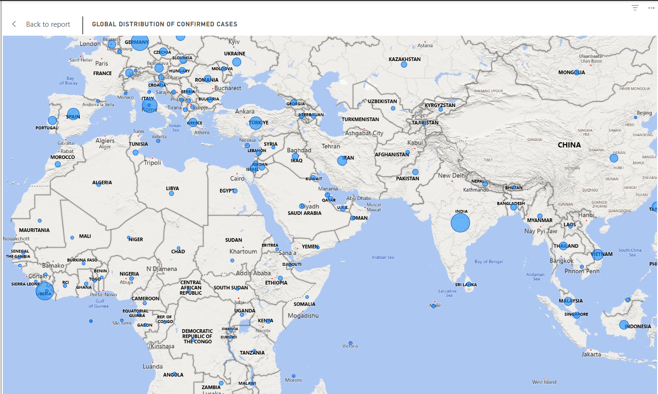
SLIDE 6
Dashboard Detail — Map & Country Comparison
PASTE ZOOMED SCREENSHOT HERE (e.g. map or rate comparison chart)
6

Slide 7
SLIDE 7
Key Insights
US
The US recorded the highest total confirmed cases (104M) — more than double India's 45M, despite India's far larger population.
!
Global daily cases peaked sharply in January 2022 (Omicron wave) — the largest spike in the dataset, far exceeding the original 2020 wave.
i
Recovery Rate % varies widely by country (India ~70%, US near 0%) — this reflects inconsistent reporting and the Recovered dataset being discontinued after Aug 2021, not true differences in patient outcomes.
✓
Death Rate % was notably lower in the UK, France, Japan, and South Korea compared to Brazil, Russia, and India.
7

Slide 8
SLIDE 8
Recommendations
1
Caveat any cross-country Recovery Rate % comparison with the Aug 2021 data cutoff to avoid misleading conclusions.
2
Prioritize datasets with continuous maintenance guarantees for dashboards tracking ongoing health crises.
3
Use the Jan 2022 spike pattern to model healthcare capacity planning around future wave-driven surges.
8

Slide 9
SLIDE 9
Challenges Faced
Merge failures from column order
Inflated KPI totals
Discontinued Recovered data
Merging three wide-format CSVs required unpivoting each, then joining on matching keys — a mismatched join-column order caused a silent merge failure.
Initial measures summed the cumulative column across every date row, inflating totals by orders of magnitude. Fixed by shifting to point-in-time measures.
The Recovered dataset stops updating in Aug 2021, requiring logic to capture the last valid data point rather than defaulting to zero.
9

Slide 10
Conclusion
Turned three disconnected raw datasets into a single interactive view of global COVID-19 spread, mortality, and recovery trends.
Built entirely in Power BI, with drill-down filtering by date and country.
Key learning: data storytelling isn't just clean visuals — it also means surfacing where the data itself has gaps or limitations.
Thank you

