Slide 1

Bank Marketing Campaign Insights
Who Converts, and Why
Business Analytics Case Study | AnalystLab Africa Data Analytics Internship — Week 5
Prepared by Tobiloba Osikoya

Slide 2

The Business Problem
The bank's marketing team runs telephone campaigns to sell term deposits, but conversion rates are inconsistent across customer segments.
This analysis identifies which customer characteristics and campaign approaches are most associated with subscription — so marketing can prioritize outreach, reduce wasted contact effort, and improve overall campaign efficiency.
AT A GLANCE
11,162 customers surveyed
17 features tracked per customer
Goal: identify actionable conversion drivers

Slide 3
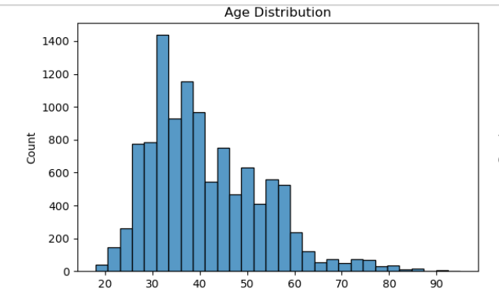
Dataset Overview
UCI Bank Marketing Dataset — direct phone-call term deposit campaigns run by a Portuguese retail bank
11,162
17
47.4%
Total Customers
Features Tracked
Deposit Conversion Rate
☷ SCREENSHOT PLACEHOLDER
[Insert Screenshot: Balance or Age
Distribution Chart]
No missing values or duplicate rows were found. “Unknown” entries in job, education, contact, and previous-outcome fields were kept as their own category rather than imputed, since they likely reflect gaps in data collection rather than a real customer behavior.
From the Jupyter notebook EDA

Slide 4



Approach & Tools
A three-stage workflow bridging analysis and storytelling
›
›
Python (Jupyter)
Power BI
PowerPoint
Data cleaning, exploratory analysis, and key-driver identification using pandas, seaborn, and correlation analysis.
An interactive dashboard translating the analysis into visuals stakeholders can explore and filter directly.
A stakeholder-ready presentation summarizing findings, insights, and recommendations.

Slide 5
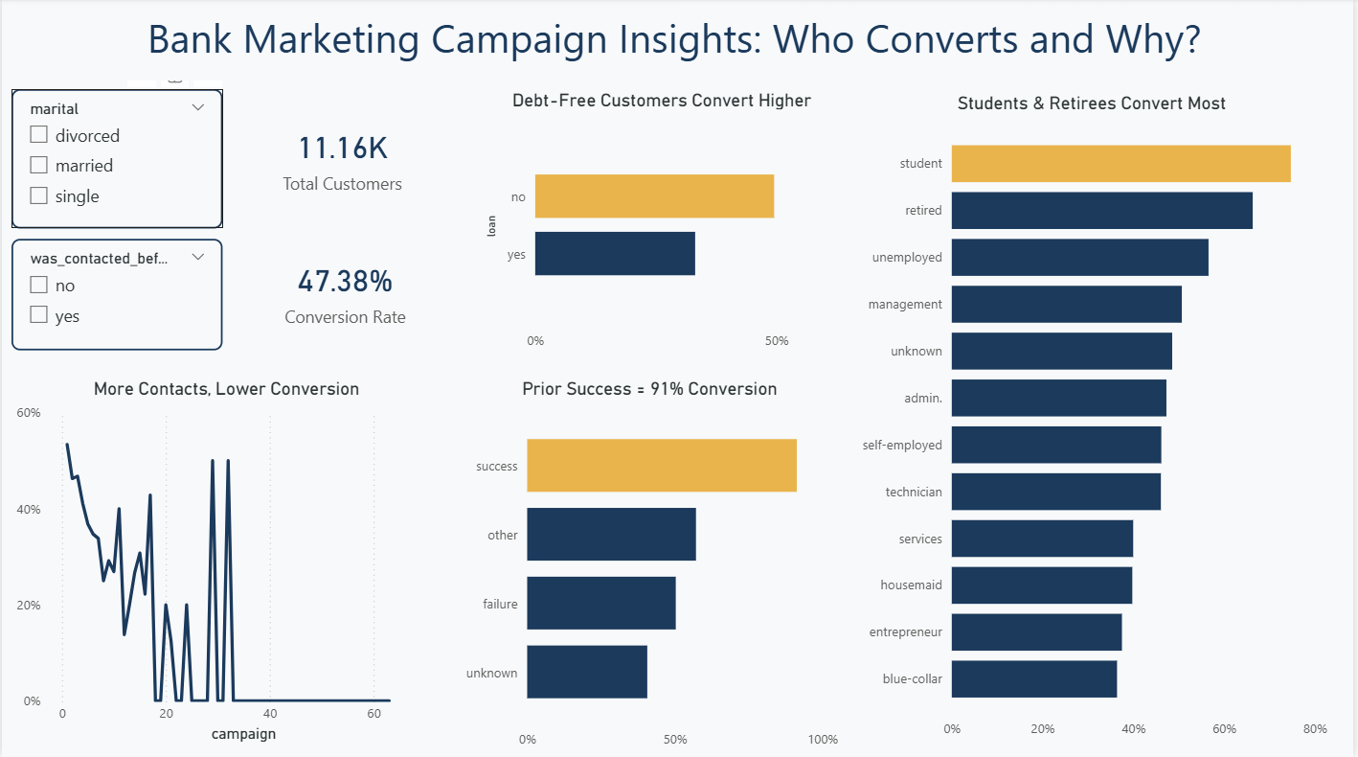
Key Visualizations — Power BI Dashboard
☷ SCREENSHOT PLACEHOLDER
[Insert Screenshot: Full Power BI Dashboard]
“Bank Marketing Campaign Insights: Who Converts and Why?”

Slide 6
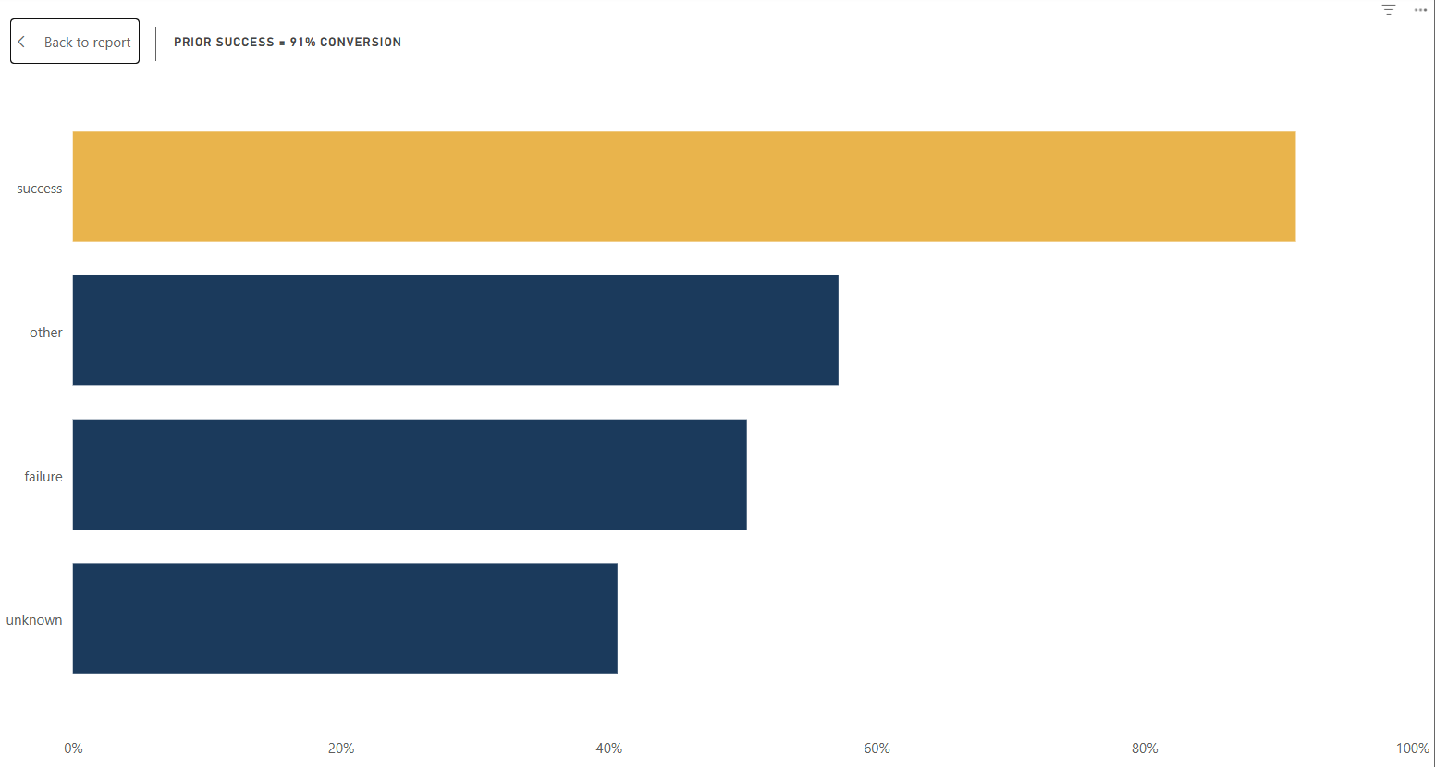
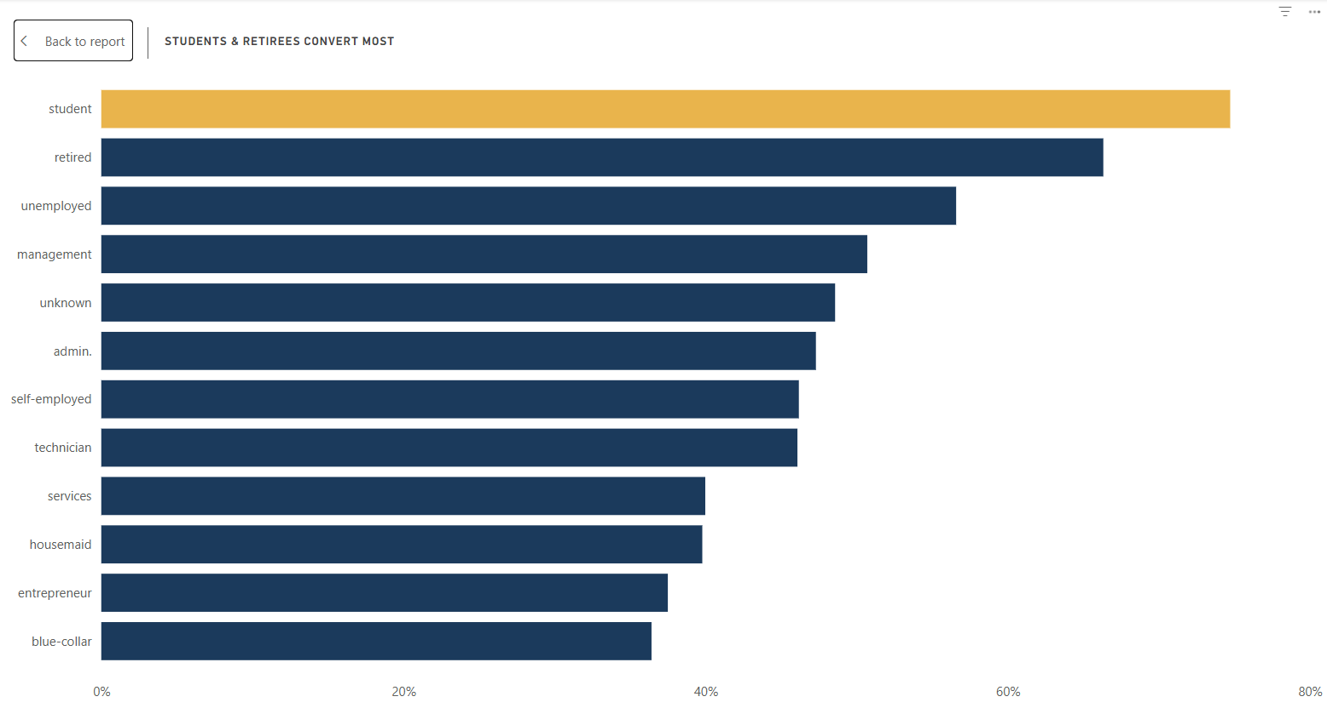
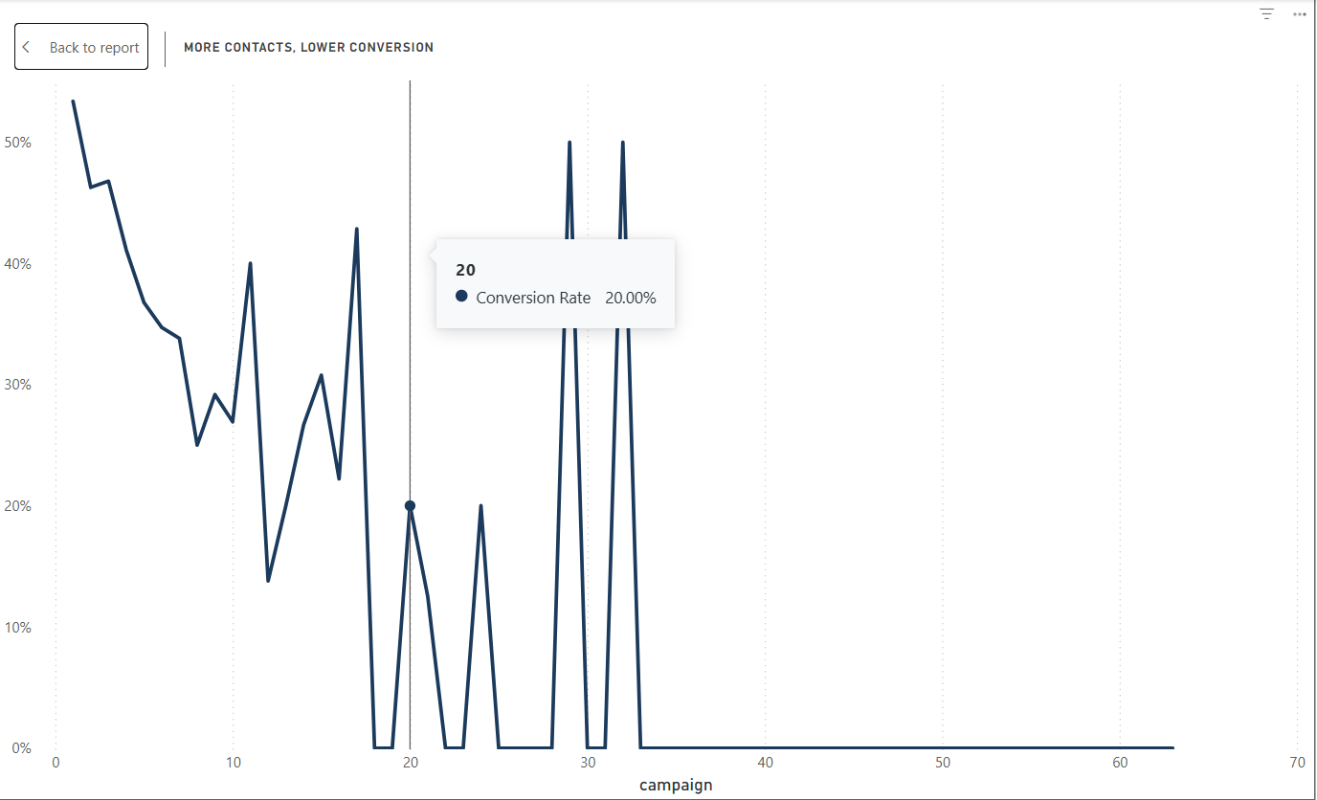
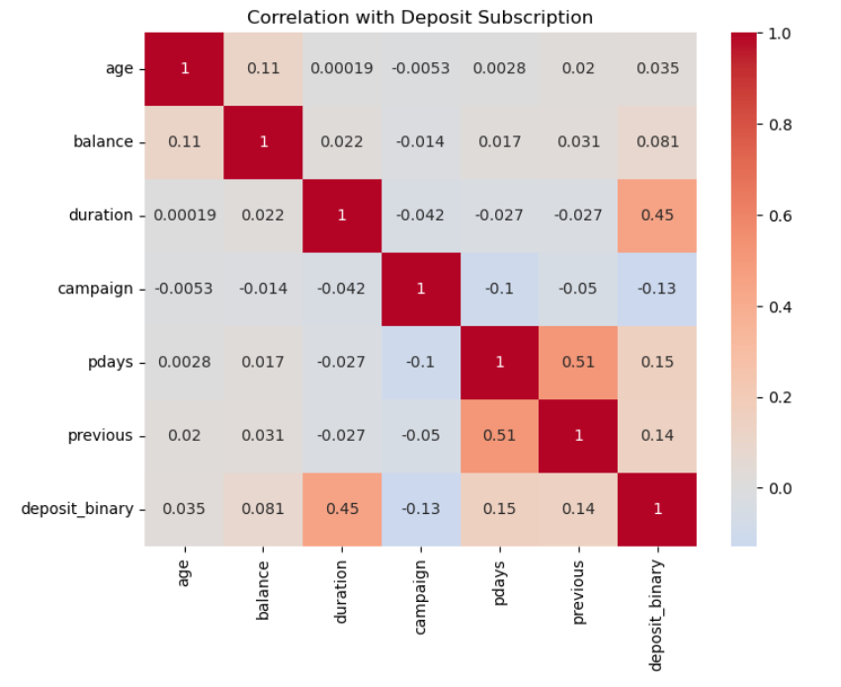
Strongest Signals
☷ SCREENSHOT PLACEHOLDER
[Insert: Prior Success =
91% Conversion]
☷ SCREENSHOT PLACEHOLDER
[Insert: Students & Retirees
Convert Most]
☷ SCREENSHOT PLACEHOLDER
[Insert: More Contacts,
Lower Conversion]
☷ SCREENSHOT PLACEHOLDER
[Insert: Correlation Heatmap
(from Python/Jupyter)]

Slide 7

Key Findings
1
Prior contact history is the strongest driver
Customers with a successful previous campaign outcome convert at over 90%, far above the ~47% baseline.
2
Debt load shapes conversion
Customers without a housing or personal loan convert markedly more than those carrying either — likely reflecting financial flexibility.
3
Life stage and marital status matter
Students, retirees, and single customers convert above average; married, blue-collar, and entrepreneur segments convert below it.
4
Repeated contact backfires
More contact attempts within a single campaign correlate with lower conversion (r = -0.13) — suggesting diminishing returns from over-calling.

Slide 8

Recommendations
1
Prioritize singles & debt-free customers
Focus outreach on segments converting well above baseline (54–67%) rather than treating all customers equally.
2
Re-engage previously successful contacts
With 90%+ conversion among prior successes, make re-engagement a standing priority in every campaign cycle.
3
Cap contact attempts at 2–3 per campaign
Reduce over-calling — additional attempts are associated with lower, not higher, conversion.
4
Profile first-time contacts by job, marital & loan status
For the largest segment (no prior outcome signal), lean on demographic and financial indicators to prioritize outreach.

Slide 9
Conclusion
Term deposit conversion is shaped less by chance and more by financial readiness, prior relationship, and contact strategy. By prioritizing debt-free and previously engaged customers, and capping repeated outreach, marketing can improve conversion efficiency without increasing campaign volume.
Data-driven targeting turns a broad calling campaign into a focused, higher-converting one.
Prepared by Tobiloba Osikoya | AnalystLab Africa Data Analytics Internship

