Slide 1
Topic 3 / Labor Identity
IDBLOOM
Inner
Identity
Turning invisible home expertise into visible economic value
From unpaid homemaker to Household Operations Specialist
Demand
Delivery
Market
Value
IDBLOOM / BPA Topic 3
0:00-0:35 / 01
Notes:
Opening thesis: IDBLOOM helps homemakers translate daily work into recognized identity and market opportunities.
[Sources] README.md; original prompt; IDBLOOM_frontend_slides.html.

Slide 2
Problem
Invisible work has no market language
01
Skills are unnamed
Resume field
Unemployed
02
Labor is unpaid and unseen
A homemaker may work all day, but her resume still says nothing.
03
Identity is hidden inside family roles
Not a lack of ability.
A lack of translation.
Hidden labor -> unnamed value
0:35-1:15 / 02
Notes:
Core problem: homemakers are not lacking ability; their work lacks market translation.
[Sources] README.md; original prompt; IDBLOOM_frontend_slides.html.

Slide 3
Mechanism
IDBLOOM = Identity + Delivery
Inner Identity
Identity Passport
Demand Delivery
>
>
AI discovers hidden skills from daily home life.
Evidence, tags, cases, availability, and value language.
Routes skills into services, content, products, and local orders.
Daily memo
Skill extraction
Evidence portfolio
Market packaging
Local matching
>
>
>
>
voice / photo / to-do
name hidden competence
cases + tags + availability
service / content / product
orders + feedback
Product flow
1:15-2:05 / 03
Notes:
Product flow: daily input -> skill extraction -> Identity Passport -> Demand Delivery.
[Sources] README.md; original prompt; IDBLOOM_frontend_slides.html.

Slide 4
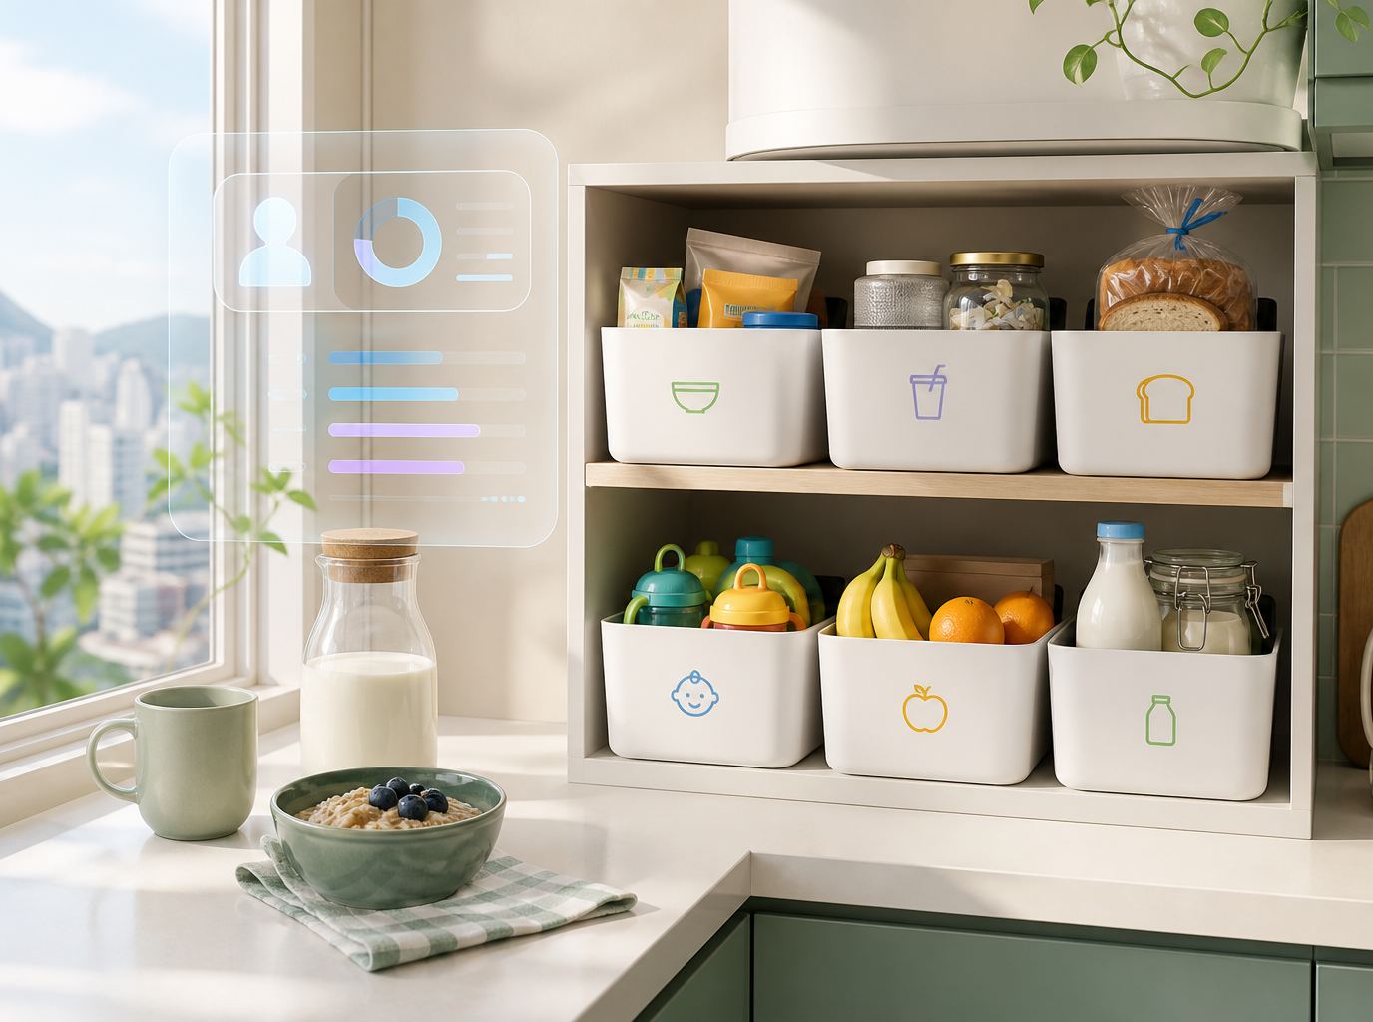
Demo Story
One kitchen reset becomes a market offer
"I used 6 storage boxes to reorganize my kitchen."
Space Planning
Storage System Design
Child Independence Training
Family Workflow Optimization
2-hour Small Kitchen Reset
HKD 450
Simulated local demand
Daily action -> skill evidence -> priced service
2:05-3:05 / 04
Notes:
Demo story: kitchen reset example used to show skill extraction and local demand packaging.
[Sources] README.md; presentation/assets/idbloom-kitchen.png; IDBLOOM_frontend_slides.html.

Slide 5
Demand Delivery
Four markets for the same hidden expertise
01
02
03
04
Content
Products
Offline Service
Knowledge Service
Xiaohongshu
TikTok
Taobao
Etsy / Shopify
local parents
community groups
workshops
consults
scripts, posts, before-after stories
templates, recipes, labels, kits
kitchen reset, meal prep, care planning
courses, family systems coaching
Same identity passport, different income paths.
Market routing
3:05-4:10 / 05
Notes:
Market routing: one identity passport can support content, products, offline services, and knowledge services.
[Sources] README.md; IDBLOOM_frontend_slides.html.

Slide 6
Comparison
Industries already monetize uniqueness
Labor Identity
Distinctiveness
Example
Digital Tool -> Value
Virtual-world designer
spatial intuition + worldbuilding
Roblox maps
game engines + AI -> creator revenue
Knowledge coach
empathy + explanation style
bilingual tutor
AI lesson plans -> workshops
Homemaker / IDBLOOM
routine design + care + taste
Mrs. Chan
AI identity engine -> local services
The missing tool is not labor matching. It is identity translation.
Why this is timely
4:10-5:00 / 06
Notes:
Comparison: other fields already monetize personal uniqueness; homemakers need identity translation.
[Sources] README.md; IDBLOOM_frontend_slides.html.

Slide 7
Model + Trust
The model works only if trust is designed in
User value
Platform revenue
Validation KPI
Safeguards
identity, income, confidence
10-15% commission, premium exports, certificates
booking rate
consent, privacy, user confirmation, quality loop
self-worth
willingness
Privacy first
Quality standard
Authorized inputs only. User confirms before anything is published.
Before-after evidence, ratings, and basic safety guidance protect buyers and users.
Business model + ethics
5:00-5:55 / 07
Notes:
Model and trust: user value, platform revenue, validation KPIs, and privacy safeguards.
[Sources] README.md; IDBLOOM_frontend_slides.html.

Slide 8
Closing
Hidden labor -> recognized opportunity
Demand Delivery Output
MATCH READY
Mrs. Chan
Local Demand
Household Operations Specialist
2-hour Small Kitchen Reset
AI should not only replace labor. It should reveal the value society has failed to see.
Space Planning
HKD 450
Care Workflow
Route
community groups -> local booking
Kitchen Reset
IDBLOOM: idbloom.tobysneko.com
Evidence: before-after storage system + family routine improvement
Next action
confirm availability and publish
IDBLOOM / final message
5:55-6:30 / 08
Notes:
Closing claim: AI should reveal hidden labor value, not only replace labor.
[Sources] README.md; presentation/assets/idbloom-demand-output.png; IDBLOOM_frontend_slides.html.

Slide 9
AI Tool Acknowledgement & Usage Transparency
In accordance with competition guidelines, AI tools were utilized solely as supporting mechanisms under strict student guidance, supervision, and iterative adaptation:
AI Tool / Platform
Role & Scope of Involvement
Student Input & Adaptation
(Core Content)
LLM (ChatGPT / Coze)
Concept brainstorming, grammar refinement, and initial prompt testing for the MVP Bot.
100% Student-Driven: Core research canvas, industry matrix analysis, identity business model, and strategic narrative were conceptualized and authored by students.
UI / Code Generation
(Codex / Figma)
Layout formatting and HTML/CSS template structure for PDF export.
100% Student-Designed: Prototype workflow, Mrs. Chan's daily case scenario, pricing logic, and UI design decisions were defined and validated by the team.
Competition transparency
6:30-7:00 / 09
Notes:
AI acknowledgement: transparency page based on competition requirement and team AI usage statement.
[Sources] README.md; user-provided acknowledgement reference image; IDBLOOM_frontend_slides.html.

