Slide 1
IDBLOOM
Turning invisible home expertise into visible economic value
From unpaid homemaker to Household Operations Specialist
Musea + Agency
IDBLOOM | BPA Topic 3 Labor Identity
Time: 0:00-0:35 | Slide 1/8
Notes:
Opening thesis: IDBLOOM helps homemakers translate daily work into recognized identity and market opportunities.
[Sources] README.md; pasted prompt; source deck 212(1).pptx.

Slide 2
Invisible work has no market language
A homemaker may work all day, but her resume still says:
Unemployed
•
skills are unnamed
Not a lack of ability.
A lack of translation.
•
labor is unpaid and unseen
•
identity is hidden inside family roles
IDBLOOM | BPA Topic 3 Labor Identity
Time: 0:35-1:15 | Slide 2/8
Notes:
Use this slide to set the core tension. Many details from the old problem/context slides can be said verbally here.
[Sources] README.md; IDBLOOM_方案深化.md; pasted prompt.

Slide 3
IDBLOOM: Identity + Delivery
Inner Identity
Identity Passport
Demand Delivery
daily memo
skill extraction
evidence portfolio
market packaging
local matching
voice/photo/todo
name hidden competence
cases + tags + availability
service/content/product
orders + feedback
IDBLOOM | BPA Topic 3 Labor Identity
Time: 1:15-2:05 | Slide 3/8
Notes:
Explain the product in one clean path: record daily life, extract skills, build identity evidence, then route to opportunities.
[Sources] README.md; IDBLOOM_方案深化.md; pasted prompt.

Slide 4
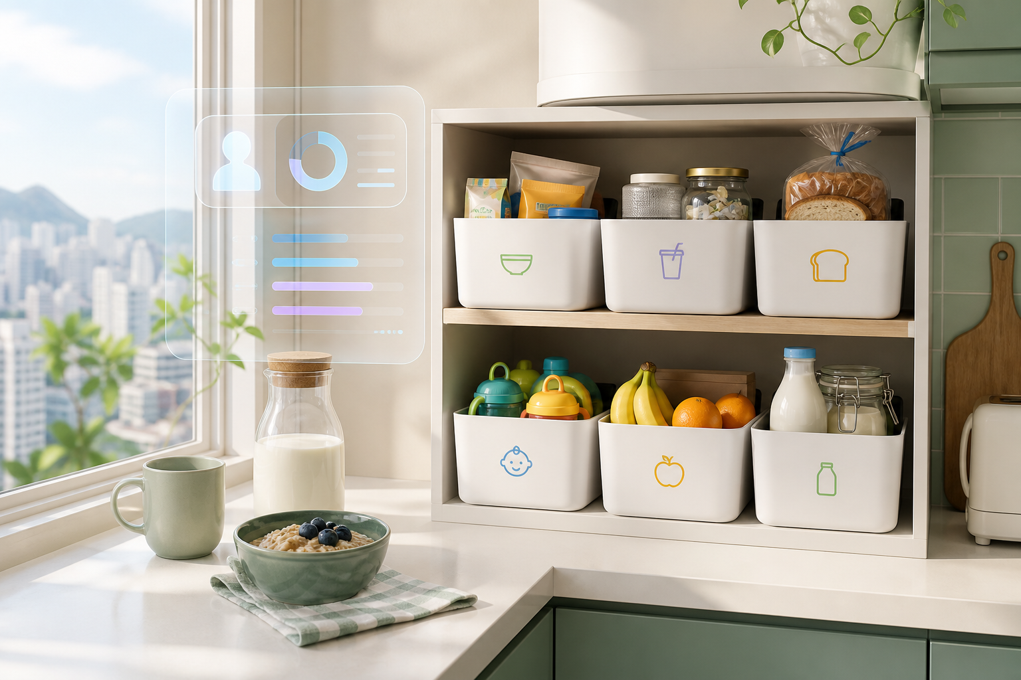
One kitchen reset becomes a market offer
"I used 6 storage boxes to reorganize my kitchen."
Space Planning
Storage System Design
Child Independence Training
Family Workflow Optimization
2-hour Small Kitchen Reset
Simulated local demand: HKD 450 weekend trial
IDBLOOM | BPA Topic 3 Labor Identity
Time: 2:05-3:05 | Slide 4/8
Notes:
This is the 30-second demo anchor: daily kitchen organization becomes skill tags and then a priced local service.
[Sources] README.md; 第一组任务一_IDBLOOM网站Demo开发指令.md; assets/idbloom-kitchen.png.

Slide 5
Demand Delivery routes skills to four markets
Content
Products
Offline Service
Knowledge Service
Xiaohongshu / TikTok
Taobao / Etsy / Shopify
local parents / community
workshops / consults
scripts, posts, before-after stories
templates, recipes, labels, kits
kitchen reset, meal prep, care planning
courses, family systems coaching
Same identity passport, different income paths.
IDBLOOM | BPA Topic 3 Labor Identity
Time: 3:05-4:10 | Slide 5/8
Notes:
Merge the old online content, e-commerce, offline service, and knowledge service slides into one clean market routing slide.
[Sources] README.md; IDBLOOM_方案深化.md; source deck slides 12-18.

Slide 6
Industries monetize uniqueness
Labor Identity | Distinctiveness | Example | Digital tool -> value
Virtual-world designer | spatial intuition + worldbuilding | Roblox maps | game engines + AI -> creator revenue
Knowledge coach | empathy + explanation style | bilingual tutor | AI lesson plans -> workshops
Homemaker / IDBLOOM | routine design + care + taste | Mrs. Chan | AI identity engine -> local services
The missing tool for homemakers is not labor matching. It is identity translation.
IDBLOOM | BPA Topic 3 Labor Identity
Time: 4:10-5:00 | Slide 6/8
Notes:
Use the comparison to answer the BPA theme directly: digital tools help personal uniqueness become economic value.
[Sources] README.md; pasted prompt; IDBLOOM_方案深化.md.

Slide 7
The model works only if trust is designed in
User value
Platform revenue
Validation KPI
Safeguards
identity
income
confidence
10-15%
commission
premium exports
booking rate
self-worth
willingness-to-pay
consent
privacy
quality loop
Privacy first
Quality standard
•
authorized inputs only
•
before/after evidence
•
user confirms before publishing
•
ratings + basic safety guidance
IDBLOOM | BPA Topic 3 Labor Identity
Time: 5:00-5:55 | Slide 7/8
Notes:
The prompt's validation metrics are framed here as KPIs to test, not as unsupported achieved results.
[Sources] README.md; IDBLOOM_方案深化.md; pasted prompt.

Slide 8
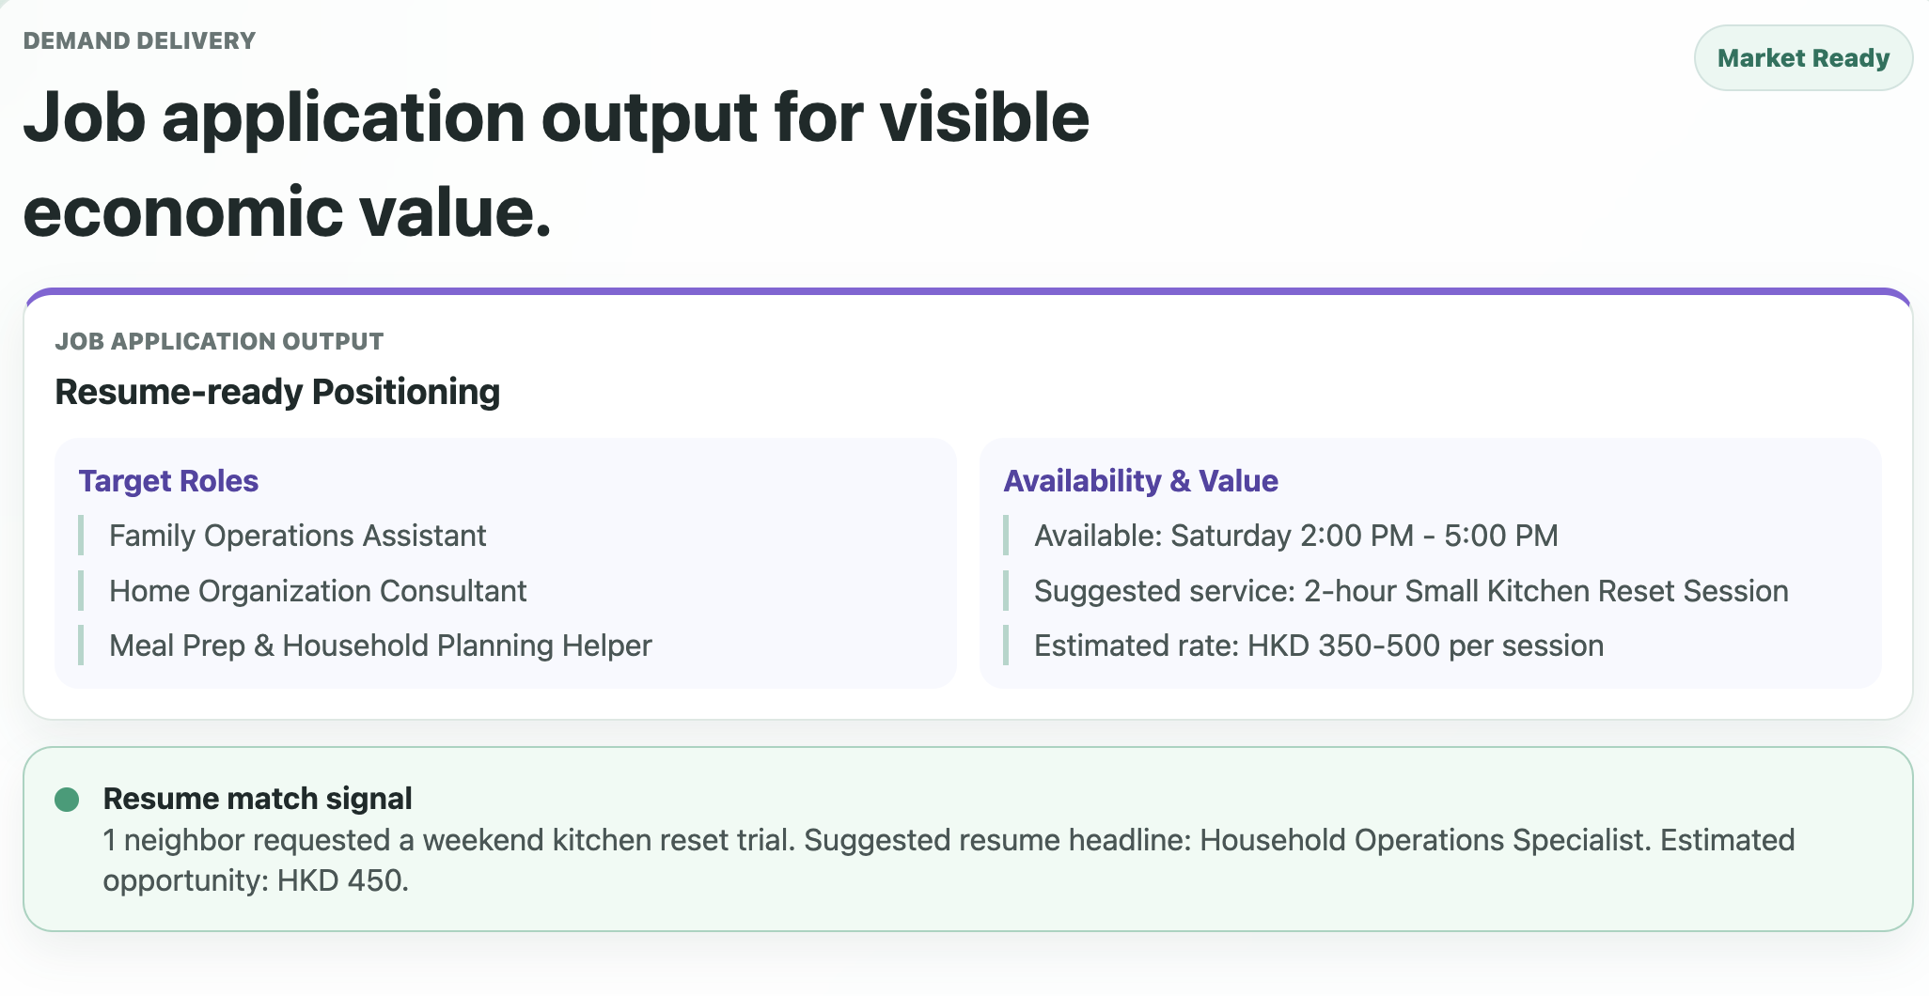
Hidden labor -> recognized opportunity
AI should not only replace labor.
It should reveal the value society has failed to see.
IDBLOOM: idbloom.tobysneko.com
AI Usage Acknowledgement
Our team used AI tools to support brainstorming, language polishing, slide structure refinement and prototype simulation. The core idea, target user, business judgment, storyline and final adaptation were developed and validated by our student team.
IDBLOOM | BPA Topic 3 Labor Identity
Time: 5:55-6:30 | Slide 8/8
Notes:
Close by returning to the opening tension: IDBLOOM does not invent value, it makes existing value visible.
[Sources] README.md; source deck media image24.png; pasted prompt.

