Slide 1

Fùchóu
An Action packed Stealth game set in
an industrial revolution China

Slide 2
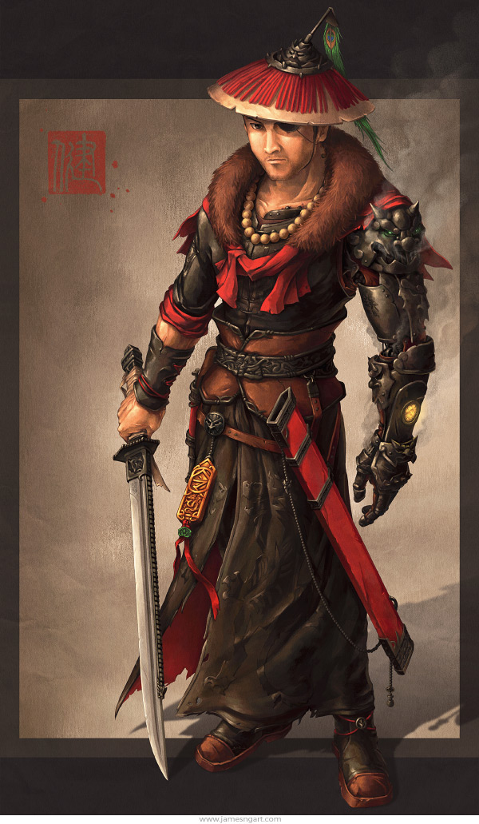
Fùchóu is an action-packed stealth game about a liberation story where the player fights to overthrow a ruthless dictator. Ex monk turned assassin the player must use a variety of gadgets and tactics to sneak their way past or butcher a variety of enemy.
Two Routes the player can take, Genocidal or
Stick to the monks code
Choices in gameplay, the player can sneak
past guards using choke holds, or fight
them sword to sword

Slide 3
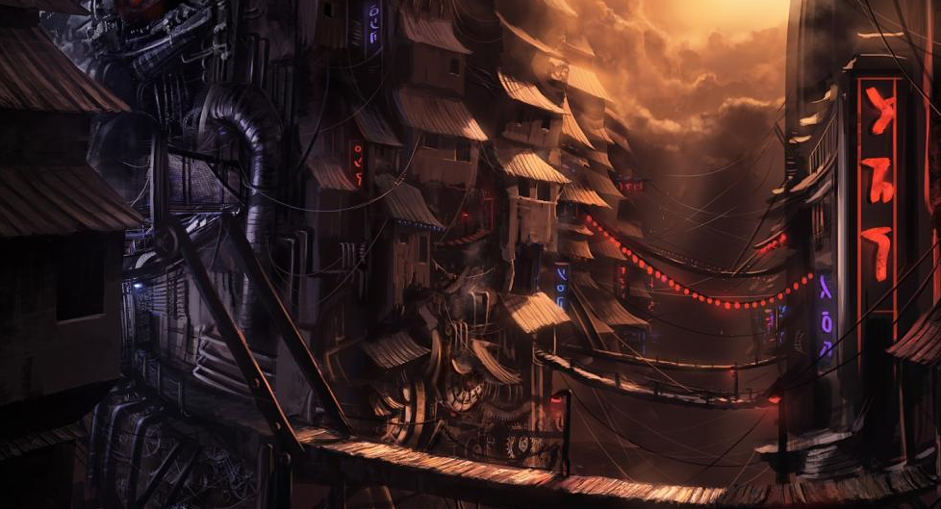
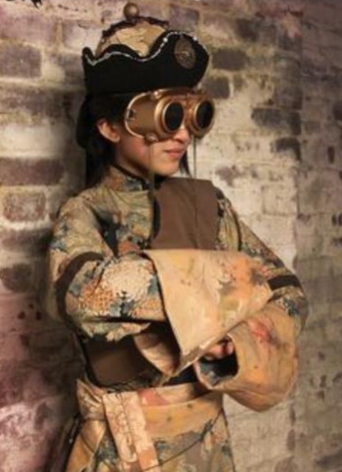
Set in alternate universe
Early industrial age steampunk China with a brutal dictator

Slide 4
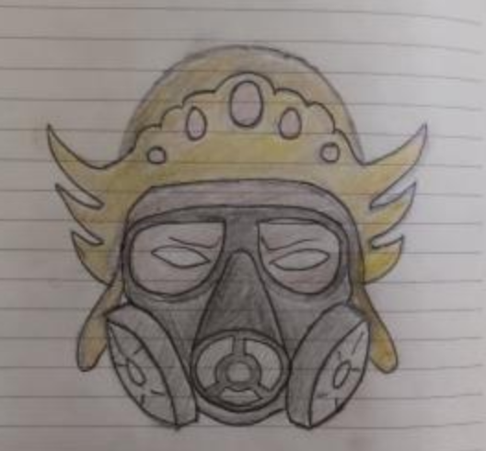
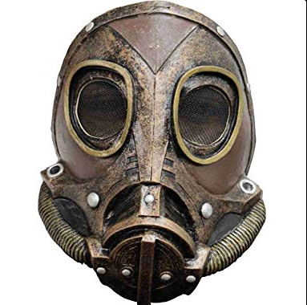


Slide 5
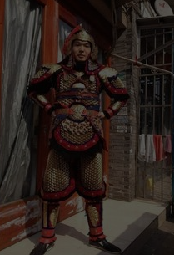
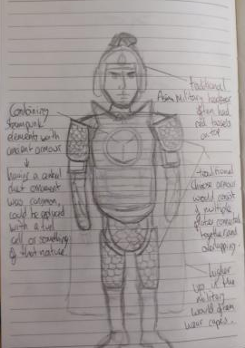

Slide 6
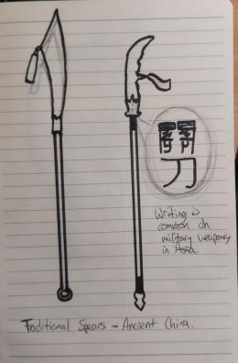
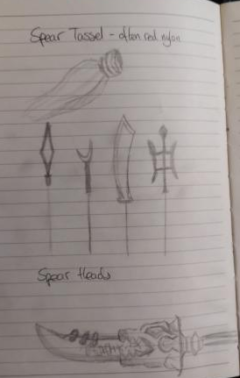
Aimed at mature audiences you can turn the streets into a blood bath using lethal magical gadgets.
Transmutation Disc that lets player traverse environment
The Shock hook, that lets you stun enemies from afar.

Slide 7
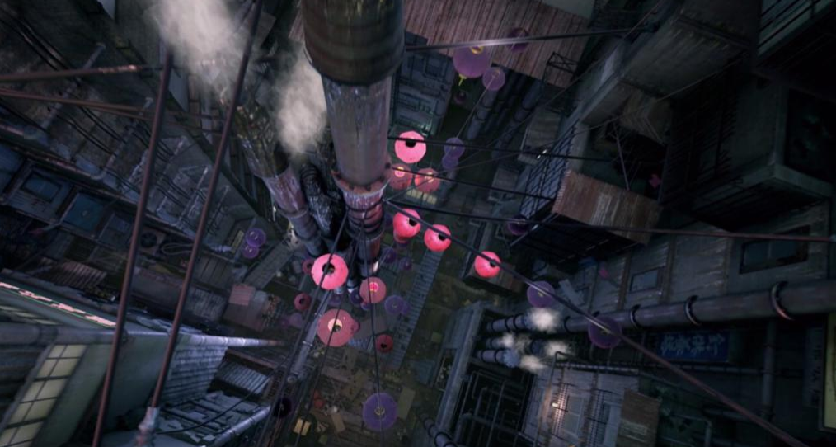
Using the environment
Clouds of dust to get behind enemies
Hidden pathways by climbing over pipes.

Slide 8
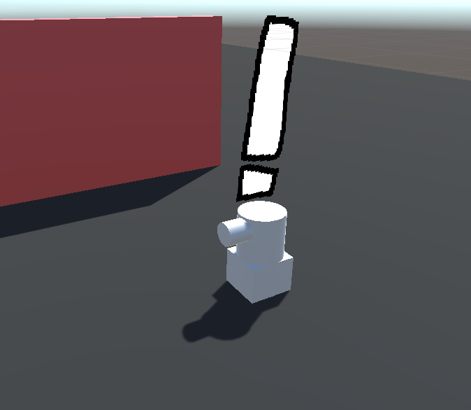
AI Guards that hunt down player
Playable Demo

