Slide 1

SCDT42 Web Application Development CW1
BLU16274423
Name: Toby Bluck
Course: BSc (Hons) Computing and Digital Technologies
Notes:
Image Reference
Background: https://www.dcdevshop.com/wp-content/uploads/2019/09/learn-wordpress-development.jpg

Slide 2
Introduction
AllStars Sports Bar
This presentation will be looking at:
Analysis of their website.
Business process & business improvement.
Recommendation for website.
Increasing online presence.
75% of users use a website to rate credibility of a company.
86% of users that visitor a website want information on services etc.
Notes:
This presentation will be looking at AllStars, through analysing meticulously and drawing valuable conclusions about the company and its website. The purpose of this is to find flaws and to strengthen them to improve the business processes within the company and make it more appealing digitally for clients. This presentation will cover all aspects of their website and the process involved with increasing online presence. This is back up by statistics as 75% of users use a website to rate credibility of a company and 86% of users that visitor a website want information on services etc. (Chambers, 2019)

Slide 3
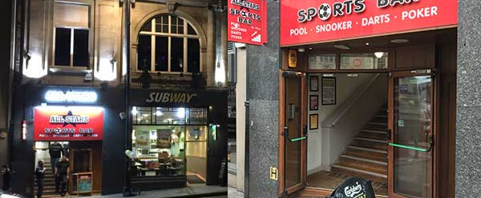
Business Overview
What does AllStars do and/or provide?
Food and drinks
HD sports
Parties
Where are they located?
Who are their audience?
Notes:
AllStars Business purpose is to serve beverages to clients while providing them the best quality sports entertainment and pub sports facilities to use while staying.
The main aims and objectives for this business is to provide excellent accommodation for the community that like sport and building a brand around that to tailor to this demographic and to further build its brand.
So far AllStars have built their brand in the south Ranging from Weston-Super-Mare to Taunton.
This brand has built a portfolio of services, such as: Bars and food, Live sport entertainment, Pool and hosting special events and parties which can be booked at one of the venues.
The main demographic that AllStars tries to appeal to and cater to is the adult audience ranging from 18 onwards. As this allows them to provide alcoholic beverages for them to enjoy.
They have 4 Venues so far which are all placed in high traffic areas within cities which allows for the chance of more people being swayed into going into.
For the more loyal AllStars clients a discount card can be purchased which allows for discounts on purchases within their venues. (Allstarssportsbars.co.uk, n.d.); (Haden, 2015)
Image Source: https://www.allstarssportsbars.co.uk/images/bristol_external.jpg

Slide 4
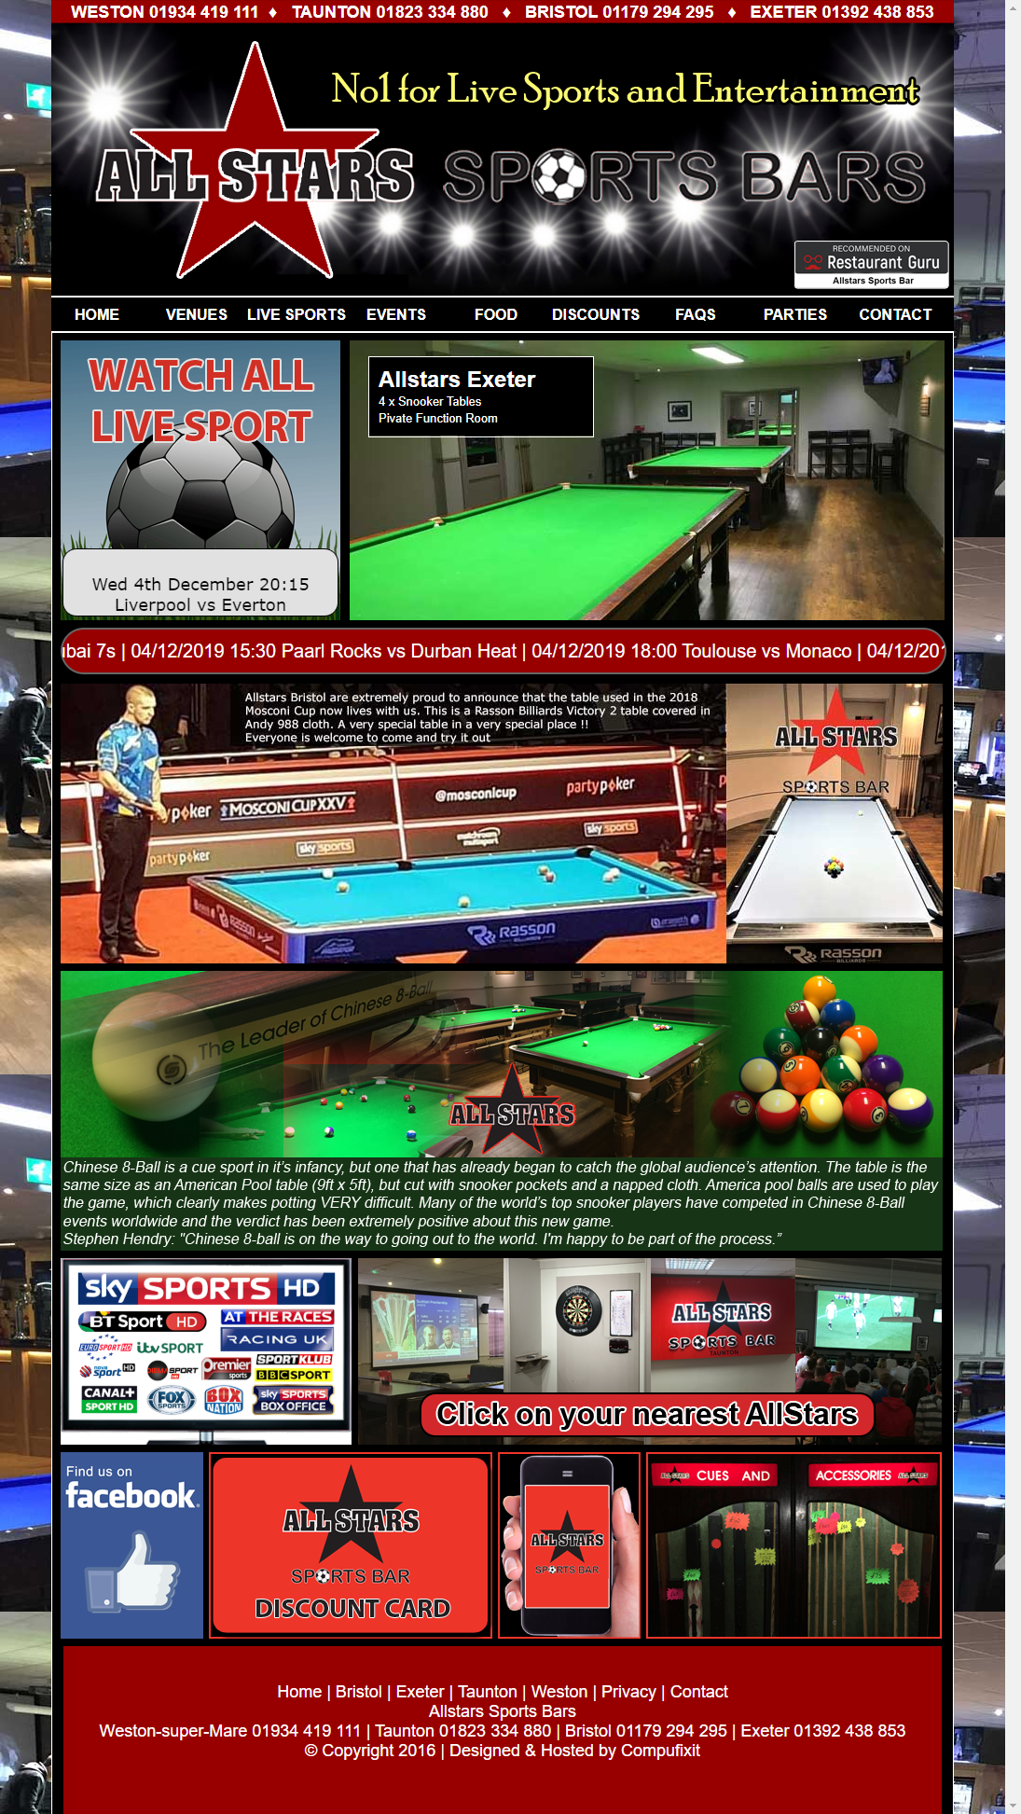
Analysis of Current Website
Front End
Good Points:
Contact info within footer
Scrolling banner on homepage
Embedded Google Maps
Bad Points:
Broken Images
Cluttered Home page
Outdated design
Back End
Good Points:
Alt tags on <img> tag
Meta tags/description for SEO
Bad Points:
Viewport isn’t optimized
Complexed class naming i.e. AWMWLO for Nav
No Favicon
Notes:
Back end
Good points, meta description is they’re for searches and SEO, Alt tags are used on images which conforms to W3 accessibility standards.
Bad points, No H1 tags on home page only in the other pages on the website, Viewport isn’t optimised for mobile devices, complicated naming on classes i.e. AWMELO for NAV. Outdated HTML as it is not semantic making it hard to read. No Favicon which doesn’t create association on web browser tabs.
Front end-
Good points, contact info within the footer of each page, scrolling banner on the home page to deliver information of upcoming matches and google map embedded into venue pages.
Bad points, broken images on events, cluttered home page, style is dated, inconsistent displaying content, background is overwhelming and off putting.
To analyse this website a checklist was used, as well as a SEO checker and google developer tools. Its purpose it to deliver information and it does. The website implements JS and other features mentioned above but overall needs an overhaul to fit with today’s expectations.
(Cappel, Huang, 2016); (Standards - W3C, n.d.); (Vries, 2015); (Seobility, n.d.)

Slide 5
Process Improvement Opportunities
What is a Business Process?
Core values and processes focusing on customers.
Affects the business but customer focused
What Business Process AllStars Use?
Marketing is used widely
Customer Support is within the website
Improvements on Business Process?
Marketing could be improved with multiple methods.
Broaden social media presence on site
Notes:
Business processes are the core values and processes which show and create value and experiences within the customers. Business processes are customer focused but directly affects the business but are optimized for efficiency.
Overall through the analysis of the website, the business processes have been made clear. It firmly uses marketing on all pages to demonstrate what they have to offer for all customers. Furthermore, the other business process which is applicable is customer support as they allow for communication in the terms of a number to call and contact form for any question/bookings.
Improvement on business processes, marketing, this is because they lack a diverse range of marketing techniques and repeat the same thing over all pages, when they could market different areas all together and use social media to influence. However, the presence on social media on their website is weak where it could be the forefront as they are very active on social media (Design, n.d.); (Gallia, 2019)

Slide 6
Recommendations
Overhaul front end to make a modern appearance
Modern UI Design
Ensure scalability on devices for ease of use
Scalability
Old and poorly made logo, could be refreshed alongside modern UI
Redesign Logo
Capture high resolution, clear images to be used.
Images
Change layout to fit within statistic and web principles
Content
Notes:
Modern UI/front end, overhaul of the visual aspect of the website to fit more modern standards, that customers come to expect from a professional company. Make the palette easier on the eyes.
Scalability on different devices, improve the media queries so full scalability applies on mobile devices as a higher majority are using mobile/tablet devices to browse the internet.
Clearer, informative content on first half of pages + social media, reduce the amount of clutter on the home page, replace it with a clear laid out content which would convey information easier, add JS carousel to replace Marquee (scrolling banner).
Redesign logo, an overhaul on the logo and banner on the pages to fit in with a more updated/modern design as it is outdated. A refresh could provide extra attention.
Clearer/fixed images, many images within the website are blurred or do not display (events page) replace with updated pictures which would be clearer for the customers to view. (26 Web Design Principles (2019 Ultimate Guide) by Atelier Studios, 2019

Slide 7
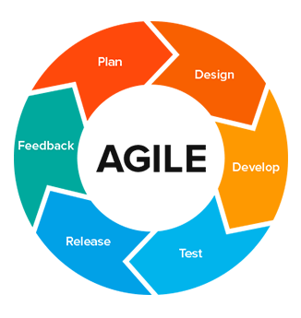
Web Development Methodologies
Agile
Time focused opposed to stages
Completed in Sprints
Client plays a large role
Using of Agile
Recommendations be broken down to increments
Sprints preformed
Review and modifications
Notes:
Agile focuses on time instead of stages, to build a project bit by bit. Each increment is done through a sprint which is allocated amount of time, sprints are normally done in weeks. Each task/increment is given a value by the client which sets the importance of the spirts, a client is relied heavily in the methodology.
Using Agile methodology, the recommendations can be broken down and liaised with the client allowing for sprints to do be done on each point and then feedback from the client. This would overall have a quicker turnover than other methods and allows the client to review each sprint to see the content to judge whether it is suitable or needs to be adapted to their requirements/needs. The main reason why this has been chosen is that the flexibility is superb, implementing is fast and new opportunities are easier taken advantage of. High levels of communication and interaction between client as well as team members greatly help. (Gapunenko, 2019)
Image Source: https://miro.medium.com/max/470/1*Fzz56Ps_vQSTPHDO9IomXw.png

Slide 8



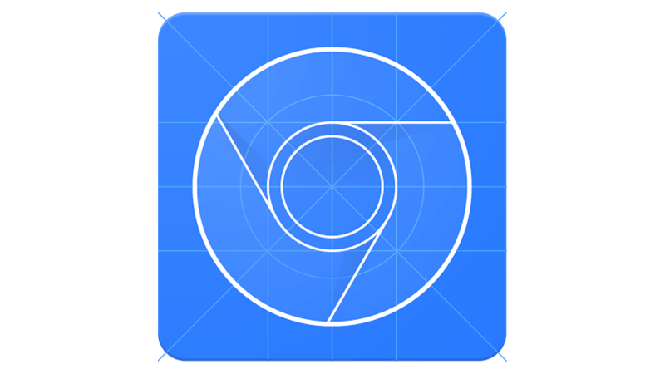
Web Development Tools
Brackets: Open source packed full of features, Free
SublimeText: Plethora of features, costs $80
Atom: Open source with GitHub
Chrome Dev Tools: made by Google for Google Chrome
Notes:
Suitable IDEs/Dev tools with features.
Brackets: Inline Editor, opens files in a window with files system to the left. A plethora of keyboard shortcuts for functionality such as finding and replacing segments of code in all the files within the folder and live previews which instantly reflect changes made within Brackets. Plugins are available. (Brackets, n.d.)
Sublime Text: Customizable to user preference, split editing, edit 2 files simultaneously side by side or 2 files together in one, command palette allows users to find functions without searching through menus making development more efficient. (Sublime Text, n.d.)
Atom: Teletype, allows for multiple users to work on file simultaneously, GitHub integration allows for you to use VCS on files/folders, smart autocompletion for increased coding speed, customisable themes and UI. Packages allow for beautify and other helpful features.
(Atom, n.d.)
Chrome Dev Tools: a plethora of helpful tools, emulate a mobile device, check the network panel to see load times of pages, Elements panel allows for the change of CSS styles. Debug JavaScript with the console panel. (Chrome DevTools, n.d.)

Slide 9




Web Development Frameworks
Front End & Back End Frameworks
Node.js
Django
Fast Execution
Scalability
Database modelling
Custom URL design
SemanticUI
Foundation ZURB
Simple phrasing
Large array of libraries to use
Building block, wireframes
Large animation library
Notes:
Back-end framework
Node.js – Extremely fast code execution, no buffering on data is outputted in chunks, single threaded model with the use of event looping which allows for high scalability within build applications. Event drive and Asynchronous communication, it waits for an event to occur and then send API data in chunks opposed to a constant stream. (About | Node.js, n.d.); (Rachowicz, 2017)
Django – allows for you to model database layouts, admin interface which automatically creates once everything is defined, design of URLs which allows for clean URLs to pages to be made, design your own templates to reduce redundancy. (Docs.djangoproject.com, n.d.)
Front-end framework
Foundation-ZURB- Base styles to use as wireframes and customised, MotionUI Sass animation library which allows user customization, new grid system(flexibox), new building block and templates to kickstart projects, well tunes for rails backend. (Foundation.zurb.com, n.d.)
Semantic-UI- User Friendly HTML, JS uses simple phrasing for functions, logging allows for faster debugging, themes/UI to be developed with inheritance and deployed everywhere. 4 libraries to choose from: React, Angular, Meteor & Ember. (Semantic-ui.com, n.d.)
All would be applicable as they are responsive, fast developing and can be easily deployed, suitability wise Node.js would be the optimal framework as its single threaded performance and fast scaling, front end they are both equal competitors
Image Sources:
Node.js: https://software.intel.com/sites/default/files/managed/fa/a0/Runtime-logo-Node.jpg
Django: https://cdn.freebiesupply.com/logos/thumbs/2x/django-logo.png
SemanticUI: https://www.stickpng.com/img/icons-logos-emojis/tech-companies/semantic-ui-logo
FoundationZURB: https://pbs.twimg.com/profile_images/1011319510006226946/ocLJW3ku_400x400.jpg

Slide 10
Selection of Web Development Tool and Frameworks
Node.js & FoundationZURB
Node.js is small and resource friendly
High performance for applications
Foundation uses basic style for wireframes
Friendly phrasing
Atom & Chrome Dev Tools
Atom for auto-completion of code for efficiency
Atom’s clean UI
Chrome Dev tools has many useful panels
81.2% users in the world use chrome.
Notes:
Web tools
Atom has been chosen as the IDE because: Multiple people can work on one project meaning transferring of files between users, Autocompletion of code is a massive benefit as the efficiency and project will progress faster. A nice simple UI, clean and easy to understand and customizable to fit user preferences is why it is suitable opposed to the other IDES
Chrome Dev Tools this is a tool when used correctly can find valuable information, all the panels are useful, and the large amount of documentation and instructions/guides using it which is why it is recommended. The other reason Google Chrome is one of the most used browsers in the world. As of October 2019 Chrome, had 81.2% users using it. (W3schools.com, n.d.)
Frameworks
Back- Node.js, small and compact, friendly to develop when using none demanding application as high performance single threaded which would suite requirements, with scalability for the business to increases its presence
Front- Foundation ZURB use of basic style to build wire frames from a plan then use a UI design/plan to fashion the styles into the design desired. Friendly language use for classes and the popular JS frameworks which can be used allow for most developers to pick this framework up.
Image Sources:
Node.js: https://software.intel.com/sites/default/files/managed/fa/a0/Runtime-logo-Node.jpg
FoundationZURB: https://pbs.twimg.com/profile_images/1011319510006226946/ocLJW3ku_400x400.jpg
Atom: https://seeklogo.com/images/A/atom-logo-19BD90FF87-seeklogo.com.png
Chrome Dev Tools: https://developers.google.com/web/tools/images/chrome-devtools-16x9.png

Slide 11
Conclusion
Conclusion & Next Steps
What's been established?
Agile methodology implementing into next steps
What would happen in the next steps
5+ Sprints to be used approx.
Notes:
Overall with what’s be drawn there is clear room for improvements and planning to be done which will help the website flourish.
With the agile methodology described this will be implemented to move onto the next stages of this project. The first step overall is to refer to the documentation created and the issues flagged up in this presentation and create a plan (sprint 1), review, then move onto the design phase where a wireframe would be created to get the basics of the website & a UI design (sprint 2), reviewing. Building the base of the website with the frameworks, presenting it (sprint 3), review, styling of web page, review w/ client. Testing, client review (sprint 4). Clients changes to final product if any, then deployment (sprint 5). Presentation with client to finish everything up with documentation and live website

Slide 12
Reference # & Section | References
#1 – Introduction | Chambers, J. (2019). 15 Website & UX Statistics of 2018-2019]. [Online] UKWebHostReview. Available at: https://www.ukwebhostreview.com/website-and-ux-statistics/ (Accessed 27 Nov. 2019).
#2 – Business Overview | Haden, J. (2015). How to Write a Great Business Plan: Overview and Objectives. [online] Inc.com. Available at: https://www.inc.com/jeff-haden/how-to-write-a-killer-business-plan-overview-and-objectives.html [Accessed 23 Nov. 2019].
# 3 - Analysis | Cappel, J, Huang, Z (2016) ‘A Usability Analysis of Company Websites’, Journal of Computer Information Systems, vol. 48, no. 1, pp. 117-123
#4 – Analysis | Standards - W3C (n.d.) W3.Org, [Online]. Available at https://www.w3.org/standards/ (Accessed 28 November 2019).
#5 – Analysis | Vries, H. (2015) The Ultimate Website Analysis Checklist (Revised for 2020!), ART+Marketing, [Online]. Available at https://artplusmarketing.com/the-ultimate-website-analysis-checklist-2a605f41809b (Accessed 28 November 2019).
#6 – Process Improvement | Design, G. (n.d.) Growth-Driven Design | A Smarter Website Redesign Process., Growthdrivendesign.Com, [Online]. Available at https://www.growthdrivendesign.com/ (Accessed 28 November 2019).
#7 – Process Improvement | Gallia, A. (2019) Top 10 Business Processes: Our List of Greatest Hits | Process Street | Checklist, Workflow and SOP Software, Process Street, [Online]. Available at https://www.process.st/top-10-business-processes/ (Accessed 28 November 2019).
# 8 – Recommendations | 26 Web Design Principles (2019 Ultimate Guide) by Atelier Studios (2019) Atelier, [Online]. Available at https://www.atelierstudios.com/web-design-principles/ (Accessed 29 November 2019).
#9 – Proposed Web Dev Methodologies | Gapunenko, I. (2019) Web development methodologies and approaches, ADCI Solutions, [Online]. Available at https://www.adcisolutions.com/knowledge/web-development-methodologies-and-approaches (Accessed 29 November 2019).
#10 – Web Dev Tools | Brackets, [Online]. Available at http://brackets.io/ (Accessed 25 November 2019).
Reference # & Section | References
#11 – Web Dev Tools | Sublime Text (n.d.), Sublimetext.Com, [Online]. Available at https://www.sublimetext.com/ (Accessed 25 November 2019).
#12 – Web Dev Tools | Atom (n.d.) Atom, [Online]. Available at https://atom.io/ (Accessed 25 November 2019).
#13 – Web Dev Tools | Chrome DevTools (n.d.) Google Developers, [Online]. Available at https://developers.google.com/web/tools/chrome-devtools (Accessed 25 November 2019).
#14 – Web Framework Evaluation | Rachowicz, J. (2017) When, How And Why Use Node.js as Your Backend, Netguru.Com, [Online]. Available at https://www.netguru.com/blog/use-node-js-backend (Accessed 25 November 2019).
#15 – Web Framework Evaluation | Docs.djangoproject.com. (n.d.). Django documentation. [online] Available at: https://docs.djangoproject.com/en/2.2/intro/overview/ [Accessed 25 Nov. 2019].
#16 – Web Framework Evaluation | Foundation.zurb.com. (n.d.). Foundation. [online] Available at: https://foundation.zurb.com/ [Accessed 25 Nov. 2019].
#17 – Web Framework Evaluation | Semantic-ui.com. (n.d.). Semantic UI. [online] Available at: https://semantic-ui.com/ [Accessed 25 Nov. 2019].
#18 – Selection of Web Development Tools & Framework | W3schools.com. (n.d.). Browser Statistics. [online] Available at: https://www.w3schools.com/browsers/ [Accessed 26 Dec. 2019].
#19 – Business overview | Allstarssportsbars.co.uk. (n.d.). Allstars Sports Bars. [online] Available at: https://allstarssportsbars.co.uk/home/ [Accessed 4 Dec. 2019].
#20 – Analysis of Website | Seobility. (n.d.). allstarssportsbars.co.uk | Website SEO Review | Seobility.net. [online] Available at: https://freetools.seobility.net/en/seocheck/check?url=https%3A%2F%2Fallstarssportsbars.co.uk%2F&crawltype=1 [Accessed 30 Nov. 2019].

