Slide 1
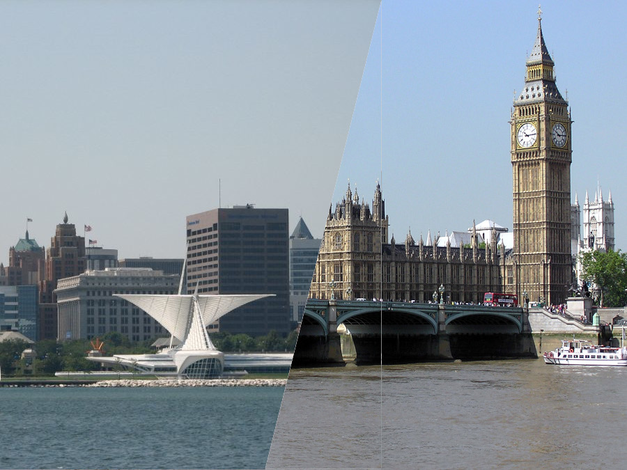
Similar neighbourhoods
in Milwaukee and London

Slide 2
Background
My wife’s family hail from Milwaukee while I am from London. The aims of this work are threefold:
To ascertain which neighbourhoods in Milwaukee are most similar to where my wife was raised or to areas of London.
To help American visitors find places to stay outside ‘tourist London’.
As we are looking to move within London next year, it would be useful to see a list of areas similar to those we prefer and also similar to areas of Milwaukee.
The measures of similarity will be measured by the types of local amenities in the different areas and the affluence of the area based on house prices.

Slide 3
Data cleaning
The data sources were:
Locality definitions from Milwaukee City Council and the Royal Mail.
House prices from Milwaukee City Council and HM Land Registry.
Local amenity lists from Foursquare (termed ‘venues’ by Foursquare).
A range of geographic services for positioning of neighbourhoods and properties.
7629 venues (1199 from Milwaukee, 6430 from London).
Property prices for 2155 houses in Milwaukee and 78 418 in London.
(From 5515 sales in Milwaukee and 1 029 229 sales in England.)
188 venue categories shared by at least some of the 163 neighbourhoods in both cities making a total of 189 features when property prices are added.

Slide 4
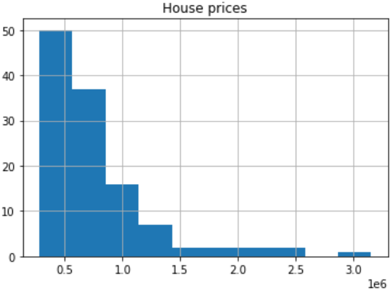
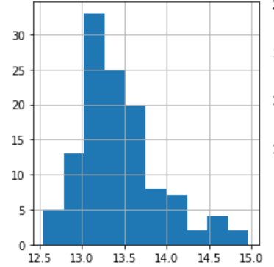
Data cleaning
The US Census API is very slow but I only needed to run it once to cache the data I needed.
Other than this extracting house prices and finding averages for neighbourhoods was straightforward. The data did have to be transformed to minimise skew (left is untransformed London prices).
The Foursquare API worked well and was more consistent about categorisation in its JSON responses than it has sometime been in the past.

Slide 5
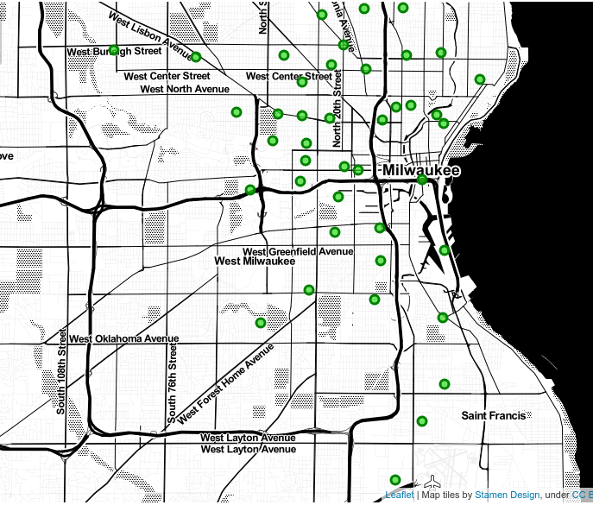
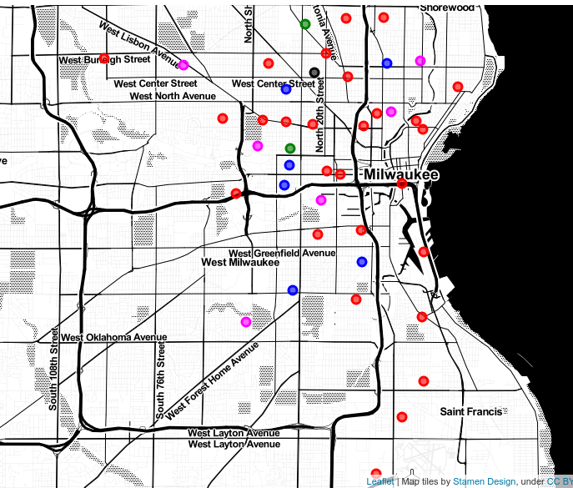
Milwaukee clustering
There was little evident pattern here – the clustered neighbourhoods, in reality, have little in common.

Slide 6
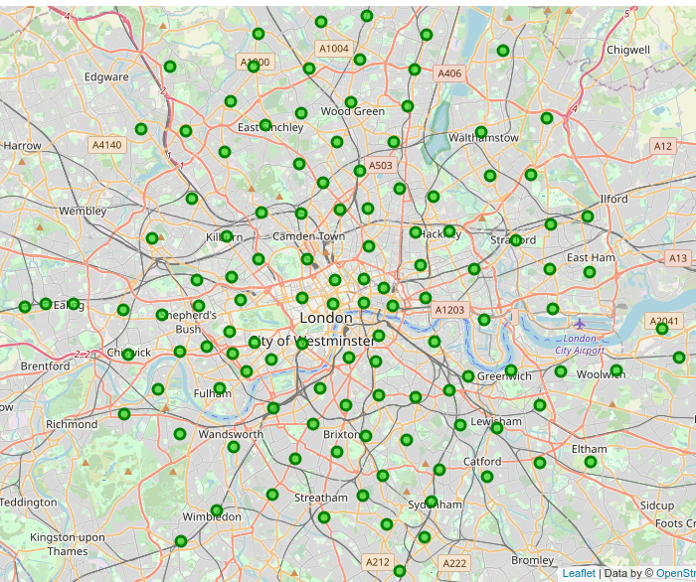
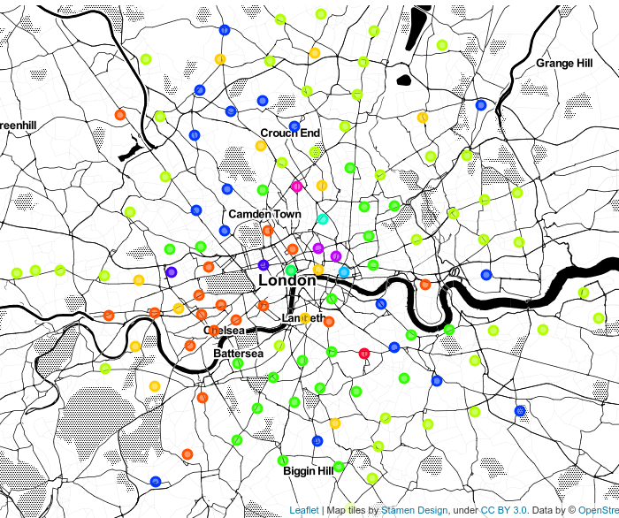
London clustering
This time a lot of the clusters made sense: the wealthy areas, the poorer but hipper areas, suburban well-off areas, suburban poorer areas and city-centre/CBD areas were all quite distinct.

Slide 7
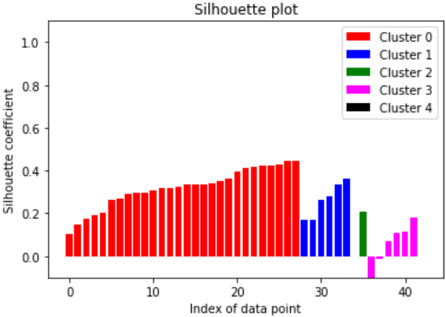
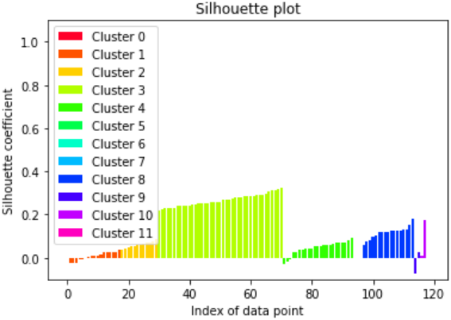
Separate city results
The clustering for Milwaukee did not appear to find any clusters that made sense when compared with reality. In London the clustering seemed to worked well and identified postcodes where I would be happiest to live*.
This was not entirely expected as the silhouette plot made the clustering of Milwaukee (top) look much better than that of London (bottom).
Running k-means repeatedly did not significantly change values of k that worked best, nor the clusters that resulted.
* SW2, SW4, SW9, SW12, SW17, SE4, SE5, SE8, SE24, E1, E2, E8, E9 and N16

Slide 8
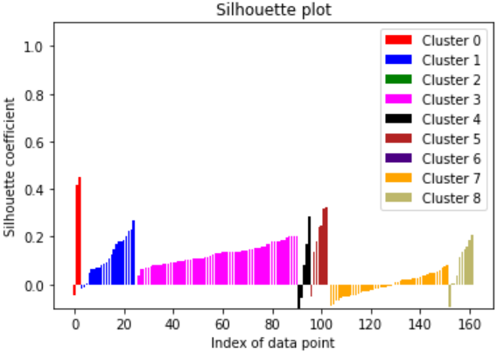
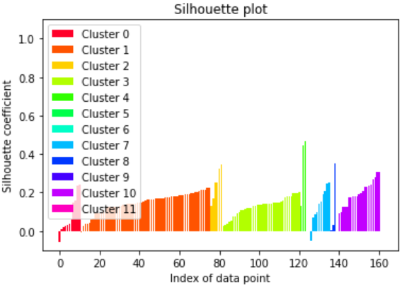
Combined city results
The best values of k when clustering neighbourhoods were 9 (top) and 12 (bottom) but in both cases the clusters produced did not seem to group similar neighbourhoods at all.
The London postcodes were certainly not grouped as well as when done within London.
Neighbourhoods tended to be clustered with others from their home city when I ran clustering on all of them. This tends to suggest that the neighbourhoods are dissimilar, even based on features the cities have in common.
Only around ¼ (32) of London postcodes seemed to have any commonalities with neighbourhoods on Milwaukee at all.

Slide 9
Conclusions
Milwaukee and London are sufficiently different that it is not possible to compare neighbourhoods between them.
Milwaukee neighbourhoods are more similar to each other than London postcodes and hence are more difficult to categorise.
London postcodes fall into 5 categories: Rich Western, Affluent Suburban, Regular Suburban, Cool Inner, Central/CBD.
Using Foursquare categories one-hot encoded leads to a very sparse feature matrix which in turn means that many neighbourhoods can be clustered by their lack of an amenity rather than its presence. With so many 0’s in the matrix this may well dominate the clustering algorithm meaning the results it produces lack reliability.

