Slide 1

109 – 1
Special Topics on Control Technology
Homework Report
Homework7 - Plot Research Data
Graduate Institute of Electrical Engineering
Po-Chih Chen R09921009
EE II 206
次世代手術自動化系統實驗室
Next-generation Automated Surgical Apparatus Lab

Slide 2
Homework Guidelines
Topics: Plot Research Data
Find any data set and analyze and plot the data using Matlab, Python, or R.
Edit your program to plot at least 3 figures for the same set of data.
Put as many descriptions/ideas/findings as possible on your figures.
Discuss with your classmates at least twice: At your first meeting, ... discuss the data format and possible methods / functions... to analyze / plot the data.
Use the PPTX format to edit your own result on the tasks/codes/jobs you did the analysis and the detailed description of your data/plots/explanation.
Submit your HW07 report ----- to NTU Cool by the 11pm of 12/9/20 (Wed)

Slide 3

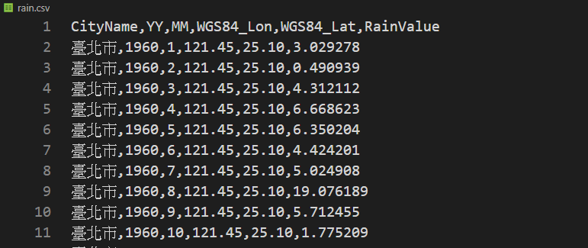
Data set and my code
Rain fall in Taipei (from1960 to 2017, includes rain fall data from 22 observation stations)
Data Source: https://data.gov.tw/dataset/130309
Raw data in csv format:
My code can be found here: https://github.com/TobyChen0106/Special-Topics-on-Control-Technology-Homework07

Slide 4
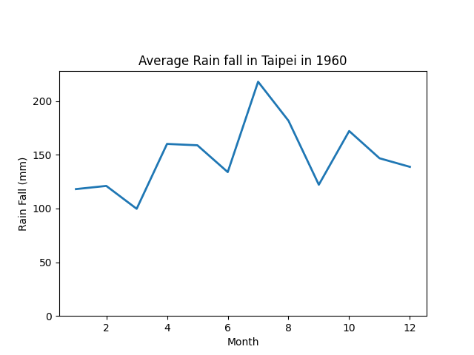
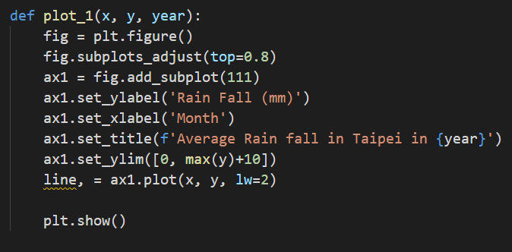
Figure 1
Code:
Label
Title
Y axis upper and lower bound

Slide 5
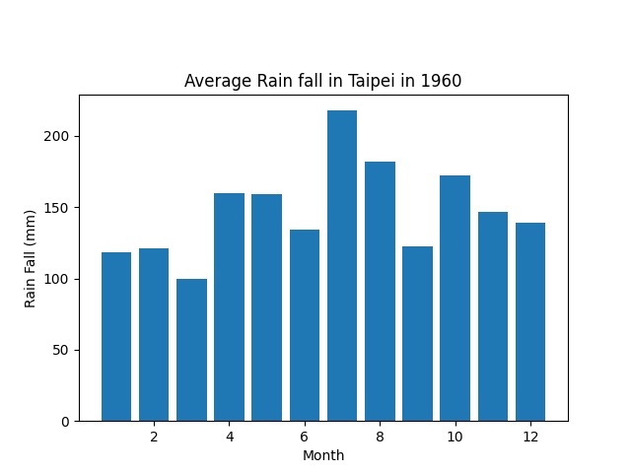
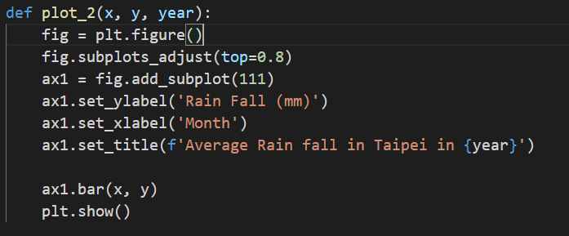
Figure 2
Code:
Bar plot

Slide 6
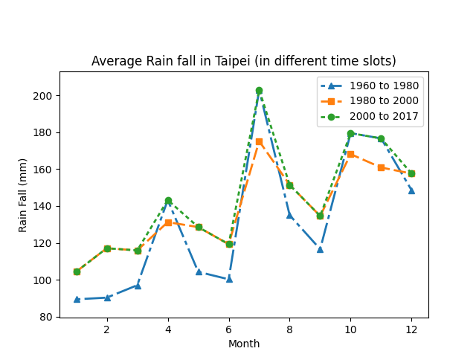
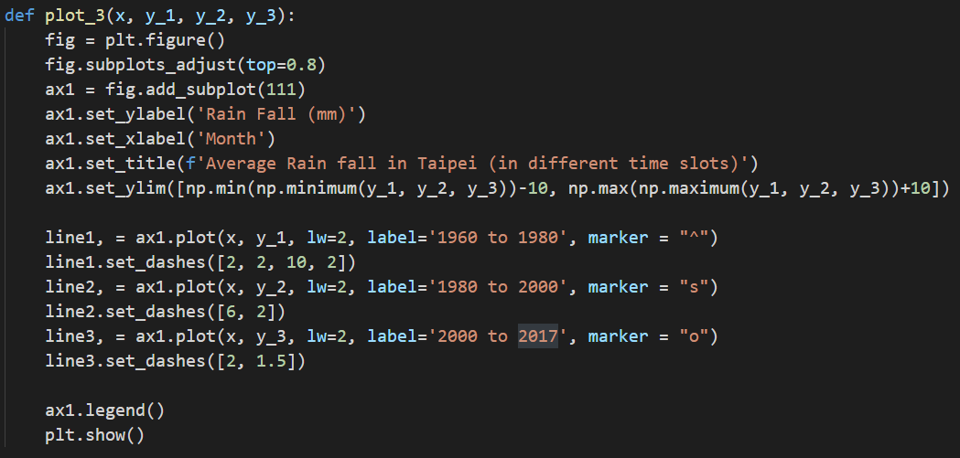
Figure 3
Code:
Add marker
Adjust dashed line
Add legends

