Slide 1



Review of Summertime Winds at George Bush International Airport (KIAH)
Eric Zappe
National Weather Service
Houston Center Weather Service Unit

Slide 2
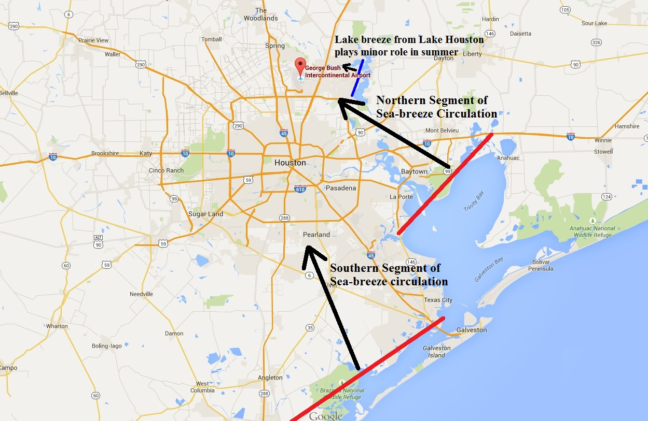
Geography of Houston Metro Area
* Northern segment typically precedes
arrival of southern segment.
* Winds from 120/140 degrees develop
behind northern segment.
* Winds from 150/170 degrees develop
behind southern segment.

Slide 3
July 22, 2015 Event
Afternoon convection developed east of KIAH with outflow boundaries arriving at KIAH prior to 21Z.
Interaction of aforementioned outflow boundaries, northern segment of sea-breeze circulation (and possible enhancement from lake breeze from Lake Houston) maintained easterly winds for approximately 2 hours.
A persistent and deep southerly flow was noted through the lowest 5,000 feet in the afternoon/evening. This allowed main (southern) segment of sea-breeze circulation to arrive from the south prior to 23Z.
See following slides for animation of kiah reflectivity data
and tiah 0.1 velocity data

Slide 4
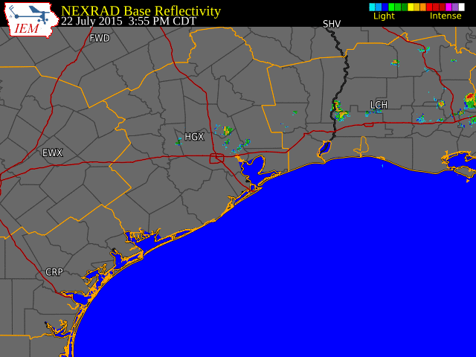
kiah Reflectivity–Animation (July 25, 2015)

Slide 5
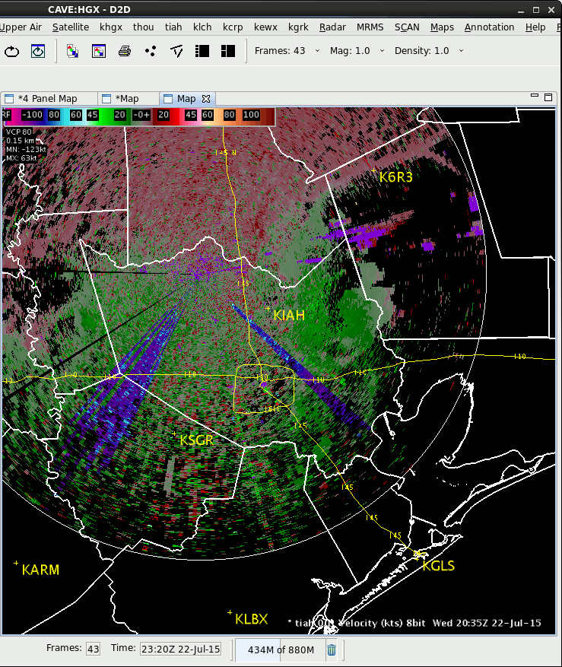
tiah 0.1 Degree Velocity - Animation
July 22, 2015 20:35Z – 23:10Z
KIAH 0.5 Degree Velocity (
Easterly winds spawned from outflow boundaries followed by southerly winds from southern
segment of sea breeze

Slide 6
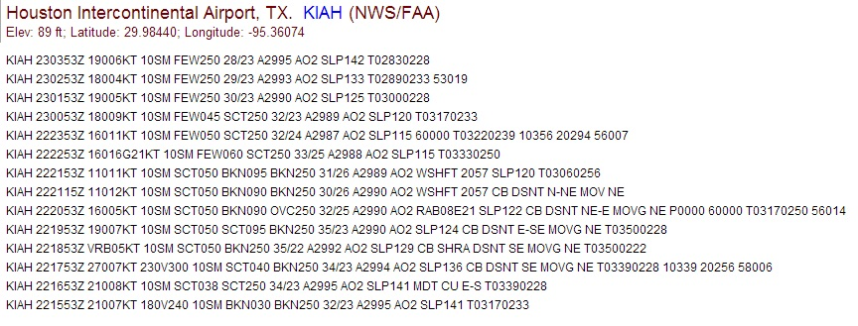
KIAH METARs – July 22, 2015
NOTE: earlier METARs displayed at bottom
Arrival of southern segment
Effects from outflow boundaries and sea breeze

Slide 7
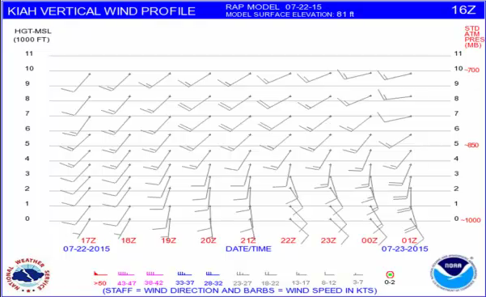

KIAH RAP Vertical Wind
Profile - July 22, 2015
16Z issuance - top image
23Z issuance – bottom
NOTE: Pronounced southerly winds through the lowest 5,000 feet allowed for the southern segment of sea-breeze to arrive within a few hours of northern segment.

Slide 8
July 23, 2015 Event
There was no convection on this day.
A persistent and deep southerly flow was noted through the lowest 5,000 feet in the afternoon/evening.
These winds held the northern segment of the sea-breeze circulation east of KIAH while some semblance of the southern segment may have arrived late.
Surface winds at KIAH stayed between 180/230 degrees.
See following slide for tiah 0.1 velocity data

Slide 9
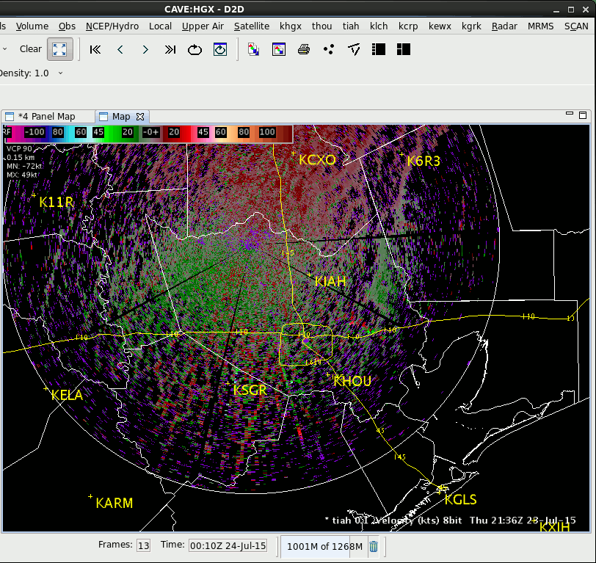
tiah 0.1 Velocity- Animation
July 23, 2015 21:36Z – 00:50Z
Sea breeze stayed
east of KIAH

Slide 10
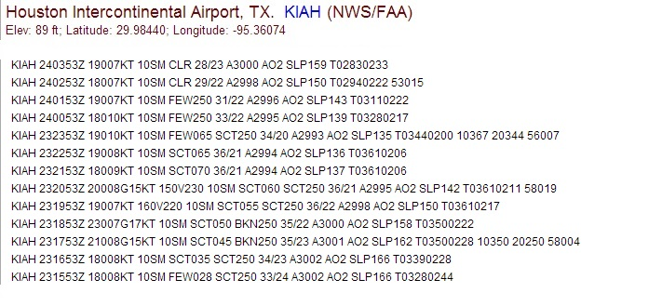
KIAH METARs – July 23, 2015
NOTE: No sea breeze arrival
NOTE: earlier METARs displayed at bottom

Slide 11

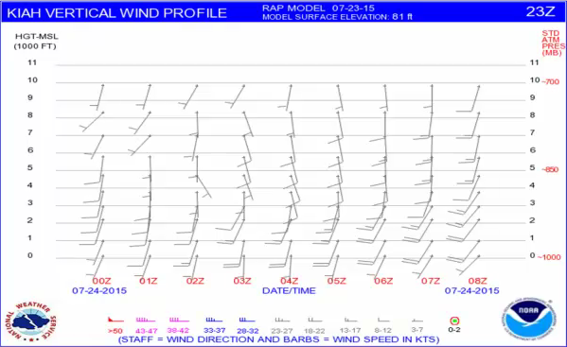
KIAH RAP Vertical Wind
Profile - July 23, 2015
15Z issuance - top image
23Z issuance – bottom
NOTE: Both wind profiles indicated pronounced southerly winds (i.e., 10 knots or stronger) would extend through the lowest 5,000 feet and last through at least 00Z.

Slide 12
July 24, 2015 Event
There was no convection on this day.
A weak southerly flow was noted through the lowest 5,000 feet in the afternoon/evening.
In particular, winds within the lowest 3,000 feet were only 5 knots which enabled the northern segment of the sea-breeze circulation to arrive by 22Z with southeast winds (from 130 degrees and near 10 knots ) developing in its wake and lasting for about 3 hours.
See following slide for tiah 0.1 velocity data

Slide 13
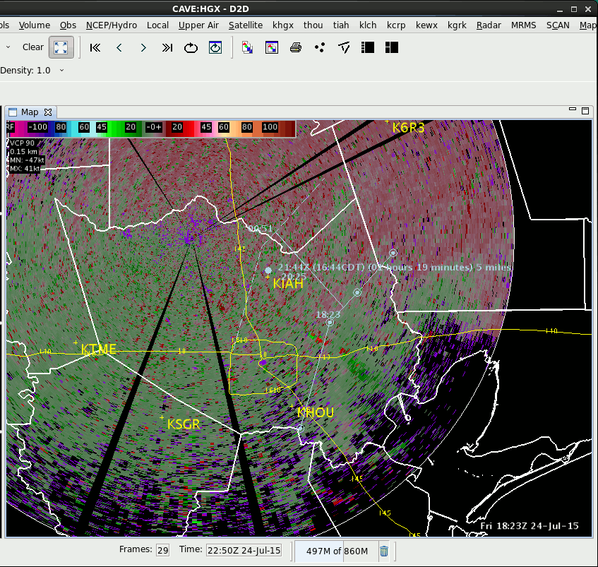
tiah 0.1 Velocity- Animation
July 24, 2015 18:23Z – 20:25Z
NOTE: Radar went offline after 20:25Z
Outline of sea breeze
In light blue

Slide 14
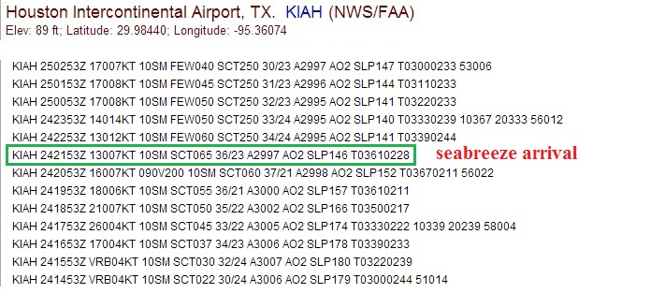
KIAH METARs – July 24, 2015
NOTE: earlier METARs displayed at bottom

Slide 15
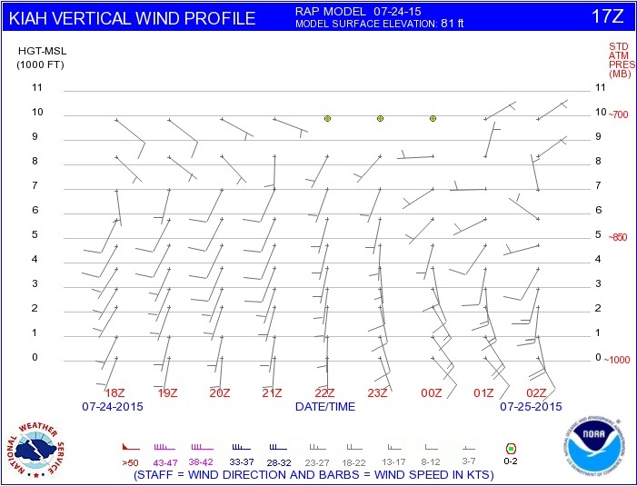
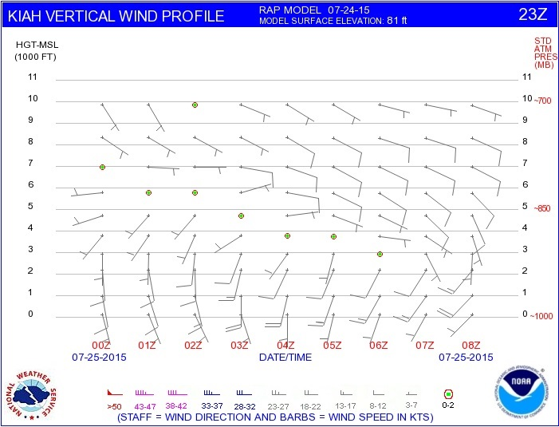
KIAH RAP Vertical Wind
Profile - July 24, 2015
17Z issuance - top image
23Z issuance – bottom
NOTE: 17Z issuance indicated light southerly winds (i.e., 5 knots) would extend from surface through the lowest 5,000 feet and last through at least 00Z. Some semblance of sea-breeze arrival around 00Z.

Slide 16

What Can We Learn?
KIAH RAP Vertical Wind Profile graphics can be a valuable tool in forecasting afternoon winds in the summer.
Identify potential changes in wind direction/speed.
Light winds within lowest 5,000 feet will favor
arrival of northern segment of sea breeze with winds
between 120/140 degrees.
Southerly winds of 10 knots or stronger within lowest 5,000 feet will preclude arrival of northern segment with winds
backing no more than 160 degrees.
Northern segment of sea breeze (if conditions support) normally arrives after 5 PM CDT and precedes arrival of southern segment. However, east or southeast winds in the lowest 5,000 feet will favor an earlier arrival of the northern segment.
Inflow into thunderstorm development near KIAH can result in both an earlier arrival and prolonged event of easterly winds at KIAH!!

