Slide 1
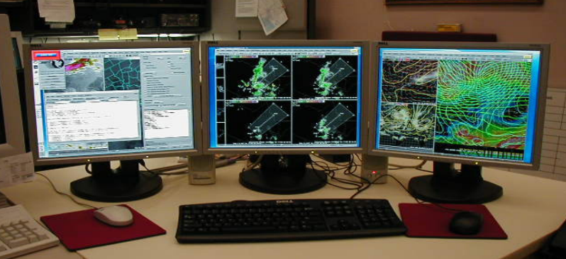



Utilizing Model 4 Panels on AWIPS to Forecast Convection
Eric Zappe
National Weather Service
Houston Center Weather Service Unit

Slide 2
This tutorial will demonstrate the usefulness of employing model 4 panels to forecast timing/place of convection.
This event took place during the afternoon of June 14, 2016 across Houston CWSU (ZHU) portions of the Gulf Coast region.
The following case study contains AWIPS 4-panel snapshots of GFS and RAP forecast models.

Slide 3
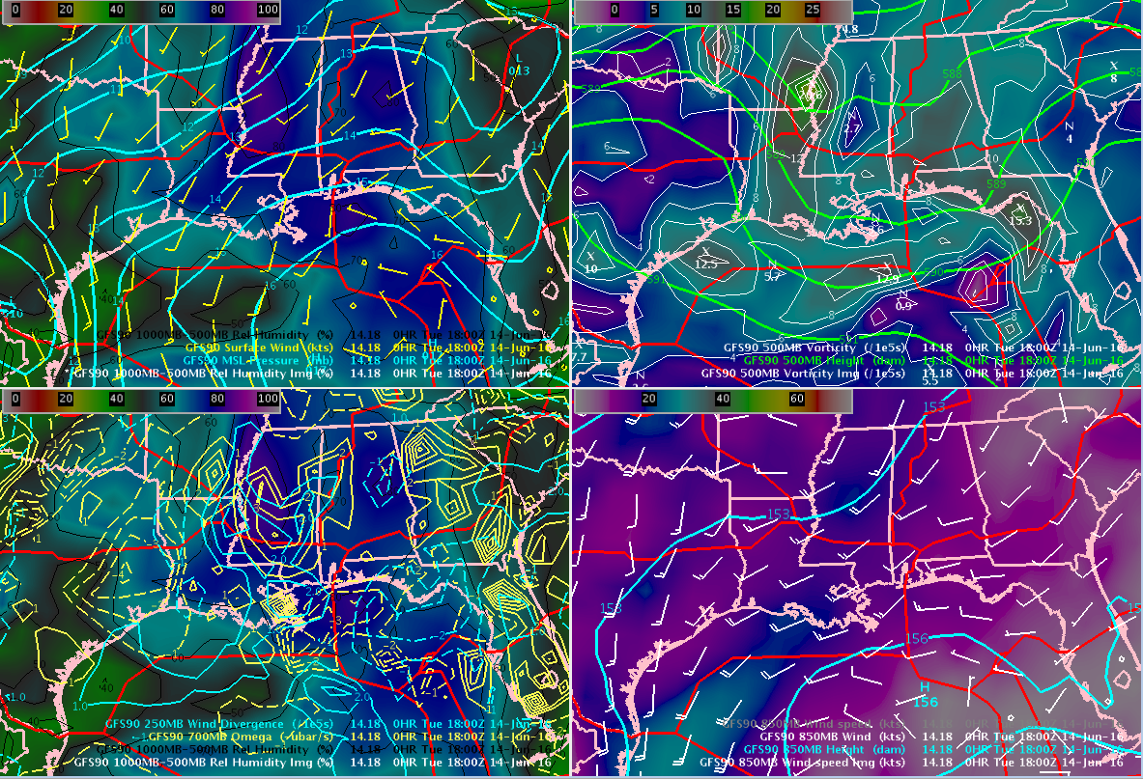
I first like to view GFS model to discern large (synoptic) scale features…
Sfc
500
250/700
850

Slide 4
Top left is surface features
Top right is 500 mb features
* MSL Pressure
* Surface Wind
* 100MB-500MB RH (image)
* 500MB Height
* 500MB Vorticity
* 500MB Vorticity (image)
Sfc
500
250/700
850

Slide 5
Bottom left is 700/250 mb features
Bottom right is 850 mb features
Sfc
500
* 250MB Wind Divergence
* 700MB Omega
* 1000MB-500MB RH (image)
* 850MB Height
* 850MB Winds
* 850MB Winds (image)
250/700
850

Slide 6

A broad trough (and associated lift) was noted from Louisiana eastward as well as over the northern half of the Gulf of Mexico
Higher moisture
500 mb shortwaves
H
Sfc
500
250 mb divergence / 700 mb omega couplets
(large scale ascent)
Higher 850 mb winds
(promoting shear)
250/700
850

Slide 7
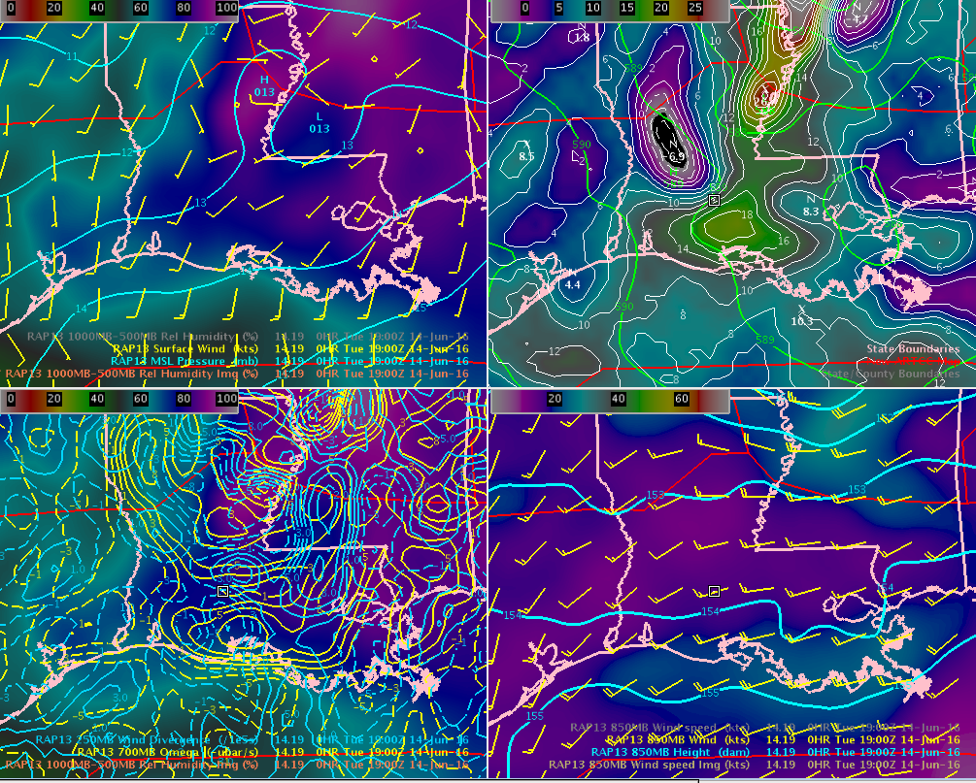
I then look at the finer details using same 4-panel configuration of 13 km RAP model
RAP13 19Z June 14, 016
Sfc
500
250/700
850

Slide 8
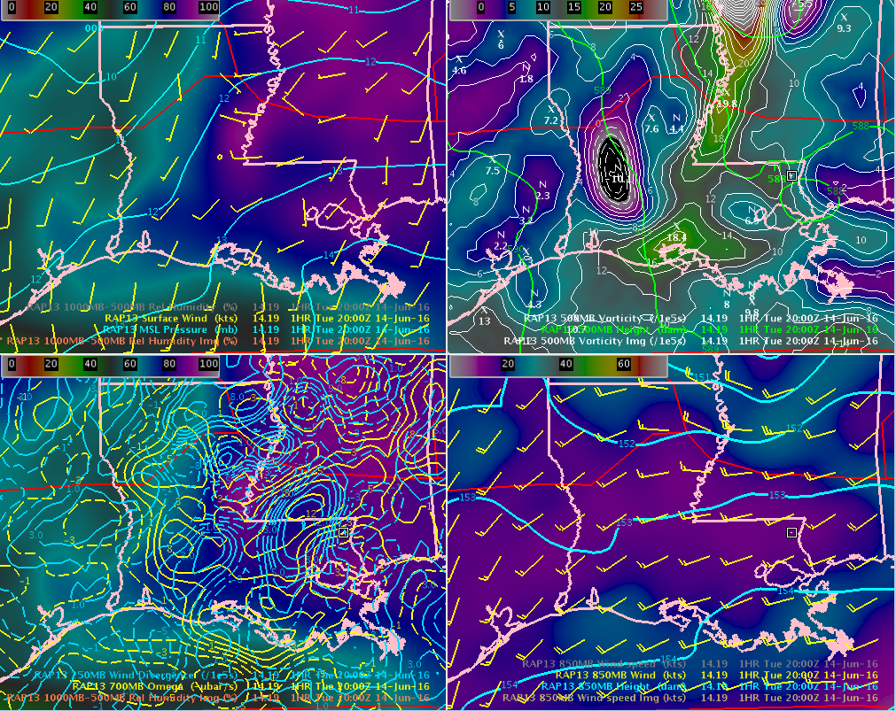
RAP13 provides one-hour time steps, so I advance to see trends of weather features…
RAP13 20Z June 14, 016
Sfc
500
250/700
850

Slide 9
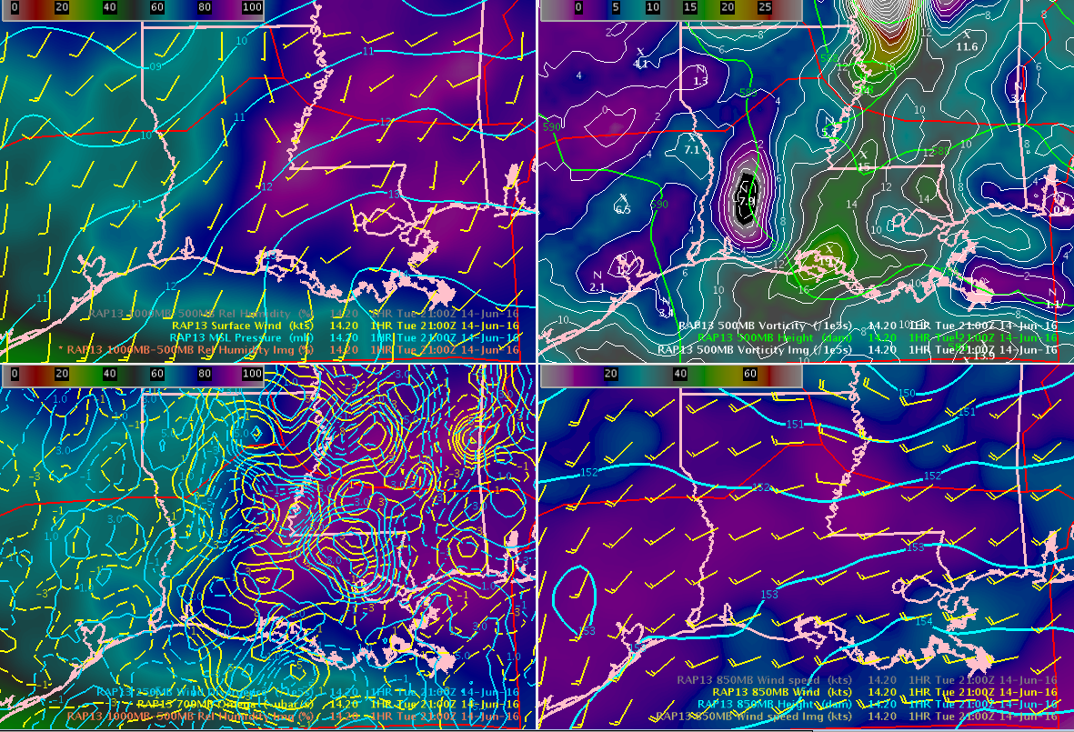
such as strengthening/weakening of winds and 500 mb shortwaves
RAP13 21Z June 14, 016
Sfc
500
250/700
850

Slide 10
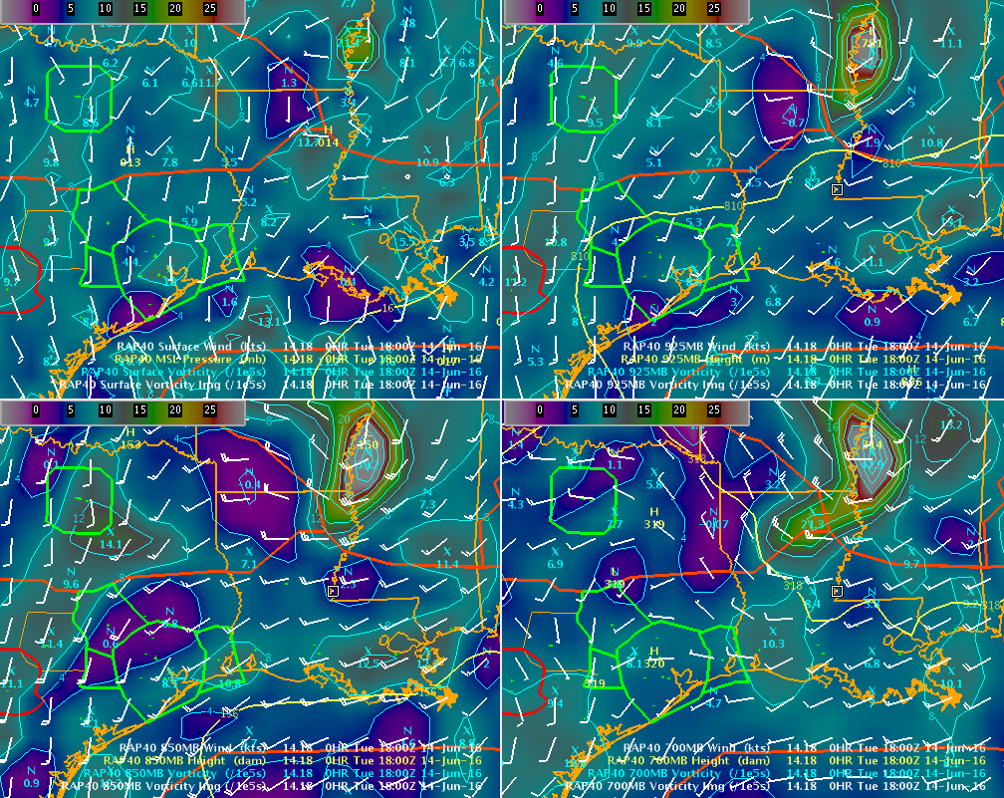
I also like to see lowest slices of the atmosphere to identify lifting mechanisms
RAP40 18Z June 14, 016
Sfc
925
850
700

Slide 11
Top left is surface features
  Top right is 925 mb features
* MSL Pressure
* Surface Wind
* Surface Vorticity
* Surface Vorticity (image)
* 925MB Height
* 925MB Wind
* 925MB Vorticity
* 925MB Vorticity (image)
Sfc
925
850
700

Slide 12
Bottom left is 850 mb features
  Bottom right is 700 mb features
Sfc
925
* 850MB Height
* 850MB Wind
* 850MB Vorticity
* 850MB Vorticity (image)
* 700MB Height
* 700MB Wind
* 700MB Vorticity
* 700MB Vorticity (image)
850
700

Slide 13

I like to loop these images to detect trends, such as increasing/decreasing PVA/NVA
RAP40 18Z-20Z loop
Sfc
925
850
700

Slide 14

I like to loop these images to detect trends, such as increasing/decreasing PVA/NVA
RAP40 18Z-20Z loop
Increasing southwest winds will enhance shear/instability
Sfc
925
Strong and deep layer vorticity maxima (here 925-700 mb) favors showers over storms
Decreasing NVA/
increasing PVA at 700 mb
850
700

Slide 15
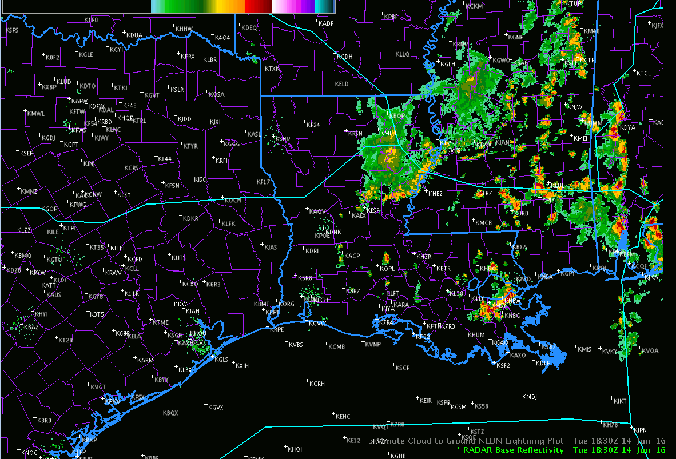
Here’s the mosaic radar loop for the western half of the Gulf Coast region
Strong and deep layer vorticity max (in this case 925-700mb) favors showers over storms
Decreasing NVA/
increasing PVA at 700 mb
Increasing southwest winds at 925 mb will enhance shear/instability

Slide 16
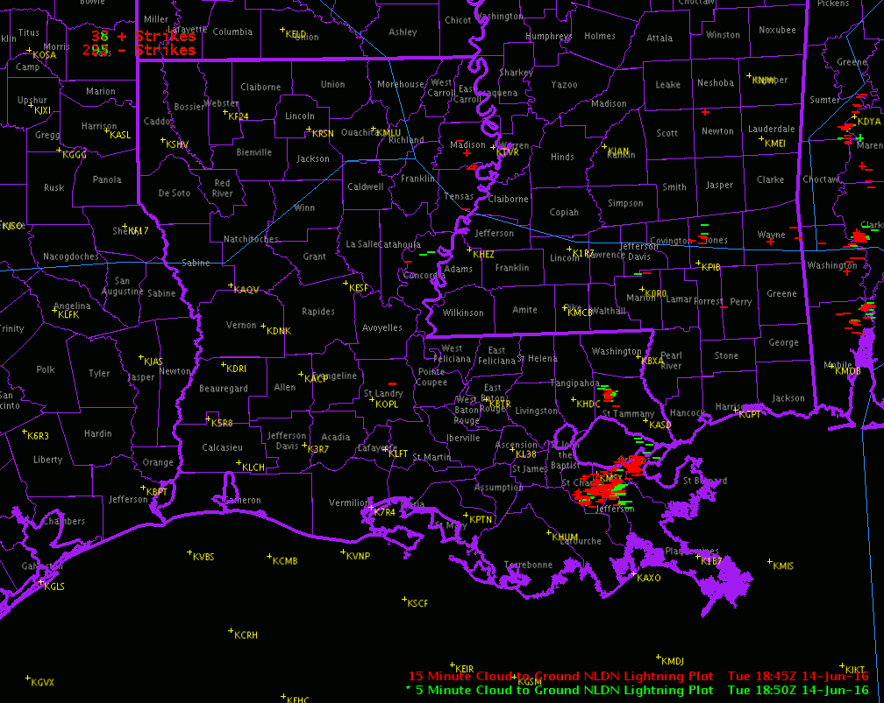
Here’s the lightning for the same sector
5-minute strikes green 15-minute (older) strikes red
Strong and deep layer vorticity max (in this case 925-700mb) favors showers over storms
Decreasing NVA/
increasing PVA at 700 mb
Increasing southwest winds at 925 mb will enhance shear/instability

Slide 17
Once again, the other 4 panel of RAP model
RAP13 19Z June 14, 016
Higher moisture
(1000/500 mb)
Decreasing NVA/
increasing PVA
Sfc
500
250 mb divergence/700 mb omega couplets
(large scale ascent)
Higher 850 mb winds will enhance shear. Moisture advection determined by wind orientation
250/700
850

Slide 18

Now for quick review of necessary ingredients for thunderstorm development

Slide 19
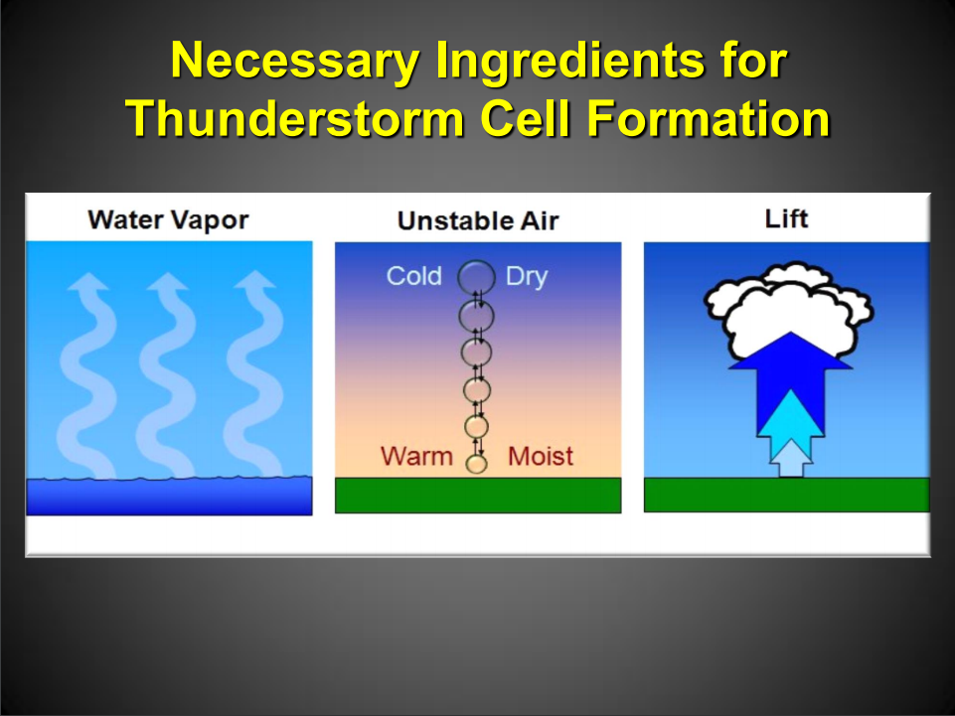

Slide 20
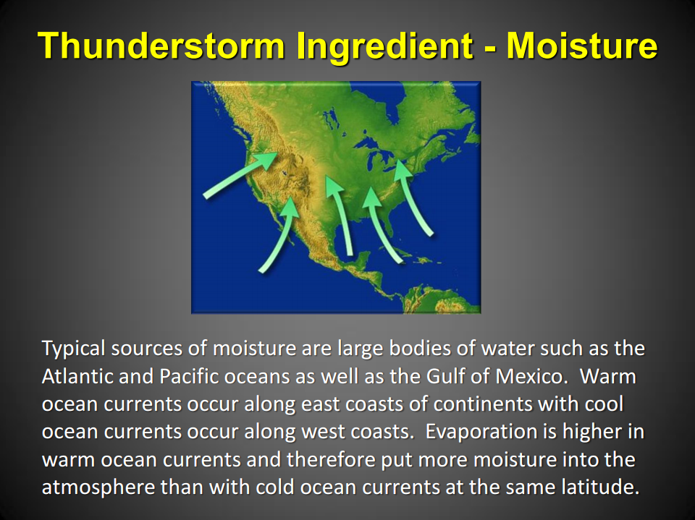

Slide 21
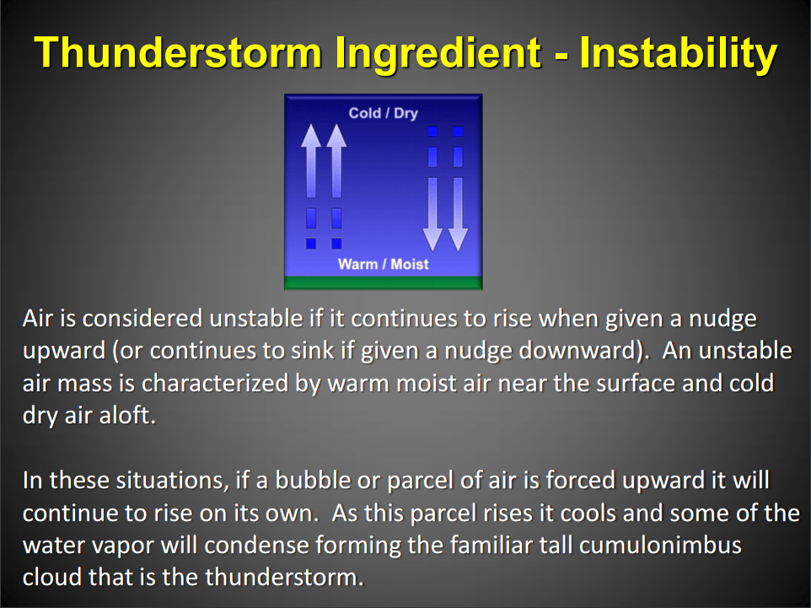

Slide 22
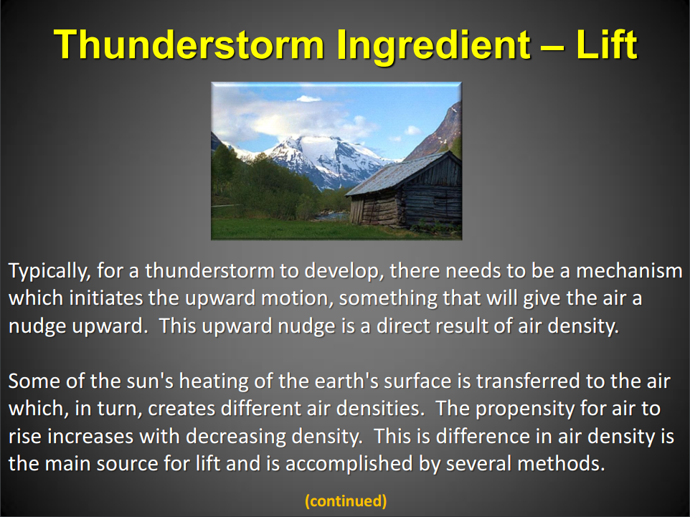

Slide 23
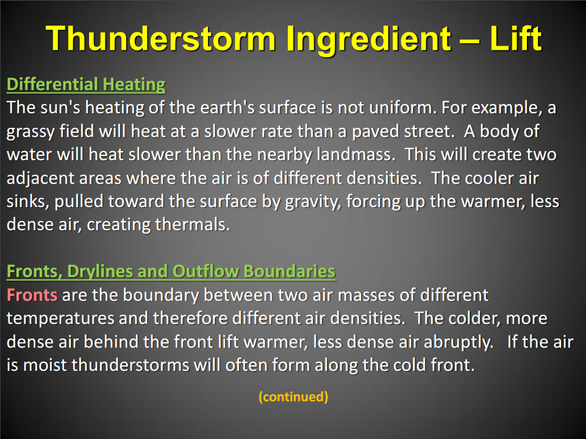

Slide 24
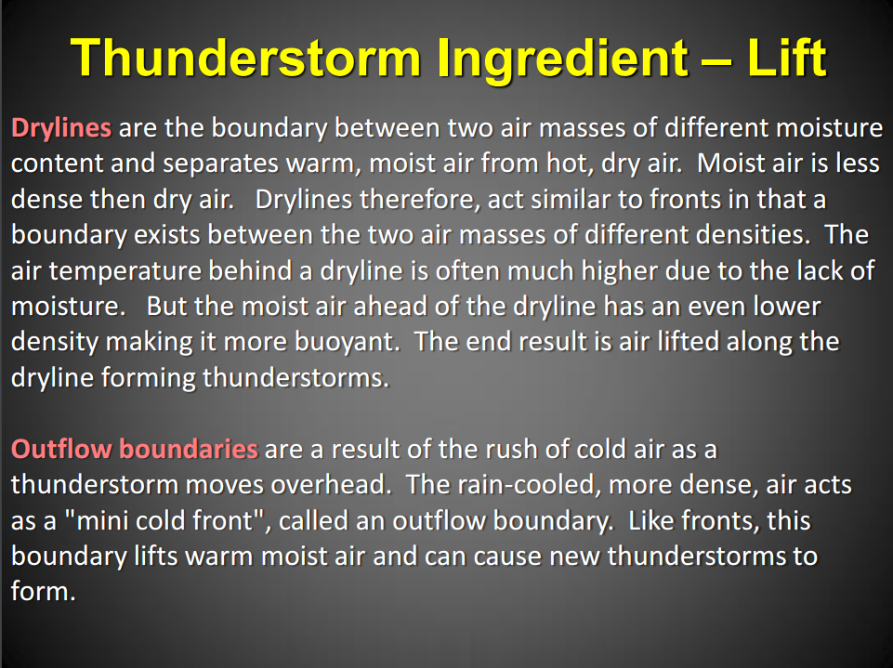

Slide 25
The End
Eric Zappe
National Weather Service
Houston Center Weather Service Unit

