Slide 1


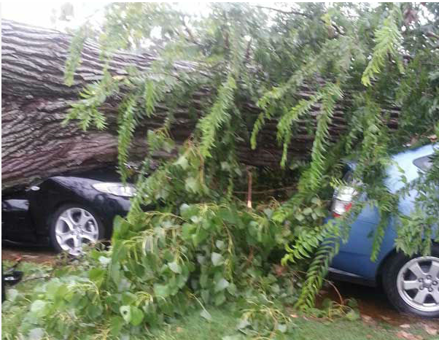
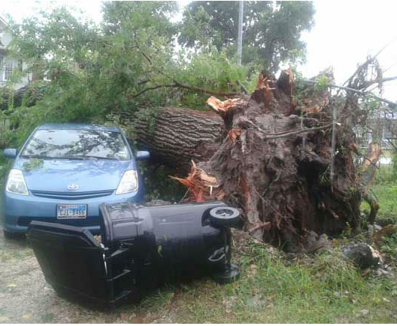
Houston Severe Weather Event August 16, 2013
Photos courtesy of KTRK Channel 13 Houston

Slide 2

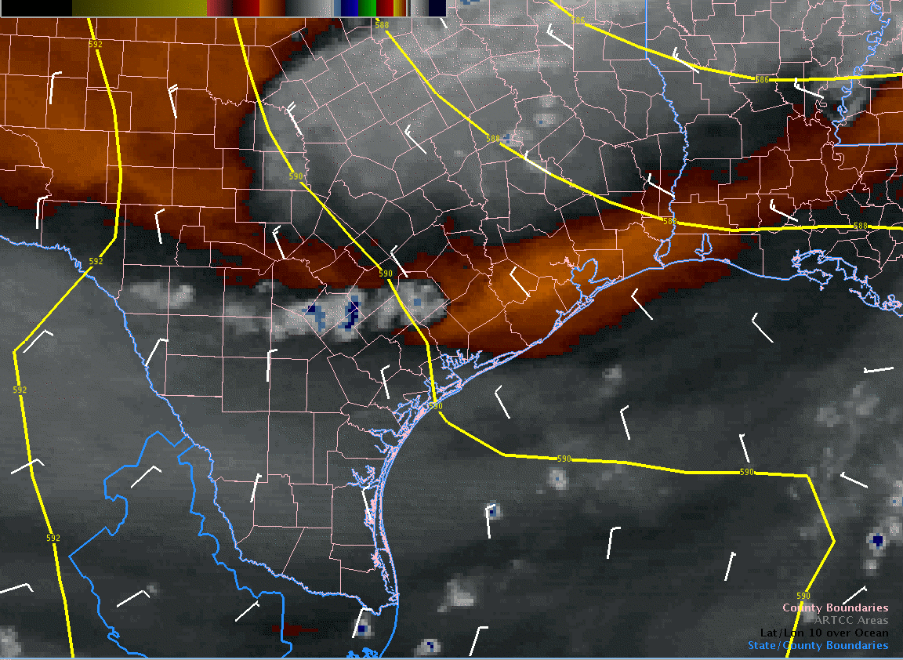
Water Vapor Imagery (RAMSDIS Color)
Very dry conditions in the
mid-upper levels as the shortwave trough approaches
(increasing risk of downburst winds)

Slide 3
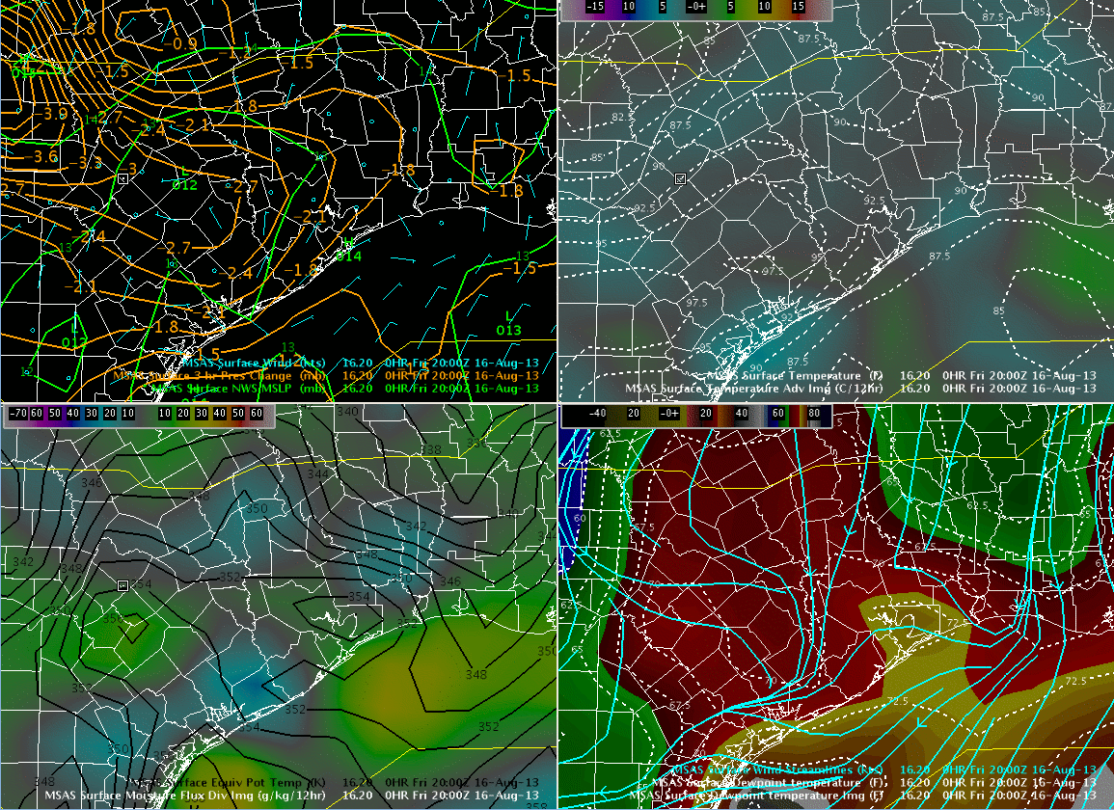
MSAS Analysis (20Z-23Z)
Thermal trough
Temperature
Dewpoint Temperature
Moisture axis
Surface theta-e ridge

Slide 4
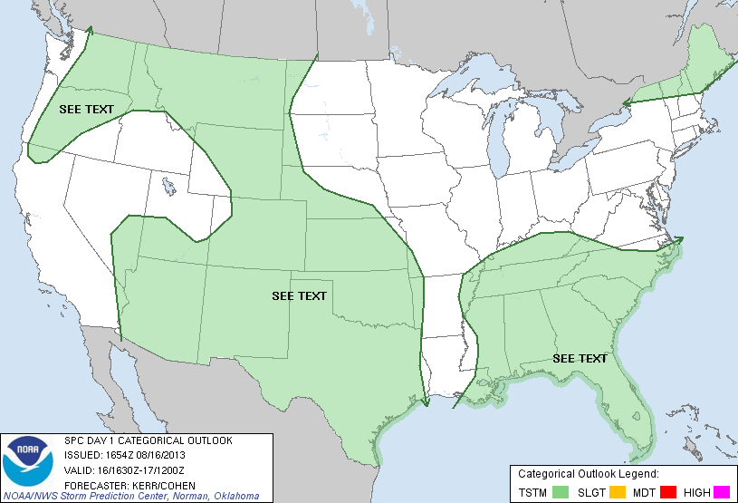
SPC Day 1 Categorical Outlook

Slide 5
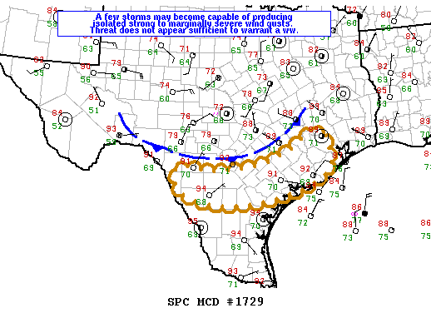
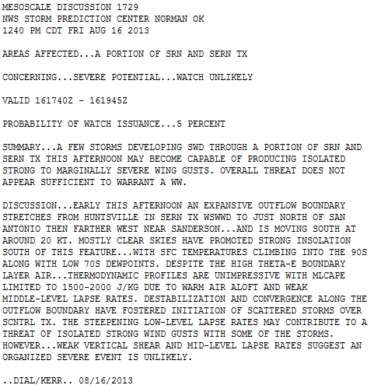
SPC Mesoscale
Discussion 1729

Slide 6
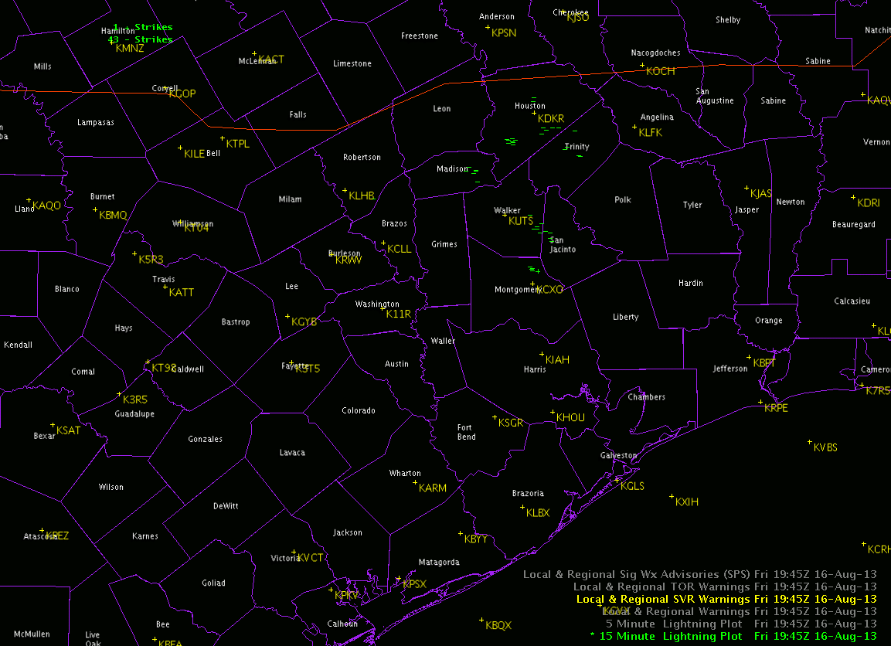
15 Minute Lightning Data(20Z-00Z)

Slide 7
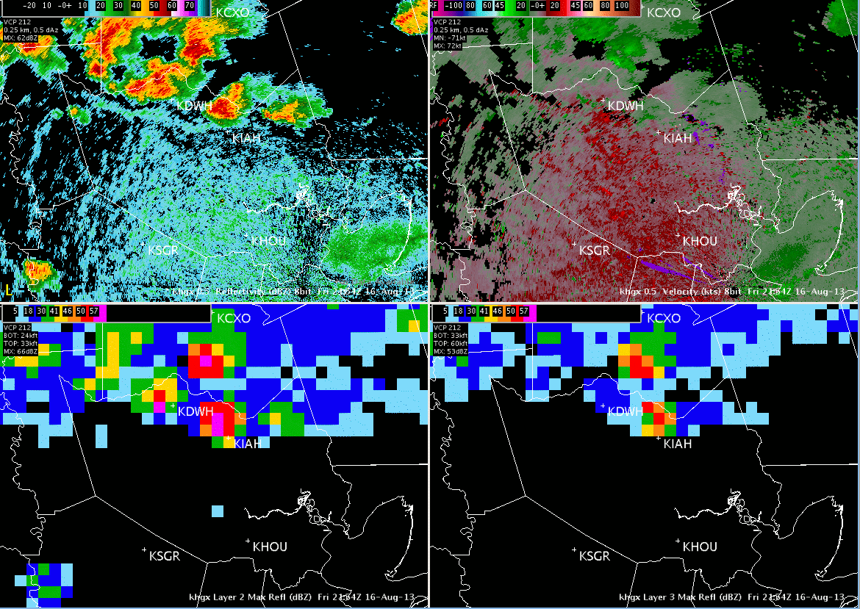
Microburst at KIAH (around 20Z)
KHGX 0.5 Reflectivity
KHGX 0.5 Velocity
KHGX Layer 2 Max Refl
KHGX Layer 3 Max Refl

Slide 8
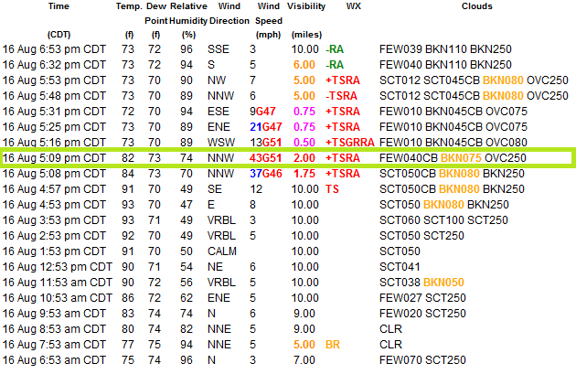
Weather Observations for:
Houston, Houston Intercontinental Airport

Slide 9
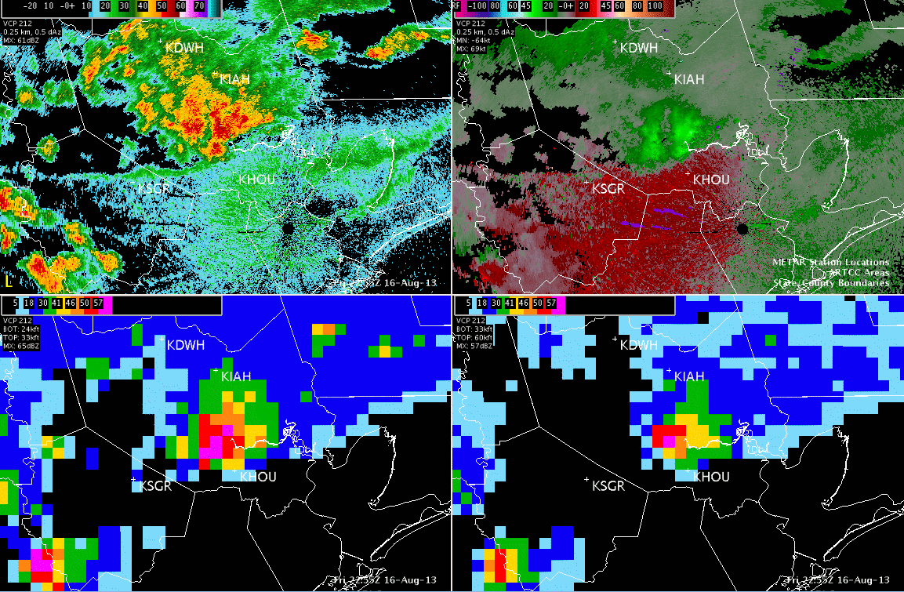
Microburst at KHOU (around 2315Z)
KHGX 0.5 Reflectivity
KHGX 0.5 Velocity
KHGX Layer 2 Max Refl
KHGX Layer 3 Max Refl

Slide 10
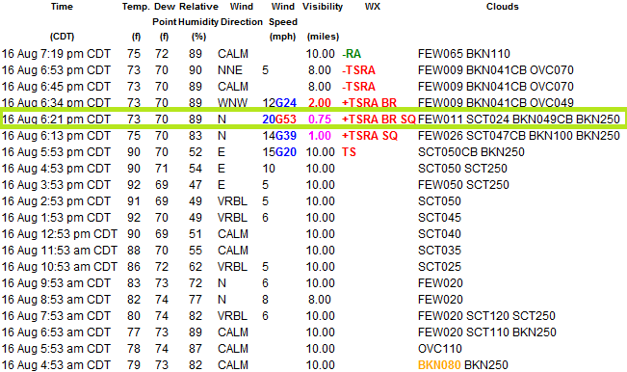
Weather Observations for:
Houston, Houston Hobby Airport

Slide 11
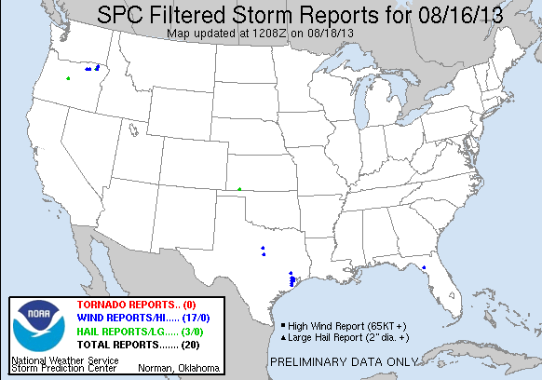
Storm (Wind) Reports

Slide 12
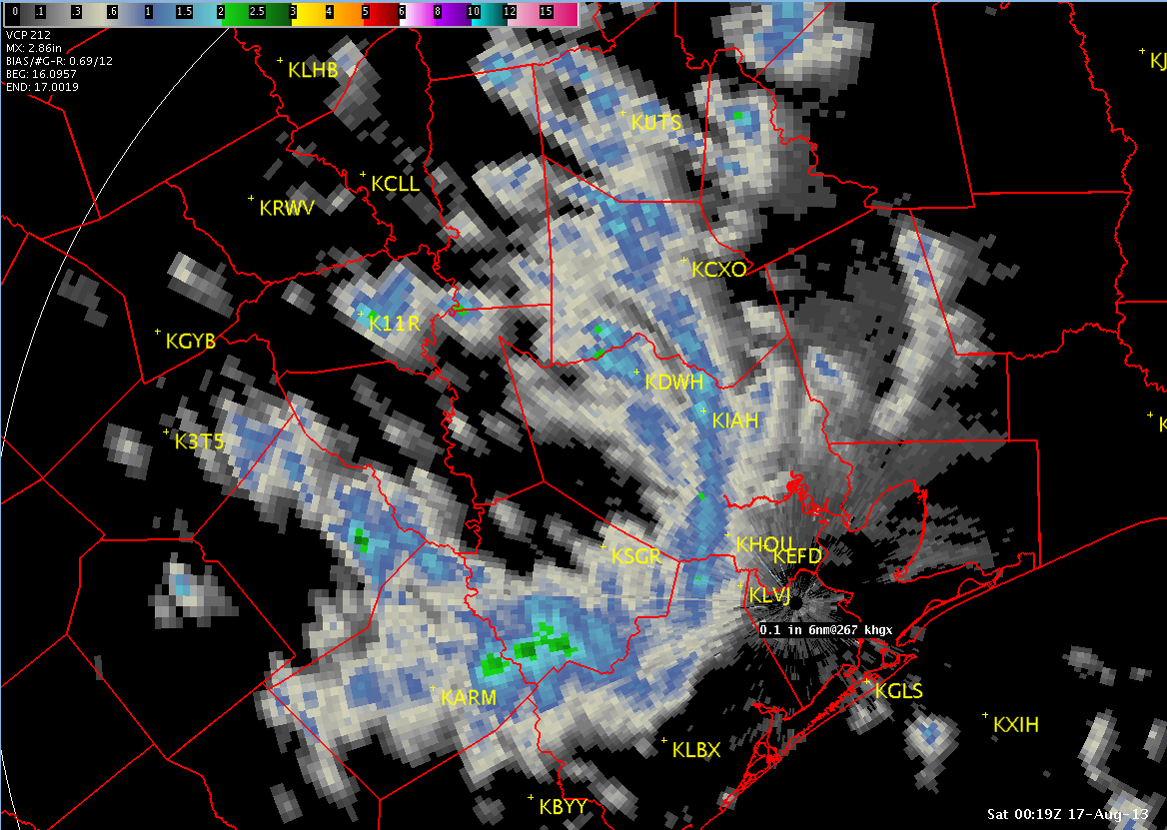
Storm Total Precipitation
BEG: 16 0957Z
END: 17 0019Z
Storm Track

