Slide 1
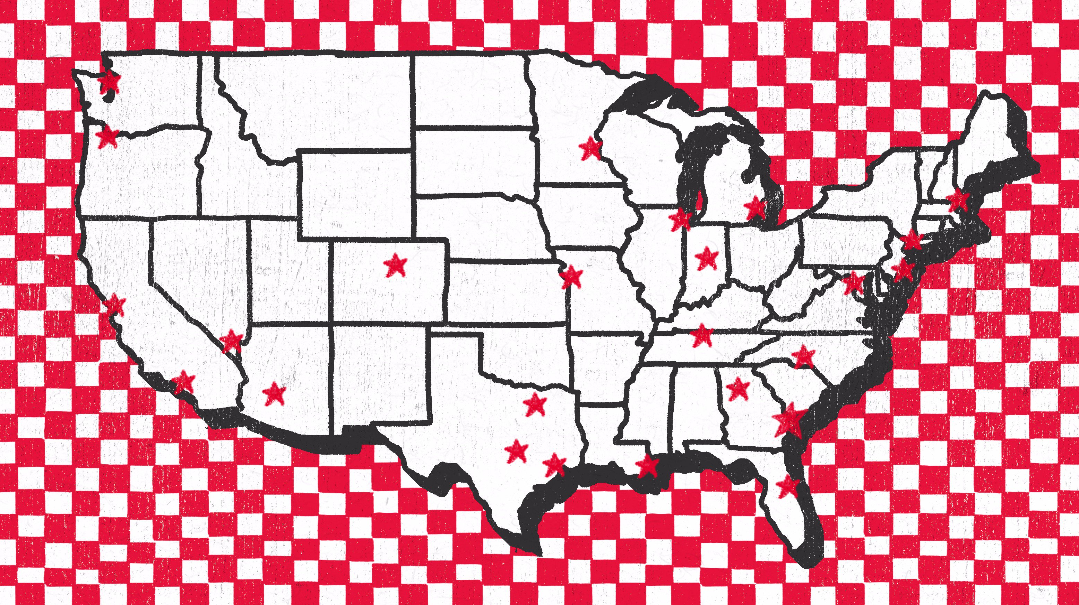
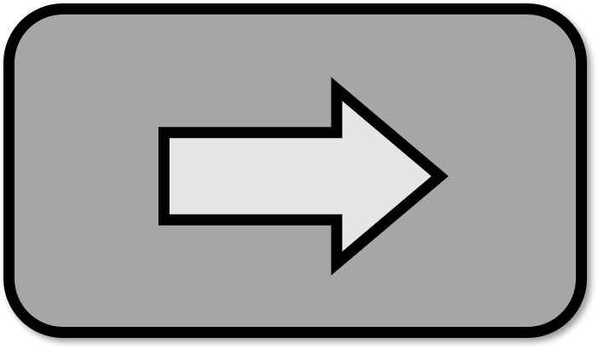








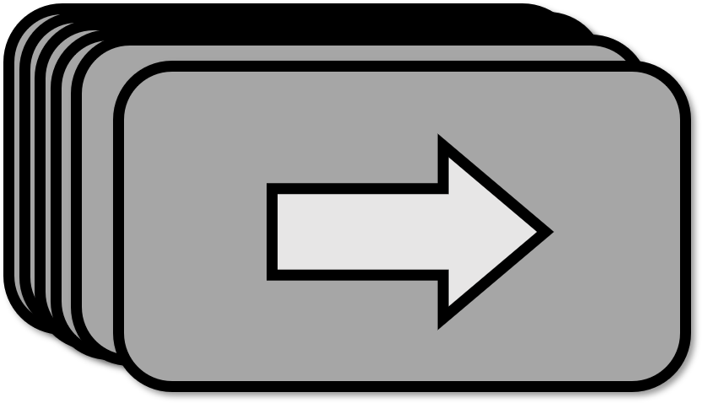

Players
Map
Decks
PlayerCard
WhyBot
5
T
10
50
42
WhyBot
5
T
50
42
WhyBot
5
T
ChickenHand
ShipmentHand
50
42
42

Slide 2
WhyBot
50
5
T
10
42

Slide 3


Slide 7
