Slide 1
A New Method for Representing Inclinometer Data for Slope Stability
Toby cumins

Slide 2
Introduction to Inclinometers

Slide 3
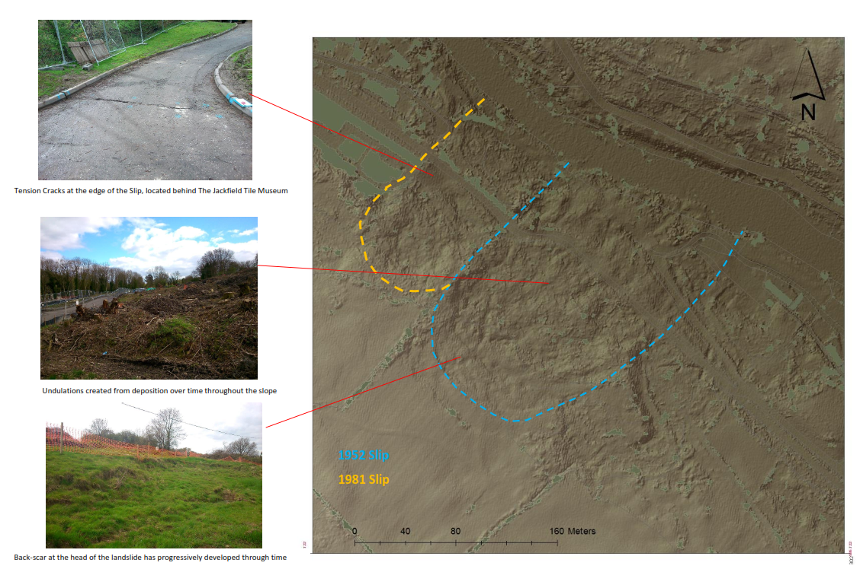
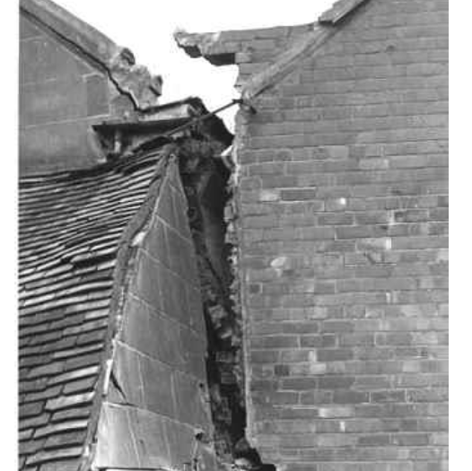
Shallow Surface Landslips – Jackfield Site
Notes:
Why needed

Slide 4
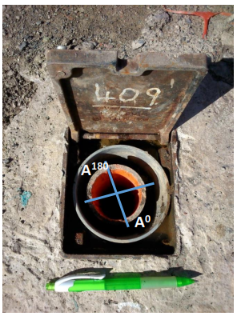
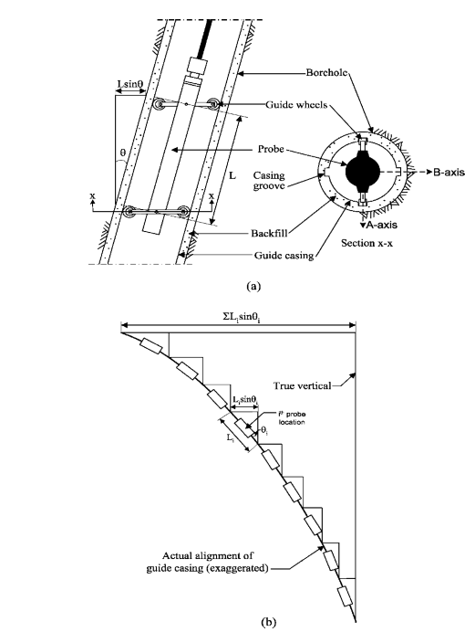
Inclinometers Setup
Notes:
How they work

Slide 5
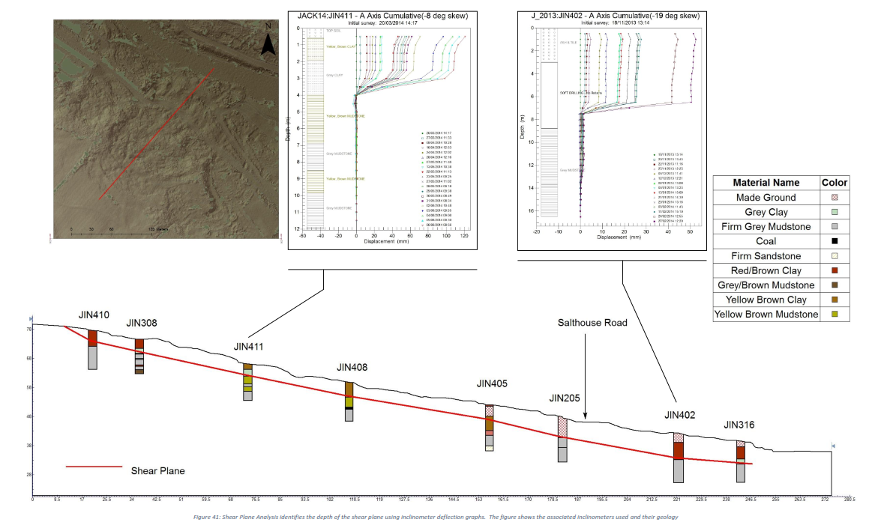
Current Inclinometer Models
Notes:
Current Models and problems

Slide 6
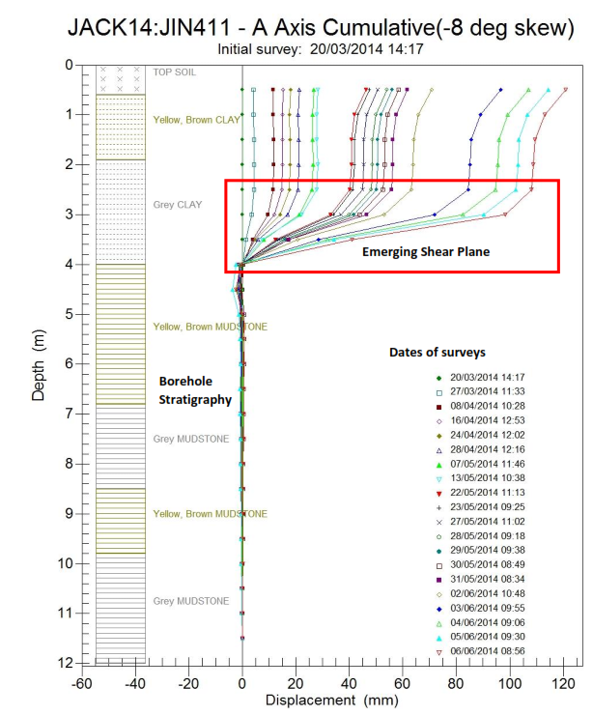
Current Inclinometer Model
Notes:
Current Models and problems

Slide 7
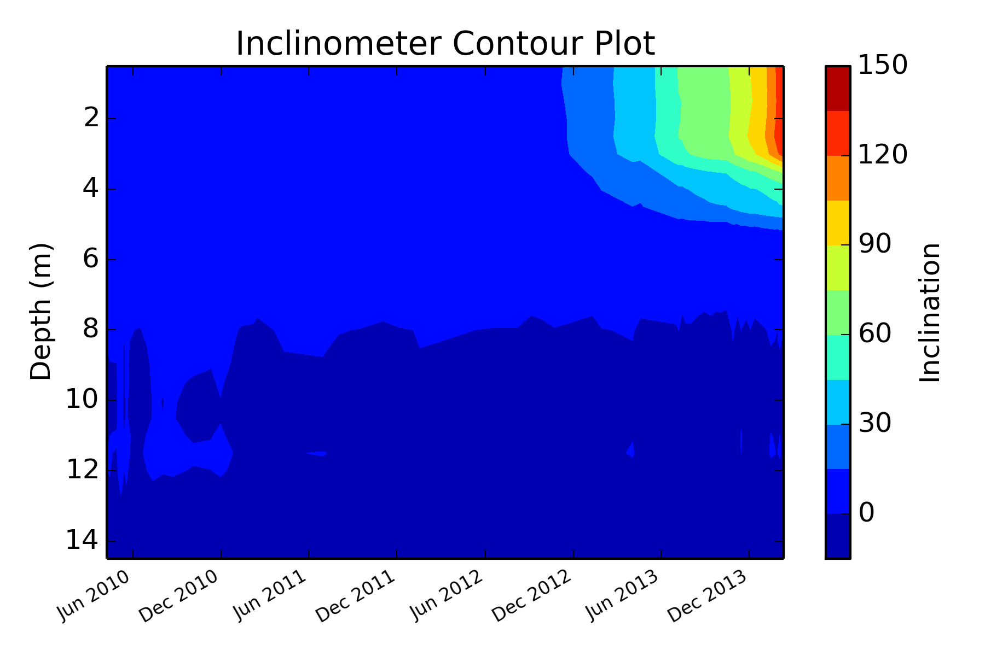
Proposed Inclinometer Model
Notes:
Current Models and problems

Slide 8
Program Development

Slide 9
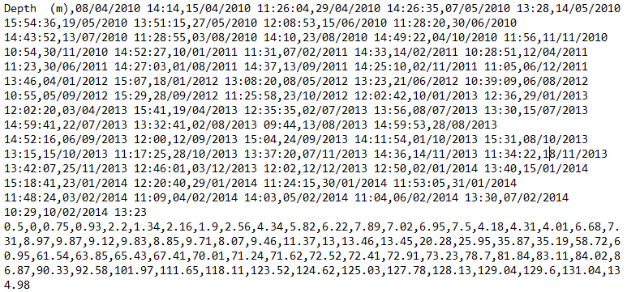
Data Collection/Processing

Slide 10
Data Collection/Processing

Slide 11
Data Collection/Processing

Slide 12
Data Collection/Processing
X
Y

Slide 13
Proposed Inclinometer Models

Slide 14
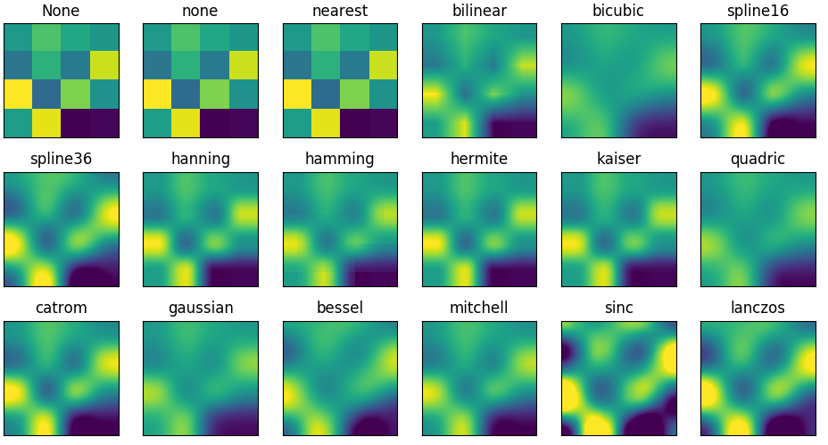
Contour Modelling

Slide 15
Thank you for listening, Questions Welcome!
Conclusion
Shallow landslips are common, and in some localities increasing annually.
Primary aims: Research Slope Stability; Research Contouring Methods; Create Program For Easy Data Analysis.
Minimise risk and damage caused by shallow landslips
Acknowledgements : Farnham, N. Renforth, P. Gernon, O.

