Slide 1

Chapter 2 :: Combinational Logic Design
Digital Design and Computer Architecture
David Money Harris and Sarah L. Harris
2-<<number>>

Slide 2
Chapter 2 :: Topics
2.1 Introduction
2.2 Boolean Equations: sum of product, product of sum
2.3 Boolean Algebra: axiom, theorem
2.4 From Logic to Gates
2.5 Multilevel Combinational Logic
2.6 X’s and Z’s, Oh My
2.7 Karnaugh Maps
2.8 Combinational Building Blocks
239 Timing
2-<<number>>

Slide 3
Update:
When you email me question,
  Please list session #: CPSC 330-01, 330-02, 330L-01, etc.
  For lab question, please attach screenshot
Office hour in zoom: waiting room
We have a Slack channel for CPSC330
The following are in Canvas/Pages:
Lecture topic’s link,
syllabus,
course calendar
2-<<number>>

Slide 4
Please mute your microphone at the beginning.
Warm up questions:
6 level computer
Green computing/ a perfect green computing example
why do we learn the following?
  hardware design? Hint: how hardware optimization can improve system performance
  logic design?
  Boolean theorem
2-<<number>>

Slide 5
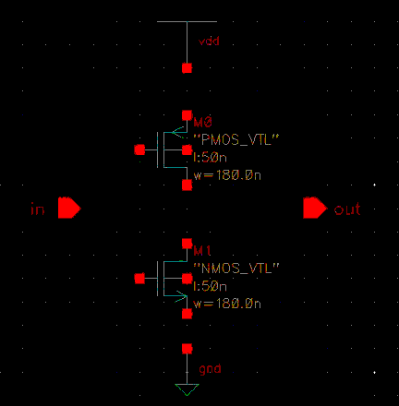
Some review
What lines are missing?
Is there a problem with NMOS width according to schematic tutorial: www1.chapman.edu/~zhao/CPSC330/Labs/SchematicInv_CadenceSetup_freePDK45.docx
Why PMOS width is larger than NMOS’
2-<<number>>

Slide 6
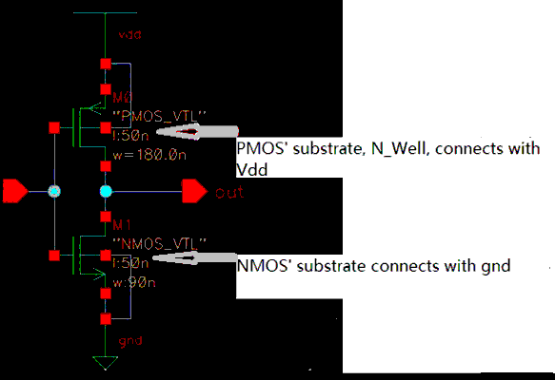
Positive charge’s speed is slower than that of negative charge. To make the switch time of PMOS part similar with that of NMOS, we need to use wider width for PMOS transistor to increase its driving ability: width of PMOS , NMOS are 180nm, 90nm, in 45nm technology respectively
Note: Symbol of PMOS, NMOS in Virtuoso Schematic is different from those in text book. Please note the arrow and the substrate connection in PMOS(upper) and the arrow and well connection in NMOS(bottom);
2-<<number>>

Slide 7
Some review
What are the three design constraints that affect electrical device’s price, perfermance and battery life?
What is the benefit of simplifying logic equation?
2-<<number>>

Slide 8
2.1. Introduction
Why do we learn Boolean axiom and Boolean theorem?
2-<<number>>

Slide 9
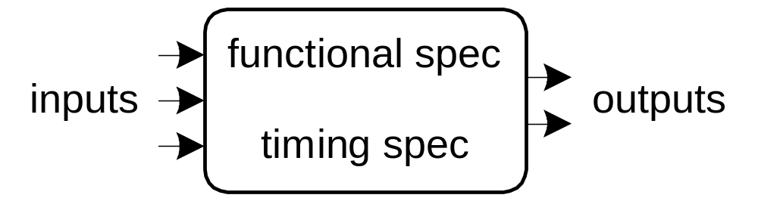
Introduction
A logic circuit is composed of:
Inputs
Outputs
Functional specification
Timing specification
2-<<number>>

Slide 10
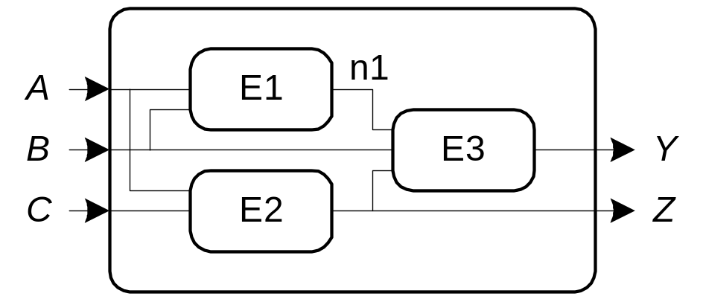
Circuits
Nodes
  Inputs: A, B, C
  Outputs: Y, Z
  Internal: n1
Circuit elements
  E1, E2, E3
  Each a circuit
2-<<number>>

Slide 11
Types of Logic Circuits
Combinational Logic
  Memoryless
  Outputs determined by current values of inputs
Sequential Logic
  Has memory
  Outputs determined by previous and current values of inputs
2-<<number>>

Slide 12
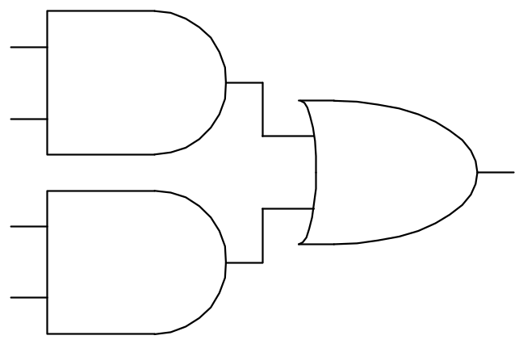
Rules of Combinational Composition
Every circuit element is itself combinational
Every node of the circuit is either designated as an input to the circuit or connects to exactly one output terminal of a circuit element
The circuit contains no cyclic paths: every path through the circuit visits each circuit node at most once
Example:
2-<<number>>

Slide 13
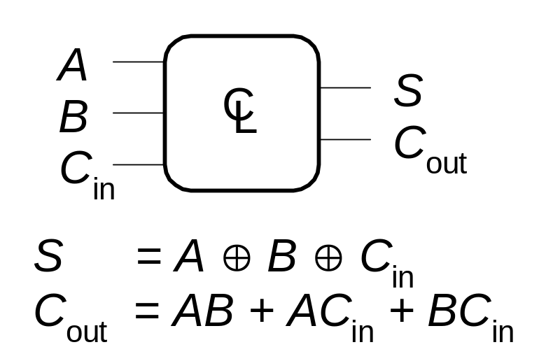
2.2 Boolean Equations
Functional specification of outputs in terms of inputs
Example:
S = F(A, B, C_{in})
C_{out} = F(A, B, C_{in})
2-<<number>>

Slide 14
Some Definitions
Complement: variable with a bar over it
A, B, C
Literal: variable or its complement
A, A, B, B, C, C
Implicant: product of literals
ABC, AC, BC
Minterm: product that includes all input variables
ABC, ABC, ABC
Maxterm: sum that includes all input variables
(A+B+C), (A+B+C), (A+B+C)
2-<<number>>

Slide 15
If a circuit has inputs, A,B,C,D
Which one is minterm:
ABD, CD, A_ (i.e. A_bar ), AB_CD_
Which one is maxterm:
C+D, A+B_+D, A_ +B_+C_+ D
2-<<number>>

Slide 16
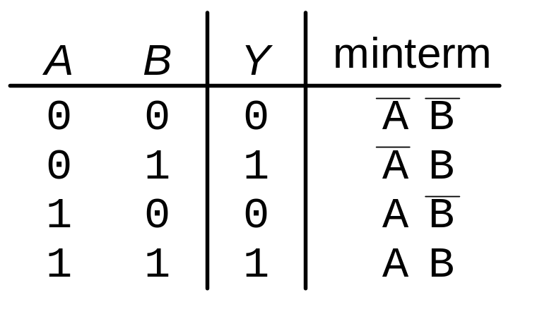
Sum-of-Products (SOP) Form
All Boolean equations can be written in SOP form
Each row in a truth table has a minterm
A minterm is a product (AND) of literals
Each minterm is TRUE for that row (and only that row)
The function is formed by ORing the minterms for which the output is TRUE
Thus, a sum (OR) of products (AND terms)
Y = F(A, B) =
2-<<number>>

Slide 17
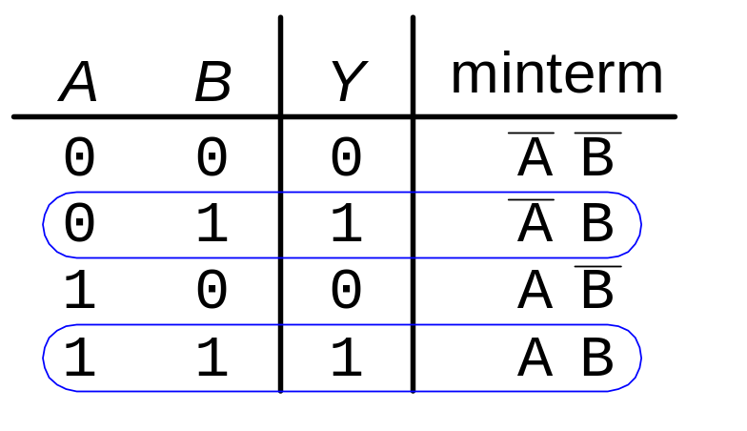
Sum-of-Products Form
Sum-of-Products (SOP) Form
All Boolean equations can be written in SOP form
Each row in a truth table has a minterm
A minterm is a product (AND) of literals
Each minterm is TRUE for that row (and only that row)
The equation is formed by Oring(summing) the minterms for which the output is TRUE
Thus, a sum (OR) of products (AND terms)
Y = F(A, B) =
2-<<number>>

Slide 18
Sum-of-Products Form
Sum-of-Products (SOP) Form
All Boolean equations can be written in SOP form
Each row in a truth table has a minterm
A minterm is a product (AND) of literals
Each minterm is TRUE for that row (and only that row)
The function is formed by ORing the minterms for which the output is TRUE
Thus, a sum (OR) of products (AND terms)
Y = F(A, B) = AB + AB
2-<<number>>

Slide 19
Write minterms for the following truth table:
A B | Y Y
0 0 | 0
0 1 | 0
1 0 | 1
1 1 | 1
A B | Y Y
0 0 | 1
0 1 | 1
1 0 | 0
1 1 | 0
A B C | Y Y
0 0 0 | 1
0 0 1 | 1
0 1 0 | 0
0 1 1 | 0
1 0 0 | 1
1 0 1 | 1
1 1 0 | 0
1 1 1 | 0
2-<<number>>

Slide 20
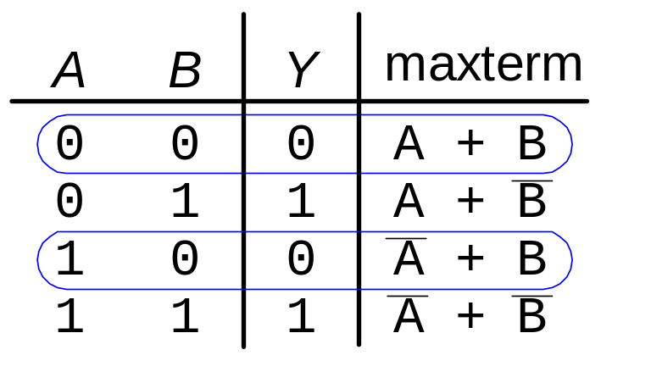
Product-of-Sums (POS) Form
All Boolean equations can be written in POS form
Each row in a truth table has a maxterm
A maxterm is a sum (OR) of literals
Each maxterm is FALSE for that row (and only that row)
The function is formed by ANDing the maxterms for which the output is FALSE
Thus, a product (AND) of sums (OR terms)
Y = F(A, B) = (A + B)(A + B)
2-<<number>>

Slide 21
Minterm vs. Maxterm
When the output is True on only a few rows of a truth table, we use Minterm.
Vice versa.
 | Definition | In truth table | To obtain equation
Minterm | Product involving all inputs | Minterm is true for that row | look for minterms for which the output is True Summing them
Maxterm | Sum of all inputs | Maxterm is false for that row | Look for maxterms and ANDing them
2-<<number>>

Slide 22
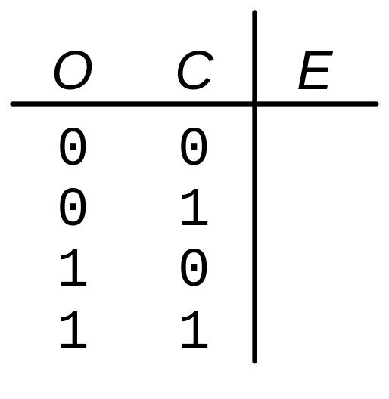
Boolean Equations Example
You are going to the cafeteria for lunch
  You won’t eat lunch (E)
  If it’s not open (O) or
  If they only serve corndogs (C)
Write a truth table for determining if you will eat lunch (E).
2-<<number>>

Slide 23
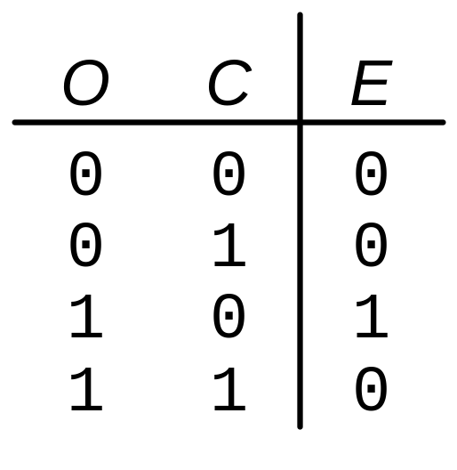
Boolean Equations Example
You are going to the cafeteria for lunch
  You won’t eat lunch (E)
  If it’s not open (O) or
  If they only serve corndogs (C)
Write a truth table for determining if you will eat lunch (E).
2-<<number>>

Slide 24
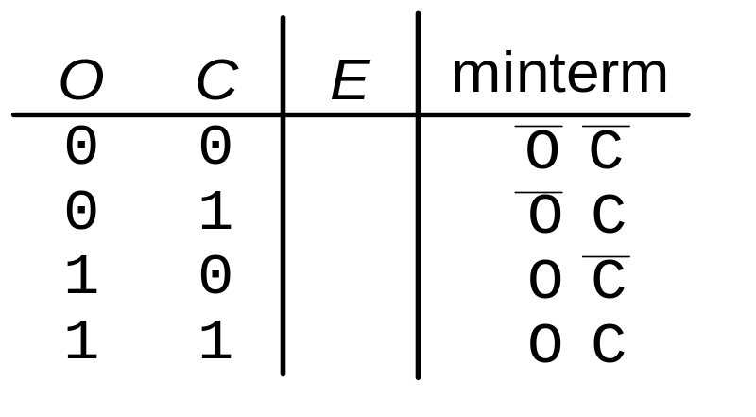
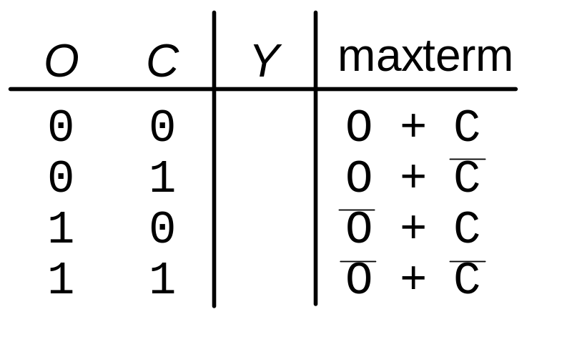
SOP & POS Form
SOP – sum-of-products
POS – product-of-sums
2-<<number>>

Slide 25
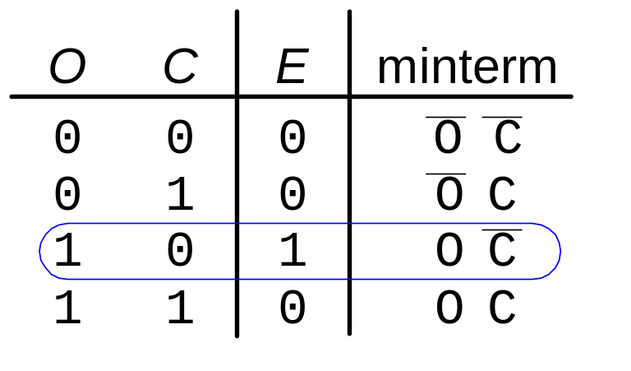
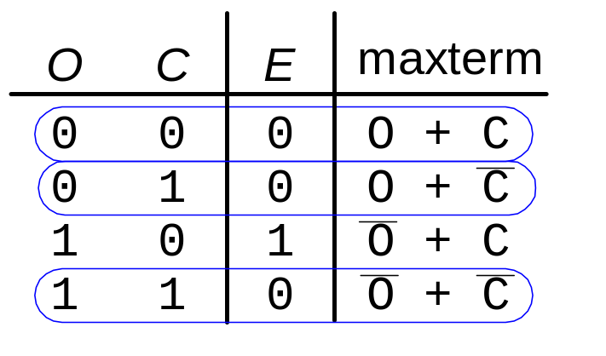
SOP & POS Form
SOP – sum-of-products
POS – product-of-sums
Y = OC
Y = (O + C)(O + C)(O + C)
2-<<number>>

Slide 26
2.3 Boolean Algebra
Set of axioms and theorems to simplify Boolean equations
Like regular algebra, but in some cases simpler because variables can have only two values (1 or 0)
Axioms and theorems obey the principles of duality:
  ANDs and ORs interchanged, 0’s and 1’s interchanged
2-<<number>>

Slide 27
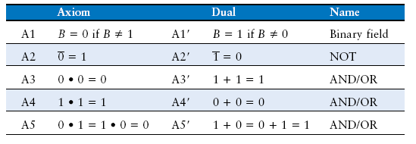
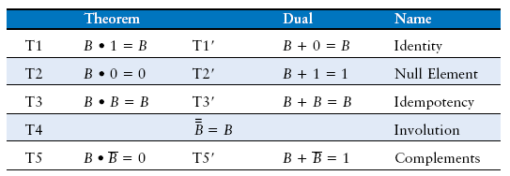
2.3.1 Boolean Axioms
2-<<number>>

Slide 28
What is 1+1+1 in middle school math?
What is that in digital logic? (1+1+1, i.e. 1 or 1 or 1)
2-<<number>>

Slide 29
2.3.2 Boolean Theorem with one variable
2-<<number>>

Slide 30
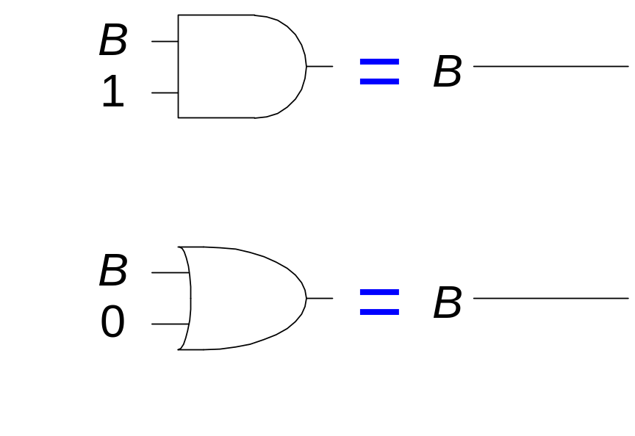
T1: Identity Theorem
B 1 = B
B + 0 = B
2-<<number>>

Slide 31
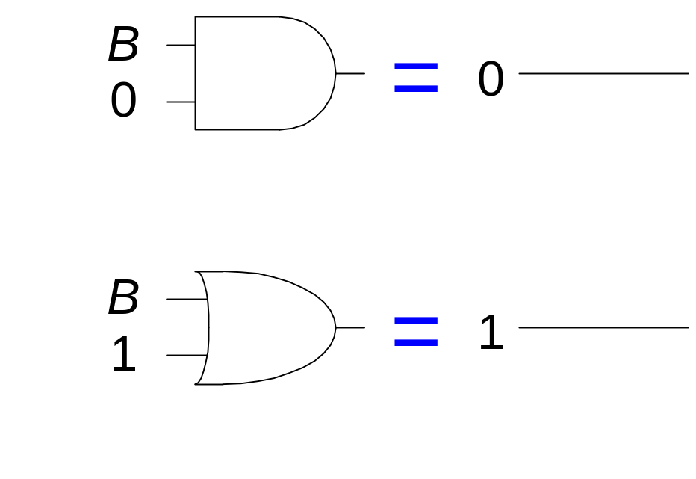
T2: Null Element Theorem
B 0 = 0
B + 1 = 1
2-<<number>>

Slide 32
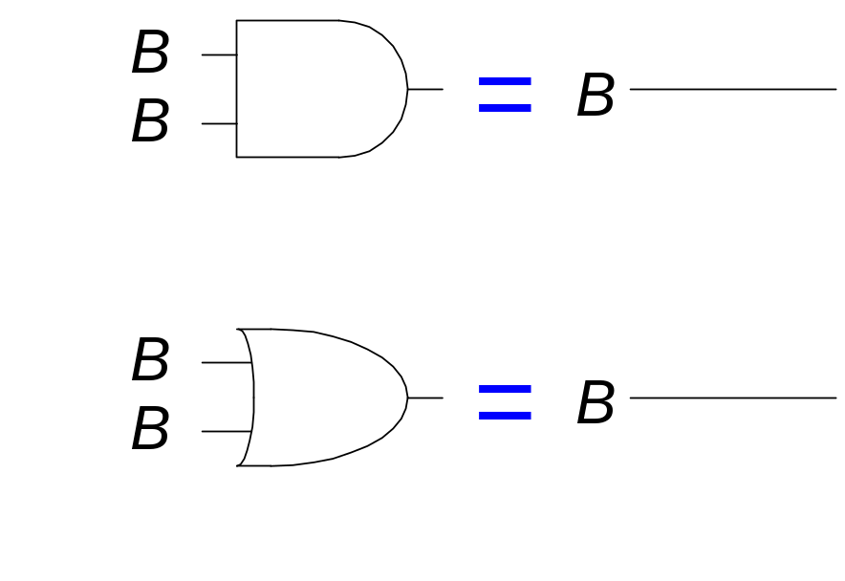
T3: Idempotency Theorem
B B = B
B + B = B
2-<<number>>

Slide 33
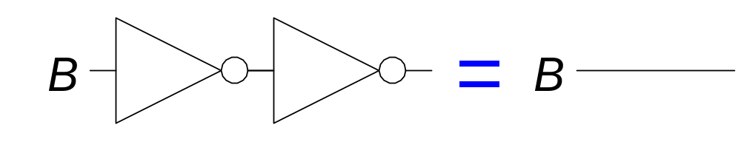
T4: Identity Theorem
B = B
2-<<number>>

Slide 34
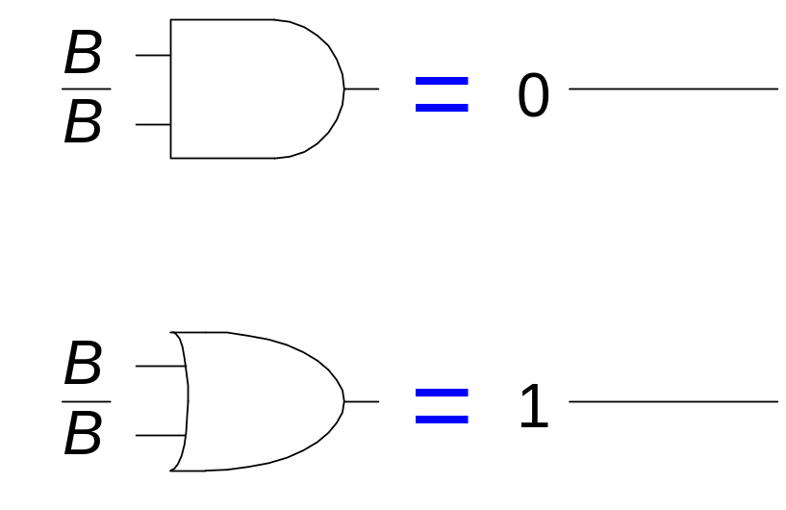
T5: Complement Theorem
B B = 0
B + B = 1
2-<<number>>

Slide 35
Boolean Theorems: Summary
2-<<number>>
Notes:
https://www.electronics-tutorials.ws/boolean/bool_6.html

Slide 36
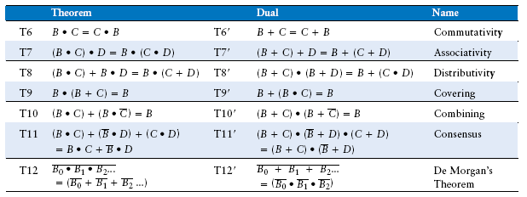
2.3.3 Boolean Theorems of Several Variables
2-<<number>>

Slide 37
IN CLASS EXERCISE
Show step to prove:
B*C + B*C_ = b
(B+C)(B+D)= B+C*D
B+B*C =B
(B+C)(B_+D)(C+ D) = (B+C)(B_ +D )
2-<<number>>

Slide 38
Obtain equation from truth table and Simplify, respectively:
A B | Y Y
0 0 | 1
0 1 | 1
1 0 | 0
1 1 | 0
A B | Y Y
0 0 | 0
0 1 | 1
1 0 | 1
1 1 | 1
2-<<number>>

Slide 39
Try to simplify:
C_ *D+ C_ *E + D_ *E_
2-<<number>>

Slide 40
Simplifying Boolean Expressions: Example 1
Y = AB + AB
= B(A + A) T8
= B(1) T5’
= B T1
Combination is used in the above example: A_ +A =1
Now try the following:
Y1= A_B + ABC
Y2= AB_ + AB_C_
Y3=A_B_ + A_B_C
2-<<number>>

Slide 41
Simplifying Boolean Expressions: Example 2
Y = A(AB + ABC)
= A(AB(1 + C)) T8
= A(AB(1)) T2’
= A(AB) T1
= (AA)B T7
= AB T3
Now try the following:
Y5= B (CDE+CDEF+CDEF_G)
2-<<number>>

Slide 42
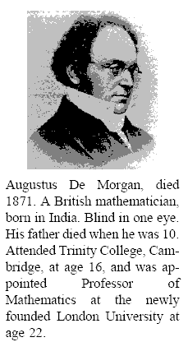
DeMorgan’s theorem (T12 in previous table)
Source: Digital Logic and Computer Architecture, Chapter 2
2-<<number>>

Slide 43
DeMorgan’s Law
A+B+C = A * B * C
A*B*C = A + B + C
Thumb of rules:
  exchange operators ;
  Break long bar to short bars
Try: Simplify
Y6= (ED)_*H + E_ + D_
Y7 = (J+K+L+M)_ *P + J_*K_*L_*M_
2-<<number>>

Slide 44
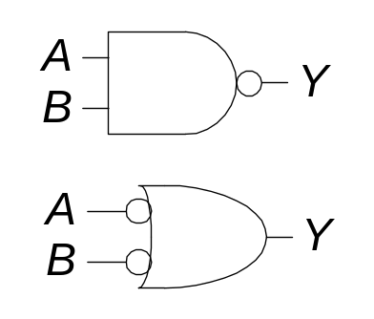
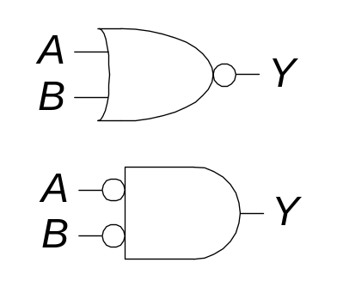
DeMorgan’s Theorem
Y = AB = A + B
Y = A + B = A B
2-<<number>>

Slide 45
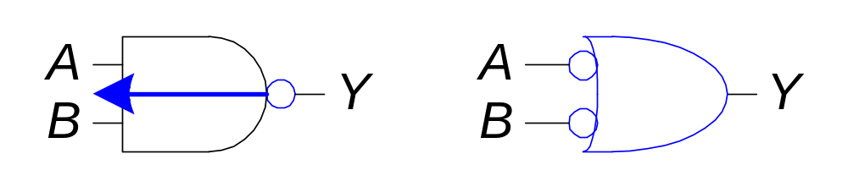
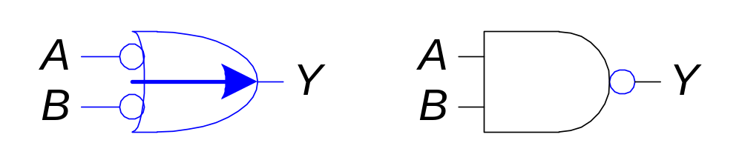
Bubble Pushing
Assume bubble in schematic means inverting.
Pushing bubbles backward (from the output) or forward (from the inputs) changes the body of the gate from AND to OR or vice versa.
Because: (A*B)_ = A_+B_
  Hence: Pushing a bubble from the output back to the inputs puts bubbles on all gate inputs.
Because: (A_ +B_)= (A*B)_
  Pushing bubbles on all gate inputs forward toward the output puts a bubble on the output and changes the gate body.
2-<<number>>

Slide 46
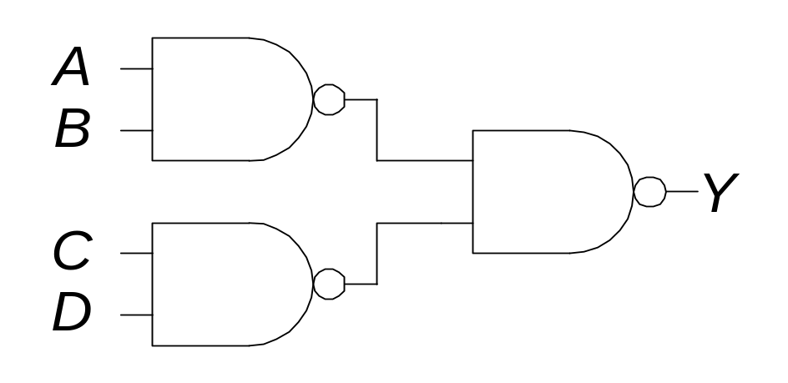
Bubble Pushing
What is the Boolean expression for this circuit?
2-<<number>>

Slide 47
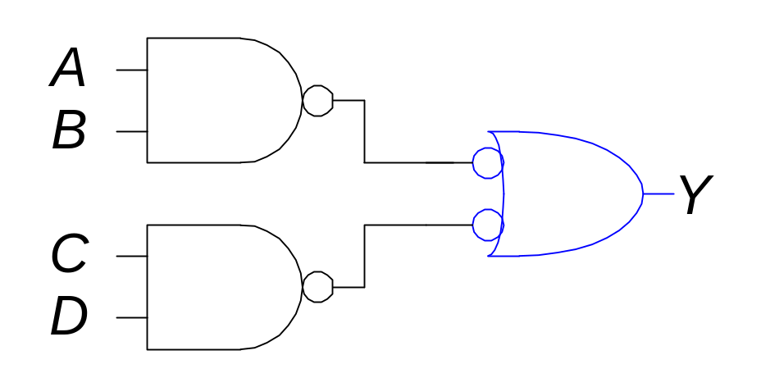
Bubble Pushing
What is the Boolean expression for this circuit?
Y = AB + CD
2-<<number>>

Slide 48
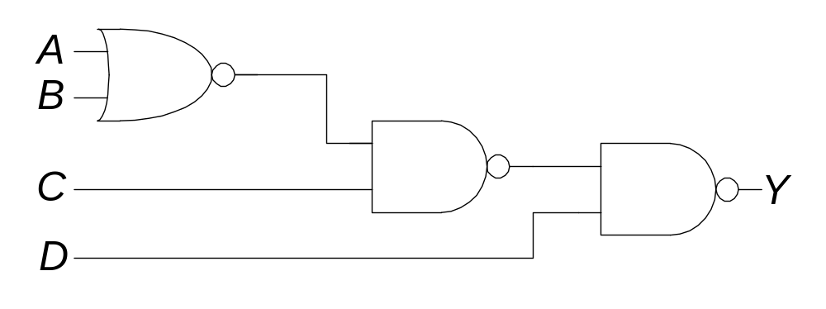
Bubble Pushing Rules
Begin at the output of the circuit and work toward the inputs.
Push any bubbles on the final output back toward the inputs.
Draw each gate in a form so that bubbles cancel.
2-<<number>>

Slide 49
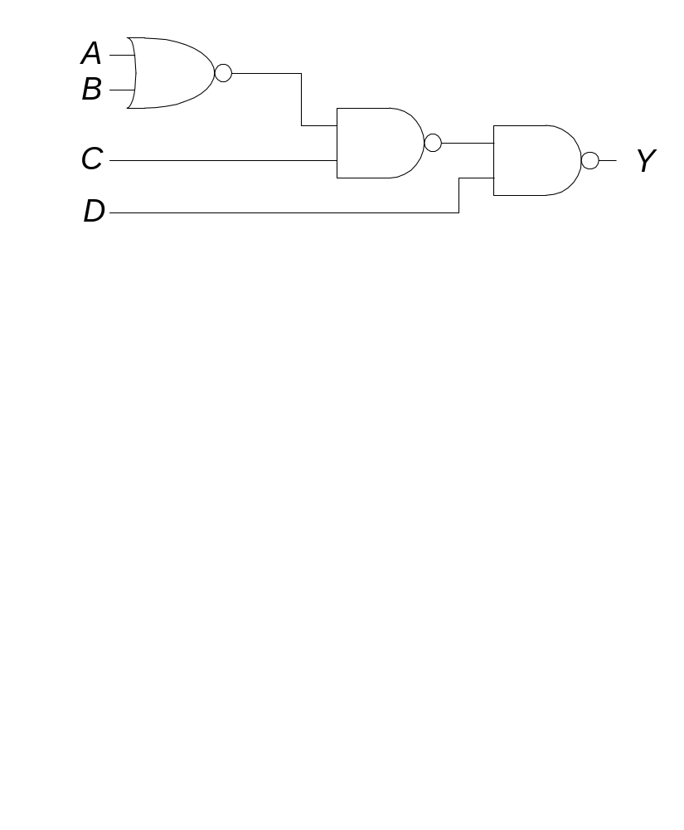
Bubble Pushing Example
2-<<number>>

Slide 50
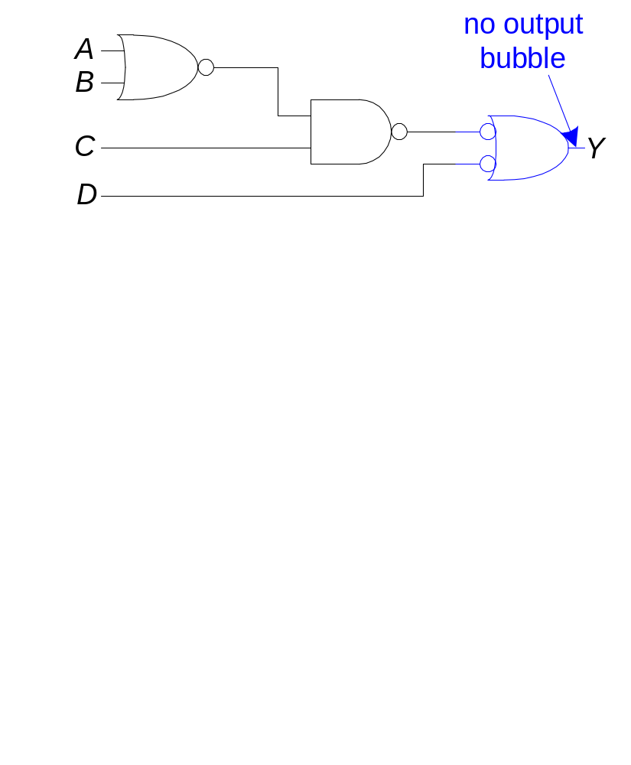
Bubble Pushing Example
2-<<number>>

Slide 51
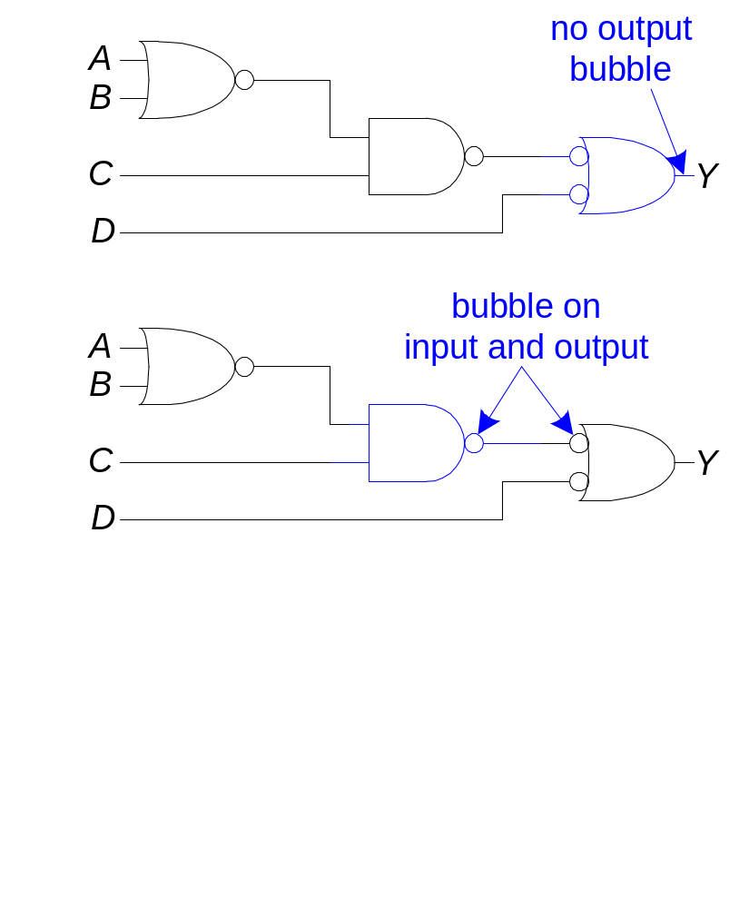
Bubble Pushing Example
2-<<number>>

Slide 52
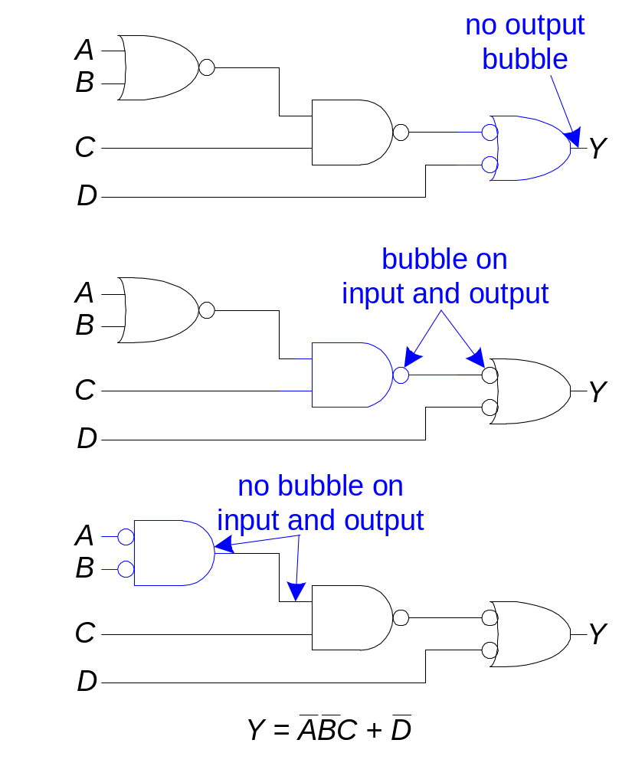
Bubble Pushing Example
2-<<number>>

Slide 53
Appendix
2-<<number>>

Slide 54
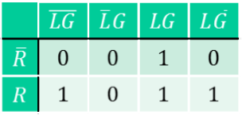
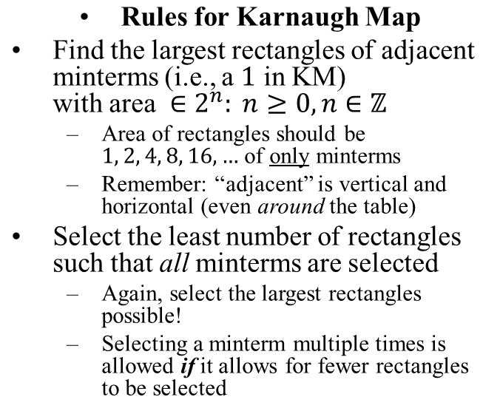
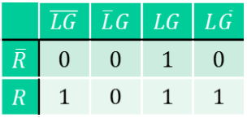


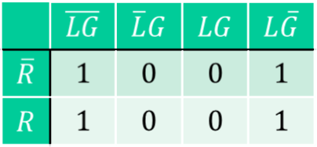
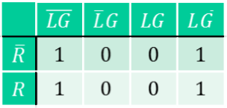
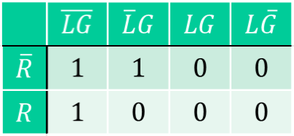
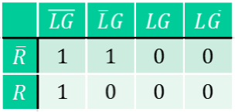
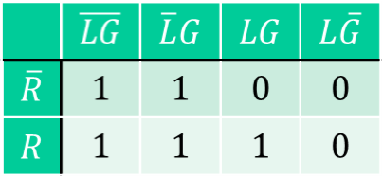
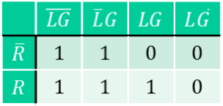
Correct and Incorrect Patterns
Correct
Incorrect (Apophenia)
2-<<number>>

Slide 55








Logic Simplifying Examples
Correct
Incorrect
2-<<number>>

Slide 56
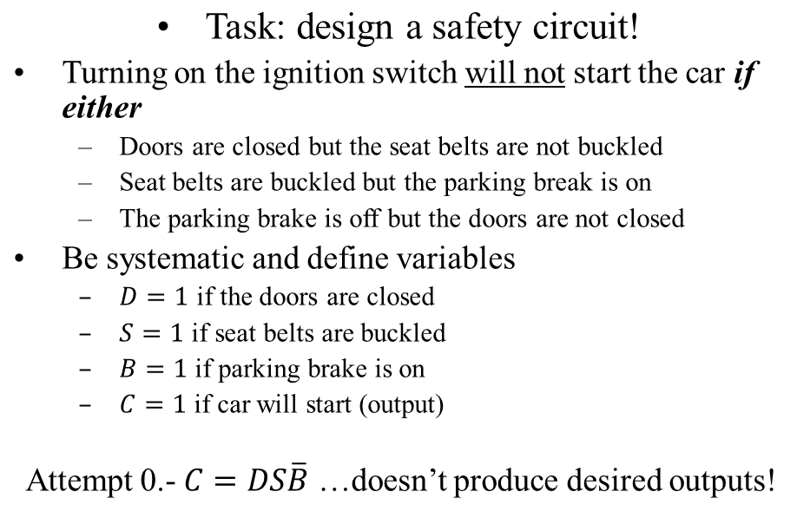
Your first job at Tesla (Logic Warmup)
2-<<number>>

Slide 57
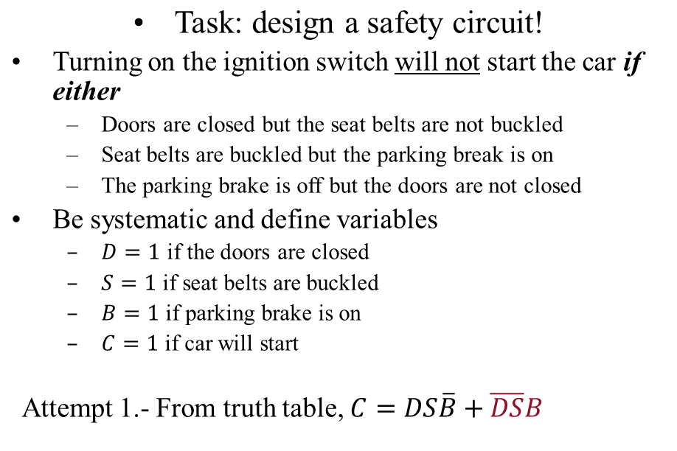
Your first job at Tesla (Logic Warmup)
D | S | B | C
0 | 0 | 0 | 0
0 | 0 | 1 | 1
0 | 1 | 0 | 0
0 | 1 | 1 | 0
1 | 0 | 0 | 0
1 | 0 | 1 | 0
1 | 1 | 0 | 1
1 | 1 | 1 | 0
2-<<number>>

Slide 58
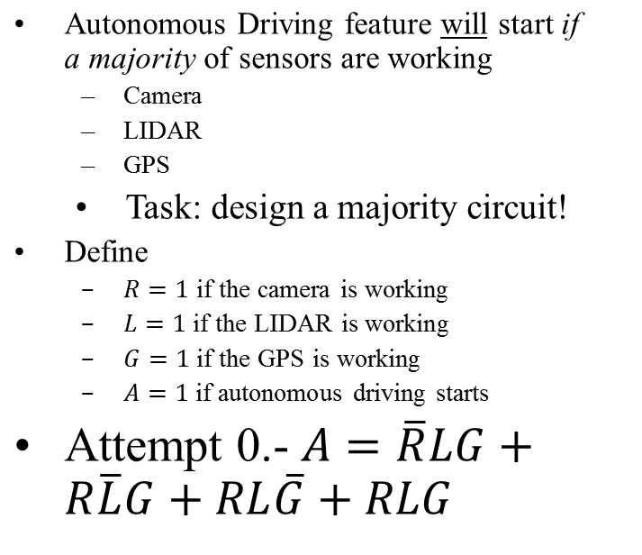
Your second job at Tesla (Logic Simplification)
R | L | G | A
0 | 0 | 0 | 0
0 | 0 | 1 | 0
0 | 1 | 0 | 0
0 | 1 | 1 | 1
1 | 0 | 0 | 0
1 | 0 | 1 | 1
1 | 1 | 0 | 1
1 | 1 | 1 | 1
Can we do better?
(i.e., less variables, gates, or connections)
2-<<number>>

Slide 59
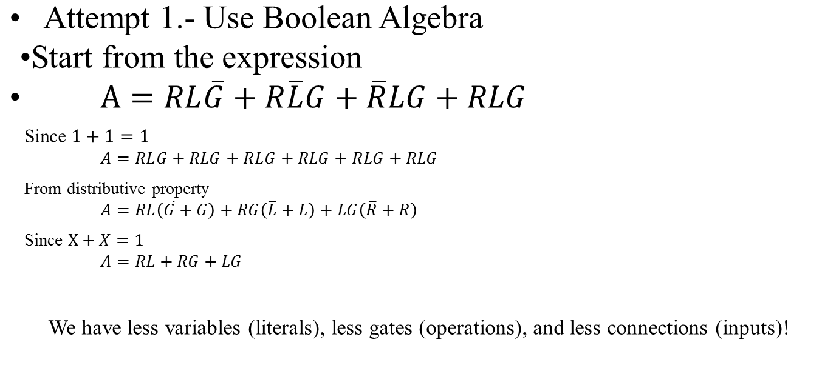
Simplifying the Majority Circuit
R | L | G | A
0 | 0 | 0 | 0
0 | 0 | 1 | 0
0 | 1 | 0 | 0
0 | 1 | 1 | 1
1 | 0 | 0 | 0
1 | 0 | 1 | 1
1 | 1 | 0 | 1
1 | 1 | 1 | 1
2-<<number>>

Slide 60
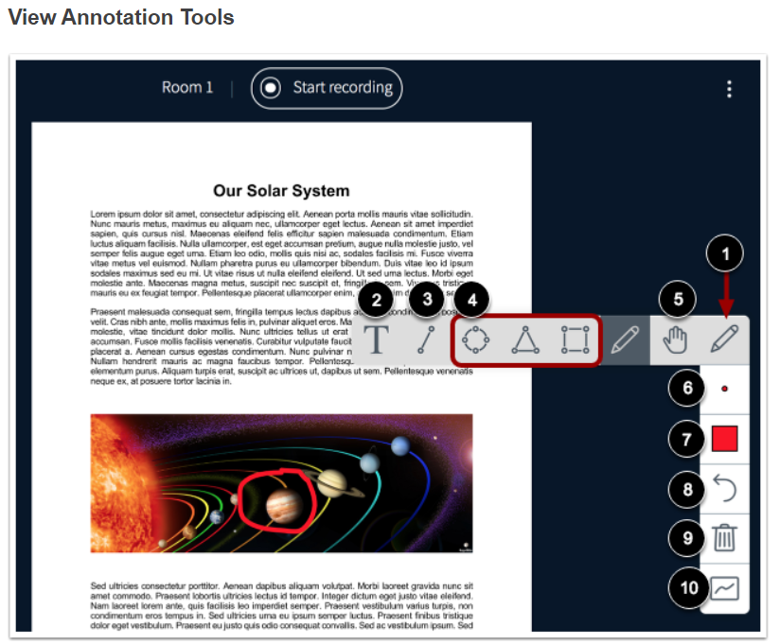
I may share whiteboard in Canvas/Conference
There are annotation tools, see the “View Annotation Tools” graph in the middle of the following link:
https://community.canvaslms.com/docs/DOC-12848-415265961
You can use Pencil, line, Text tools.
To use the Text annotation tool in whiteboard:
  you have to create a text box to type in.
  Click the ‘T’,
  then press the mouse button at the upper left corner of the place where you want to create the box,
  drag to the lower right corner,
  and release the mouse button.
  You will see a box that you can type in.
2-<<number>>

